Slide 1
Reinforcement Learning to Enhance Spatial Reuse in Dense Wireless Networks
a Thesis Proposal

Slide 2
Outline
Motivation
Spatial Reuse in Wireless Networks
Current SR Solutions for IEEE 802.11 WLANs
Reinforcement Learning for SR in IEEE 802.11ax
Research Activity
Future Work

Slide 3
Motivation

Slide 4
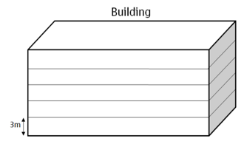
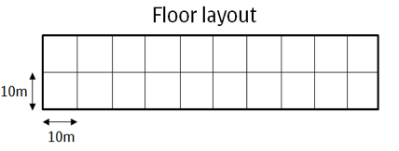
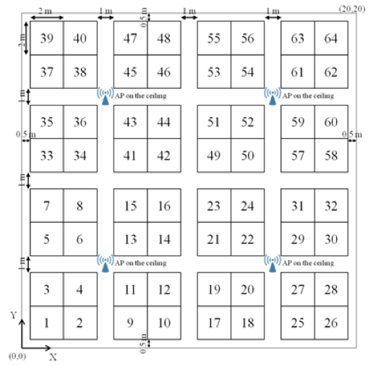
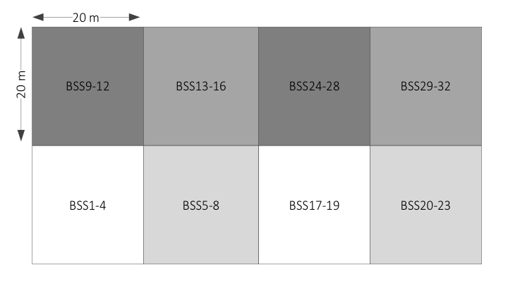
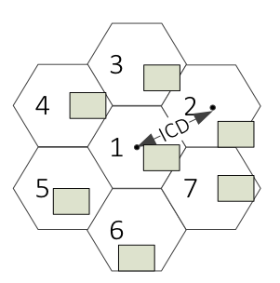
Next-generation IEEE 802.11 WLANs
Topologies
Future WLAN deployments will be characterised by the high amount of devices that will coexist (e.g. 1 user/m²). The TGax provides a set of dense scenarios.
Scenarios in IEEE 802.11ax
Residential
Enterprise
Indoor small BSS
Outdoor large BSS
Residential
+ Outdoor large BSS
Coordinated
Uncoordinated
Mixed
A central entity controls all the devices in the WN
Examples: University campus, offices
Independent WNs act autonomously
Examples: Residential buildings
Coordinated & uncoordinated deployments coexist
Examples: shopping mall

Slide 5
Coexistence Issues in IEEE WLANs
Mainly produced by coexistence between devices operating at the same frequency band. Several mechanisms are provided in Time, Frequency and Space domains.
Root Causes
Weaknesses in the current distributed mechanisms
Hidden/Exposed node problems
Collisions by backoff
…
Dense & chaotic scenarios
Easiness of deployments
Heterogeneous deployments
High bandwidth requirements
Computational power moving to the cloud (more communication)
…
Potential Solutions
Time
Scheduling
Contention Window (CW) adaptation
Frequency
Dynamic Spectrum Access (DSA)
Dynamic Channel Bonding (DCB)
Space
Space
Transmission Power Control (TPC)
Carrier Sense Threshold CST adjustment
Directional Transmissions
Interference cancellation

Slide 6
Challenges
Wireless channels are dynamic
Network conditions
Users activity
Traffic patters
Wireless channels are shared
Strict QoS in many applications

Slide 7
Moving into Artificial Intelligence
Why AI?
AI may satisfy the high-demanding requirements in next-generation scenarios. Upward trend in combining AI with Wireless Communications.
Q-learning
Packet routing [2]
Problem
NP-complete
Variable environment
Fast-convergence must be granted
Previous Work
AP selection [3, 4]
Neural Networks
Rate sampling [5]
Multi-Armed Bandits
Energy harvesting [6]
Solution
Observations-based learning process
Optimal solution approximation
Sensitive to modifications
[2] Littman, M., & Boyan, J. (1993, July). A distributed reinforcement learning scheme for network routing. In Proceedings of the international workshop on applications of neural networks to telecommunications (pp. 45-51). Psychology Press.
[3] Bojovic, B., Baldo, N., Nin-Guerrero, J., & Dini, P. (2011, December). A supervised learning approach to cognitive access point selection. In GLOBECOM Workshops (GC Wkshps), 2011 IEEE (pp. 1100-1105). IEEE.
[4] Bojovic, B., Baldo, N., & Dini, P. (2012, January). A neural network based cognitive engine for IEEE 802.11 WLAN access point selection. In Consumer Communications and Networking Conference (CCNC), 2012 IEEE (pp. 864-868). IEEE.
[5] Combes, R., Proutiere, A., Yun, D., Ok, J., & Yi, Y. (2014, April). Optimal rate sampling in 802.11 systems. In INFOCOM, 2014 Proceedings IEEE (pp. 2760-2767). IEEE.
[6] Miozzo, M., Giupponi, L., Rossi, M., & Dini, P. (2015, June). Distributed Q-learning for energy harvesting Heterogeneous Networks. In Communication Workshop (ICCW), 2015 IEEE International Conference on (pp. 2006-2011). IEEE.

Slide 8
Motivation - Recap
1
Challenging next-generation scenarios
1.1
Coexistence issues in WNs
1.2
Main causes: high-density, chaotic deployments, bandwidth-hungry applications…
1.3
Potential solutions: Time, Space and Frequency domains
2
Moving into AI

Slide 9
Spatial Reuse in Wireless Networks

Slide 10
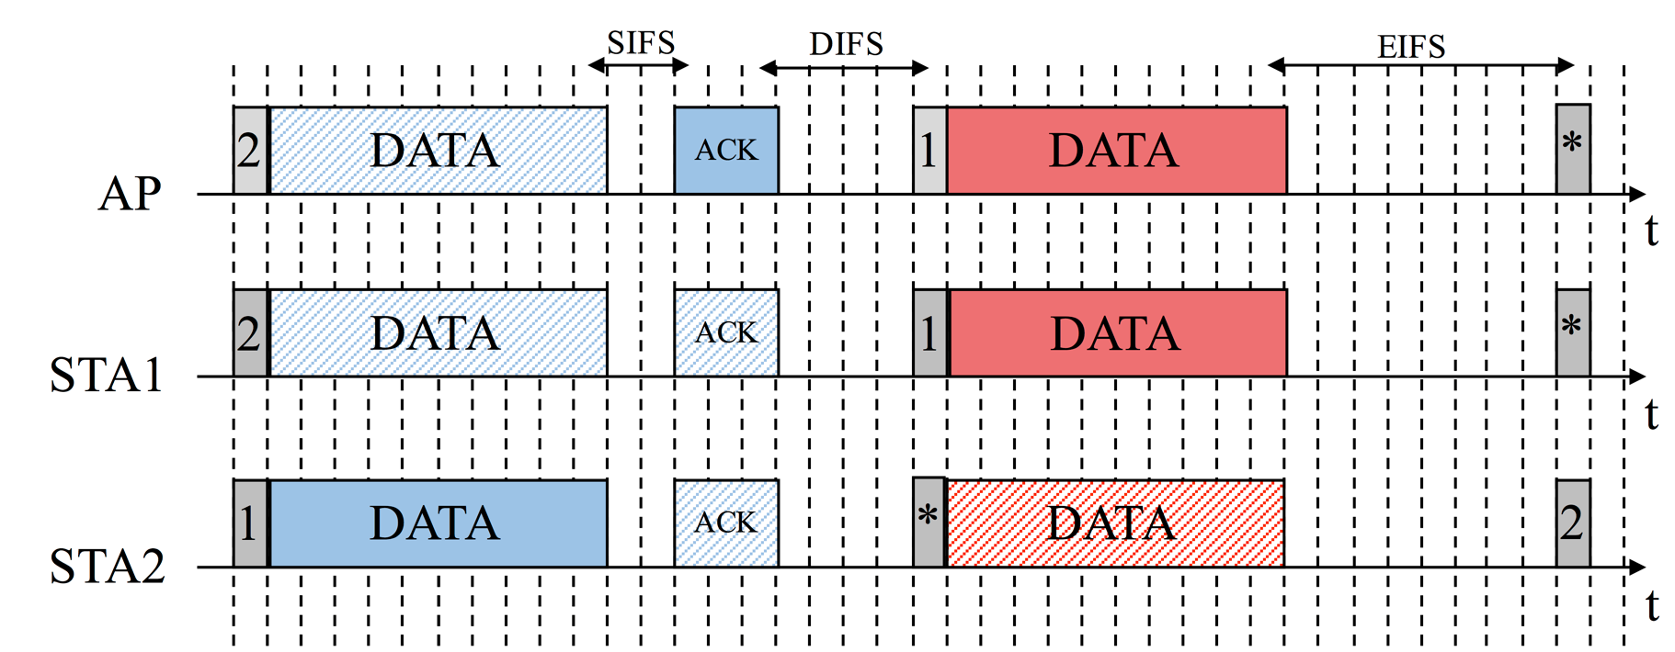


DCF in IEEE 802.11 WLANs
The Distributed Coordination Function (DCF) orchestrates the channel access for IEEE 802.11 devices in a decentralised way. It uses CSMA/CA and BEB.
Node 1 listens to Node 2
AP
STA 1
STA 2
Data range
Carrier sense range
*Conditioned to a fixed CST

Slide 11


DCF in IEEE 802.11 WLANs
CSMA/CA is not optimal in dense environment. Leads to coexistence issues such as Hidden or Exposed terminal problems. The overall throughput is compromised.
Hidden Terminal Problem
Exposed Terminal Problem
AP 1
Transmitters do not sense each other
Receivers are affected by interferring nodes
The collisions probability increases
Transmitters sense each other
Receivers are not affected by interferring nodes
The number of parallel transmissions decreases
Exposed Terminal Problem
STA 1
AP 2
STA 2
Hidden Terminal Problem
EXAMPLE: AP2 and AP3 transmit to STA2 and STA3, respectively. However, both STA2 and STA3 listen to AP2 and AP3, so collisions may occur.
EXAMPLE: AP1 and AP2 can transmit to STA1 and STA2, respectively. However, only one AP can transmit at the same time.
STA 3
Data range
AP 3
Carrier sense range
*Conditioned to a fixed tx power / CST

Slide 12
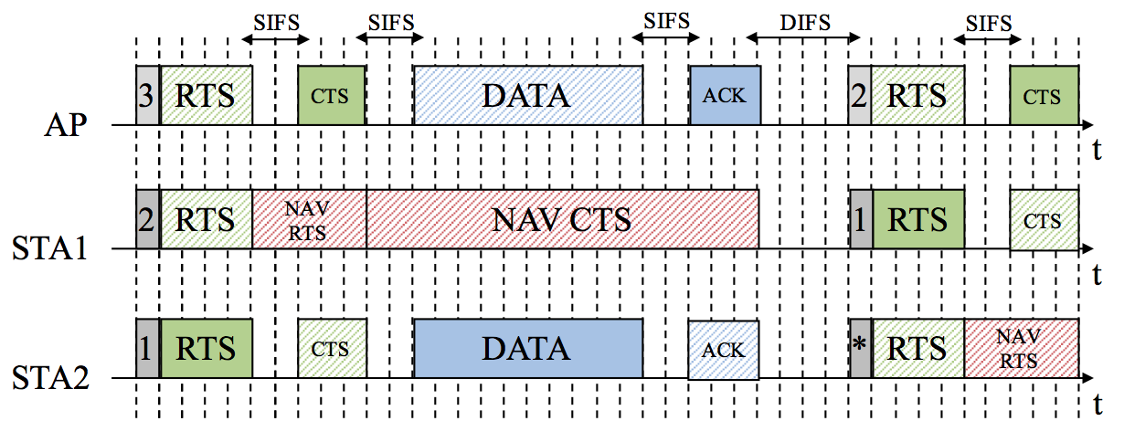
Ready-to-Send/Clear-to-Send (RTS/CTS)
RTS/CTS attempts to solve the collisions problem, but coexistence issues still appear in IEEE 802.11 WLANs
RTS/CTS does not solve the performance issues in CSMA/CA
Performance anomalies in case of existing asymetric links [1]
Hidden node problem still occurs
RTS or CTS not heard
AP 1
STA 1
STA 2
Data range
AP 2
Carrier sense range
*Conditioned to a fixed tx power / CST

Slide 13
Spatial Reuse
Spatial reuse aims to increase the capacity in an area in which several devices share the medium.
TPC
CST adjustment
Directional Transmissions
Interference cancellation
Decrease the transmission area
Increase the number of parallel transmissions
Increase the transmission area
Allow further transmissions
Reduce the carrier sense area
Increase the number of parallel transmissions
Increase the carrier sense area
Allow further transmissions
Reduce the interference area
Increase the number of parallel transmissions
Increase the number of parallel transmissions
PHY overhead of training sequences
STA 1
Antenna 3
AP 1
Antenna 4
STA 1
Antenna 1
STA 2
AP 1
AP 1
STA 1
AP 1
AP 1
Antenna 2
STA 1
AP 1
STA 1
Antennas 1 and 2 transmit simultaneously to antennas 3 and 4, respectively.
AP 2
AP 2
STA 1
Initial tx power
Reduced CST to avoid AP3’s interference
Initial CST in which collisions occur
Omnidirectional transmission
Directional transmission
Reduced tx power

Slide 14
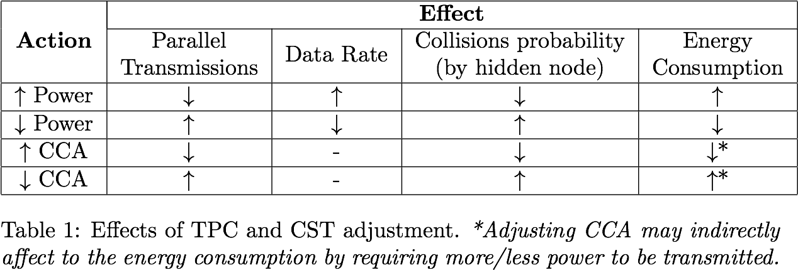
Effects on TPC and CST Adjustment
Adjusting either the power or the sensitivity has direct effects on the performance of a WLAN, specially in high-density scenarios.

Slide 15
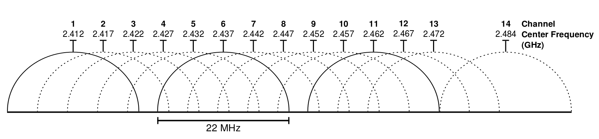


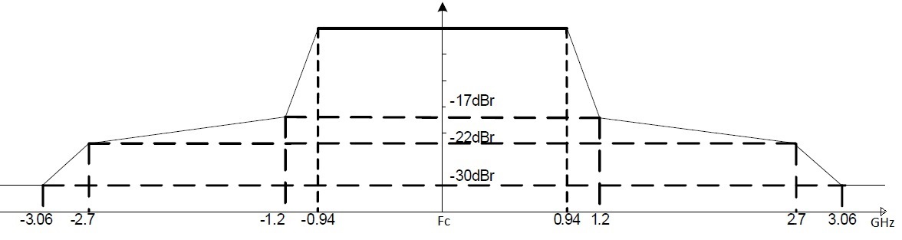
Dynamic Channel Allocation
DCA aims to properly allocate the available frequency channels among the overlapping wireless devices. A proper DCA relaxes the SR problem.
Industrial, Scientific and Medical (ISM) band
Smart channel allocation helps at reducing the interference
The number of parallel transmissions is notably increased
Shared by many technologies (802.11, 802.15, U-LTE…)
2.4 and 5 GHz bands
Overlapping channels with co-channel interference
AP 1
AP 1
STA 1
STA 1
AP 2
AP 2
STA 2
STA 2
STA 3
STA 3
AP 3
AP 3
Channel 1
Channel 2
Channel 3

Slide 16
Spatial Reuse in WNs - Recap
1
DCF shows poor performance in dense environments
1.1
Hidden and Exposed node problems
1.2
RTS/CTS aims to solve hidden node problem, but also has weaknesses
1.3
In general, trade-off between idle periods and collisions
2
SR aims to increase the number of parallel transmissions in overlapping scenarios
2.1
SR depends the transmit power and the CST
2.2
Other advanced techniques help at SR enhancement
2.3
Tuning the transmit power and the CST implies several trade-offs

Slide 17
Current SR Solutions for IEEE 802.11 WLANs

Slide 18
Previous Work in TPC
Power Adaptation
Topology control
Per-packet based
Interference unaware
Interference aware
Busy Tone or Multiple Channel
Single Channel
Single Channel
Busy Tone or Multiple Channel
Single Channel

Slide 19
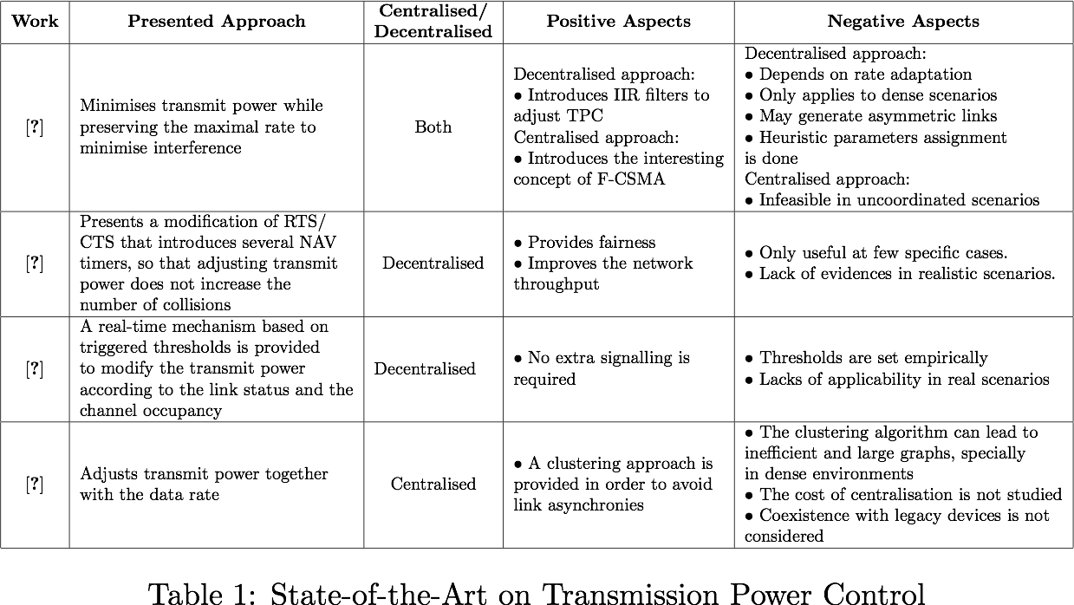
Previous Work in TPC

Slide 20
Previous Work in CST Adjustment
CST Adaptation
Uncoordinated
Coordinated
Centralised
Communication-based
DSC

Slide 21
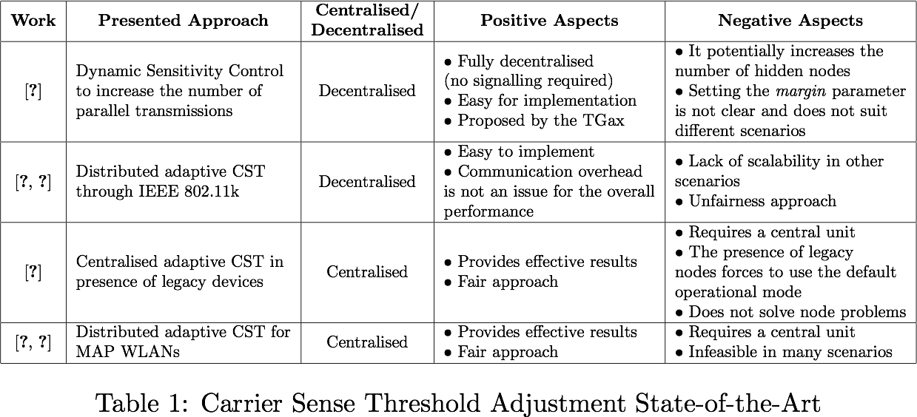
Previous Work in CST Adjustment

Slide 22
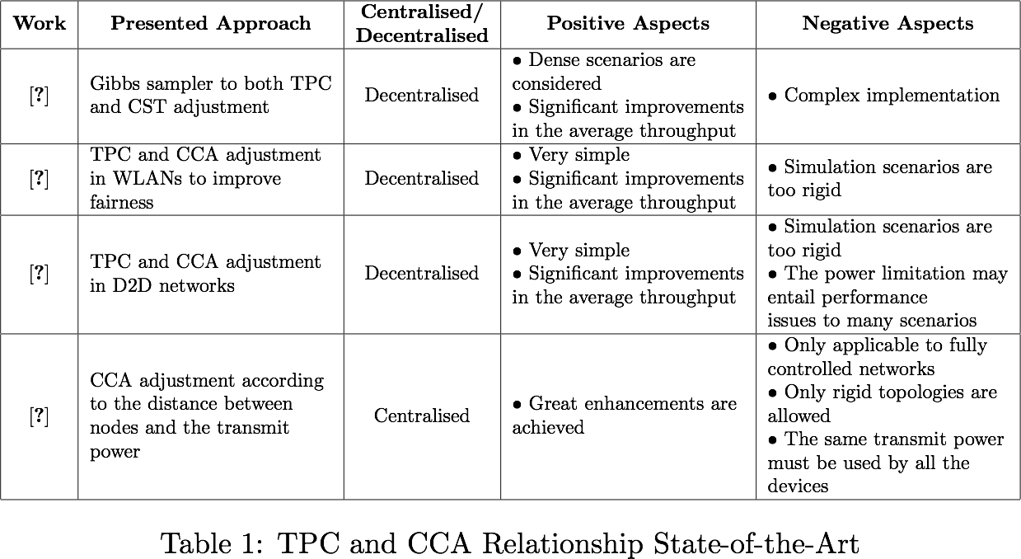
Tranmit Power and CST Relationship

Slide 23
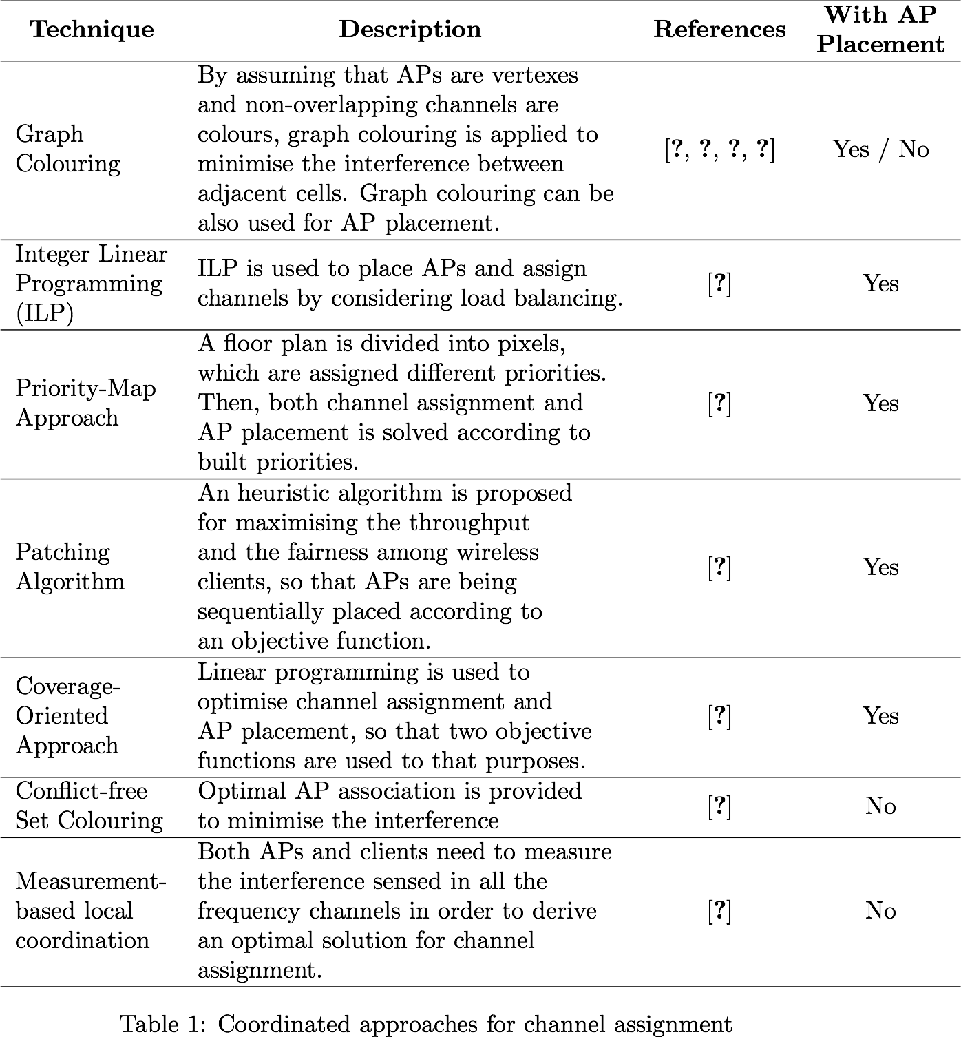
Previous Work in DCA - Coordinated

Slide 24
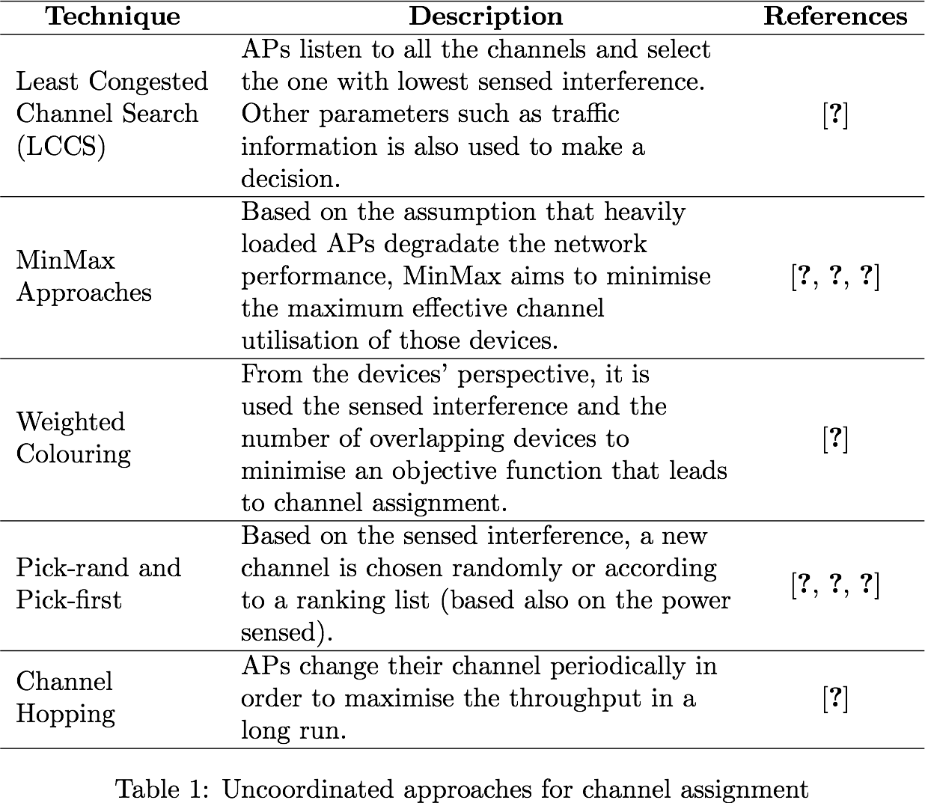
Previous Work in DCA - Unoordinated

Slide 25
Reinforcement Learning for SR in IEEE 802.11ax

Slide 26
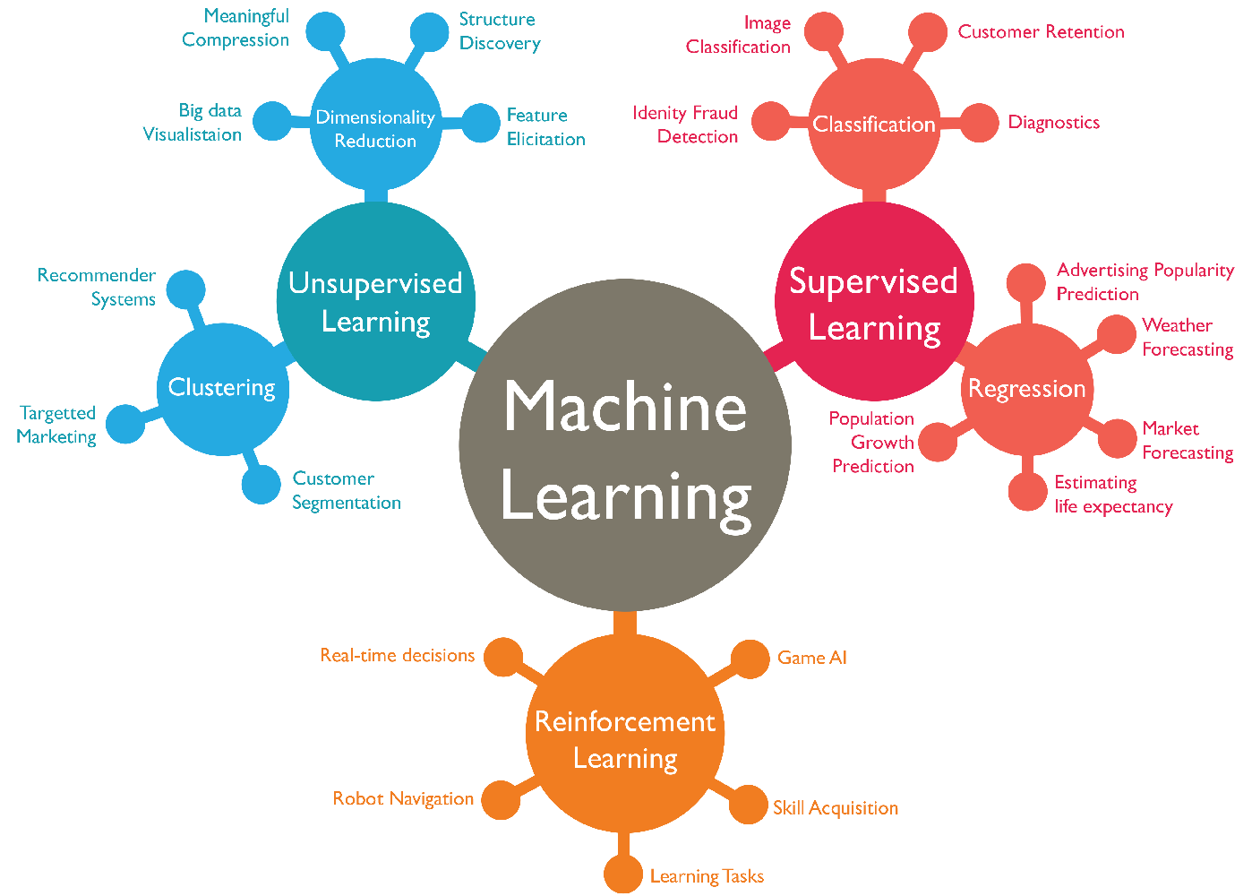

Slide 27
RL in WNs – State-of-the-Art
Many categorizations: learner (passive/active), environment (known/unknown), model (with/without states)…
+ tabular (Monte-Carlo and TD(λ))
+ Function approximation (large states space)
Prediction
Control
* gradient descend (GTD2 and TDC)
* least-squares methods (LSTD(λ) and λ-LSPE)
+ optimizing online performance (bandit problems and MDPs)
+ methods that aim at developing methods that can be used in large-scale applications
* Direct methods (estimate
the optimal action-values directly)
* Actor- critic methods
based on direct policy improvement and policy gradient

Slide 28
RL in WNs – Feasibility & Considerations

Slide 29
Research Activity

Slide 30
Expected Contributions
1
Understand challenges & limitations in future WLANs
2
Study the practicality of using RL to enhance SR in WNs
Design decentralised ML-based solutions for enhancing SR
Integrate these solutions with others, such as DCB
3.1
4
Provide centralised ML-based solutions for enhancing SR
3.2

Slide 31
Analytical Models & Simulation Tools
Tools: CTMN, Komondor, ns-3…

Slide 32
Ongoing work
Understanding the challenges and limitations in future WLANs, thus allowing researchers to deeply understand the topic and provide new solutions. To do so, we aim to perform an exhaustive analysis of the state-of-the-art in spatial reuse, as well as in the usage of Artificial Intelligence (AI) in WNs.
Exploring the feasibility of applying AI techniques to enhance spatial reuse in WNs, i.e., studying its practicality to show if they allow improving the performance of a given WN. In addition, we aim to show the benefits and limitations of applying a set of techniques for different architectures (e.g., fully centralised, uncoordinated, etc.). Regarding the network architecture, it is important to deeply analyse in which devices must a candidate solution be implemented, as well as in which of the protocols layer (e.g., PHY, MAC, Network, etc.). For the latter, the decision must be done according to the available input information in each level and the impact on the network performance.
Designing decentralised ML-based solutions for enhancing spatial reuse, so that WNs become autonomous systems through self-configuration. Moreover, it is also of importance to provide real-time mechanisms that can satisfy the challenge that variability in WNs supposes. We aim to explore both coordinated and uncoordinated approaches, motivated by the chaotic scenarios in which several independent WNs coexist (e.g., residential buildings).
As an extension of the previous point, we also aim to provide centralised ML-based solutions, so that many other fully controlled scenarios (e.g., university campus, airport, etc.) are covered. In such environments, it is important to analyse the trade-off between the optimality of the solution and the required time to achieve it.
Integrating the abovementioned solutions with others, such as Dynamic Channel Bonding, to provide a higher improvement in WNs performance.

Slide 33
Future Work

Slide 35
Reinforcement Learning to Enhance Spatial Reuse in Dense Wireless Networks

Slide 36
References
[2] Littman, M., & Boyan, J. (1993, July). A distributed reinforcement learning scheme for network routing. In Proceedings of the international workshop on applications of neural networks to telecommunications (pp. 45-51). Psychology Press.
[3] Bojovic, B., Baldo, N., Nin-Guerrero, J., & Dini, P. (2011, December). A supervised learning approach to cognitive access point selection. In GLOBECOM Workshops (GC Wkshps), 2011 IEEE (pp. 1100-1105). IEEE.
[4] Bojovic, B., Baldo, N., & Dini, P. (2012, January). A neural network based cognitive engine for IEEE 802.11 WLAN access point selection. In Consumer Communications and Networking Conference (CCNC), 2012 IEEE (pp. 864-868). IEEE.
[5] Combes, R., Proutiere, A., Yun, D., Ok, J., & Yi, Y. (2014, April). Optimal rate sampling in 802.11 systems. In INFOCOM, 2014 Proceedings IEEE (pp. 2760-2767). IEEE.
[6] Miozzo, M., Giupponi, L., Rossi, M., & Dini, P. (2015, June). Distributed Q-learning for energy harvesting Heterogeneous Networks. In Communication Workshop (ICCW), 2015 IEEE International Conference on (pp. 2006-2011). IEEE.
[1] Sobrinho, J. L., De Haan, R., & Brazio, J. M. (2005, March). Why RTS-CTS is not your ideal wireless LAN multiple access protocol. In Wireless Communications and Networking Conference, 2005 IEEE (Vol. 1, pp. 81-87). IEEE.
[7] Wilhelmi, F., Bellalta, B., Cano, C., & Jonsson, A. (2017). Implications of Decentralized Q-learning Resource Allocation in Wireless Networks. arXiv preprint arXiv:1705.10508.

