Slide 1
Reinforcement Learning to Enhance Spatial Reuse in Dense Wireless Networks
a Thesis Proposal

Slide 2
Motivation

Slide 3
Explain main goal: move WNs to RL/AI
Explain the issues in dense WN
Explain possibilities (time, frequency, space)
Characterize scenarios (IEEE 802.11ax)

Slide 4
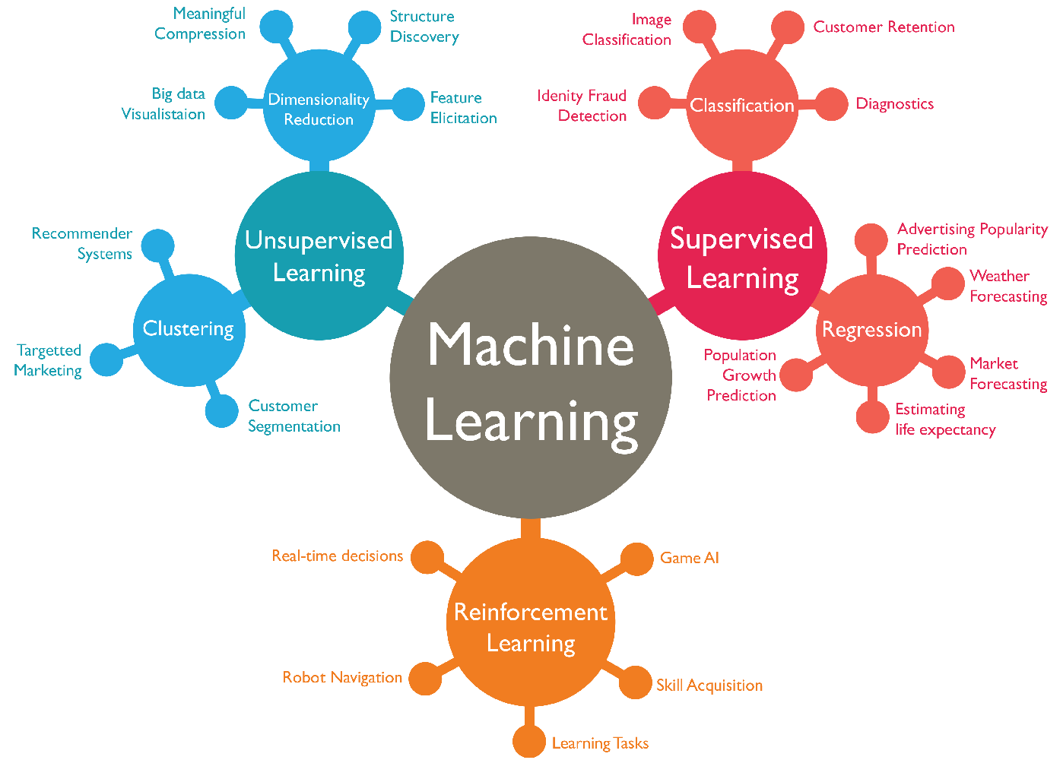

Slide 5
Main Problem
Computational power moving to the cloud (more communication)
Easiness of deployments
Coexistence issues in WNs
New BW requirements of new apps
Heterogeneous deployments

Slide 6
Main Solutions
Frequency
DSA
DCA
Space
TPC
CST adjustment
Beamforming
Coexistence issues in WNs
Time
Scheduling
FT-CSMA/CA

Slide 7
Spatial Reuse in Wireless Networks

Slide 9
Problem Formulation

Slide 11
Reinforcement Learning in WNs

Slide 12
RL in WNs – State-of-the-Art
Many categorizations: learner (passive/active), environment (known/unknown), model (with/without states)…
+ tabular (Monte-Carlo and TD(λ))
+ Function approximation (large states space)
Prediction
Control
* gradient descend (GTD2 and TDC)
* least-squares methods (LSTD(λ) and λ-LSPE)
+ optimizing online performance (bandit problems and MDPs)
+ methods that aim at developing methods that can be used in large-scale applications
* Direct methods (estimate
the optimal action-values directly)
* Actor- critic methods
based on direct policy improvement and policy gradient

Slide 13
RL in WNs – Feasibility & Considerations

Slide 14
Current Contributions & Ongoing Work

Slide 16
Future Work

Slide 18
Reinforcement Learning to Enhance Spatial Reuse in Dense Wireless Networks

