Slide 1
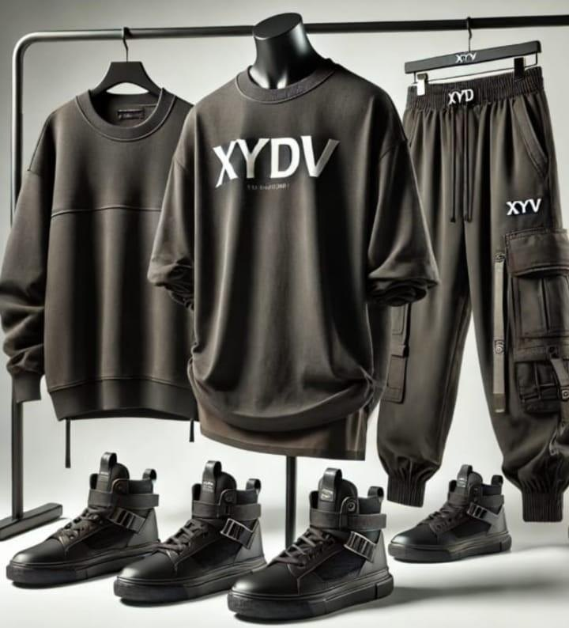
XYDV
APPAREL
Collection Lookbook
Men · Women · Training · Outerwear · Casual

Slide 2
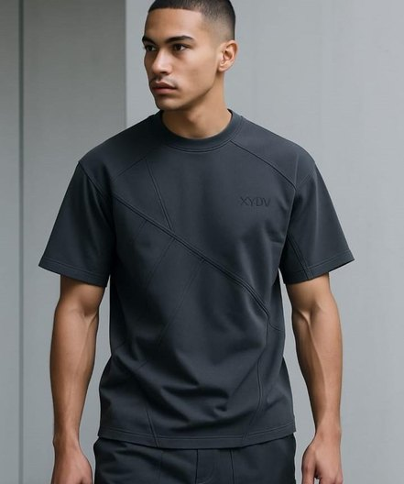
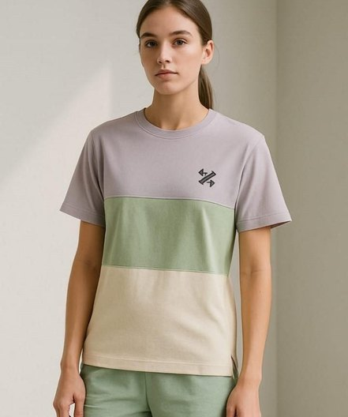
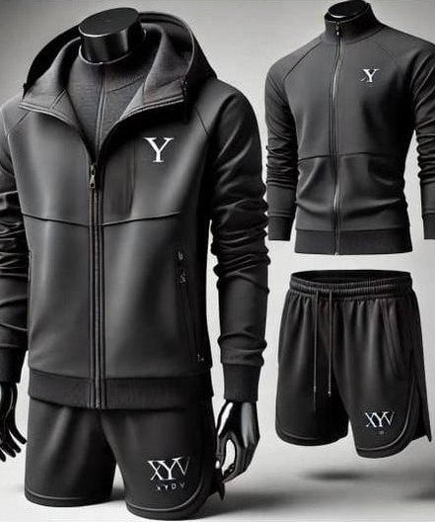
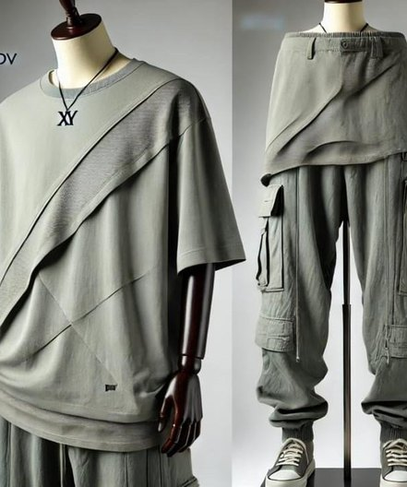
The Collection
XYDV / LOOKBOOK
Sports and everyday wear for men and women, built on clean seams and tonal branding.
Men's Essentials
Women's Essentials
Training & Gym Sets
Casual & Semi-Formal
Tees · Joggers · Outerwear
Tees · Tops · Sets
Jackets · Shorts · Bras
Outfits · Layers · Denim

Slide 3
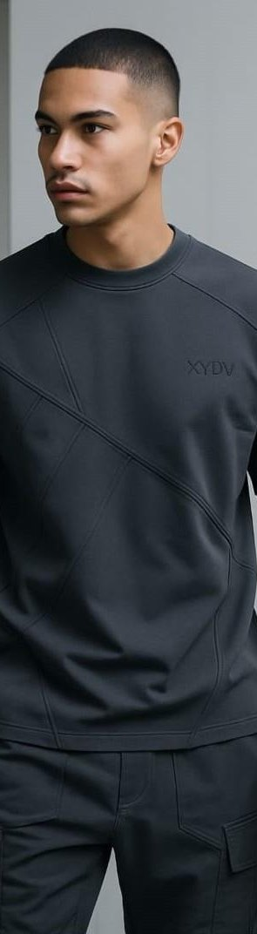
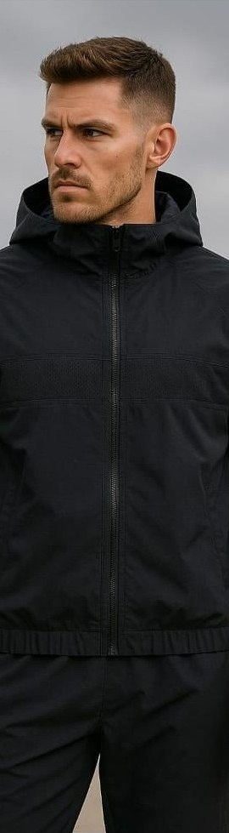
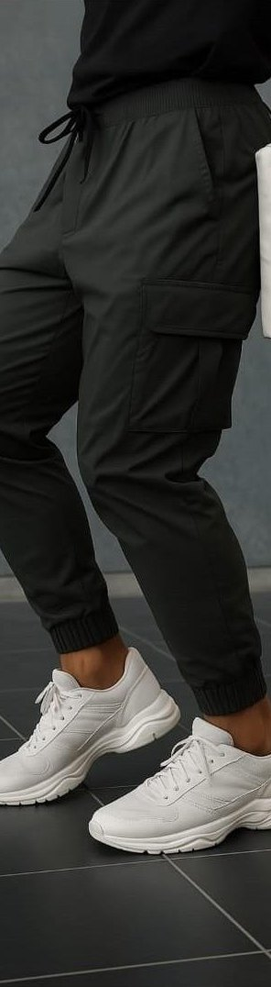
Men
01
Tees · Joggers · Training sets · Outerwear · Casual

Slide 4
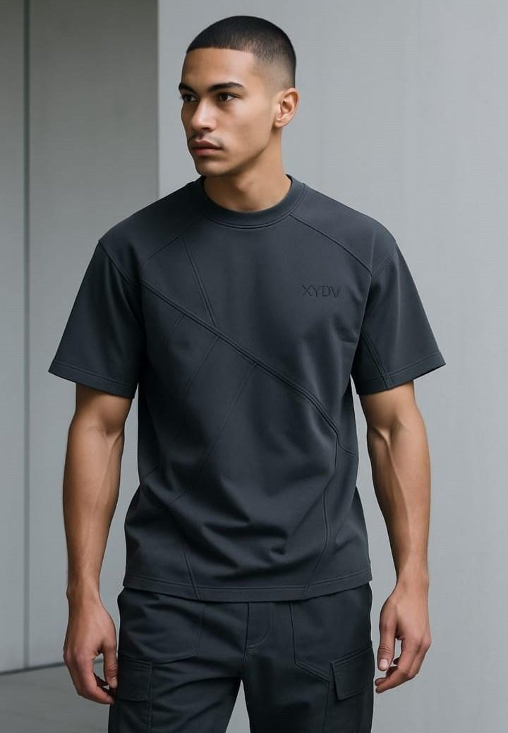
Sports T‑Shirt
MEN / 01
A training tee built around geometric paneling, with diagonal seams cutting across the front for a sharp, structured look.
Diagonal panel seams across the front
Ribbed crew neck
Tonal XYDV chest logo
Relaxed athletic fit
COLOURWAY Charcoal

Slide 5
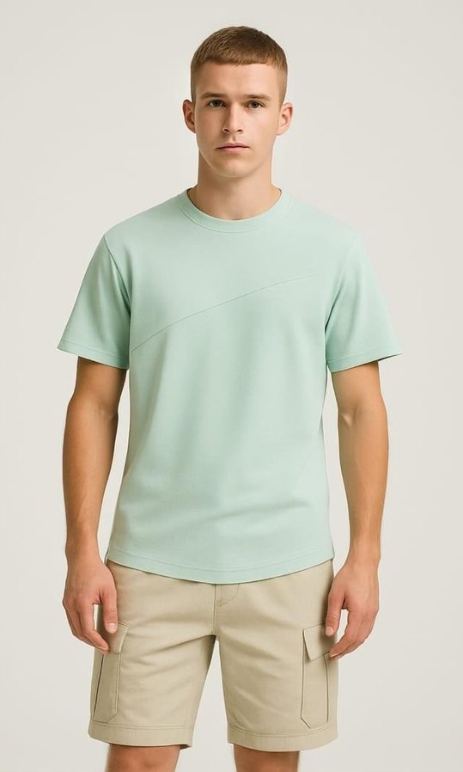
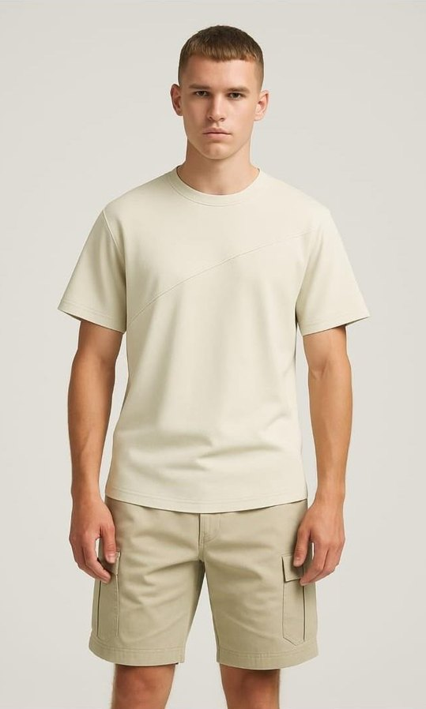
Diagonal Seam T‑Shirt
MEN / 02
An everyday essential with one sweeping seam across the chest. Minimal, clean and easy to pair.
Single diagonal chest seam
Ribbed crew neck
Regular fit
COLOURWAYS Mint · Stone
Mint
Stone

Slide 6
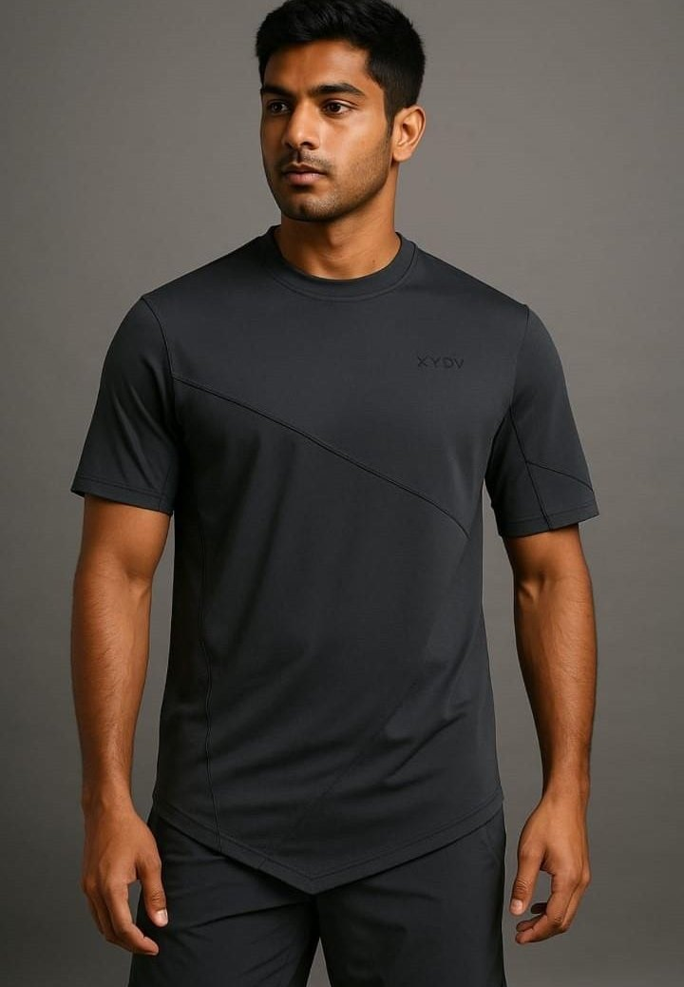
Sportswear T‑Shirt
MEN / 03
A sharper take on the training tee, with an angled front hem and a diagonal seam for a technical edge.
Asymmetric dipped hem
Diagonal front seam
Tonal XYDV chest logo
Athletic fit
COLOURWAY Black

Slide 7
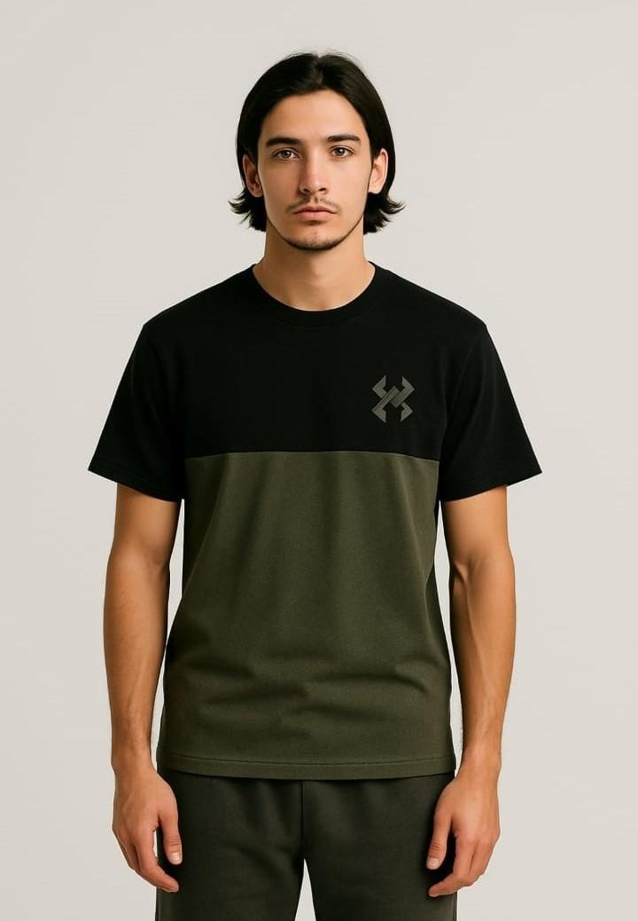
Casual Colourblock T‑Shirt
MEN / 04
Two-tone blocking with the XYDV mark on the chest. Laid-back, but still considered.
Horizontal two-tone colour block
XYDV icon on the chest
Ribbed crew neck
Regular fit
COLOURWAY Black / Olive

Slide 8
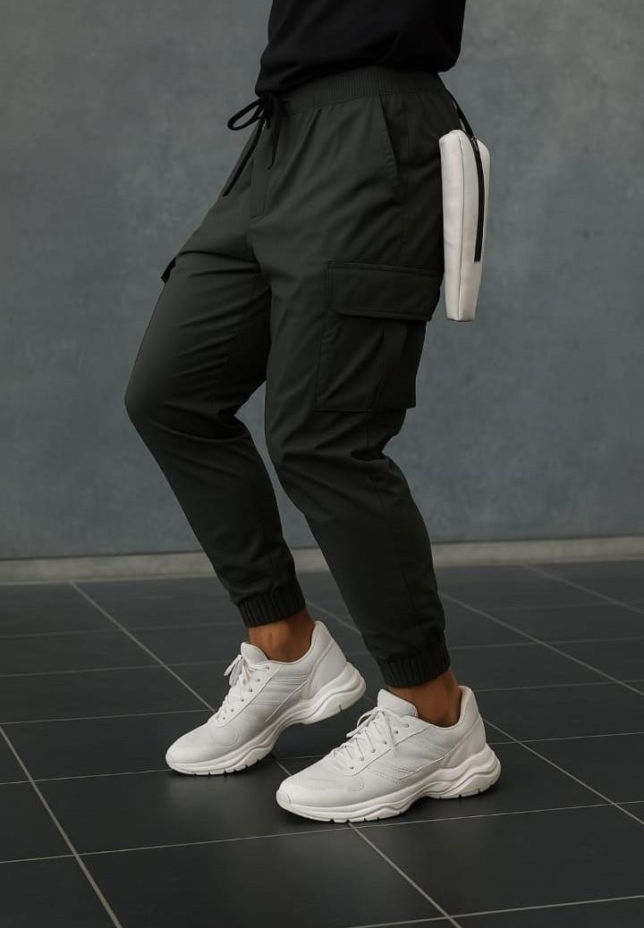
Cargo Joggers
MEN / 05
Tapered cargo joggers with a drawstring waist and cuffed ankles that go from gym to street.
Drawstring elastic waist
Flap cargo pocket
Ribbed ankle cuffs
Tapered leg
COLOURWAY Charcoal

Slide 9
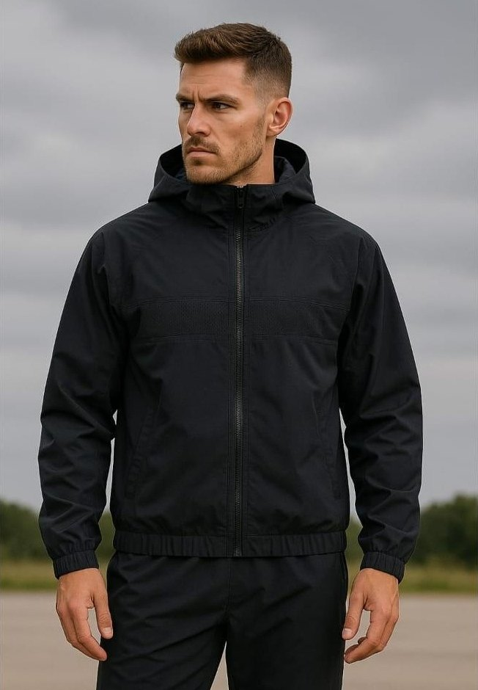
Windbreaker
MEN / 06
A lightweight hooded shell for outdoor sessions and cool mornings. Full-zip and stripped back.
Attached hood
Full-length front zip
Elasticated cuffs and hem
Chest yoke seam
COLOURWAY Black

Slide 10
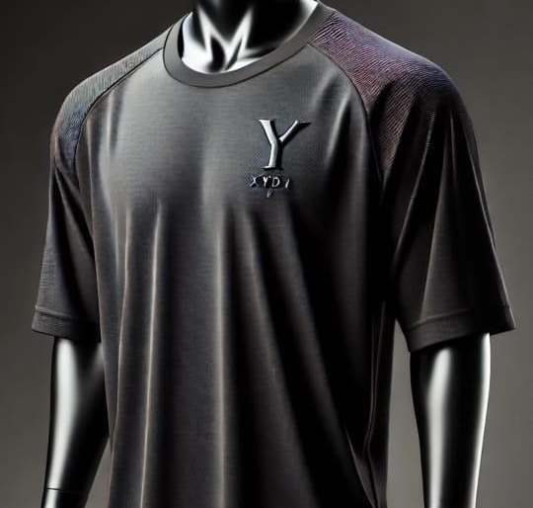
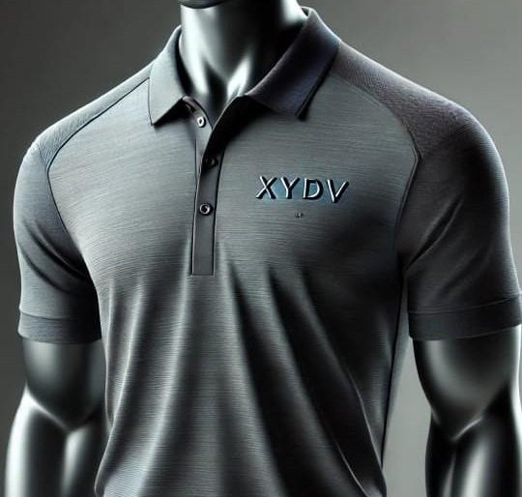
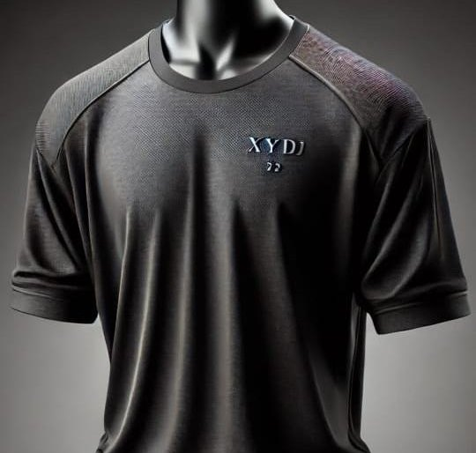
Sportswear T‑Shirts
MEN / SPORTSWEAR
Raglan-sleeve training tees and a sport polo, finished with textured shoulder panels and tonal XYDV branding.
Raglan crew tee
Sport polo
Textured-shoulder tee

Slide 11
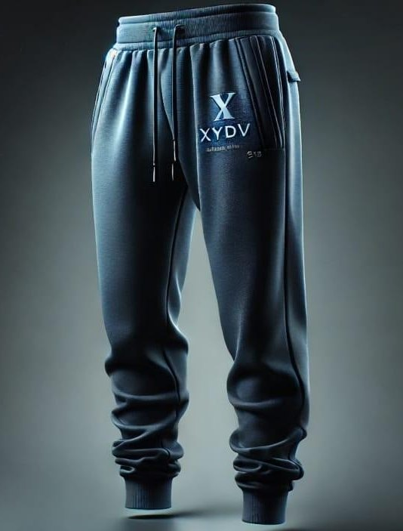
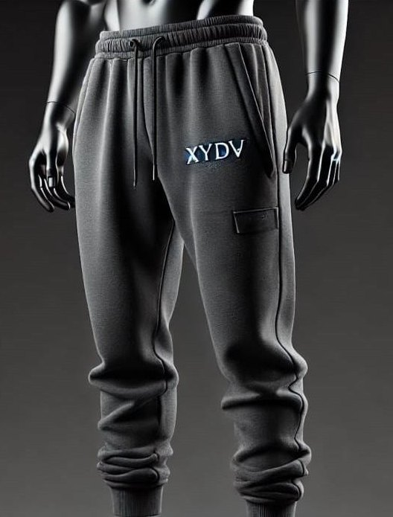
Sportswear Lowers
MEN / SPORTSWEAR
Fleece-look joggers with drawstring waists, cuffed ankles and the XYDV wordmark on the thigh.
Drawstring waist
Ribbed ankle cuffs
XYDV thigh branding
Slate jogger
Charcoal cargo jogger

Slide 12
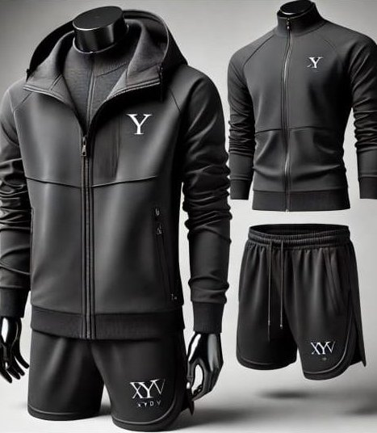
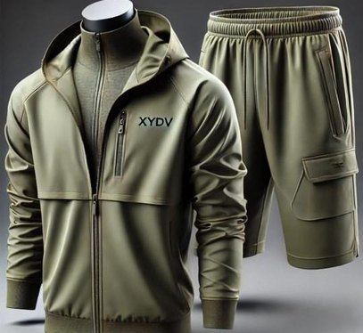
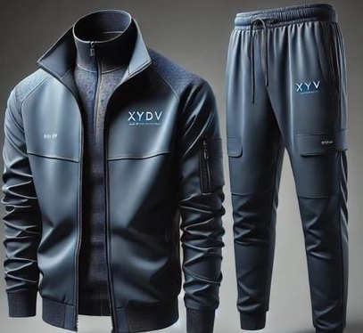
Sports & Gym Combos
MEN / TRAINING SETS
Coordinated jacket-and-bottom sets, built to be worn together from warm-up to cool-down.
Olive jacket & shorts
Steel track set
Black hooded set

Slide 13
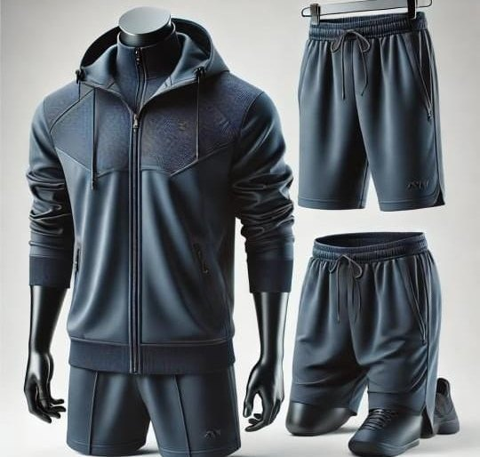
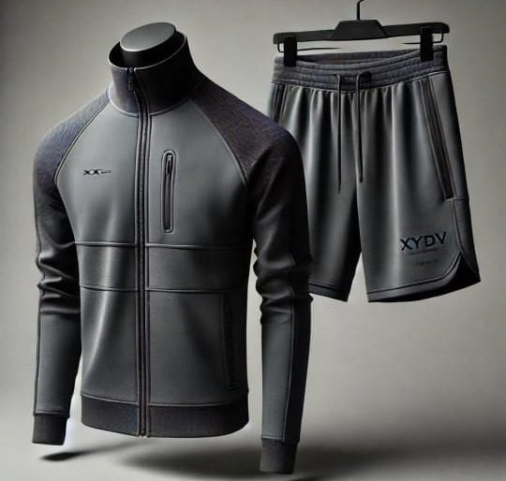
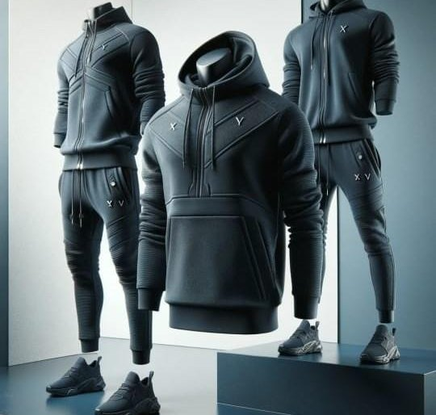
Layered Training Sets
MEN / TRAINING SETS
Navy and grey layering pieces: hooded jackets, hoodies, joggers and shorts that mix across the range.
Navy hooded short set
Grey track jacket & shorts
Navy layering trio

Slide 14
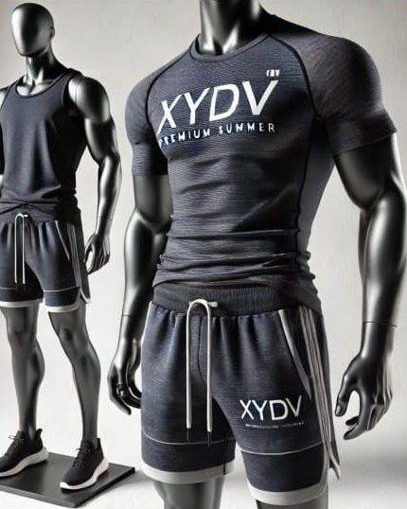
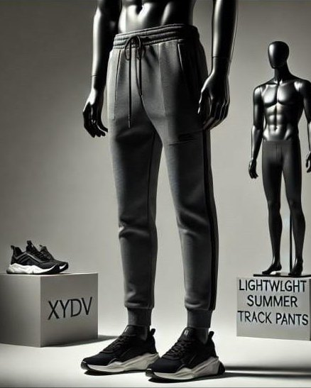
Summer Training Kit
MEN / TRAINING SETS
Breathable tees, tanks and shorts with lightweight track pants for hot-weather sessions.
Training tee and tank
Drawstring shorts
Lightweight track pants
Tee, tank & shorts
Lightweight track pants

Slide 15
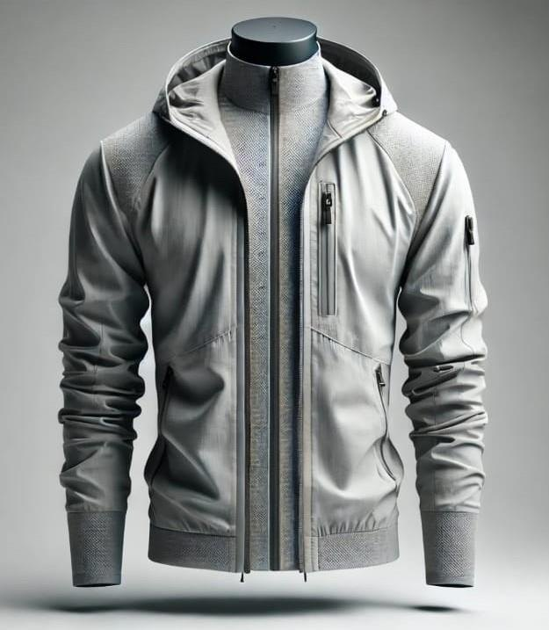
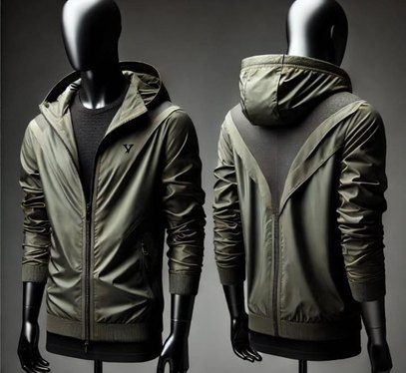
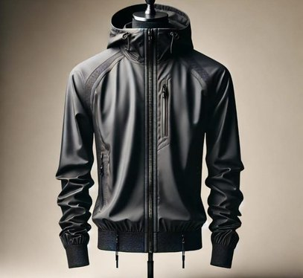
Wind Cheaters
MEN / OUTERWEAR
Hooded wind cheaters with zip pockets and ribbed cuffs, in three core colours.
Olive
Black
Ash grey

Slide 16
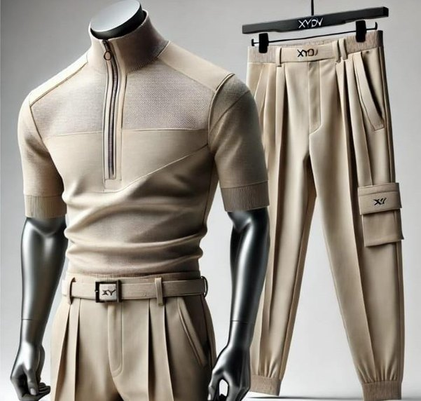
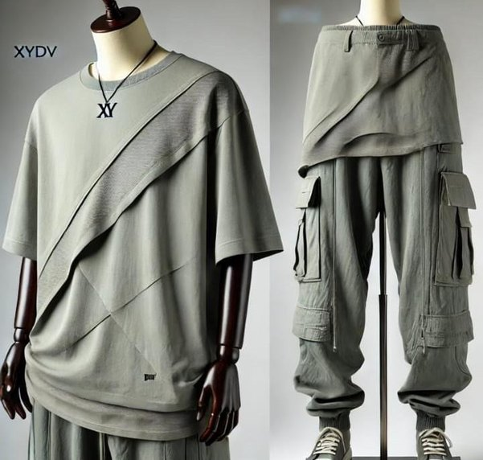
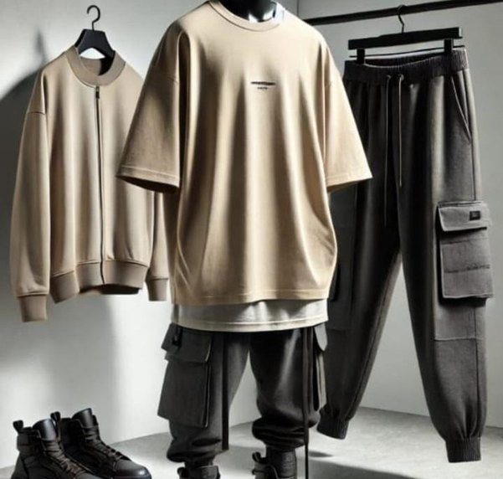
Semi-Formal & Casual
MEN / CASUAL
Relaxed shapes in muted stone and sage, bridging smart-casual and streetwear.
Stone half-zip & pleated trousers
Sage layered tee & cargos
Sand oversized tee & cargos

Slide 17
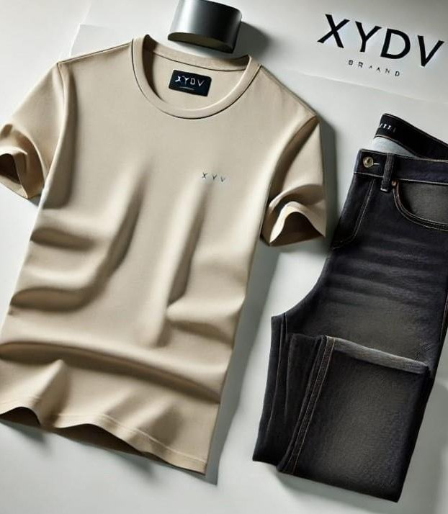
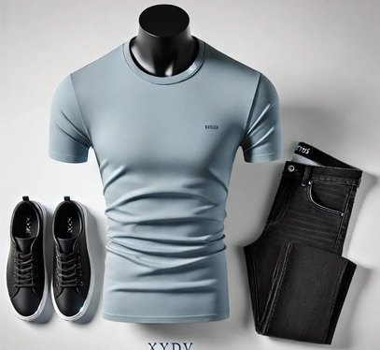
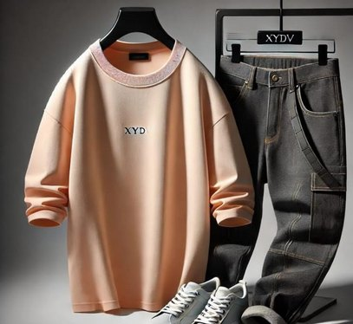
Tee & Denim Outfits
MEN / CASUAL
Clean XYDV tees styled with dark denim for easy, everyday outfits.
Powder blue tee
Peach long-sleeve
Stone tee & dark denim

Slide 18
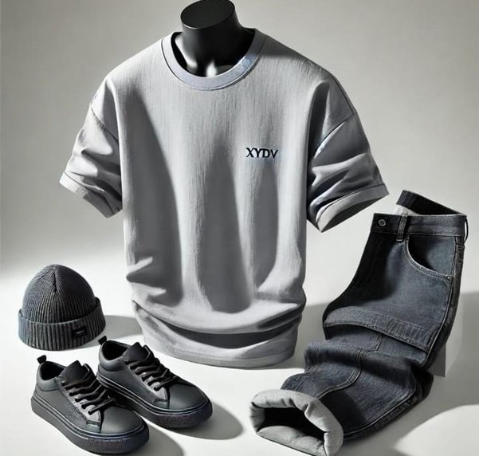
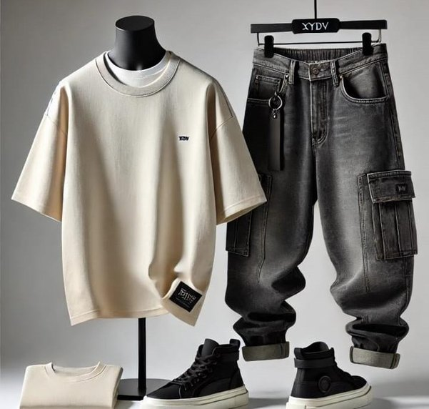
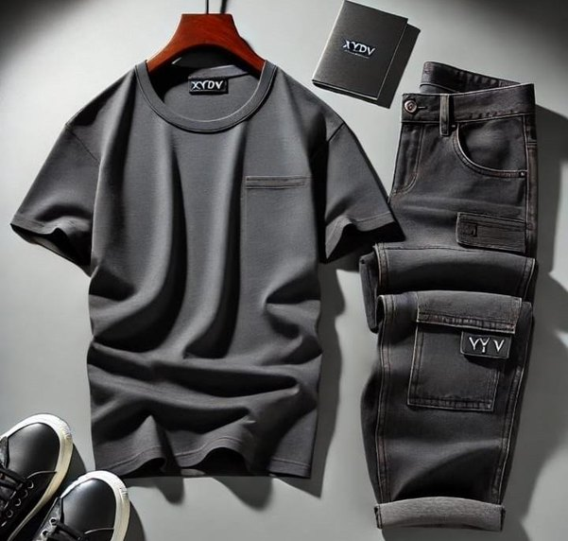
Relaxed Denim Outfits
MEN / CASUAL
Boxy tees with washed and cargo denim for a laid-back weekend look.
Grey tee & denim
Cream tee & cargo denim
Charcoal pocket tee & denim

Slide 19
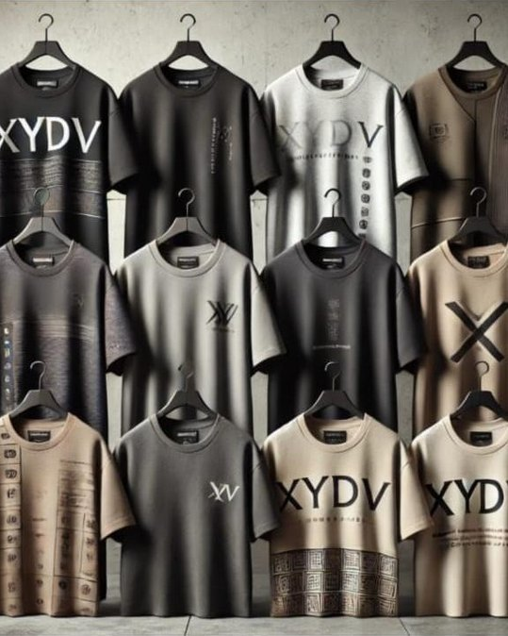
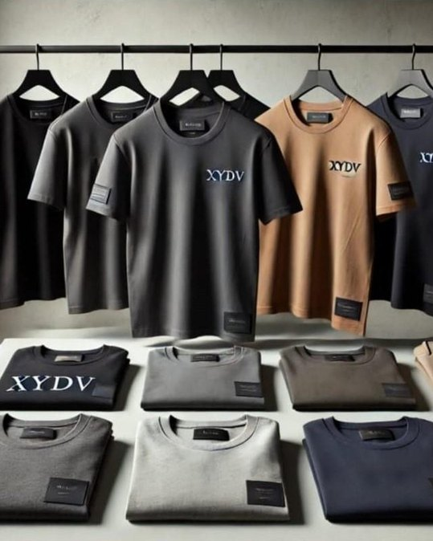
Casual T‑Shirt Collection
MEN / CASUAL
A full rail of casual tees, from bold XYDV graphics to minimal logo essentials.
Bold XYDV graphic prints
Small chest logos
Neutral core colours
Graphic & logo tees
Essential logo tees

Slide 20
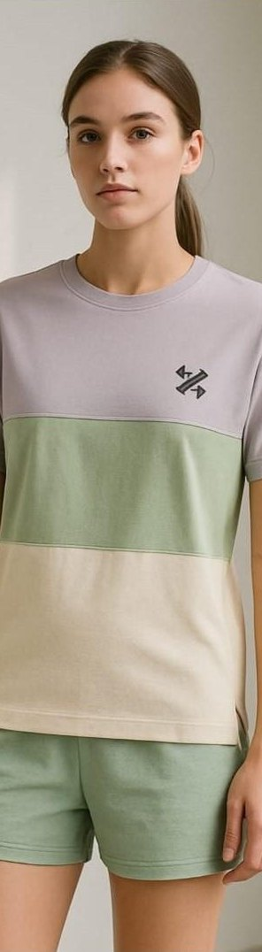
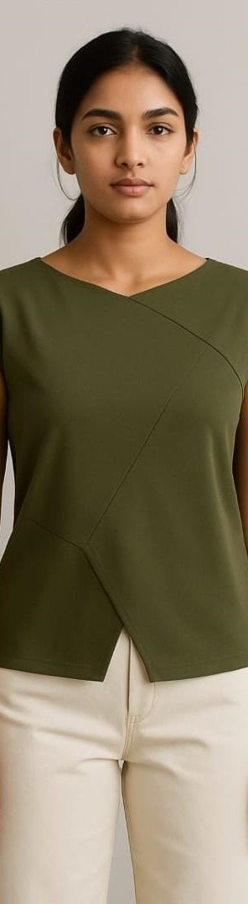
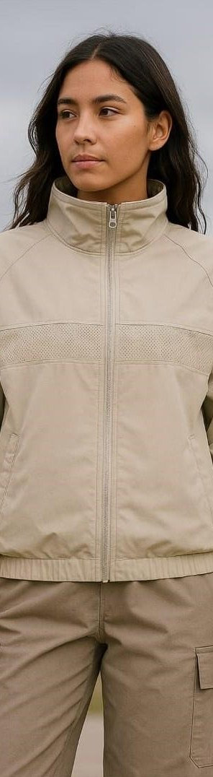
Women
02
Tees · Tops · Sets · Training · Outerwear

Slide 21
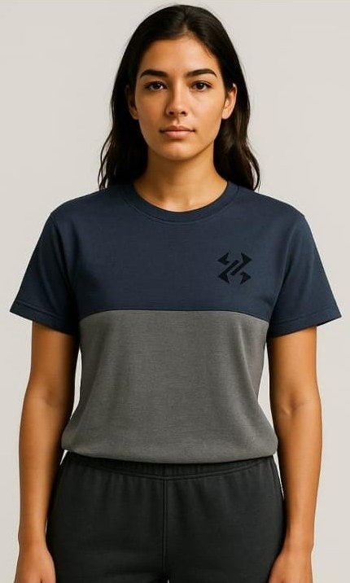
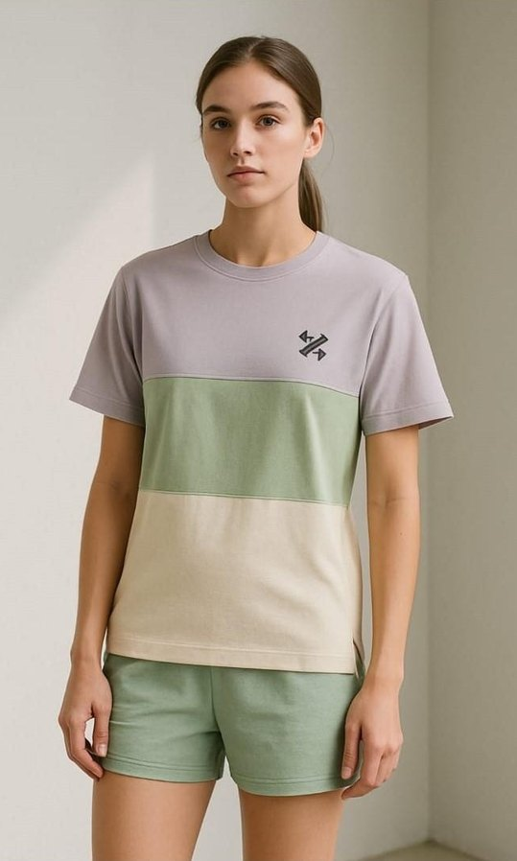
Colourblock T‑Shirt
WOMEN / 01
Soft colour-blocked tees in a relaxed fit, finished with the XYDV mark on the chest.
Two-tone and three-tone versions
XYDV icon on the chest
Crew neck, relaxed fit
Navy / Grey
Lavender / Sage / Cream

Slide 22
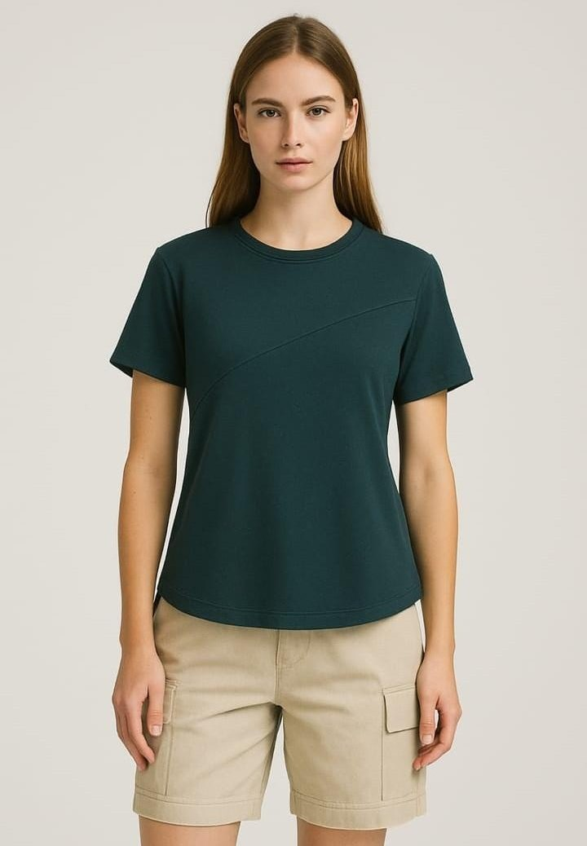
Casual Top
WOMEN / 02
The diagonal-seam essential cut for women, with a gently curved hem and an easy fit.
Diagonal chest seam
Curved hem
Crew neck
Short sleeves
COLOURWAY Forest Green

Slide 23
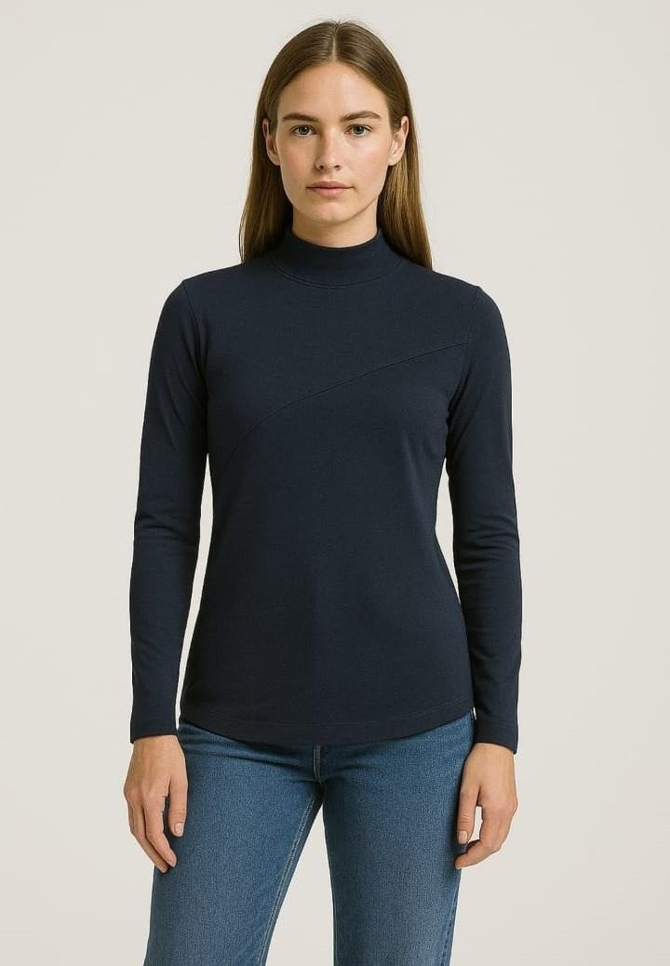
High Neck T‑Shirt
WOMEN / 03
A sleek long-sleeve layer with a mock neck and diagonal seam. Polished, but simple.
Mock high neck
Long sleeves
Diagonal chest seam
Curved hem
COLOURWAY Navy

Slide 24
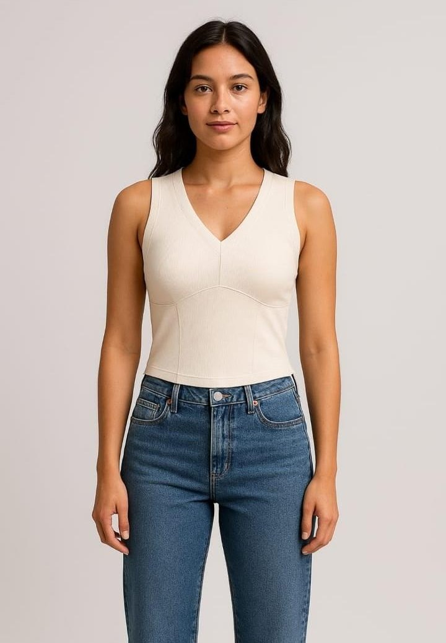
V-Neck Sleeveless Top
WOMEN / 04
A fitted sleeveless top with a deep V-neck and sculpting seam lines. A versatile base layer.
Deep V-neckline
Contour seam panels
Fitted, slightly cropped length
COLOURWAY Ivory

Slide 25


Juni Wrap-Neck Top
WOMEN / 05
A crossover neckline flows into an asymmetric wrap hem. The statement piece of the women's line.
Crossover wrap neckline
Asymmetric split hem
Sleeveless cut
COLOURWAYS Olive · Khaki
Olive, on model
Khaki, flat lay

Slide 26

Crop Top & Pant Set
WOMEN / 06
A ribbed strappy crop top paired with high-waisted, pleated wide-leg trousers.
Ribbed cami crop top
High-waisted pleated trousers
Wide-leg silhouette
COLOURWAY Black / Taupe

Slide 27

Windbreaker
WOMEN / 07
A light stand-collar shell with a perforated chest panel, made for breezy days outdoors.
Stand-up collar
Full-length zip
Perforated chest panel
Elasticated cuffs and hem
COLOURWAY Stone

Slide 28



Cargo Joggers
WOMEN / TRAINING SETS
Relaxed balloon-leg cargo joggers with elastic waists and cuffed ankles.
Charcoal balloon cargo
Cargo jogger trio
Wide-leg cargo

Slide 29



Jacket, Bra & Shorts Sets
WOMEN / TRAINING SETS
Colour-blocked zip jackets paired with sports bras, shorts and leggings.
Jacket, bra & shorts
Jacket & leggings
Full training set

Slide 30



Cropped Jacket Sets
WOMEN / TRAINING SETS
Boxy cropped jackets matched with sports bras and running shorts.
Olive cropped set
Black utility set
Navy layered set

Slide 31



Winter Training Sets
WOMEN / TRAINING SETS
Oversized hooded jackets and anoraks over shorts and crop tops for cold-weather training.
Crop tee, jacket & shorts
Slate hooded set
Olive anorak set

Slide 32



Modern Gym Tops
WOMEN / ACTIVEWEAR
Long-sleeve cropped tops with contour seams and XYDV waistbands.
High-neck crop top
Raglan crop top
Hooded crop top

Slide 33



Sports Bras
WOMEN / ACTIVEWEAR
Supportive bras and fitted tops with clean panelling in soft, muted colours.
Rose wrap-panel top
Lilac seamless bra
Sage longline bra

Slide 34



Shrugs & Layers
WOMEN / ACTIVEWEAR
Soft shrugs and fitted layers worn over sports bras and base tops.
Blush shrug & bra
Charcoal drape shrug
Mint half-zip top

Slide 35


In Progress
COMING SOON
New XYDV styles currently in development.
Sleeveless base layer
Washed black denim

Slide 36

XYDV
APPAREL

