Slide 1


PROJECT B.A.B.A.U (Bioinformatics Algorithms for Better Analysis and Utilization)
Project made by Marco Azevedo at

Slide 2
01
UNVEILING THE INSPIRATION
The Origins of This Project

Slide 3
WHY B.A.B.A.U?
B.A.B.A.U. (Bioinformatics Algorithms for Better Analysis and Utilization) is more than just a clever acronym—it’s the name of my father. Reflecting on his journey and all he endured inspired me to develop solutions not only to aid those affected by lung cancer but also to enhance early detection methods. This Project aims to empower medical professionals with better tools for study and analysis as to propose more effective treatment plans for their patients. But what could a budding data analyst like me do about a complex medical issue? First, I needed to find a problem where I could apply my skills and produce a solution. So, what about a way to identify the type of cancer just by using lung imaging?

Slide 4
02
HOW TO FOLD THIS DATA?
Is it really possible?

Slide 5
YES IT IS!
Yes its = True With the usage of CT-Scan imaging we can more easily identify diferent tipes of cancer

Slide 6
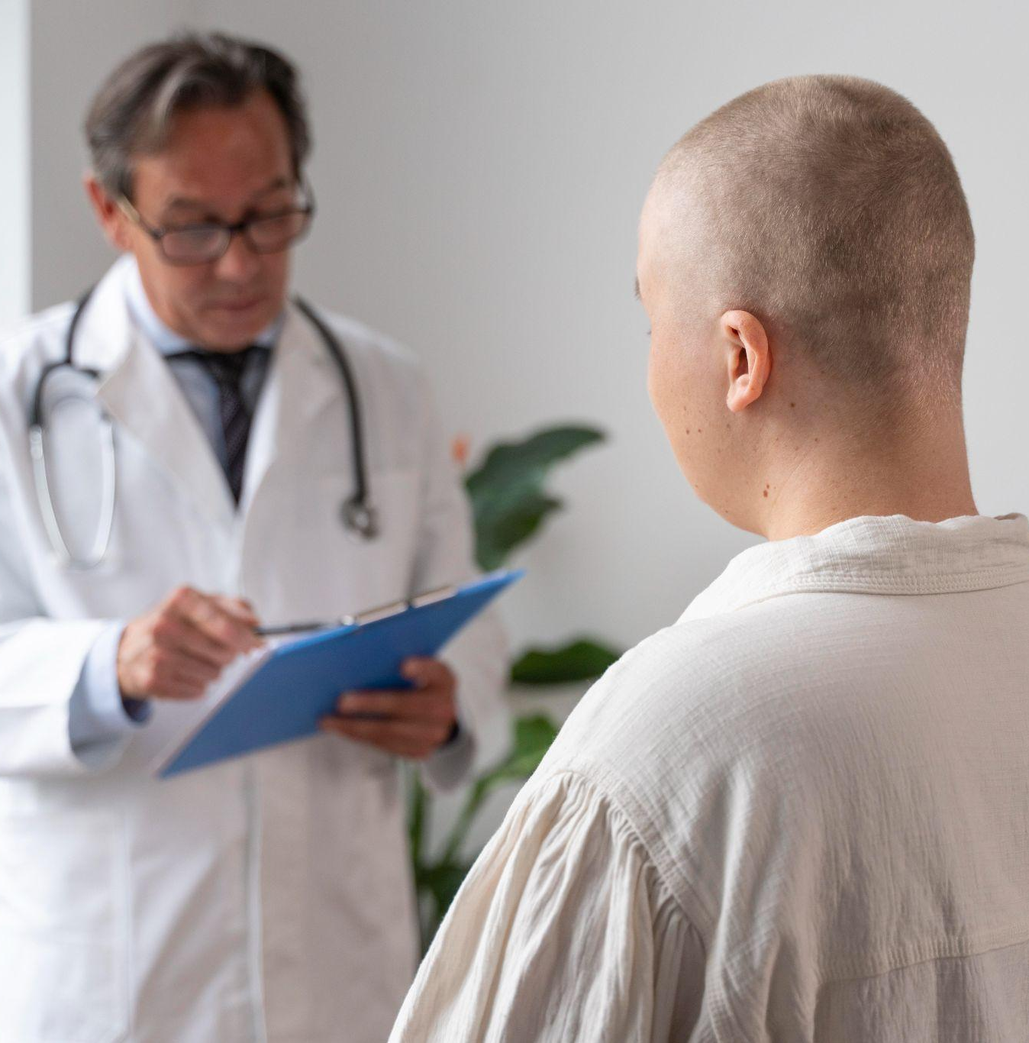
So how can we train_data to make it fit(?)
First of all lets analyze the main types of lung cancer and how they can be identified using images: The two main types of lung cancer are non-small cell lung cancer (NSCLC) and small cell lung cancer (SCLC). Non-small cell lung cancer is more common, more easily identified by imaging and includes three main subtypes:
Adenocarcinoma (40%): This is the most common form of lung cancer in non-smokers, though it also occurs in smokers. It usually develops in the outer regions of the lungs. It may have spiculated margins and sometimes shows ground-glass opacities.
Squamous cell carcinoma (25% ~ 30%): This type is often linked to smoking and tends to be found in the central part of the lungs, near a main airway (bronchus), possibly causing airway obstruction.
Large cell carcinoma (10% ~ 15%): This type can occur in any part of the lung and tends to grow and spread quickly.

Slide 7
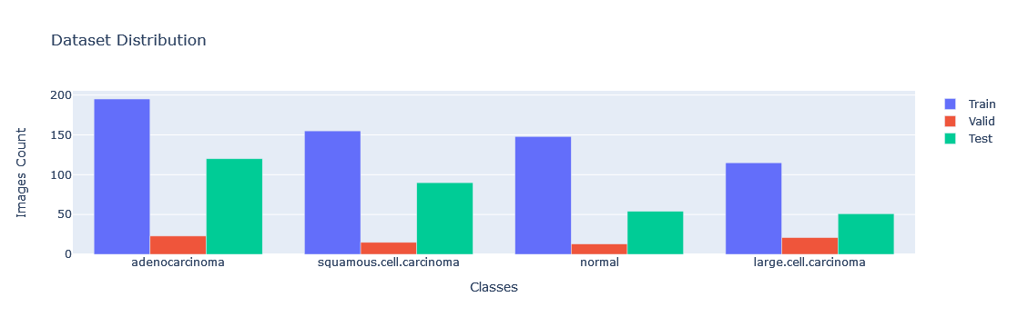
What About the Data Set?
The Data set used is clearly unbalanced, but it closely matches real-world prevalence, which is advantageous for training an effective model. The realistic distribution helps in building a model that is robust and generalizes well.

Slide 8
def create_model():
03
“initely time to”
Lets see if we can build a model that can handle our request

Slide 9
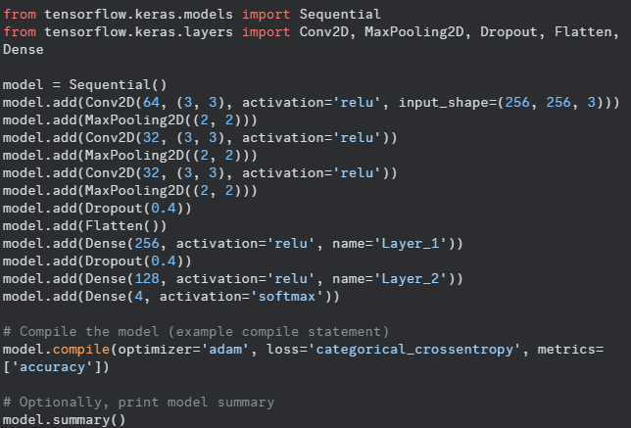
The 1st try
This is how my first working model looked like. Very simple, but stable enough to handle the data Train_set - accuracy: 0.9986 - loss: 0.0025
Valid_set - accuracy: 0.7235 - loss: 1.3454
The model demonstrates a strong ability to learn and classify images with high accuracy on the training set. But there was a clear difference between the Train Set and the Validation Set With a few adjustments this could be resolved.

Slide 10
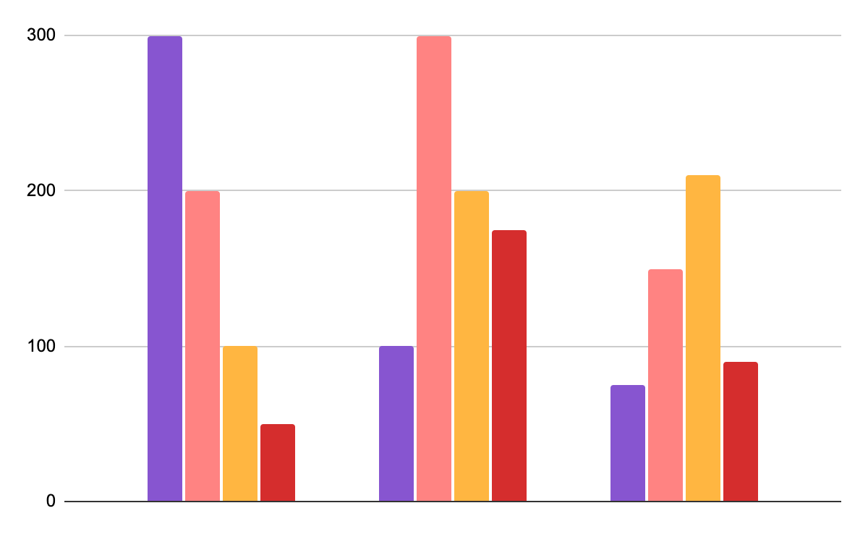
TIME TO EVALUATE
04
Lets analyse our flaws and see where we can improve

Slide 11
What can we do to improve our model?
Small data Set
01
Model is too simple
02
Who to evaluate each class?
03
This was one of the original issues, I always knew that the data set was somewhat too small, so data augmentation might be a good solution.
By being too simple the model would not reflect correctly the validation data set, i will try to tweek the model and increase the epochs
We need something to check between each class, to see how the model is performing. AUC ROC Curve should do the job perfectly fine.

Slide 12
BUILD IT FIX IT HYPER TUNE IT
05
if Model == “good“ : Print(“nice job”)

Slide 13
How did it perform?
Average Training Precision: 0.2287 Average Training Recall: 0.2449 Average Validation Precision: 0.2448 Average Validation Recall: 0.2645
With only 30 epochs the Model at first sight performed “worst” then before Average Training Accuracy: 0.6248
Average Training Loss: 0.7536
Average Validation Accuracy: 0.6528
Average Validation Loss: 0.7536
Even if the results came back a bit lower, we finally have model with similar results between Training and Validation Set

Slide 14
Can we do better?
Average Training Precision: 0.2287 Average Training Recall: 0.2449 Average Validation Precision: 0.2448 Average Validation Recall: 0.2645
Let's try 100 epochs
Average Training Accuracy: 0.7374 Average Training Loss: 0.5520
Average Training accuracy: 0.7557
Average Training recall: 0.6965
Average Training AUC: 0.9419

Slide 15
Can we do better?
Average Training Precision: 0.2287 Average Training Recall: 0.2449 Average Validation Precision: 0.2448 Average Validation Recall: 0.2645
Average Validation Accuracy: 0.6528 Average Validation Loss: 0.8644
Average Validation accuracy : 0.6865
Average Validation Recall: 0.6388
Average Validation AUC: 0.8895
By increasing the epochs, I was able to increase some results and still maintain a close relation between the Train and validation set Also, by introducing new metrics I was able to confirm that the model is performing well.

Slide 16
So what now?
Did it work?
What can it be used for?
Yes it did, as far as a proof of concept we have all what it needs to implement this CNN Model and show is functionality
If we were to deploy this model, it could be used first of all to store and create a CT-Scan image database that could be used for medical training and the model itself could improve cancer identification at a much higher speeds and create an automated process that would prevent unnecessary time loss.

Slide 17
SPECIAL THANKS TO:
André Oliveira Dooinn Kim Gonçalo Fazenda And all my classmates at IronHack

Slide 18
THIS WORK IS DEDICATED TO MY PARENTS

