Slide 1
Banking Application

Slide 2
Index
Modules
Tech Stacks
Design Documents
APIs

Slide 3
Modules

Slide 4
Modules
Accounts Microservice
Transaction Microservice
Eureka Discovery Server
Zuul Gateway Proxy

Slide 5















Tech Stacks

Slide 6
Tech Stacks
Java 8
Springboot
Spring JPA
Sping Cloud Security with JWT Authentication
Kafka
H2 Database
Eureka Discovery server (Service registry)
Zuul Gateway Proxy
Feign Client
JUnit4
Jacacco for code coverage in local
Sonarlint for static code analysis in local
Zipkin & Sleuth for distributed tracing
Swagger
Docker
Jenkins
Openshift (Kubernetes)

Slide 7
Design Documents

Slide 8
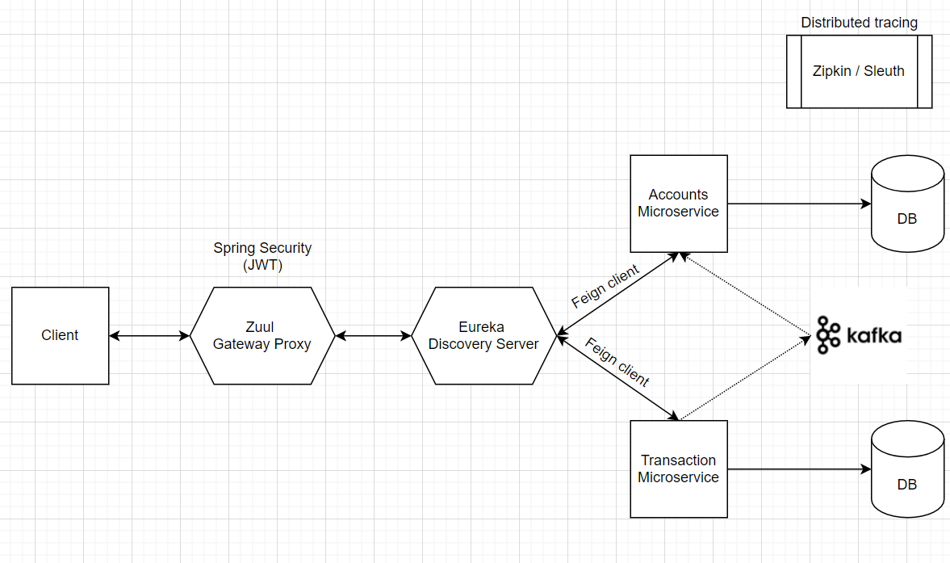
High level architecture

Slide 9
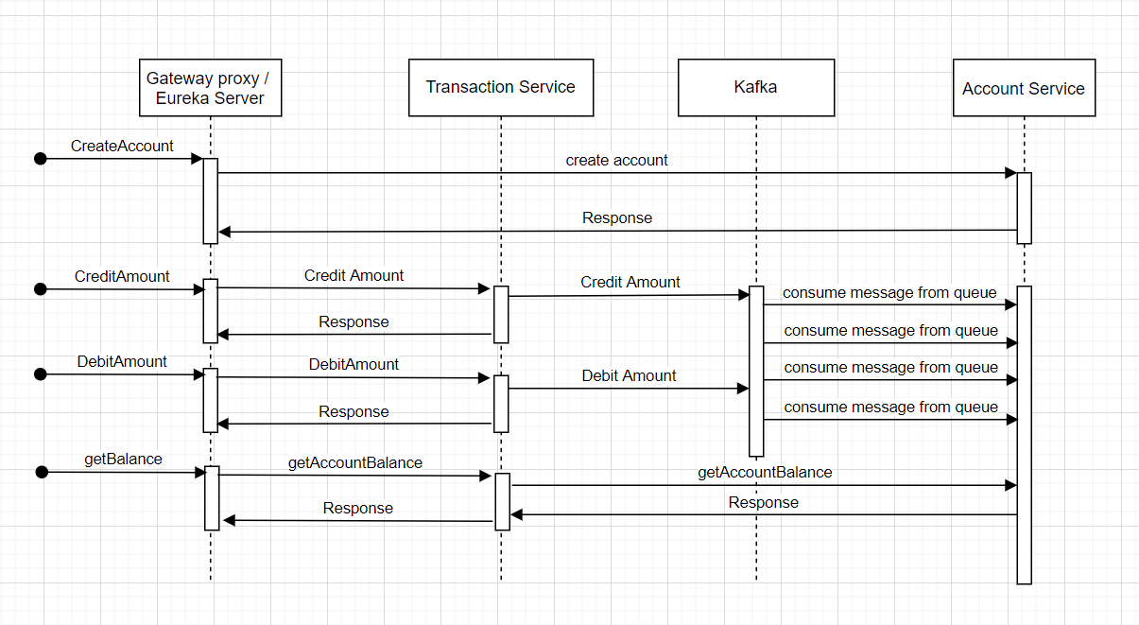
Sequence Diagram

Slide 10
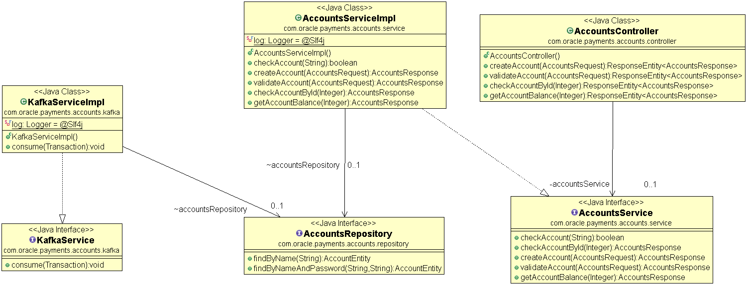
Class Diagram – Accounts Service

Slide 11
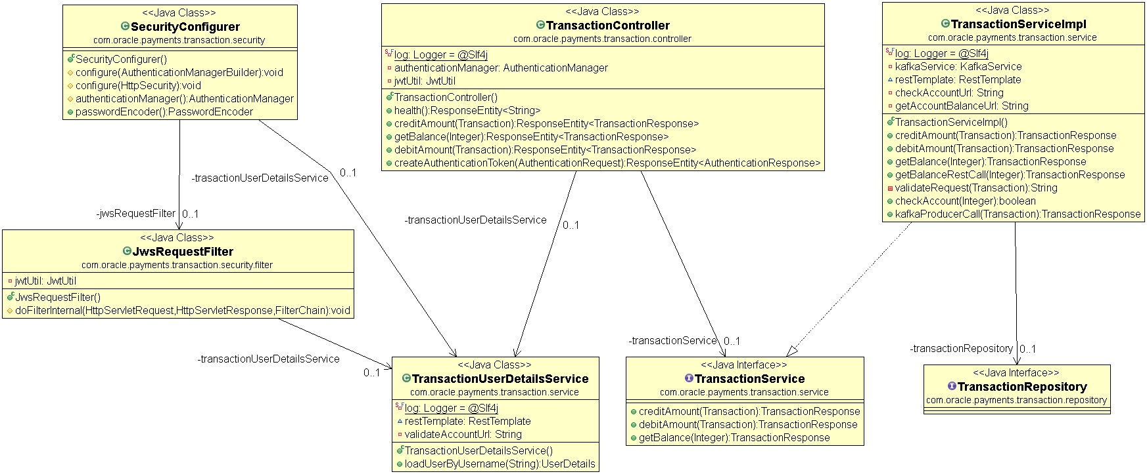
Class Diagram – Transaction Service

Slide 12
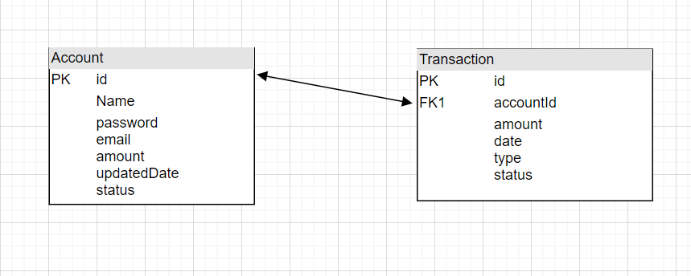
Data model

Slide 13
APIs

Slide 14
H2 Console:
  http://localhost:8762/accounts-service/h2-console
  http://localhost:8762/transaction-service/h2-console
Eureka Server
  http://localhost:8761/
Zipkin
  http://localhost:9411/zipkin/

Slide 15
Create Account
http://localhost:8762/accounts-service/accounts/createAccount
{
"email": "oracle@oracle.com",
"name": "oracle",
"password": "oracle@123"
}

Slide 16
Authentication
http://localhost:8762/transaction-service/transaction/authenticate
{
"username": "oracle",
"password": "oracle@123"
}

Slide 17
Credit Amount
http://localhost:8762/transaction-service/transaction/creditAmount
{
"accountId": 1,
"amount": 1000
}

Slide 18
Debit Amount
http://localhost:8762/transaction-service/transaction/debitAmount
{
"accountId": 1,
"amount": 100
}

Slide 19
Get Balance
http://localhost:8762/transaction-service/transaction/getBalance
“accountId” : 1

Slide 20
Source Code
GitHub
  https://github.com/oracle-osvc-ext/belsonraja

Slide 21
Queries

Slide 22
Thank you

