Slide 1

Adversarial machine learning
Developing Robust and Secure Machine Learning Models
Student: Allan Genari Gaarden
Faculty: Brent Lagesse

Slide 2
Background
ML models currently lack security and robustness testing
Attacks on models can go completely unnoticed
Several different attacks can be performed for the attackers’ benefit
Notes:
Problem

Slide 3
Objectives
Determine what a “secure” and “robust” model means
Develop an end-to-end product capable of storing model data and giving recommendations
Notes:
Goals

Slide 4
Motivation
Provide developers with a tool for estimating pros and cons of defenses for their model
Enlighten developers about the need for defensive techniques
Balance the computational vs security trade-offs in end-to-end systems
Notes:
Motivation and application (first point given)

Slide 5
Challenges
Learning Python
Learning Kivy
Providing a more user-friendly interface
Maintaining good coding practices
Notes:
Challenges

Slide 6
Accomplishments
End-to-end product capable of storing model data and giving recommendations
Documentation to support the future development of this project
Notes:
Result/Solution

Slide 7
Methodology
Research machine learning attack and defense concepts
Brainstorm GUI features
Design possible GUI layouts
Develop GUI and implement features
Notes:
Process/Approach

Slide 8
Technologies
Python
Kivy
GitHub
Notes:
Tools

Slide 9
demo

Slide 10
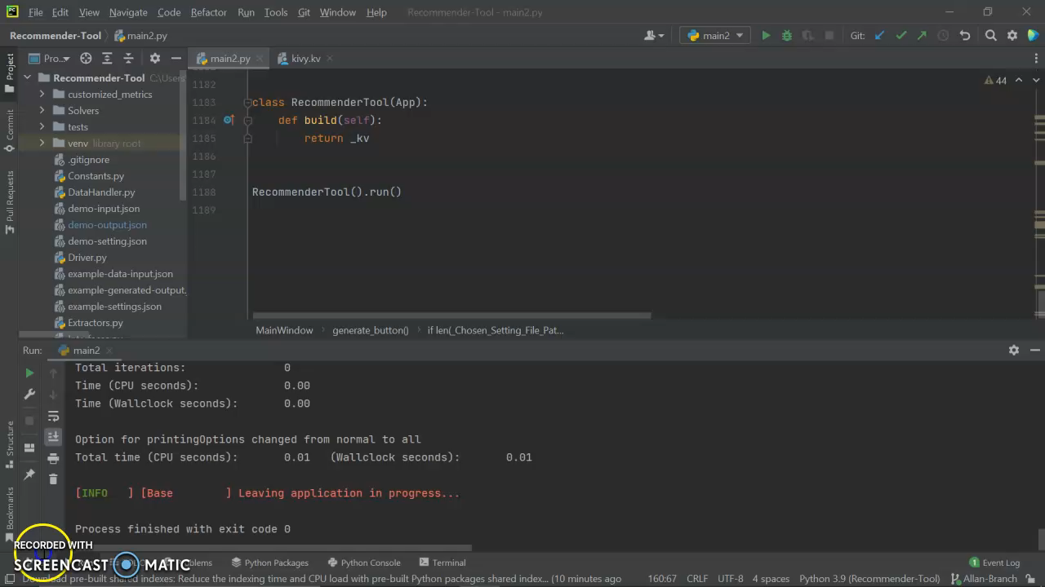

Slide 11
Future work
Further restrict user ability to cause error
Enhance GUI aesthetic
Improve feature performance/efficiency
Develop for other platforms, such as web-based
Notes:
Next Steps

Slide 12
Lessons Learned
Learned Python (and passed LinkedIn skill assessment)
Kivy
JSON
Machine Learning Concepts
GitHub
Notes:
Lessons Learned/Knowledge Gained

Slide 13

Thanks for listening! Questions?

