Slide 2


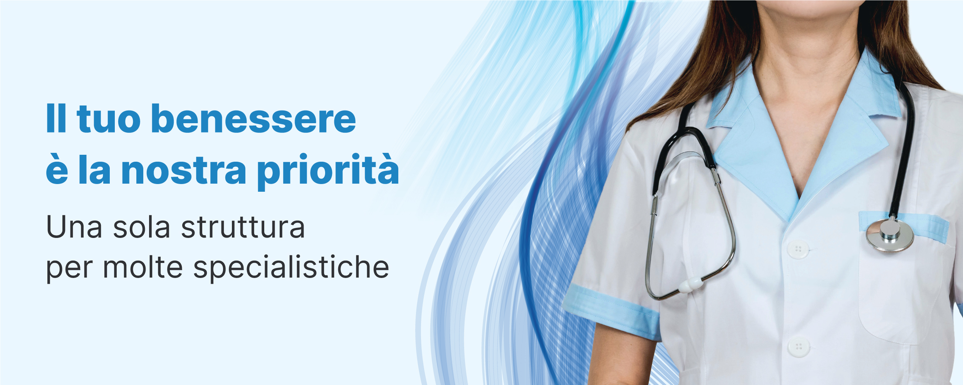
Home TV Shows Movies Recently Added My List
THE FINAL REPORT
2025
TV-PG
The final report is a series where Jacopo Beltrani (the main character) tells us about his school work experience.
We will follow his adventure in 7 episodes; each one is focused on a different aspect of is journey.
PLAY
+ MY LIST
OVERVIEW EPISODES TRAILERS & MORE MORE LIKE THIS DETAILS

Slide 3

Home TV Shows Movies Recently Added My List
NETFLIX ORIGINAL
THE COMPANY
The company where I worked at is called Blumedikal s.r.l.s. which is a private clinic located in Scorcelletti (AN).
There are different specialists as a Dentist, a Psychologist, a Dietician and others.
I was welcomed by the Owner and the secretary, who were very kind and helpful.
The period I worked there they explained everything very well and in detail.
I used to work as a front office employee where I learned how to write an e-mail properly and how to relate with patients and doctors at the same time.
At the end of my working day, I used to help with the cleaning.

Slide 4
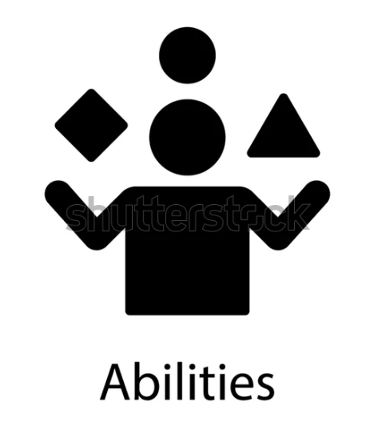
Home TV Shows Movies Recently Added My List
NETFLIX ORIGINAL
MY ABILITIES
The abilities that I have developed during this period of time are 2 types:
Soft skills (the abilities earned during my life time)
-Empathy – understanding other people's feelings
-Problem Solving – identifying issues and finding solutions
-Conflict Resolution – managing and resolving disagreements
Hard Skills (the abilities earned in work and school experiences)
-Programming – writing in C+ - C# - Java – HTML - Python
-Budgeting – managing and allocating financial resources
-Foreign Languages – speaking and writing fluently In English

Slide 5

Home TV Shows Movies Recently Added My List
NETFLIX ORIGINAL
RELATIONSHIP
The relationship I had with my tutor was fantastic, she was very kind and helpful.
From the very beginning she tried to make me feel at ease by showing me the different steps to carry out for each task.
She was always ready to help me when I was in difficulty or to praise me when I succeeded.
We also spoke about every day life, I learned that I had met her son, who is about my age, at a party some months earlier.
We talked about teenager problems and the difficult relationships in a family.

Slide 6
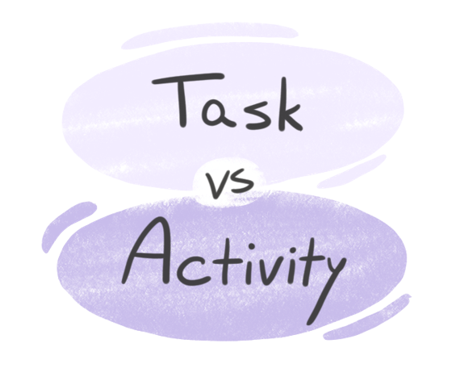

Home TV Shows Movies Recently Added My List
ACTIVITIES AND TASKS
The main task was working at the reception where I had to keep contacts with the patients, give them information / appointments and follow the economical aspects.
I also used my informatics skills by checking and sending e-mails, using the billing program and the appointment program.
COMPLETING TASKS
Completing tasks was what helped me develop confidence and problem-solving skills.
I also learned how to take initiative and handle them responsibly.
When I had a difficult task to solve, I sometimes called my supervisor and other times I searched the solution on the net.

Slide 7
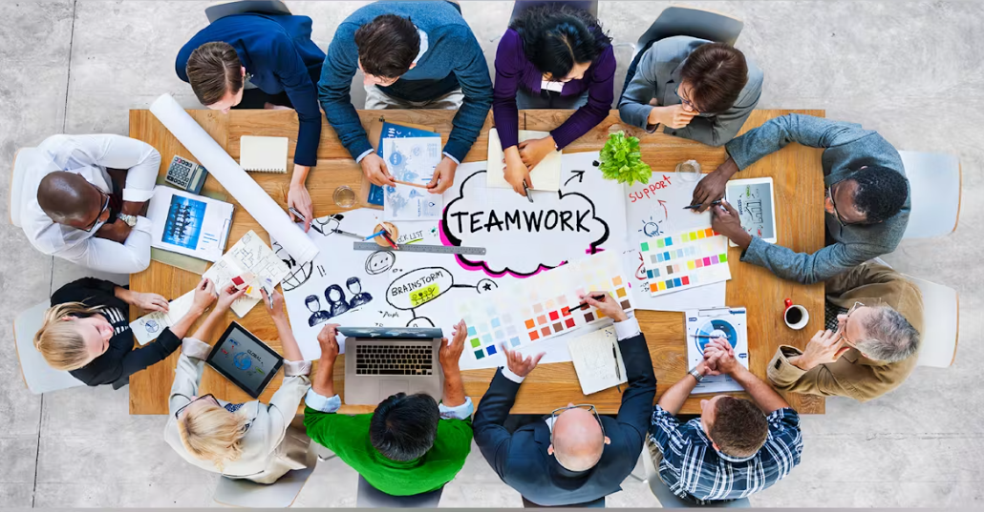

Home TV Shows Movies Recently Added My List
ME, MY SELF AND I
During this period of time, I understood that, if I have a choice, working alone is easier and more rewarding.
On the other hand, it’s necessary for some types of work to have a team or to be part of one.
MY FUTURE
The experience confirmed my interest in business and motivated me to continue studying in this field, giving me valuable insight into possible future career paths.
Although I initially found it challenging to understand the procedures, I overcame this difficulty by asking questions and carefully observing the staff.

Slide 8


Home TV Shows Movies Recently Added My List
TOOLS / DEVICES
During my school-work experience the devices and programs used were:
-PC
-PRINTER
-OPEN EMR
-GOOGLE CALENDAR
-INFINITY BY ZUCCHETTI
THE EXTERNAL TUTOR
The school tutor told us to look for a company related to our studies where to have the school-work experience.
He told us to make sure that the supervisor at work signed our daily schedule and registered if we were absent or late.
The school tutor had to make unannounced inspections; in my case he came only once.
At the end of this experience, he came to collect my report.

Slide 9

Home TV Shows Movies Recently Added My List
NETFLIX ORIGINAL
suggestions
I advised the owner of the company to add a room where the staff could cook / storage / consume their meals or to add a vending machine.
The owner told me that the adding of other rooms to the structure is already in program within the end of this year.

Slide 10





THANK YOU
FOR WATCHING
2025
YEAR LEVEL | SECTION
The final report is a series where Jacopo Beltrani (the main character) tells us about his school work experience.
We will follow his adventure in 7 episodes; each one is focused on a different aspect of is journey.
PLAY
+ MY LIST

