Slide 1
https://github.com/fastai/fastai
(My take on) High level pictorial code structure

Slide 2
batches
DataLoaders
LanguageModelData
optimizer
get_model()
BasicModel
get_language_model()
RNN_Learner
LanguageModel
SequentialRNN
LinearDecoder
forward()
nn.Module()
Learner
nn.Linear
decoder
nn.Linear
LockedDropout
dropout
ModelData
RNN_Encoder (AWDLSTM)
LanguageModel
nn.Module
dh,du,de,wd
fit()
Embedding matrix to encode input
Stack of LSTM’s to drive network
Dropout in embedding and LSTM layers
learner.model.load_state_dict
loads the following pre-trained weights
to the SequentialRNN
nn.Sequential
encoder_weight
encoder_with_dropout.embed.weight
rnns.0-2.module.weight
rnns.0-2.module.bias
decoder.weight
NLP – Language Model
eg. imdb.ipynb
get_layer_groups()

Slide 3
RNN_Encoder (AWDLSTM)
n_tok, emb_sz, nhid=nhid, nlayers=nlayers, pad_token=pad_token,
dropouth=dropouth, dropouti=dropouti, dropoute=dropoute, wdrop=wdrop
WeightDrop
wdrop
nn.RNNBase
LockedDropout
LSTM
dropouth
LockedDropout
dropouti
EnbeddingDropout
dropoute
nn.Enbedding
raw_ouput, new_h
Appent outputs, update hidden
hidden state
Create an Embedding layer
Create an LSTM for each layer being asked for
Apply Dropout
forward()
Call the embedding layer
Add dropout
Go through each layer, call that rnn layer
Append to list of outputs
Add dropout

Slide 4
get_rnn_classifier(params)
SequentialRNN
PoolingLinearClassifier
pool() does adaptive_max_pool_1d or adaptive_avg_pool1d
forward()
__init__()
self.layers=
nn.ModuleList
LinearBlock
forward()
nn.Module
nn.Linear
nn.Module
nn.Dropout
nn.BatchNorm1d
RNN_Encoder
Embedding matrix to encode input
Stack of LSTM’s to drive network
Dropout in embedding and LSTM layers
MultiBatchRNN
concat()
forward()
nn.Module
NLP – Sentiment Classifier
Eg imdb.ipynb Classifier section

Slide 5
batches
DataLoader
ModelData
optimizer
Seq2SeqRNN
GRU
RNNBase
nn.Embedding
enc_out
RNN_Learner
nn.Module
Variable(nl*bs*nh)
(Hidden state)
Encoder
Linear
t+1 Hidden state
Learner
Linear
Variable(nl*bs*nh)
(Hidden state)
ModelData
Seq2SeqRNN
Decoder
GRU
fit()
Linear
Loop n times
per .forward until
outp.data.max ==1
(Where n is corpus
length (eg enlen_99))
nn.Embedding
outp
t+1 Hidden state
nn.Module
Dropout
NLP – Sequence to Sequence eg. translate.ipynb

Slide 6
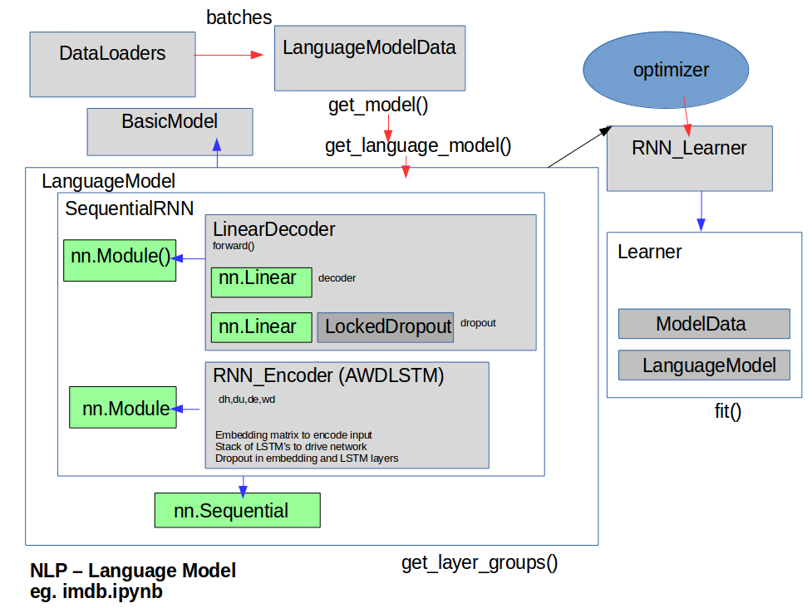
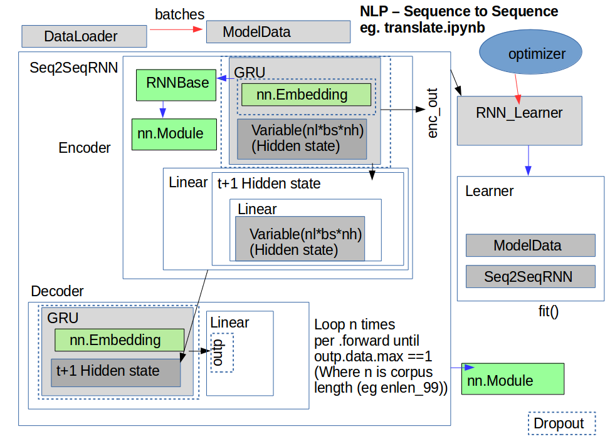
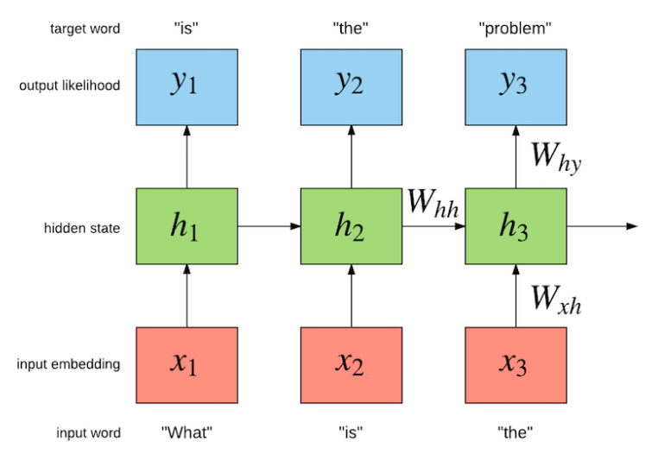
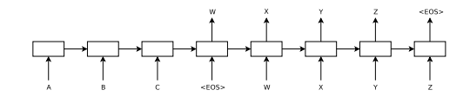
LanguageModel vs Sequence to Sequence Model

Slide 7
CV
ModelData
batches
DataLoaders
Learner
ResNet
nn.Module()
fit()

Slide 8
BasicModel
get_layer_groups()
SingleModel
get_layer_groups()
LanguageModel
get_layer_groups()
Freeze and learning rate operate on layergroups
CollabFilterModel

Slide 9
dataloader.py
DataLoader
key methods:
get_batch()
__iter__()
-dataloader just needs to return tuples (ind and dep var) for minibatches ie spit out batches of data
text.py
LanguageModelLoader
__iter__()
batchify()
get_batch()
as iterate through we grab a sequnce of c. 70 words and try to predict the next one word
ie as below i to i+70 rows and try to predict that plus one
get_batch()
...
return source[i:i+seq_len], source[i+1:i+1+seq_len].view(-1)
when we iterate over LanguageModelLoader, the sequence length is changed with a normal distribution
and significantly changed 5% of time
on first iteration: seq_len = bptt+5*5 ie 95 here
subseqently: seq_len = max(5, int(np.random.normal(bptt, 5))) where 5% of time the mean bptt=bptt/2
see awd-lstm-lm.finetune.train()

Slide 10
dataset.py
ModelData
core storage: path, trn_dl, val_dl, test_dl
key properties:
is_reg (trn_ds.is_reg)
trn_ds (trn_dl.dataset)
val_ds (ditto)
test_ds (ditto)
trn_y (trn_ds.y)
val_y (val_ds.y)
A ModelData class needs to know training set, validation set (give data loaders for these) and optionally a test set, among others
ImageData
TextData
ColumnarModelData
deprecated
TextClassifierData
text.py
LanguageModelData
get_model()
Note this ModelData class doesnt extend ModelData
As per above, a ModelData class needs to know training set, validation set (give data loaders for these) and optionally a test set, among others
all the work happens in get_model(). - the key part - where we implement AWD-LSTM and use the backbone+head
We wrap this in a LanguageModel which defines layer groups - can have different lr for layer groups
Then we turn into a RNN_Learner - Learner using cross entropy
m = get_language_model(...)
model = LanguageModel(to_gpu(m))
return RNN_Learner(...n)
RNN_Learner(model, opt_fn)

Slide 11
learner.py
Learner
Combines a ModelData object with a neural architecture (nn.Module) object
key properties:
model ()
key methods:
freeze_to()
unfreeze()
fit()- Method gets an instance of LayerOptimizer and delegates to self.fit_gen(..)
fit_gen() -Method does some preparation before finally delegating to the 'fit' method for fitting the model
lr_find() - uses the technique developed in `Cyclical Learning Rates for Training Neural Networks (2015)` to find a learning rate
predict() - run of test data if is_test otherwise validation data
ConvLearner
RNN_Learner
crit = F.cross_entropy
save_encoder()
load_encoder()
StructuredLearner
BOW_Learner
CollabFilterLearner

Slide 12
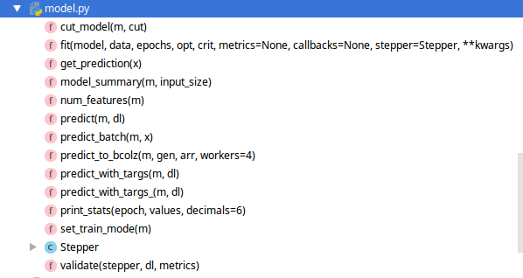
model.py
fit() - Function where everything ends up eventually
-goes through each epoch, creates an iterator form the dataloader
for epoch in tnrange(epochs, desc='Epoch'):
stepper.reset(True)
t = tqdm(iter(data.trn_dl), leave=False, total=num_batch)
-then does a for loop through it
for (*x,y) in t:

Slide 13
LayerOptimizer

Slide 14
Dataset
TextDataset
__getitem__()
ColumnarDataset

Slide 15
Typical workflow
fit() on last layer
lr_find()
fit() on last n layers

