Slide 1
https://github.com/fastai/fastai
(My take on) High level pictorial code structure

Slide 2
batches
DataLoaders
LanguageModelData
optimizer
get_model()
BasicModel
get_language_model()
RNN_Learner
LanguageModel
SequentialRNN
LinearDecoder
forward()
nn.Module()
Learner
nn.Linear()
decoder
nn.Linear()
LockedDropout
dropout
ModelData
RNN_Encoder
Embedding matrix to encode input
Stack of LSTM’s to drive network
Dropout in embedding and LSTM layers
LanguageModel
nn.Module()
fit()
nn.Sequential()
NLP – Language Model
get_layer_groups()

Slide 3
get_rnn_classifier(params)
SequentialRNN
PoolingLinearClassifier
pool() does adaptive_max_pool_1d or adaptive_avg_pool1d
forward()
__init__()
self.layers=
nn.ModuleList
LinearBlock
forward()
nn.Module()
nn.Linear
nn.Module()
nn.Dropout
nn.BatchNorm1d
RNN_Encoder
Embedding matrix to encode input
Stack of LSTM’s to drive network
Dropout in embedding and LSTM layers
MultiBatchRNN
concat()
forward()
nn.Module()
NLP – Sentiment Classifier

Slide 4
RNN_Encoder
Create an Embedding layer
Create an LSTM for each layer being asked for
Apply Dropout
forward()
Call the embedding layer
Add dropout
Go through each layer, call that rnn layer
Append to list of outputs
Add dropout
LinearDecoder
Single linear layer
Initialize weights to range
Add dropout

Slide 5
CV
ModelData
batches
DataLoaders
Learner
ResNet
nn.Module()
fit()

Slide 6
BasicModel
get_layer_groups()
SingleModel
get_layer_groups()
LanguageModel
get_layer_groups()
Freeze and learning rate operate on layergroups
CollabFilterModel

Slide 7
dataloader.py
DataLoader
key methods:
get_batch()
__iter__()
-dataloader just needs to return tuples (ind and dep var) for minibatches ie spit out batches of data
text.py
LanguageModelLoader
__iter__()
batchify()
get_batch()
as iterate through we grab a sequnce of c. 70 words and try to predict the next one word
ie as below i to i+70 rows and try to predict that plus one
get_batch()
...
return source[i:i+seq_len], source[i+1:i+1+seq_len].view(-1)
when we iterate over LanguageModelLoader, the sequence length is changed with a normal distribution
and significantly changed 5% of time
on first iteration: seq_len = bptt+5*5 ie 95 here
subseqently: seq_len = max(5, int(np.random.normal(bptt, 5))) where 5% of time the mean bptt=bptt/2
see awd-lstm-lm.finetune.train()

Slide 8
dataset.py
ModelData
core storage: path, trn_dl, val_dl, test_dl
key properties:
is_reg (trn_ds.is_reg)
trn_ds (trn_dl.dataset)
val_ds (ditto)
test_ds (ditto)
trn_y (trn_ds.y)
val_y (val_ds.y)
A ModelData class needs to know training set, validation set (give data loaders for these) and optionally a test set, among others
ImageData
TextData
ColumnarModelData
deprecated
TextClassifierData
text.py
LanguageModelData
get_model()
Note this ModelData class doesnt extend ModelData
As per above, a ModelData class needs to know training set, validation set (give data loaders for these) and optionally a test set, among others
all the work happens in get_model(). - the key part - where we implement AWD-LSTM and use the backbone+head
We wrap this in a LanguageModel which defines layer groups - can have different lr for layer groups
Then we turn into a RNN_Learner - Learner using cross entropy
m = get_language_model(...)
model = LanguageModel(to_gpu(m))
return RNN_Learner(...n)
RNN_Learner(model, opt_fn)

Slide 9
learner.py
Learner
Combines a ModelData object with a neural architecture (nn.Module) object
key properties:
model ()
key methods:
freeze_to()
unfreeze()
fit()- Method gets an instance of LayerOptimizer and delegates to self.fit_gen(..)
fit_gen() -Method does some preparation before finally delegating to the 'fit' method for fitting the model
lr_find() - uses the technique developed in `Cyclical Learning Rates for Training Neural Networks (2015)` to find a learning rate
predict() - run of test data if is_test otherwise validation data
ConvLearner
RNN_Learner
crit = F.cross_entropy
save_encoder()
load_encoder()
StructuredLearner
BOW_Learner
CollabFilterLearner

Slide 10
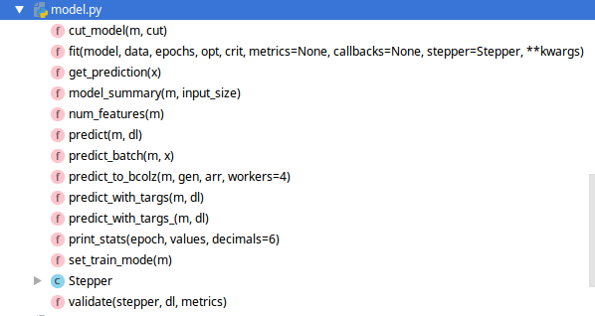
model.py
fit() - Function where everything ends up eventually
-goes through each epoch, creates an iterator form the dataloader
for epoch in tnrange(epochs, desc='Epoch'):
stepper.reset(True)
t = tqdm(iter(data.trn_dl), leave=False, total=num_batch)
-then does a for loop through it
for (*x,y) in t:

Slide 11
LayerOptimizer

Slide 12
Dataset
TextDataset
__getitem__()
ColumnarDataset

Slide 13
Typical workflow
fit() on last layer
lr_find()
fit() on last n layers

