Slide 1
BASIC DETAILS OF THE TEAM AND SOLUTION TO THE IDEA
OUR PROBLEM STATEMENT TITLE:
WEB BASED APPLICATION THAT PROVIDES INTERFACE TO BOTH FARMERS AND CONSUMERS AND SOLVES THE MIDDLEMEN PROBLEM, VARIOUS OTHER ISSUES.
TEAM NAME:
MoreThanWeb2
INSTITUTE NAME:
BANGALORE INSTITUTE OF TECHNOLOGY

Slide 2
TEAM MEMBERS
Team Leader Member 1: Name: Mohd Sameer
Btech Year III
Team Member 2: Name: Shivanshu Dev
Btech Year III
Team Member 3: Name: Mehul Poddar
Btech Year III
Team Member 4: Name: Aditya Aryan
Btech Year III

Slide 3
IDEA/APPROACH DETAILS
  Providing an efficient register and login page for both the farmers and the consumers with an easy to use interface.
  Farmer's Side
    Verification of Farmer through Aadhar card and GST details.
    A farmer's panel to easily access to all the consumers and update their stocks with many more features.
    DAO(Decentralized Autonomous Organization) to raise crowd funding through a Farmer's associations, thus eliminating the monopoly of existing 'Mandi System'.
    A QR Code(hash) to connect with the farmers and all the minute details regarding the order as well as supply-chain based traceability using decentralized based blockchain.

Slide 4
  Consumer's Side
    Verification of consumers through Aadhar card and GST details.
    Filter based search option available for consumers to optimize search system.
    A dashboard for consumer to place orders easily and see various buying options based on quality and previous consumer's reviews.
    A bidding system from different farmers to decide the price to maintain the price distribution.
    Making it easy for the consumers to meet their farmers through the above mentioned QR Code system / URL Link.

Slide 5
USE CASES:
    A platform where farmers can easily reach out to the end-consumer without any interference of middle-man.
    All farmers including the small-scale farmers too get equal opportunities to profit from their goods.
    Consumers can reach out to the farmers from all over India and get their desired products.
    To allow easy and secure crowd-funding for the farmers through the farmer's association, using blockchain technology.
    Blockchain based traceability for meet your farmers feature and IPFS decentralized storage to avoid a single point of failure.

Slide 6
TECHNOLOGY STACK
Web development tech-stack :
  React, NEXT.js for Full-Stack web app, Tailwind CSS for styling
  India stack for verification of Aadhar card and GST details.
Blockchain development tech-stack:
  IPFS file storage using web3.storage API in backend.
  Using Livepeer for decentralised video player.
  Also scope of other web3 integrations in DAO implementations using Aragon.
  Further smart contracts in solidity in hardhat Environment.

Slide 7
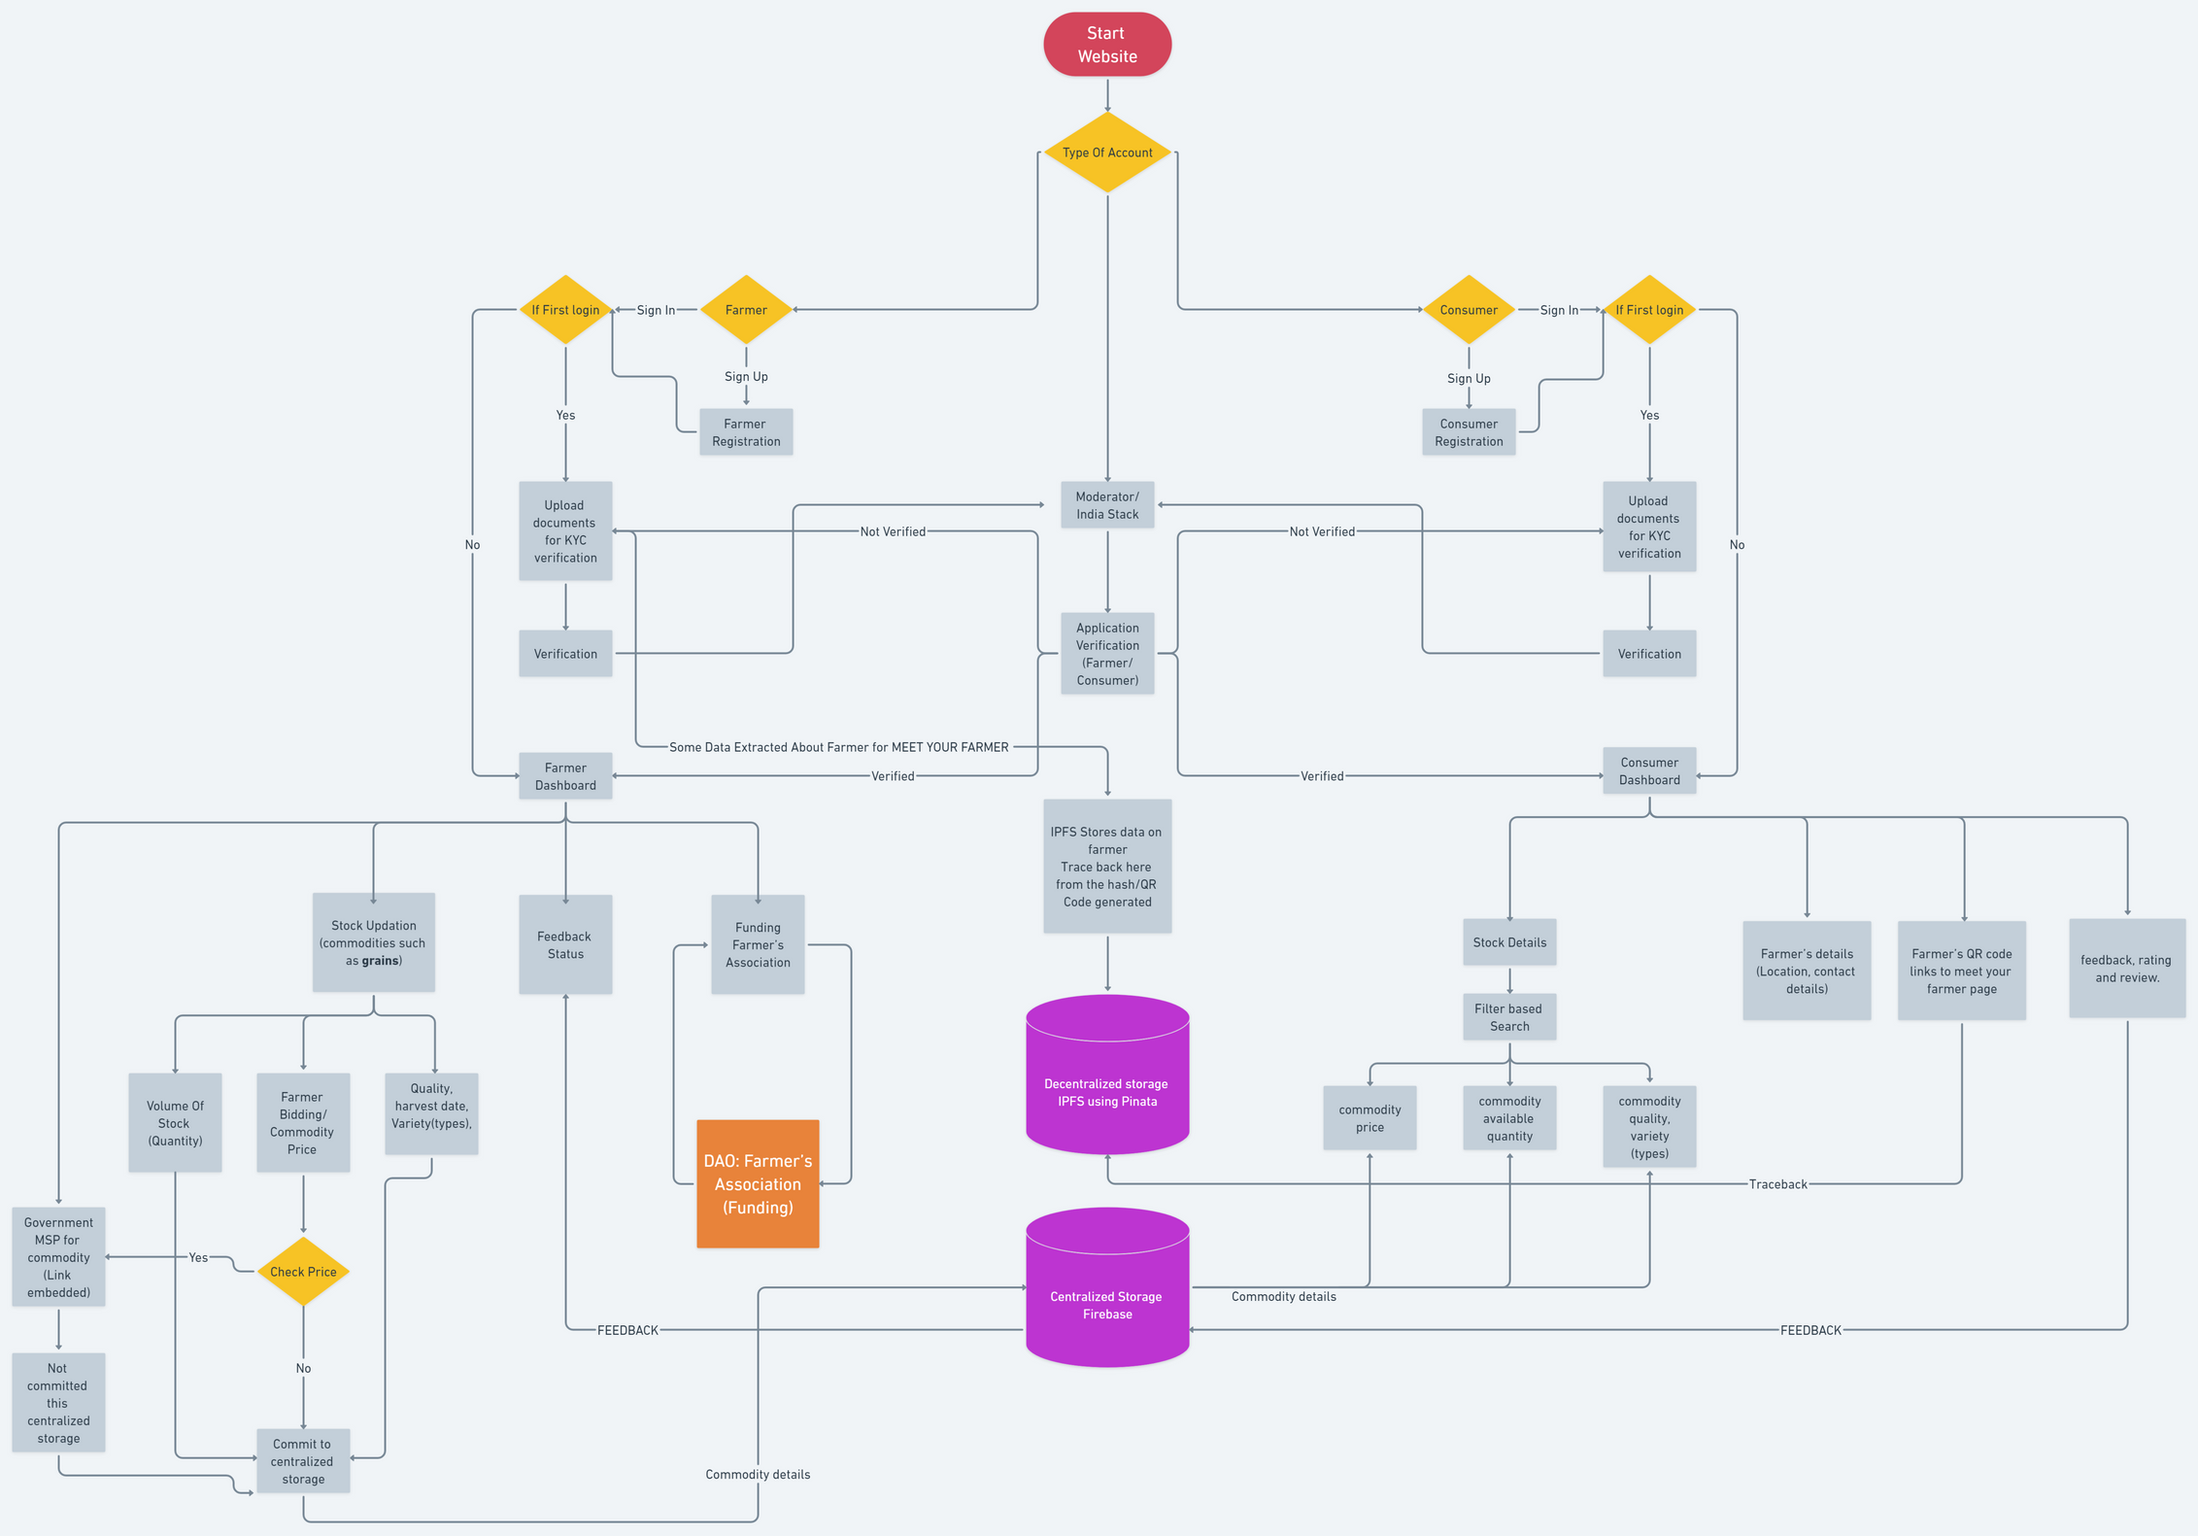
FLOWCHART
For a better view of the flowchart follow the google drive link if required
https://drive.google.com/file/d/1K19-YS2XDNZgrO53pVoHv_8rsJeucctl/view?usp=sharing

Slide 8
FUTURE AND SCOPE FOR FURTHER DEVELOPMENT OF OUR PRODUCT
Mobile development tech-stack :
Flutter using dart language for designing cross-platform mobile applications.
Internationalization feature:
We can also provide i18n and support based on location (Internationalization).

