Slide 1
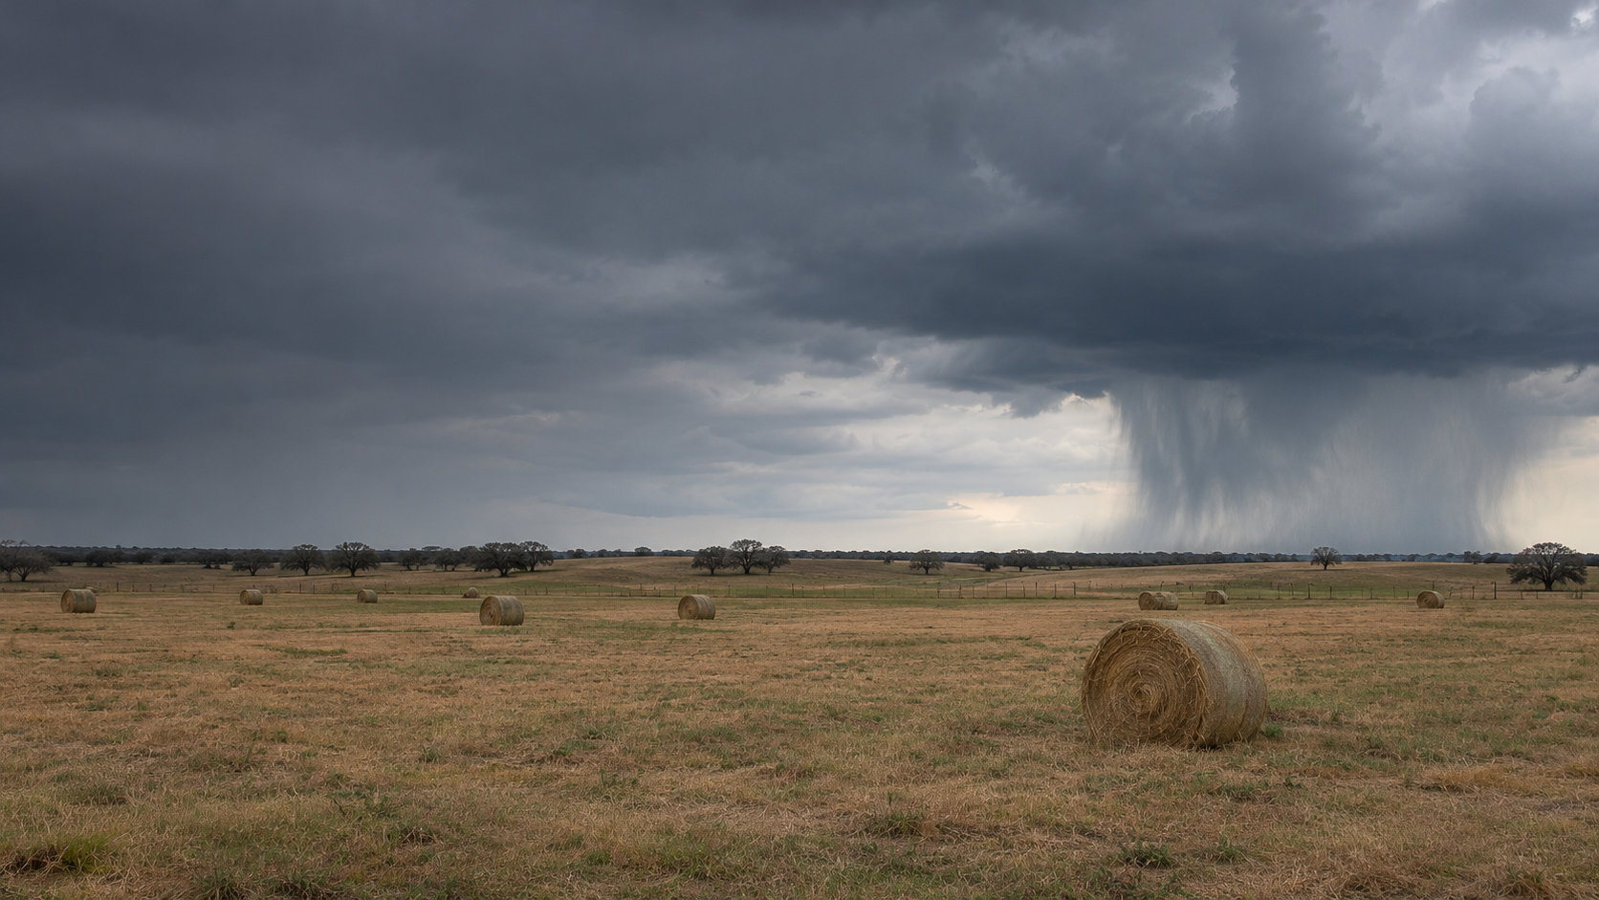
AgriHedge
Can prediction markets
insure a farm?
How our tests changed the product
Maya · Evan · Jack | ECE 473
Notes:
Speaker: Jack
Time: 0:00–0:20
Open with the question. We started with a simple idea: could listed weather contracts replace the federal rain policy a rancher already buys? The results changed the question and the product. This talk follows those decisions in order.
Sources: Course Project Guide; docs/00_OVERVIEW.md. Cover image is AI generated and illustrative, not a study site.

Slide 2
01 / ORIGINAL IDEA
We began by trying to replace PRF
USDA PRF
Kalshi
Pays on a rain grid over the farm
Two-month windows
Federal premium subsidy
Binary contracts on airport rain
One month at a time
Market prices and order books
Hypothesis: a portfolio of Kalshi contracts could copy PRF at a useful price.
Sources: docs/research/01_usda_prf_mechanics.md; docs/research/05_kalshi_weather_markets.md
02
Notes:
Speaker: Jack
Time: 0:20–1:45
PRF is the rancher's baseline, so we started with a replacement hypothesis. PRF measures rain on a grid near the farm and pays over selected two-month windows. Kalshi offers monthly binary contracts that settle on an airport gauge. Both depend on rain, so combining Kalshi strikes looked like a way to reproduce PRF. We tested cost and payout fit rather than assuming similar weather meant similar insurance. The airport, window length and subsidy became the critical differences. Transition: the first answer was negative.
Sources: docs/research/01_usda_prf_mechanics.md; docs/research/05_kalshi_weather_markets.md; docs/analysis/08_replication_quality.md.

Slide 3
02 / FIRST TEST
The replacement test said no
1.8×
0.18
20%
Kalshi cost versus
subsidized PRF
Payout fit after
book-depth limits
Of the 11-farm hedge
fillable near fair value
Better optimization could not remove these constraints.
Sources: docs/analysis/09_payout_comparison.md; 12_post_rewards_liquidity.md; 16_error_budget.md
03
Notes:
Speaker: Jack
Time: 1:45–2:35
On the original replacement question, the answer was no. A Kalshi hedge cost about 1.8 times the producer-paid PRF premium per expected dollar of payout. When we imposed the saved order-book depth, the pooled out-of-sample payout fit was about 0.18. A post-rewards snapshot suggested the 11 farms together could fill only 20 percent of their intended hedge near fair value. These numbers come from different tests, so do not present them as one combined product quote. They show why the initial hypothesis failed. Transition: we decomposed the failure.
Sources: docs/analysis/09_payout_comparison.md; docs/analysis/12_post_rewards_liquidity.md; docs/analysis/16_error_budget.md.

Slide 4
03 / DIAGNOSIS
We traced the missing fit
Airport distance causes the largest loss; monthly windows and thin books compound it.
Source: docs/analysis/16_error_budget.md, 11 farms, leave-one-year-out pooled HE
04
Notes:
Speaker: Maya
Time: 2:35–3:35
This is the experiment that made the pivot possible. We added real restrictions one at a time and evaluated each on years left out of fitting. Fit fell from a perfect target to 0.65 when the station was moved from the farm grid to the airport. Settlement data and monthly rather than two-month contracts reduced it further. The saved order book left only 0.18. The bars select the main stages of doc 16's full waterfall; they are not percentages of farm income. Geography is hard to fix with an optimizer, but the timing and available contracts suggested a narrower role. Transition: test the months farmers had not selected under PRF.
Sources: docs/analysis/16_error_budget.md; docs/analysis/17_contract_gaps_and_proposals.md.

Slide 5
04 / PIVOT
A narrower role worked better
Holdout payout fit
9 of 11
farms received a
companion recommendation
This measures rain-payout fit, not observed farm-loss reduction.
Source: docs/analysis/21_prf_companion.md; holdout medians: 10 farms with companion picks; recommendation: 11 farms
05
Notes:
Speaker: Maya
Time: 3:35–4:25
We stopped asking Kalshi to replace a subsidized policy. We kept PRF and tested a companion for months each sample farmer had left unselected. In the untouched 2001 to 2025 period, median hedge effectiveness was 0.61 for those months versus 0.23 when we tried to copy the farmer's selected PRF intervals. The app recommended a companion at 9 of 11 farms. Important caveat: PRF can offer winter intervals; these sample policies left them unselected. Winter forage value in our model is modest, and this metric tracks a rain payout, not actual farm-income loss. Transition: if the companion is small, what should it pay?
Sources: docs/analysis/21_prf_companion.md; docs/analysis/13_rain_to_loss_model.md for the modeled winter forage share.

Slide 6
05 / NEW DESIGN QUESTION
We tested how the payout should grow
Rain shortfall
Source: docs/analysis/23_exotic_payouts.md; shapes shown per $1 maximum payout
06
Notes:
Speaker: Evan
Time: 4:25–5:10
The companion result gave us a new design question. A linear PRF-style payout rises steadily as rain falls. We also tested quadratic and exponential shapes, which reserve more of the maximum payout for a severe drought. The curves show the intended term sheet before Kalshi's whole-inch strike bins. On a station-settled month, a fully filled portfolio of listed YES and NO contracts can match the binned term sheet. The farmer still bears the gap between the airport and the farm. Transition: we judged the shapes by the value they offered a modeled risk-averse farmer.
Sources: docs/analysis/23_exotic_payouts.md; docs/analysis/24_contract_design.md.

Slide 7
06 / RESULT
Severe-drought shapes won in the model
Share of the model's best contract value
Model: risk aversion 2, wealth 2× monthly value, 20% price load
Source: docs/analysis/24_contract_design.md, 111 bought-cover farm-months, modeled CRRA utility
07
Notes:
Speaker: Evan
Time: 5:10–6:00
This is a model result with explicit assumptions, not an observed farm-income result. For a farmer with relative risk aversion 2, wealth twice the month's insured value and a 20 percent price load, the best-sized exponential shape captured 93 percent of the certainty-equivalent gain of the model's unconstrained optimum. Quadratic captured 90 percent; linear captured 67 percent. On the 2001 to 2025 test years, mean gains were 1.10, 1.02 and 0.69 percent of monthly value respectively, but gains were positive in only about half the farm-months. The raw fitted optimum overfit some locations. Transition: we re-tested the apparent execution advantage at equal money.
Sources: docs/analysis/24_contract_design.md, tables C and D and numbers table. The 93/90/67 comparison is best-size modeled utility, not equal-premium HE.

Slide 8
07 / RETEST
The liquidity shortcut did not survive
Payout fit at saved-book depth, with equal premium
0 / 36
windows where a convex
shape beat linear at
equal premium
We changed our claim: shape affects modeled value, not fit per dollar.
Source: docs/analysis/24_contract_design.md, table A; 36 insured windows
08
Notes:
Speaker: Evan
Time: 6:00–6:45
The first exotic study compared shapes at the same maximum payout and found convex ones used fewer contracts. That made them look easier to fill. We then held the premium fixed, a fairer comparison for a farmer with a budget. At the saved November 2 book depth, pooled hedge effectiveness was 0.18 for linear and 0.16, 0.12, 0.11 for layered, quadratic and exponential. In none of the 36 insured windows did a convex shape beat linear at equal premium. This negative result changed the conclusion: severe-drought shapes may improve modeled utility, but they do not solve liquidity by themselves. Transition: our app exposes both the term sheet and the book constraint.
Sources: docs/analysis/23_exotic_payouts.md; docs/analysis/24_contract_design.md, table A.

Slide 9
08 / PRODUCT DEMO
The app makes the constraint visible
Dallas hay farm · November · quadratic payout
$6,000
$1,205
13%
maximum payout
modeled fair premium
filled near fair on
the saved book
Live walkthrough: open ?demo=exotic, then show the term sheet and price label.
Source: docs/analysis/23_exotic_payouts.md, Dallas Nov 2026 saved book from 2026-11-02
09
Notes:
Speaker: Jack
Time: 6:45–7:50
Open the app at http://localhost:8473/?demo=exotic. Show the Dallas example. Click Design this contract and point to the term sheet: the payout is highest when monthly airport rain is at most one inch. Then point to the price-source label. Today the default future month may not have a listed book, so the screen labels the quote estimated and may say no book yet. Click Compare every shape and emphasize its same-premium column. The slide's 13 percent fill comes from the saved November 2, 2026 order book, not today's future-month quote. If the live app is slow, use this slide and state the saved-book result directly. Do not demo the Claude advisor; its live API mode has only scripted-client tests.
Sources: docs/analysis/23_exotic_payouts.md, Dallas execution example; docs/analysis/24_contract_design.md advisor caveat; docs/DEMO.md.

Slide 10
09 / METHOD
How we tested each change
Data
Evaluation
11 representative farms
Farm grid and airport rain history
Saved November 2 order book
Error budget: leave-one-year-out
Companion/design: 1951–2000 fit,
2001–2025 holdout
Limit: we have not shown that the product reduces observed farm income loss.
Sources: docs/analysis/16_error_budget.md; 21_prf_companion.md; 24_contract_design.md
10
Notes:
Speaker: Maya
Time: 7:50–9:05
Keep the method short and tied to the claims. We used 11 representative farms, historical rainfall on their PRF grids and the relevant airport stations, and the saved November 2 book to make execution limits concrete. For the newer design study, we fit on 1951 to 2000 and tested on 2001 to 2025. Earlier error-budget tests left one year out at a time. Hedge effectiveness is reduction in variation of a defined payout target, not the share of farm losses insured. The utility analysis uses a modeled loss curve and assumed risk preferences and wealth. We still need observed farm-loss validation and farmer interviews before claiming real insurance value. Transition: here is the answer we can defend now.
Sources: docs/analysis/16_error_budget.md; docs/analysis/21_prf_companion.md; docs/analysis/24_contract_design.md; docs/analysis/13_rain_to_loss_model.md.

Slide 11
10 / CONCLUSION
A narrow answer, and the next test
At our tested farms, Kalshi rain contracts did not replace PRF.
A companion can track some unselected rain months.
Severe-drought shapes improved modeled value.
Next: observed losses, farmer preferences, and market depth.
Sources: docs/analysis/21_prf_companion.md; 24_contract_design.md; docs/milestone2/milestone2_update.tex
11
Notes:
Speaker: Jack
Time: 9:05–9:50
Answer the question directly. The replacement hypothesis failed. The companion found a narrow role where market contracts track unselected rain months better. The design study suggests a severe-drought payout can be valuable to a modeled risk-averse farmer, while the equal-premium retest and saved book show why it is not yet a scalable product. For the final report we need to compare payouts with observed farm losses, ask farmers about their risk preferences, and test whether deeper or earlier-listed markets make a real order possible. Stop by 9:50 to leave the hard ten-minute cutoff safe.
Sources: docs/analysis/21_prf_companion.md; docs/analysis/23_exotic_payouts.md; docs/analysis/24_contract_design.md; docs/milestone2/milestone2_update.tex.

