Slide 1
Employee Records System
Python CLI | SQLite Database | Matplotlib Charts
Belvah Shanyisa • April 2026

Slide 2
Problem Statement
• Track weekly ticket completions per employee
• Manual tracking is error-prone, hard to visualize
• Need quick views by department or whole team
• Rank metrics highest to lowest
• Persistent storage across sessions

Slide 3
Features
C
CRUD Operations
V
Visualization & Validation
• View all records ranked by tickets
• Filter by department
• Search by name (partial match)
• Add with validation
• Update by ID
• Delete with confirmation
• Terminal bar chart (Unicode)
• Matplotlib graphical chart
• Unique color shade per employee
• Duplicate prevention
• Input validation (alphanumeric, non-negative)

Slide 4
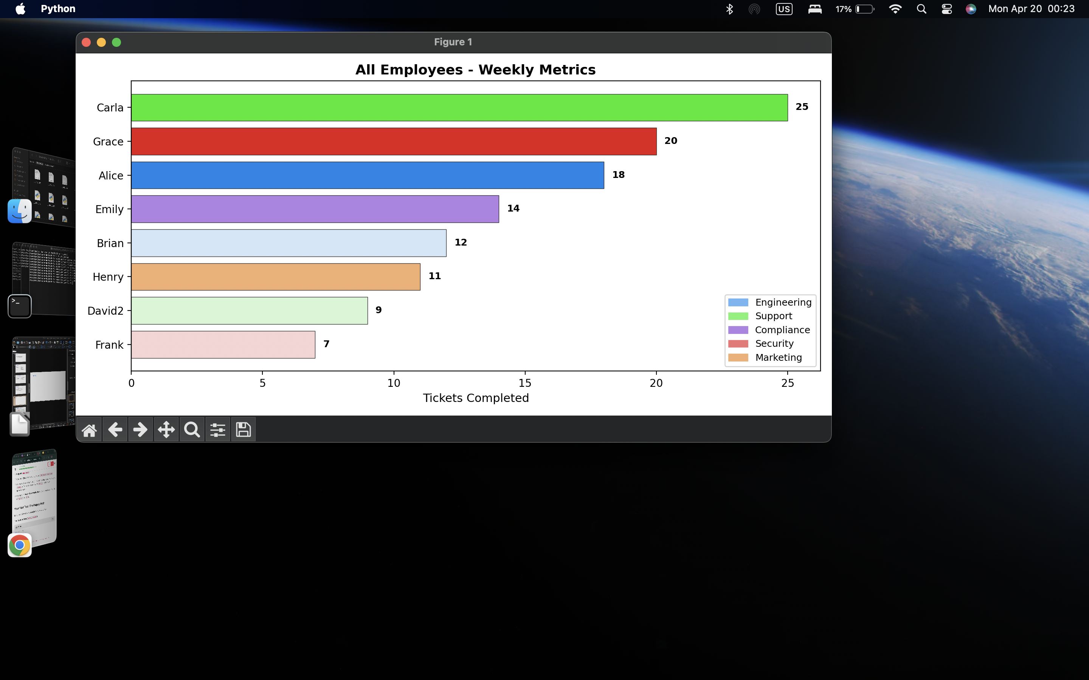
Bar Chart Visualization

Slide 5
Tech Stack
Py
SQ
Mp
Cs
Python 3
SQLite
matplotlib
colorsys
Core language
Persistent database
Graphical charts
HSL color palettes
unittest — 33 automated tests
Built-in Python testing framework

Slide 6
Code Structure — Modularized
DB
database.py
Ch
charts.py
UI
main app
• SQLite init + seeding
• get_all / get_by_id
• get_by_department
• search_by_name
• create / update / delete
• has_duplicate
• Terminal Unicode bar chart
• Matplotlib graphical chart
• generate_palette()
• get_employee_color()
• Dept-based color schemes
• CLI menu loop
• User input handling
• display_records()
• view_all / view_by_dept
• create / update / delete
• search_employee

Slide 7
Key Python Concepts
• Lists, dictionaries, SQL queries
• Functions with docstrings
• Modular imports across files
• While loops and conditionals
• f-string formatting
• try/except error handling
• List comprehensions
• Lambda sorting
• SQLite parameterized queries
• Context management (try/finally)

Slide 8
Validation Rules
• Alphanumeric usernames only
• Non-empty username required
• Department must match predefined list
• No duplicate name + department
• Non-negative integer tickets
• try/except prevents crashes

Slide 9
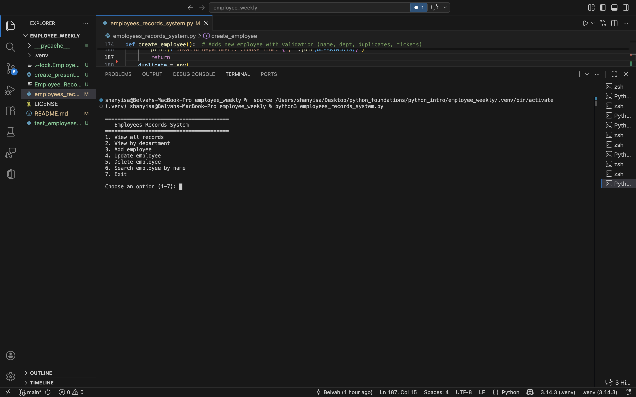
Demo — Main Menu

Slide 10
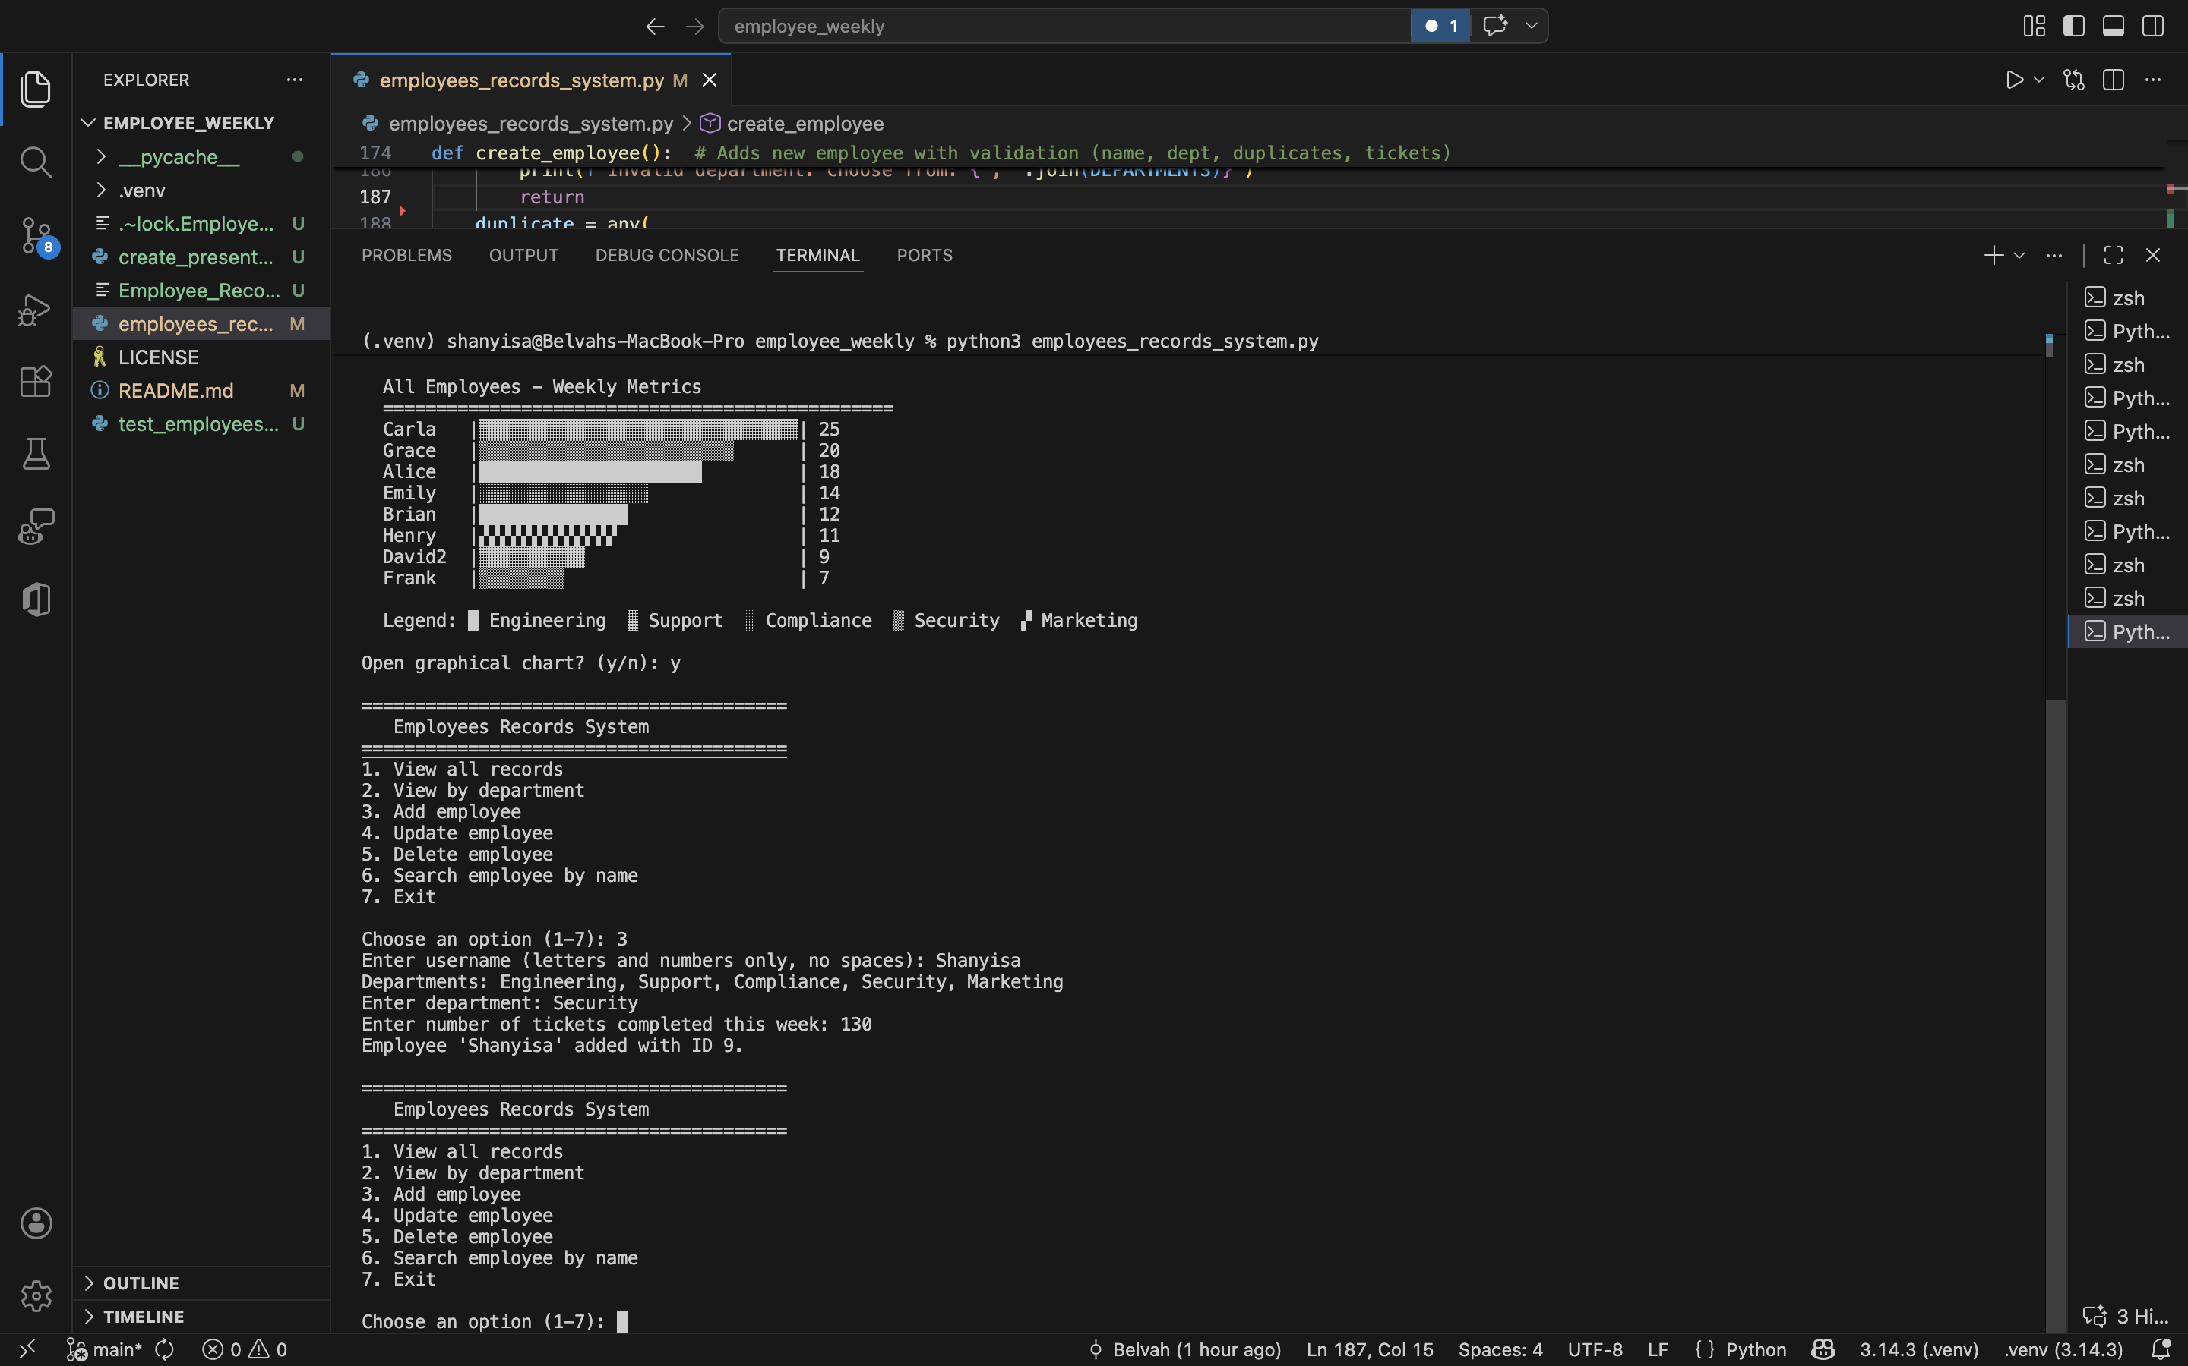
Demo — Search by Name

Slide 11
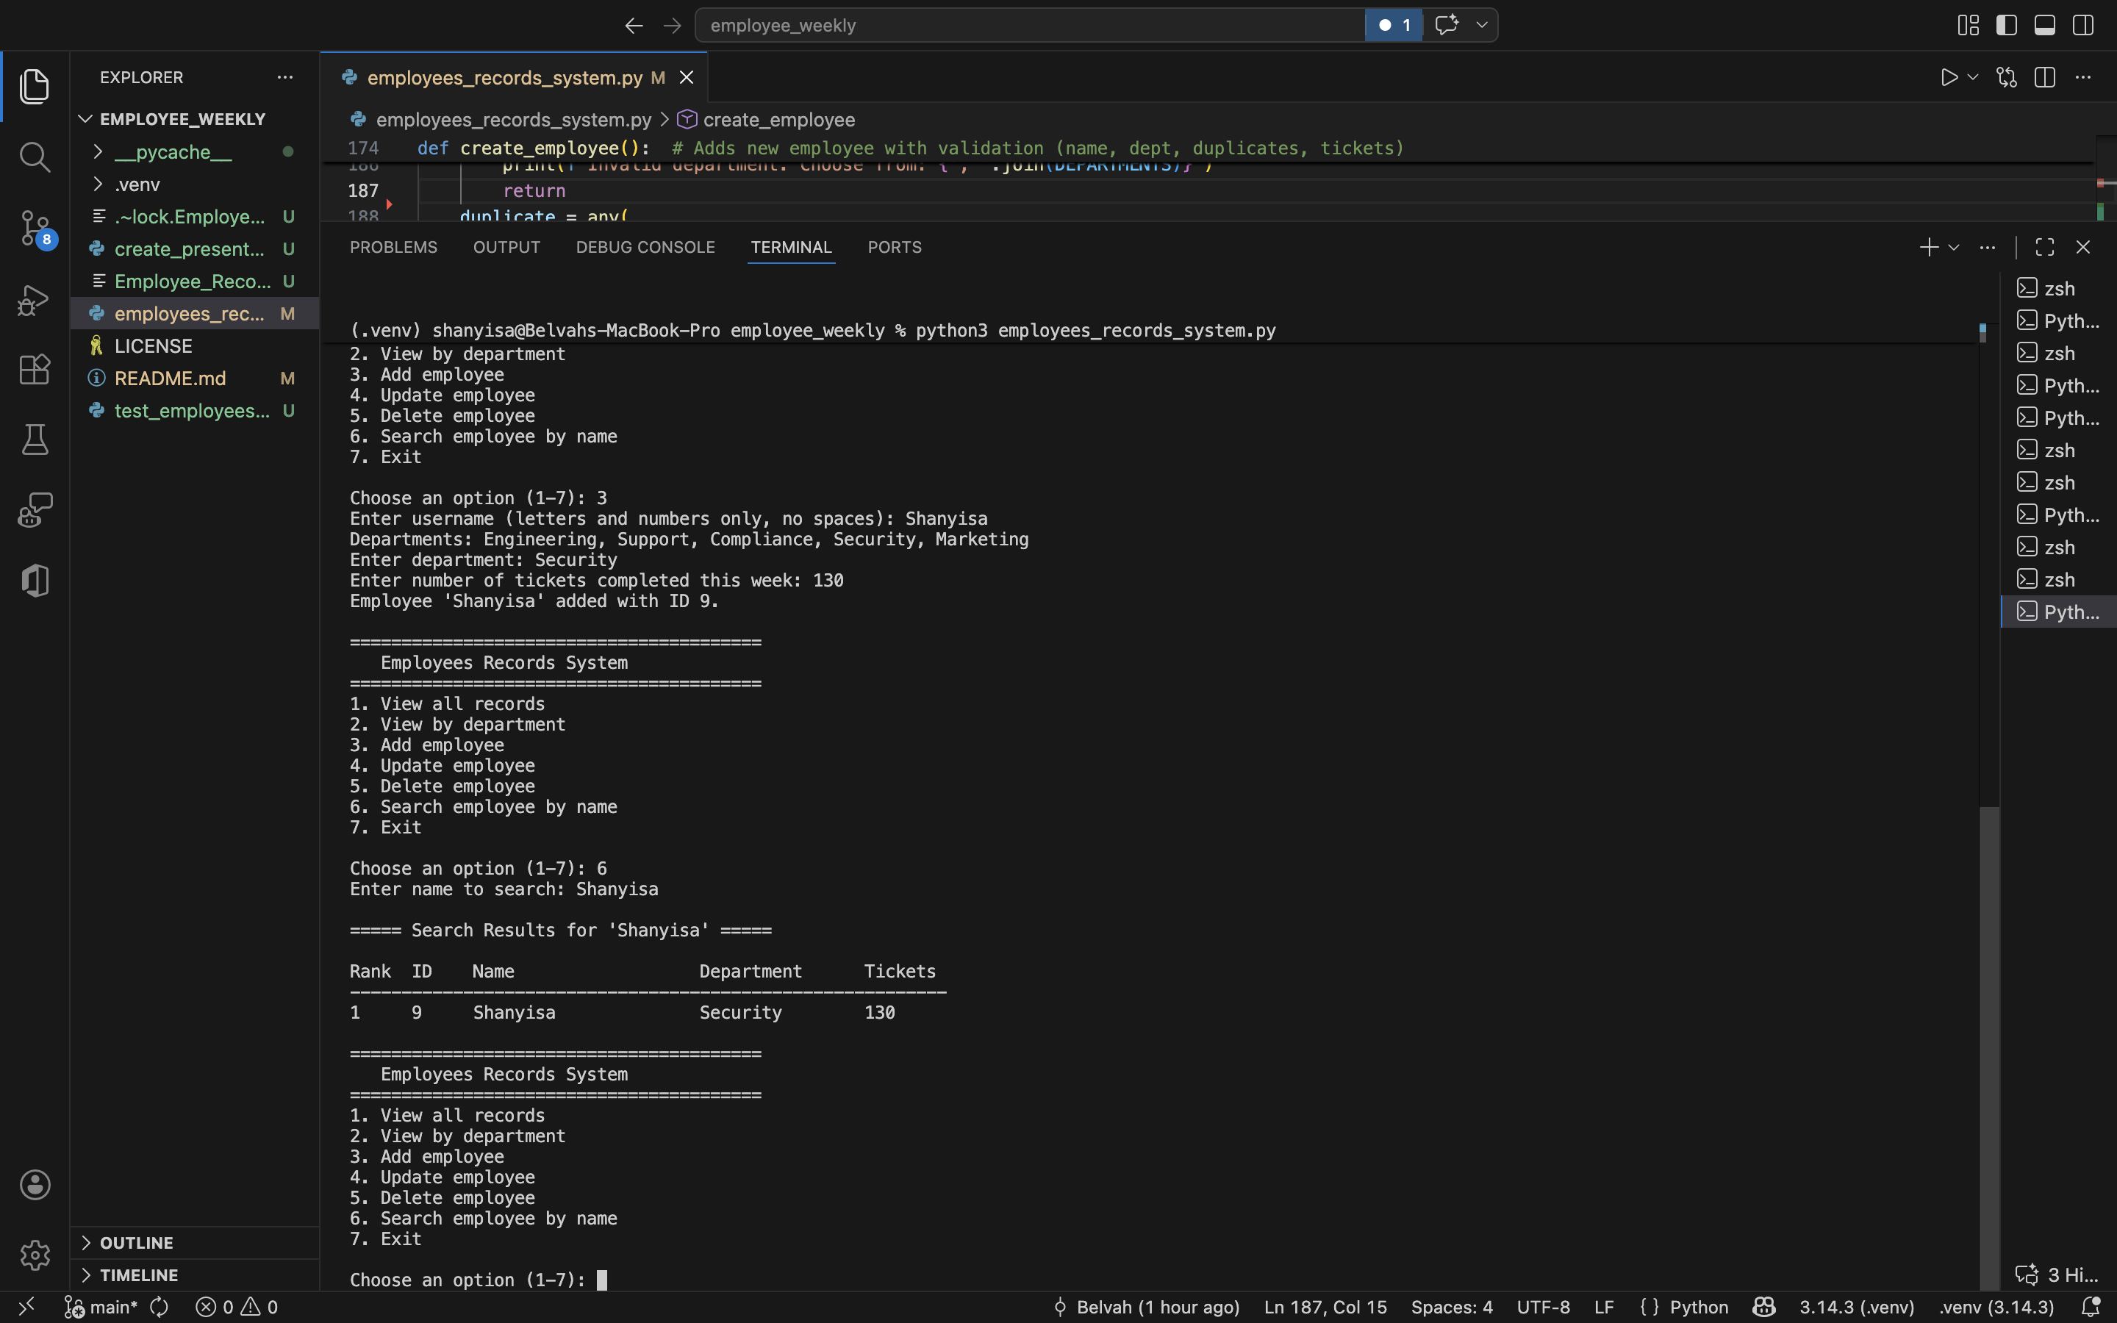
Demo — Bar Chart Visualization

Slide 12
Challenges & Lessons Learned
Challenges
Lessons Learned
• Unique color shades per employee
• Unicode bar chart alignment
• Edge cases in user input
• Organizing code across modules
• Modular code = easier maintenance
• Input validation prevents crashes
• SQLite > in-memory for persistence
• Unit testing catches bugs early

Slide 13
Future Improvements
• Export to CSV, PDF, Excel
• Configurable departments
• Web interface (Flask / Django)

Slide 14
Unit Testing
33 tests • All passing
• Database init + seeding
• Color palettes — hex, unique
• Department filtering
• Sorting by tickets
• Duplicate detection
• Input validation
• Search — exact, partial, case
• Create + delete via DB
• Update + nonexistent handling
• Isolated test database

Slide 15
Conclusion
• Full CRUD CLI app with SQLite persistence
• Dual visualizations — terminal + matplotlib
• Modularized: database, charts, main app
• Docstrings on every function
• 33 passing unit tests

Slide 16
Questions?
GitHub: github.com/Belvah
Belvah Shanyisa • misshuey3@gmail.com

