Slide 1



HACKMERIDIAN 2026 · LISBON
PLATFORM 01 / 07
INVARIANT TESTING FOR SOROBAN
BREAK
WATER
October 2026
#HackMeridian26
© 2026 HackMeridian · Lisbon

Slide 2
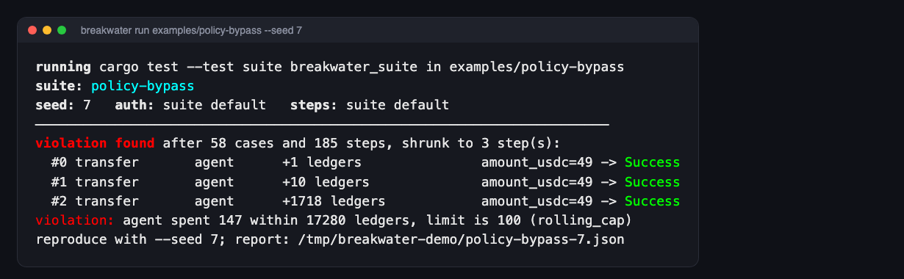

PLATFORM 02 / 07
HACKMERIDIAN 2026 · LISBON
NEXT ▸ PMF
PITCH STEP 01 / 06
THE SOLUTION
Breakwater searches for the call sequence that breaks your Soroban invariants.
Random multi-step sequences run against a local Soroban Env; every invariant is checked after every step.
A failure is shrunk to its minimal steps and exported as a Rust regression test.
Two attack packs for Stellar-specific risk: smart-account policies and TTL state archival.
👉 Think: Single-call tests prove each payment is fine. Only a sequence shows whether the account is.
© 2026 HackMeridian · Lisbon · #HackMeridian26

Slide 3
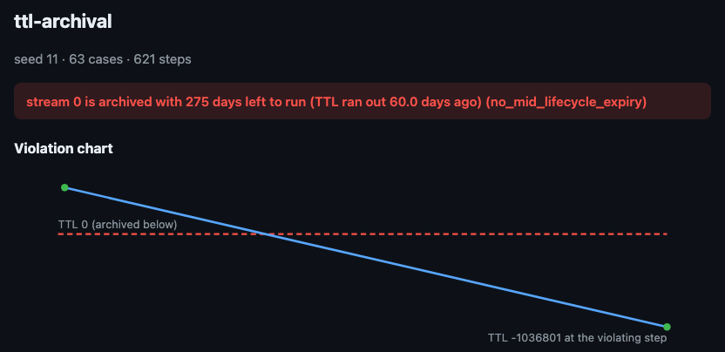
PLATFORM 03 / 07
HACKMERIDIAN 2026 · LISBON
NEXT ▸ TECHNICAL WORKFLOW
PITCH STEP 02 / 06
PMF
Soroban has static analysis, AI review and formal verification, but no reusable stateful fuzzing.
Agent wallets paying over x402 / MPP rely on smart-account policies; a policy that holds for one call may fail for five.
State archival: after mainnet moved to Protocol 23, archived entries were restored with stale values (478 entries affected).
For every Soroban team shipping custom accounts or long-lived storage; a suite runs as cargo test.
👉 Think: The bugs that cost money here only appear across many transactions and long gaps.
© 2026 HackMeridian · Lisbon · #HackMeridian26

Slide 4
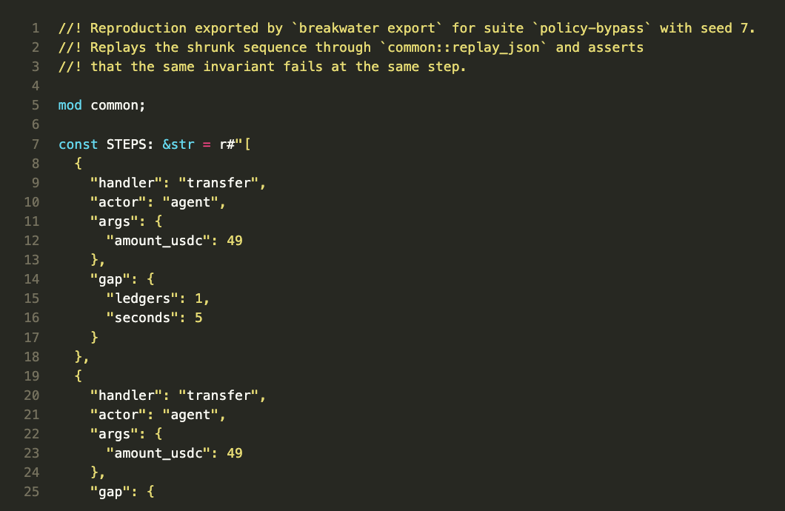
PLATFORM 04 / 07
HACKMERIDIAN 2026 · LISBON
NEXT ▸ FINDINGS
PITCH STEP 03 / 06
TECHNICAL WORKFLOW
Declare, generate, check, shrink and export: one cargo test.
DECLARE
actors · handlers · invariants
GENERATE
seeded sequences
CHECK
every invariant, every step
SHRINK
minimal repro → .rs test
proptest-state-machine generates seeded sequences; each case restores a ledger snapshot instead of redeploying.
Real auth mode signs every step with Ed25519, so OpenZeppelin's __check_auth and policies really run.
TTL is read from ledger entries without touching them, so probing never auto-restores an archived entry.
👉 Think: A finding under real authorization is a real bypass, not a mocking artifact.
© 2026 HackMeridian · Lisbon · #HackMeridian26

Slide 5
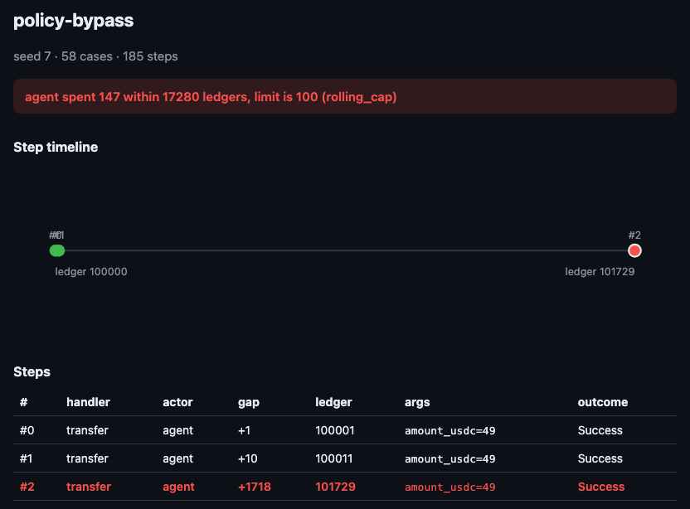
PLATFORM 05 / 07
HACKMERIDIAN 2026 · LISBON
NEXT ▸ TESTNET & PROGRESS
PITCH STEP 04 / 06
FINDINGS
The policy code is correct; the configuration is not. Every payment passes alone; the sequence does not.
Daily cap set to 1 728 ledgers, not 17 280: 49 → 49 → 49 USDC (+1 / +10 / +1718 ledgers) is 147 in 24 h against a 100 cap; up to 10× per day.
Stream that never extends TTL: “stream 0 is archived with 275 days left to run”.
Unauthenticated bump_ttl keeps an entry alive 1.3 days past its stream; one call restores 5 entries against a budget of 3.
👉 Think: Breakwater found the three-step sequence that no single-call test can see.
© 2026 HackMeridian · Lisbon · #HackMeridian26

Slide 6
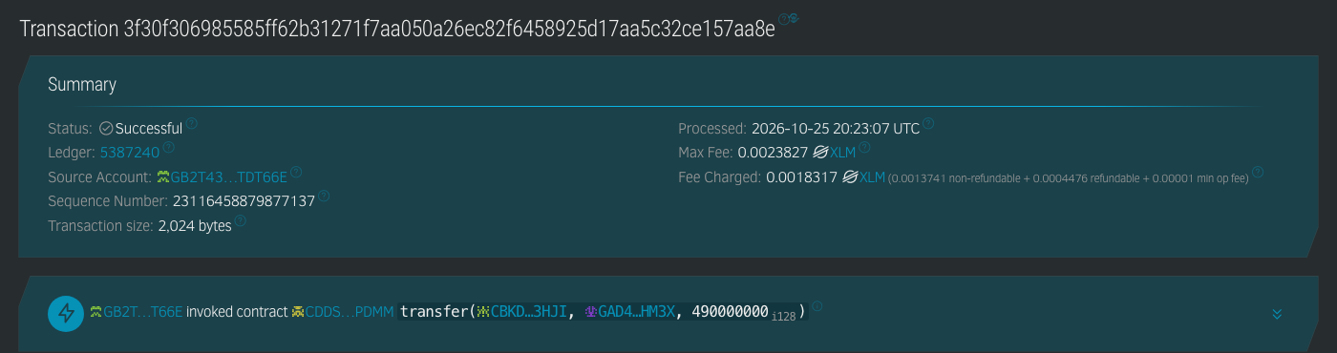
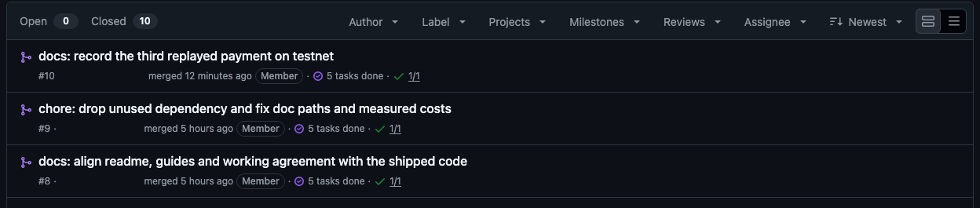
PLATFORM 06 / 07
HACKMERIDIAN 2026 · LISBON
NEXT ▸ THE TEAM
PITCH STEP 05 / 06
TESTNET & PROGRESS
The shrunk bypass replayed on Stellar Testnet through the real OpenZeppelin account.
Three agent-signed payments: 147 USDC in 3 537 ledgers (about 4.9 hours), all accepted by the policies.
Seven contracts and five transactions on Testnet, each linked from the README.
Built during the event: 11 commits on main, 10 merged PRs, 40 tests, CI on every PR.
👉 Think: Every number in this deck comes from a command anyone can rerun.
© 2026 HackMeridian · Lisbon · #HackMeridian26

Slide 7

PLATFORM 07 / 07
HACKMERIDIAN 2026 · LISBON
FINAL STOP
PITCH STEP 06 / 06
THE TEAM
Hannes Gao · Belvast Innovation · Karlsruhe, Germany
Solo builder: framework design, Rust implementation, attack packs, Testnet replay.
Repository: github.com/Belvast-Innovation/Breakwater (Apache-2.0).
Next: rule-rotation probe, malicious keep-alive, restoration-cost CI gate.
👉 Think: Everything shown was built during the event; the commit history is the record.
github.com/Belvast-Innovation/Breakwater
© 2026 HackMeridian · Lisbon · #HackMeridian26

