Slide 1
Wissenschaftlices Schreiben mit KI-Tools
Belvin Benny Thomas

Slide 2

Scientific paper – Wie siehts aus ?

Slide 3
Acknowledgements
Abstract
Index of Notation
1. Introduction
1.1 Introduction
1.2 Motivation
1.3 Goals
1.4 Main Contribution
1.5 Thesis Outline
2. Prerequisites
3 Related Work and Literature
3.1 Cite
4 Main
4.1 Overview
4.2 Content p1
4.2.1 Content, part 1.1
4.3 Content and Equations
4.3.1 Content with Images
4.3.2 Graph with explanation
5 Evaluation
5.1 Examples
6 Conclusion
6.1 Summary
6.2 Evaluation
6.3 Future Work
Appendices
A. A section
Bibliography
Statement of Authorship / Selbstständigkeitserklärung

Slide 4
3 KI Tools – Nutzung, Preise und Bewertung

Slide 5

https://scispace.com/
Notes:
Explains and summarizes papers, equations, and methods; ideal for Introduction, Methods, Conclusion

Slide 6
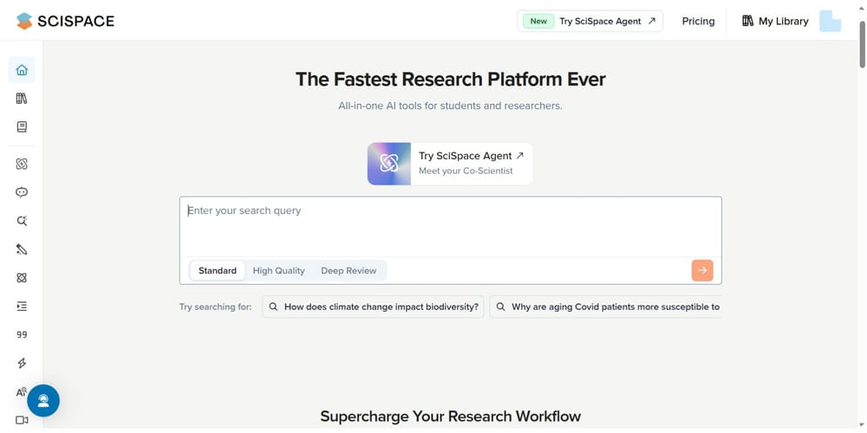
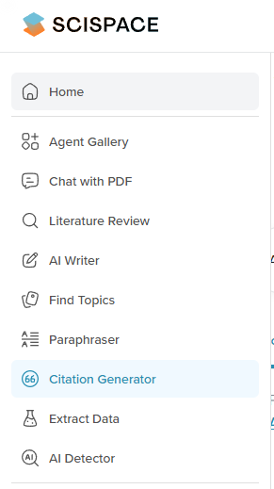
Nutzung
✅ Vereinfacht Paper-Lesen
✅ Erklärt Formeln klar
✅ Unterstützt PDFs & Web
✅ Kostenfreier Kernzugang
✅ Visuelles Studientnetzwerk
❌ Begrenzte Analysefunktionen
❌ Wenig Anpassung
❌ Keine Schreibassistenz
Notes:
✅ Pros
✅ AI Copilot simplifies reading and understanding complex papers
✅ Explains equations, technical terms, and methods clearly
✅ Works with uploaded PDFs and web-based research articles
✅ Free access to core features including Copilot
✅ Visual network of related studies enhances exploration
❌ Cons
❌ No writing assistant or citation management features
❌ Not designed for conducting literature reviews or full analysis
❌ Limited customization of output or summaries
“no writing assistant”-> SciSpace is mainly focused on reading, summarizing, and explaining research papers — not generating or rewriting academic text for you like paperpal
SciSpace → helps you understand papers (summaries, explanations, citations).
Paperpal / Jenni AI → help you write papers (generate, paraphrase, edit sentences).

Slide 7
Preiseplan
Plan | Preis/Monat | Hauptfunktionen
Kostenlos | € 0 | Basiszugang (begrenzte AI-Generierungen, grundlegende Funktionen)
Premium | ca. € 11 (jährliche Zahlung) | Alle Funktionen inkl. Zitiergenerator, AI-Zusammenfassungen, unbegrenzte Downloads
Advanced / Deep Review | ca. € 65 (jährliche Zahlung) | Erweiterte Funktionen für Institutionen/Teams (größeres Nutzungsvolumen, Enterprise-Funktionen)
Link to official pricing page : SciSpace-pricing
Notes:
Free includes - 100 monthly credits • 1 parallel task • limited literature search, chats, writing tools, summaries, and citations • standard AI model only • no exports.

Slide 8

Bewertung – scispace
Datensicherheit : ★★☆☆☆ (2/5)
Qualität des Outputs : ★★★☆☆ (3/5)
Kosten : ★★★☆☆ (3/5)
Notes:
Data storage & billing transparency not clearly documented; unclear if user uploads (PDFs/papers) are retained for model training.
decent summaries, but sometimes shallow or inaccurate for technical fields.
Free tier with limited summaries; paid plan required for export & advanced citations.

Slide 9

https://paperpal.com/
Notes:
AI academic writing tool
Real-time writing, grammar, and citation suggestions; best for Methods, Results, Discussion.

Slide 10
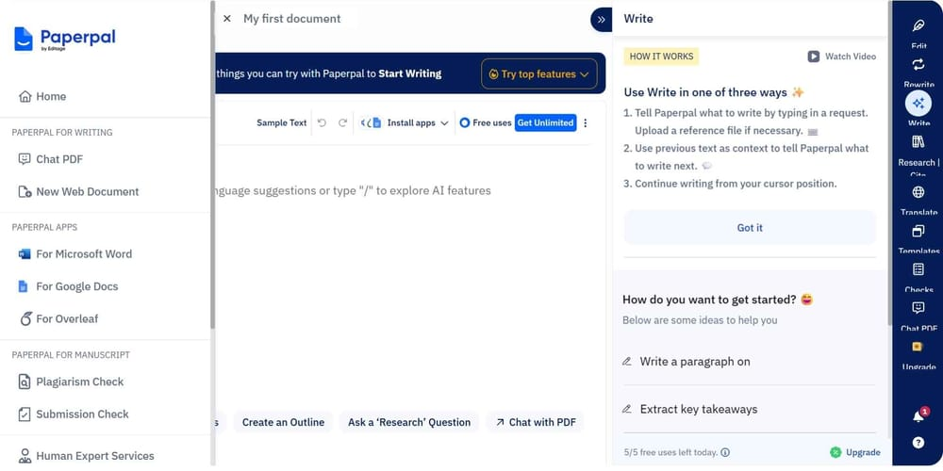
Nutzung
✅ KI-Schreibassistenz
integriert
✅ Wissenschaftlich
präzise Vorschläge
✅ Word & Web kompatibel
✅ Kostenloser Basiszugang
❌ Begrenzte Gratisfunktionen
❌ Kein Quellenfinder
❌ Eingeschränkte Themenvielfalt
Notes:
✅ KI-Schreibassistenz integriert -> inklusiv Grammatik & Stilprüfung
✅ Wissenschaftlich präzise Vorschläge
✅ Word & Web kompatibel
✅ Kostenloser Basiszugang
Advantages:
AI writing assistant built-in → helps with academic writing
Grammar & style checking
Scientifically accurate suggestions
Word & web compatible
Free basic access
Disadvantages:
Limited free features → full functionality requires Premium
No source finder → you must provide/upload papers
Limited topic coverage → not ideal for all research fields

Slide 11
Preiseplan
Plan | Price | Key Features
Free | €0 / month | Basic grammar and language suggestions, limited paraphrasing
Premium | €11,4 / month | Full writing suggestions, plagiarism checks, citation formatting, advanced paraphrasing

Slide 12
Bewertung – Paperpal
Datensicherheit : ★★★★★ (5/5)
Qualität des Outputs : ★★★★☆ (4/5)
Kosten : ★★★★☆ (4/5)
Notes:
Fully GDPR & ISO/IEC 27001 certified; no data used for AI training; transparent policies. ( both free and paid plans )
strong grammar & academic focus, needs human review for logic.
Free plan for basic editing; paid plans modestly priced.

Slide 13

https://scite.ai/
Notes:
Analyzes how papers are cited (supporting, contrasting, mentioning); best for Introduction, Discussion, References.

Slide 14
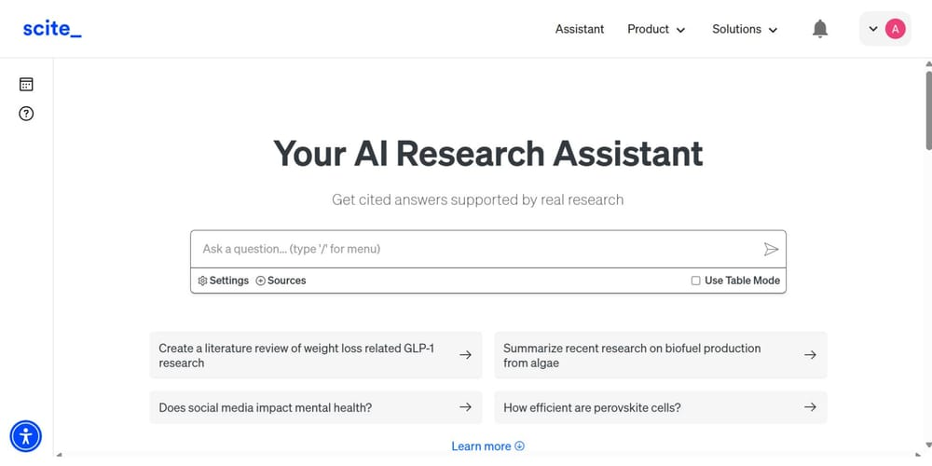
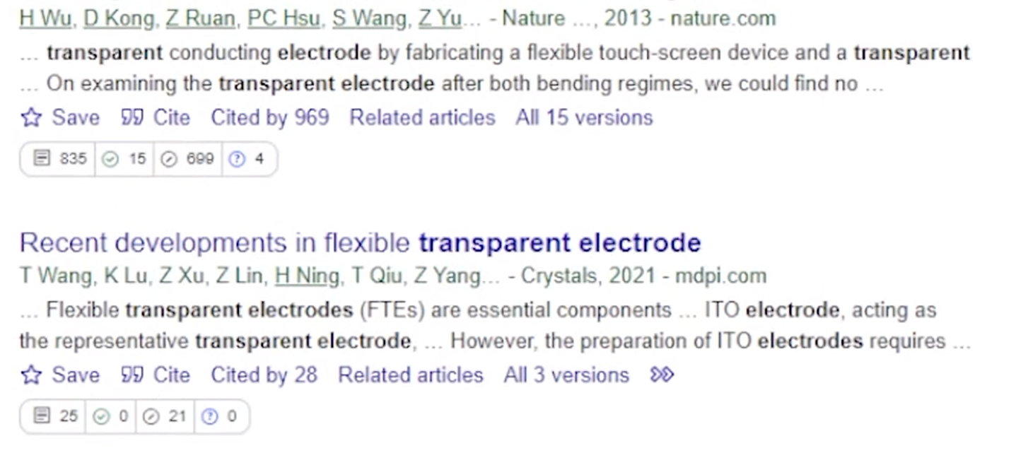

Nutzung
✅ Zitationsnetzwerk
sichtbar
✅ Belegt Aussagen
mit Beweisen
✅ Vertrauenswürdige
Quellenbewertung
✅ Plug-ins für Browser
✅ Kostenlose Basisversion
❌ Eingeschränkte Gratisnutzung
❌ Keine Schreibassistenz
❌ Komplexe Oberfläche .
Notes:
Scite.ai states it provides access to “both Open Access and paywalled content … unmatched access … across 200M+ sources”.
Advantages:
Visible citation network → see how papers are connected
Evidence-backed statements → shows supporting citations for claims
Trusted source evaluation → assess the quality of publications
Browser plug-ins → use directly while browsing
Free basic version → easy to start
Disadvantages:
Limited free usage → some features require Premium
No writing assistance → focused on research, not text production
Complex interface → learning curve required
Full-text access:
Total publications citing it , supporting , contrasting , mentioned and non stance
Many articles available, but not all; paywalls may still exist.
- Can also say find source for following sentence

Slide 15
Preiseplan
Plan | Preis/Monat | Hauptfunktionen
Kostenlos | € 0 | Begrenzte Smart-Citation-Prüfung und Dashboard-Zugriff
Personal | ca. € 11 (jährlich), € 19 (monatlich) | Smart Citations, Zitierberichte, Visualisierungstools, unbegrenzte Suchen
Advanced | ab ca. € 28 | Institutionelle/Team-Analysen, Massenexport, API, Dashboards, Admin-Kontrollen
Notes:
Plan
Price
Key Features
Free
$0 / month
Basic grammar and language suggestions, limited paraphrasing
Premium
$10–$25 / month
Full writing suggestions, plagiarism checks, citation formatting, advanced paraphrasing

Slide 16
Bewertung – scite.ai
Datensicherheit : ★★★★☆ (4/5)
Qualität des Outputs : ★★★★★ (5/5)
Kosten : ★★★★☆ (4/5)
Notes:
Mostly GDPR compliant; minor gaps on how citation data is reused internally.
excellent contextual citation support.
Freemium model; limited citations free, full access requires subscription.

Slide 17
MANCHE NICHT KI TOOLS

Slide 18
REFERENCES AND LINKS
Nicht-KI-Onlinetools
  Google Scholar: https://scholar.google.com/
  → Relevant Thesis Sections:Introduction(1), Related Work (3)
  SPSS (IBM Statistical Package for the Social Sciences):
  https://www.ibm.com/spss
  →Relevant Thesis Sections: Evaluation (5),Examples (5.1)
  JabRef: https://www.jabref.org/
  → Relevant Thesis Sections: RelatedWork (3),Bibliography
  Calibre: https://calibre-ebook.com/
  → Relevant Thesis Sections:Prerequisites (2), Related Work (3)
Notes:
Spss – statistical data analysis software
Jabref – reference management bibtex
Calibre – ebook management

Slide 19
REFERENCES AND LINKS
Nicht-KI-Onlinetools
  Citavi:https://www.ub.ovgu.de/ub/en/Service/Courses++Guided+tours++Consultation/Reference+management+with+Citavi.html
  → Relevant Thesis Sections: Related Work (3), Bibliography, Appendices
  Zotero: https://www.zotero.org/
  → Relevant Thesis Sections: Related Work (3), Bibliography
  ZMzettelkasten / Zettelkasten: https://zettelkasten.de/
  → Relevant Thesis Sections:Motivation (1.2), Main (4), Future Work (6.3)
  TextCite: https://sourceforge.net/projects/textcite/
  → Relevant Thesis Sections:Prerequisites (2), Related Work (3), Appendices
Notes:
Citavi – reference management , knowledge orga
Zotero – research sourcce collection , citation manager
Zrttelkasten – note taking , idea organisation
Textcite – manage quotations for academic writing

Slide 20

Infinity Tools: “Your Thesis Superhero Squad”

Slide 21
Acknowledgements
Abstract - SciSpace (Free Plan)
Index of Notation TextCite
1. Introduction - SciSpace (Free Plan)
1.1 Introduction
1.2 Motivation
1.3 Goals
1.4 Main Contribution
1.5 Thesis Outline
2. Prerequisites TextCite
3 Related Work and Literature - Scite.ai (Free), Zotero
3.1 Cite
4 Main - Google Scholar
4.1 Overview
4.2 Content p1
4.2.1 Content, part 1.1
4.3 Content and Equations
4.3.1 Content with Images
4.3.2 Graph with explanation
5 Evaluation – SPSS(Trial)
5.1 Examples
6 Conclusion - SciSpace (Free)
6.1 Summary
6.2 Evaluation
6.3 Future Work
Appendices TextCite
A. A section
Bibliography - Zotero
Statement of Authorship / Selbstständigkeitserklärung
KOSTENLOS !

Slide 22
Acknowledgements Paperpal
Abstract - Paperpal
Index of Notation TextCite
Introduction - Scite.ai, Google Scholar
1.1 Introduction
1.2 Motivation
1.3 Goals
1.4 Main Contribution
1.5 Thesis Outline
2. Prerequisites Paperpal
3 Related Work and Literature - Scite.ai (Free/Paid), Zotero
3.1 Cite
4 Main - Paperpal (Paid)
4.1 Overview
4.2 Content p1
4.2.1 Content, part 1.1
4.3 Content and Equations
4.3.1 Content with Images
4.3.2 Graph with explanation
5 Evaluation – SPSS (Academic license)
5.1 Examples
6 Conclusion - Paperpal
6.1 Summary
6.2 Evaluation
6.3 Future Work
Appendices Zotero / TextCite
A. A section
Bibliography - Zotero / JabRef
Statement of Authorship / Selbstständigkeitserklärung
BEZAHLT
€38 pro Monat (Paperpal + Scite.ai)
Oder
€23 pro Monat (Paperpal)
Notes:
Use Paperpal (~€23/month)
Use Scite at free tier (i.e., €0/month)
Use SPSS via free university licence (so €0/month)
Total = 23 per month
Paperpal → ~€23/month
Scite (Paid) → ~€15/month
SPSS via free university licence → €0/month
Total = 38 per month

Slide 23
DANKE !

