Slide 1
Drone Formation Control Simulator
Presentation of Final Results
Michael Faber,
Christian Grüneberg,
Belvin Benny Thomas
Autonomous Multisensor Systems Group
Institute for Intelligent Cooperating Systems
Faculty of Computer Science
Otto von Guericke University Magdeburg
31.03.2025

Slide 2
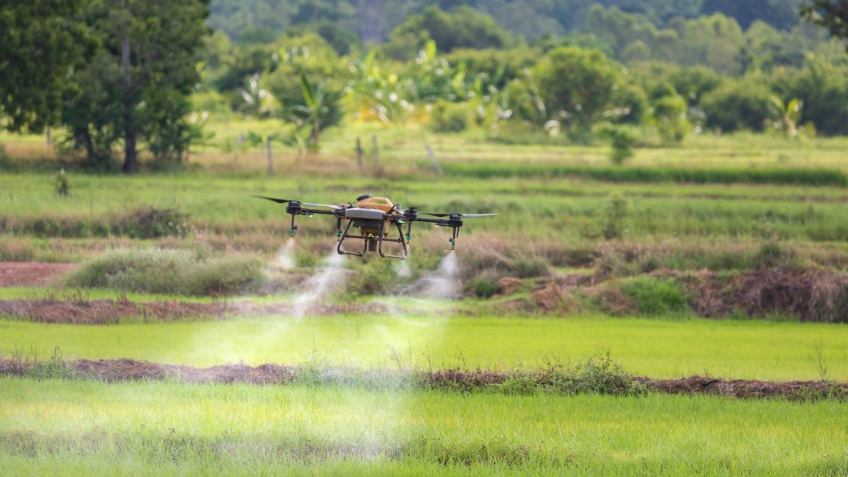
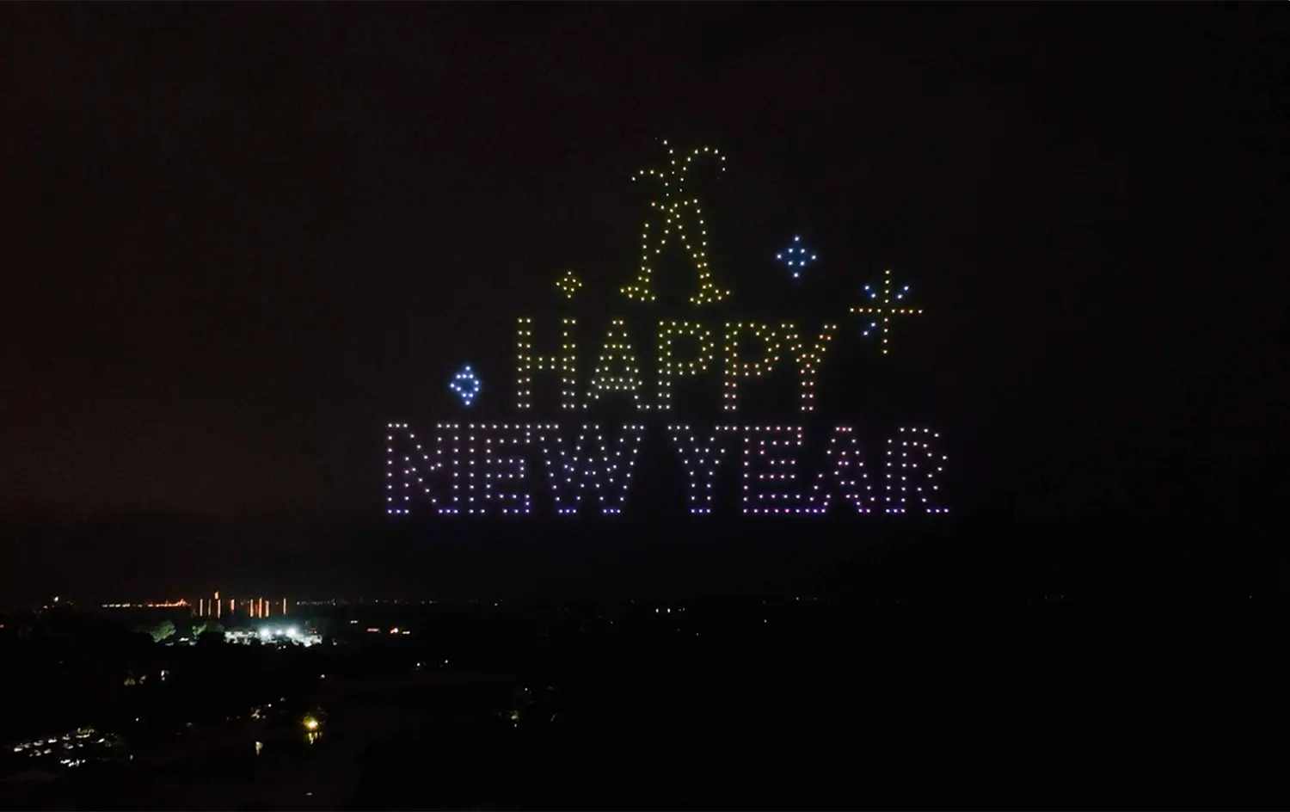
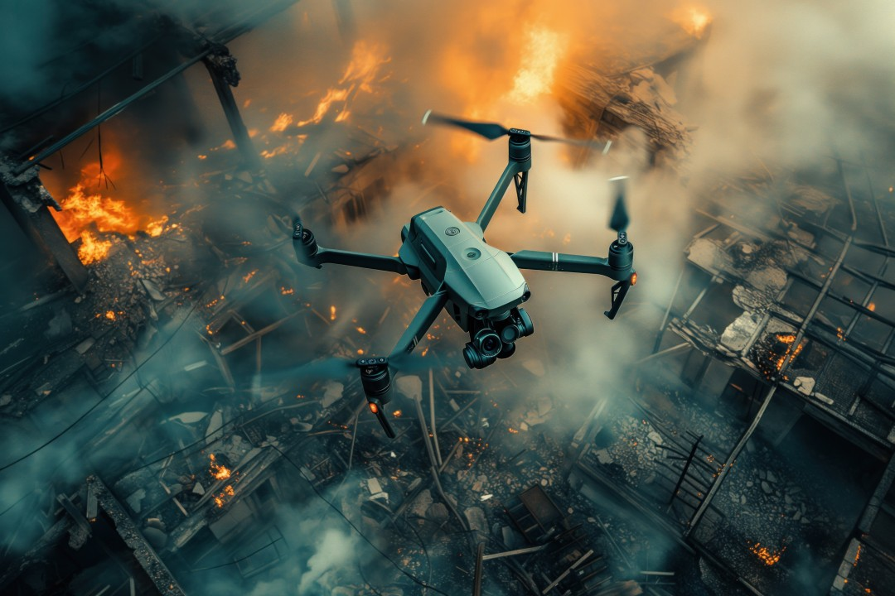
Motivation
[2]
[1]
[3]

Slide 3
Milestones
Single drone Simulation
Single drone Communication
Multiple drones Simulation
Multiple drones Communication
Formation Control
State estimation

Slide 4
Timeline
INSERT NEW TIMELINE HERE!!!
[4]

Slide 5
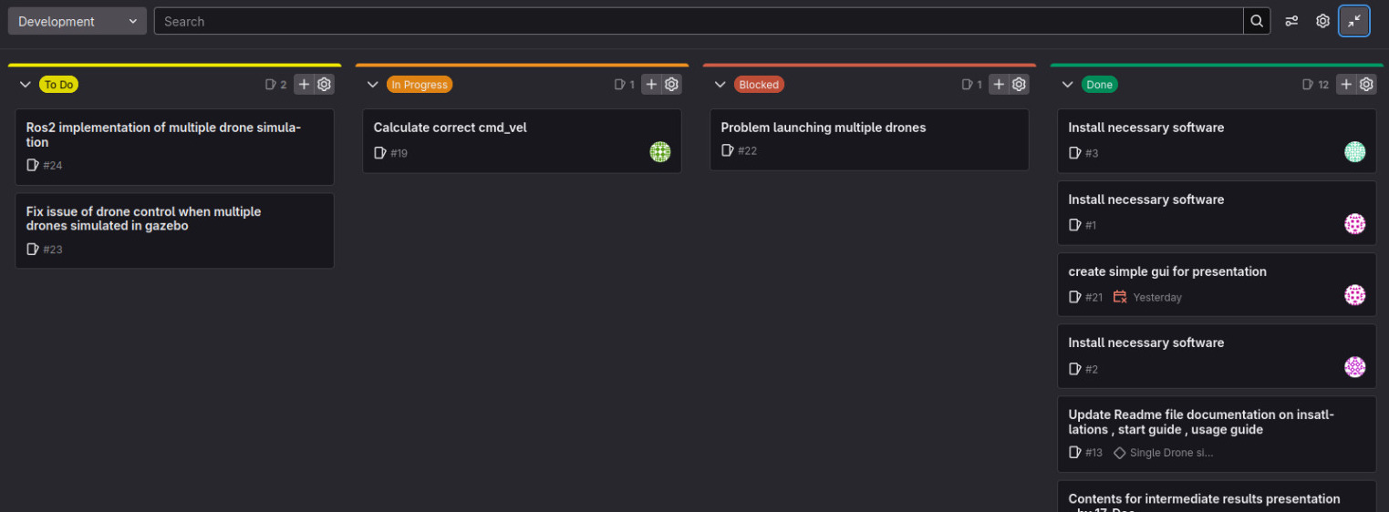
Organization
Used Git lab’s Issue Board to coordinate and assign tasks
Weekly meetings with Supervisor : Tuesday , 17.00
Weekly team meetings : Tuesday / Friday 16.00

Slide 6
Technical Background
Can be divided into three categories:
  Communication via Ardupilot
  ROS2 integration / MAVros
  World Simulation via Gazebo
All parts necessary to Simulate a drone in the ROS2 environment

Slide 7
Communication
NO LONGER WORKS OVER UDP
MAYBE COMBINE WITH ROS2/MAVROS PART??
[5]

Slide 8
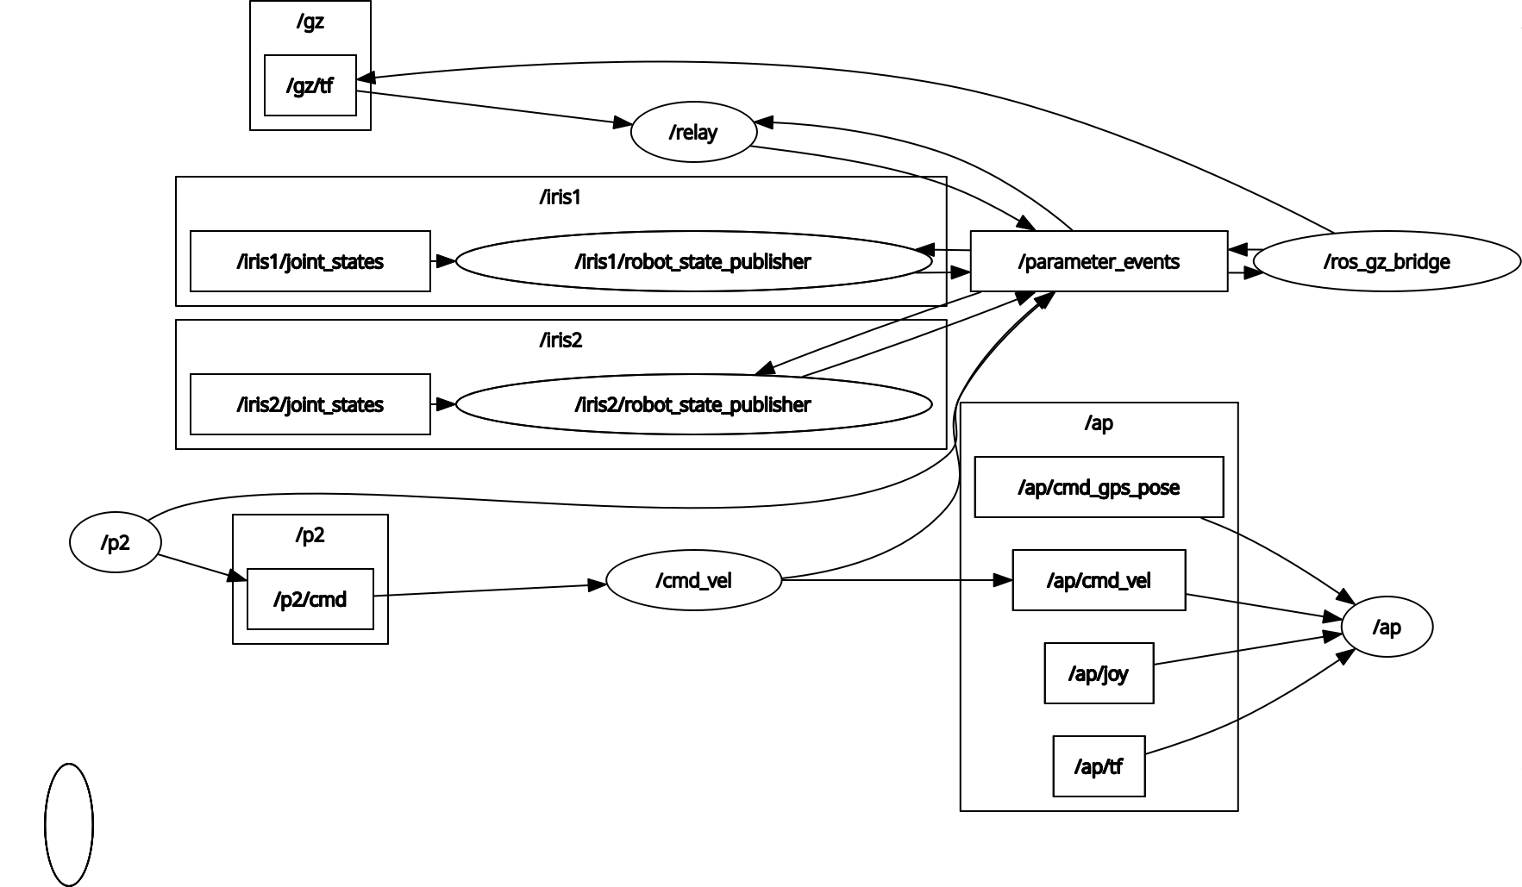
Nodegraph ROS2
Gazebo
Drones
Ardupilot SITL
Drone Formation Control

Slide 9
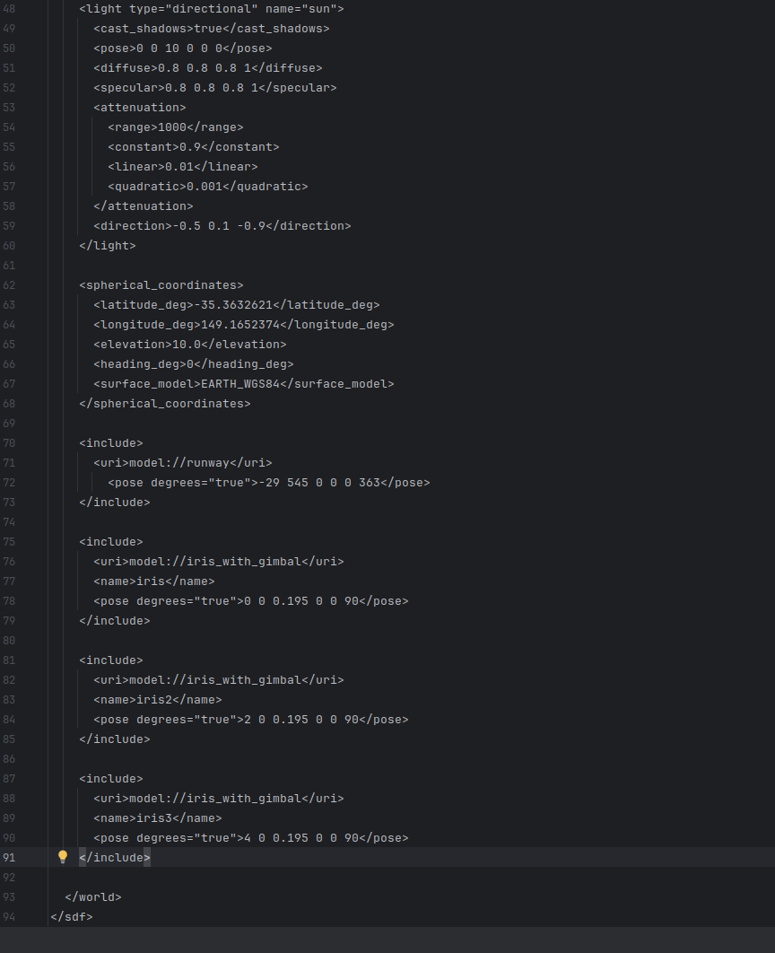
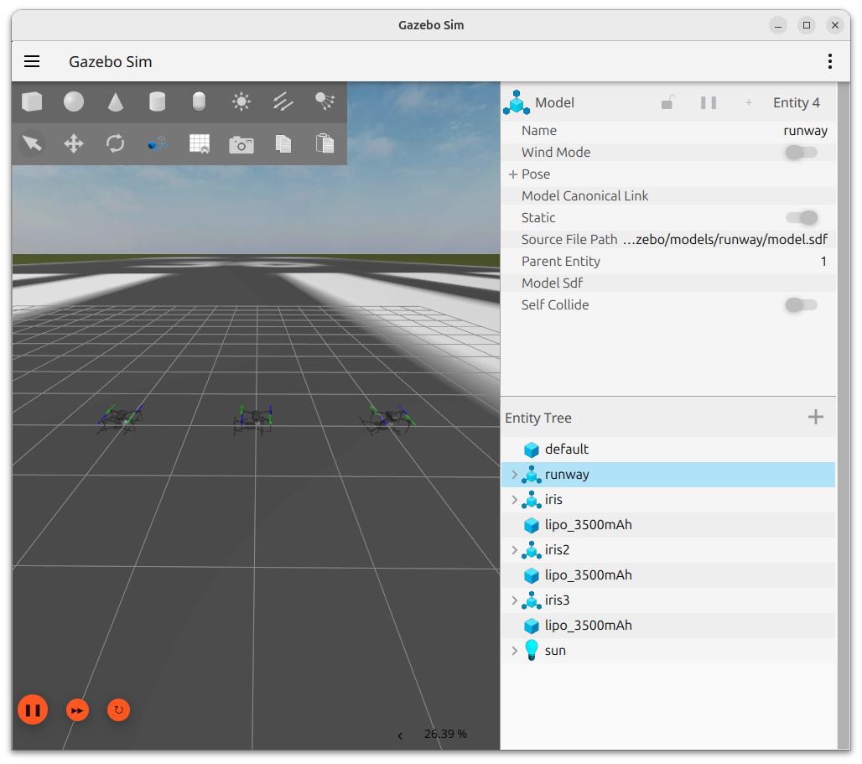
Gazebo World

Slide 10
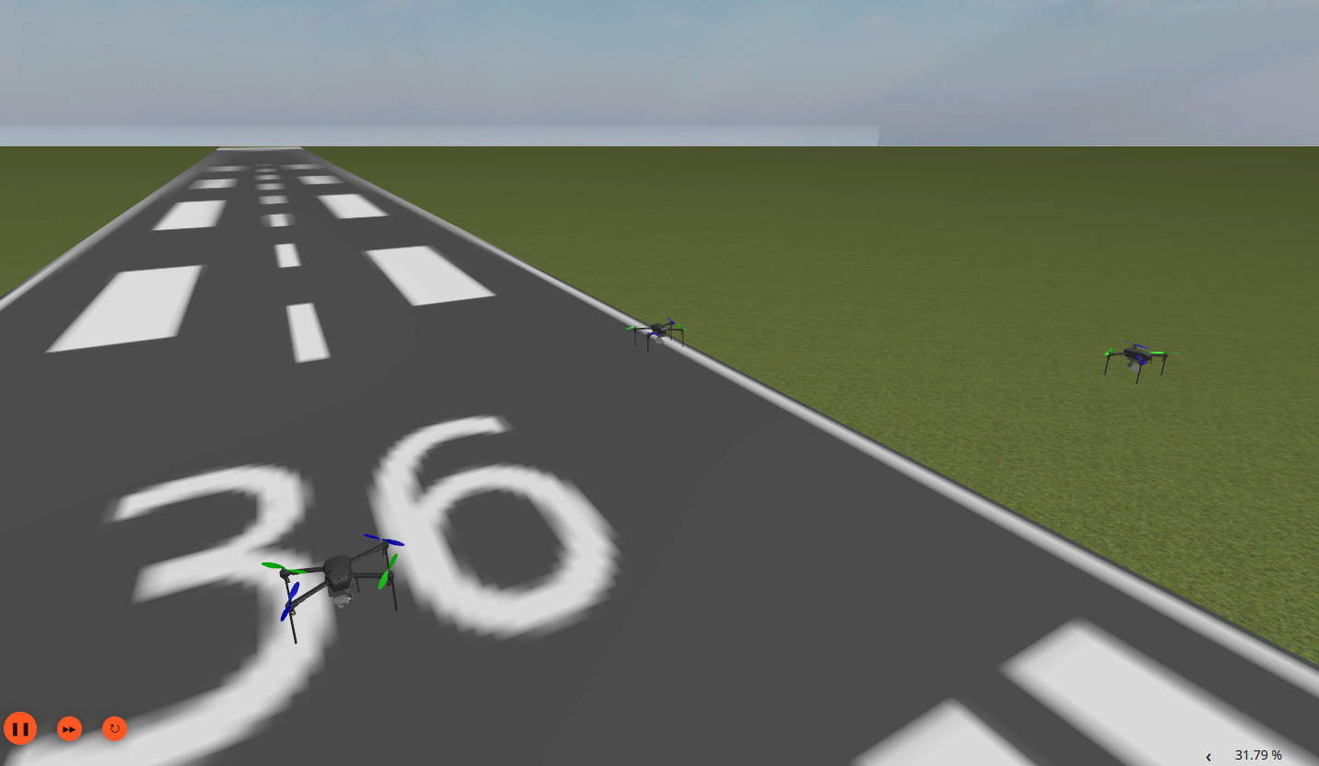
Final Results – Formation Control

Slide 11
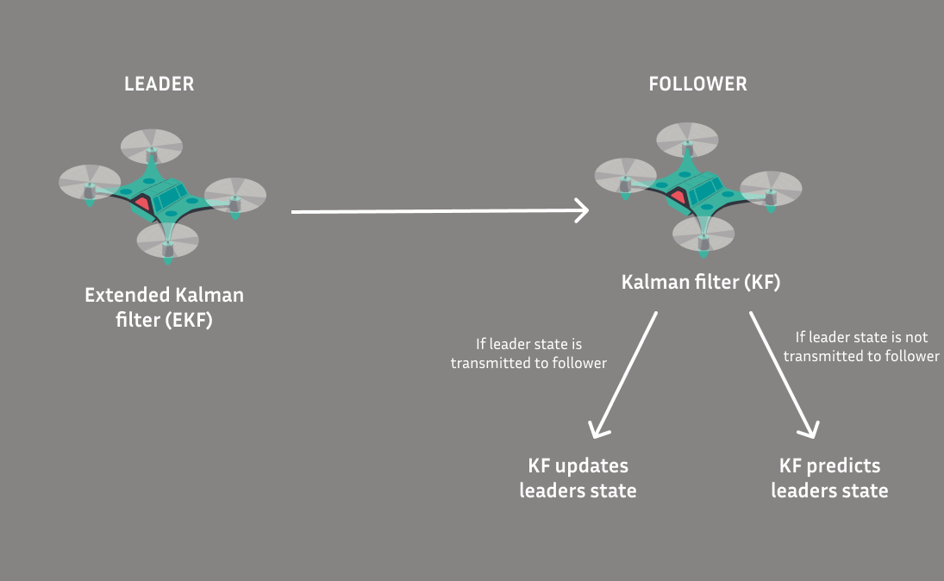
Final Results – State Estimation
[6]

Slide 12
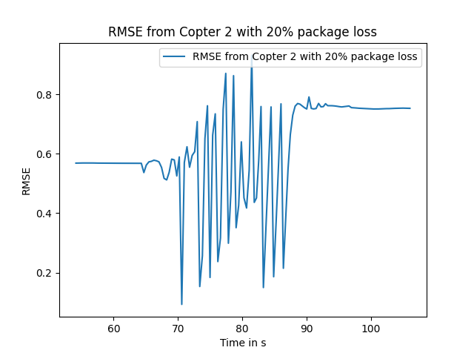
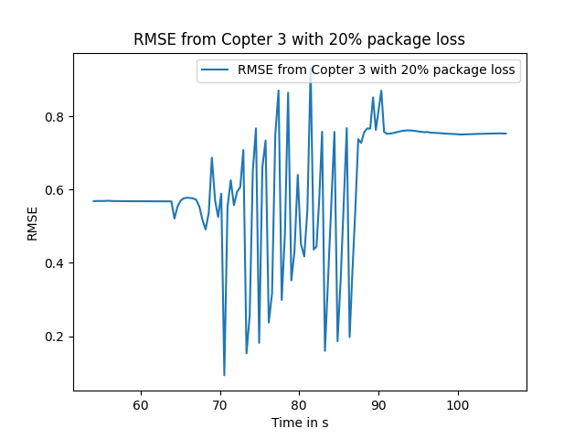
Final Results – RMSE of Kalman Filter 20%

Slide 13
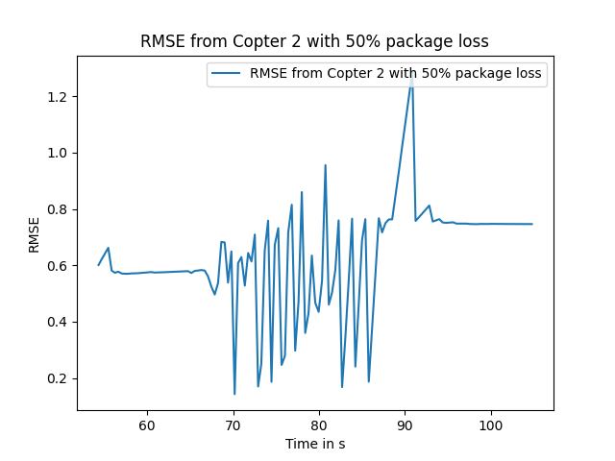
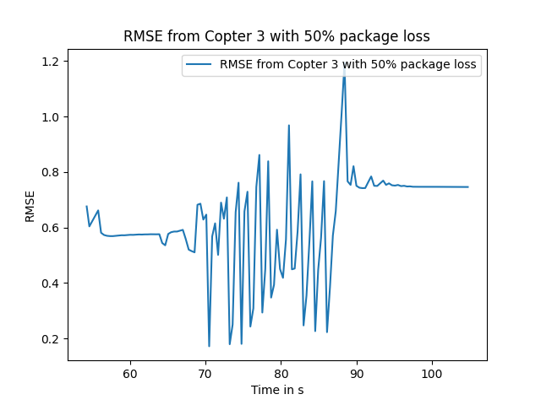
Final Results – RMSE of Kalman Filter 50%

Slide 14
Problems Faced
Infrastructure Setup :
- ROS2 jazzy and Ardupilot integration
Drone Control & Integration in ROS2 :
- Mavproxy
Multiple Drones control with ROS2
Organization :
  Finding a time to meetup weekly outside of the supervisor meeting
  Downtime during exam phase Feb and March
  Leave of a team member

Slide 15
Future work
RVIZ / robot state publisher
More formations
Modify the movement to make it more accurate
Different simulated environments
Better path planning

Slide 16
Presentation of Task and Project Plan
Drone Formation Control Simulator
Thank You For Your Attention!
Michael Faber,
Christian Grüneberg,
Belvin Benny Thomas

Slide 17
References
https://dronespace.co.ke/images/shows/hny.webp
https://cdn.wikifarmer.com/images/detailed/2024/02/Drones-in-Crop-Monitoring-and-Management-Uses-Types-Advantages-and-Limitations.jpg
https://www.linkedin.com/pulse/role-drones-disaster-management-revolutionizing-emergency-response-8fw7c
https://chatgpt.com/g/g-XDdbCexsy-gantt-chart-maker-ai
https://github.com/ArduPilot/ardupilot/tree/master/libraries/AP_DDS
,single drone image source used in Figma to make diagram
[3]

