Slide 1
Presentation of Task and Project Plan
Drone Formation Control Simulator
Michael Faber,
Christian Grüneberg,
Sourav Salkoppalu Lingaraju,
Belvin Benny Thomas
Autonomous Multisensor Systems Group
Institute for Intelligent Cooperating Systems
Faculty of Computer Science
Otto von Guericke University Magdeburg
14.11.2024

Slide 2
Outline
Project tasks
Milestones
Timeline
Responsibilities

Slide 3
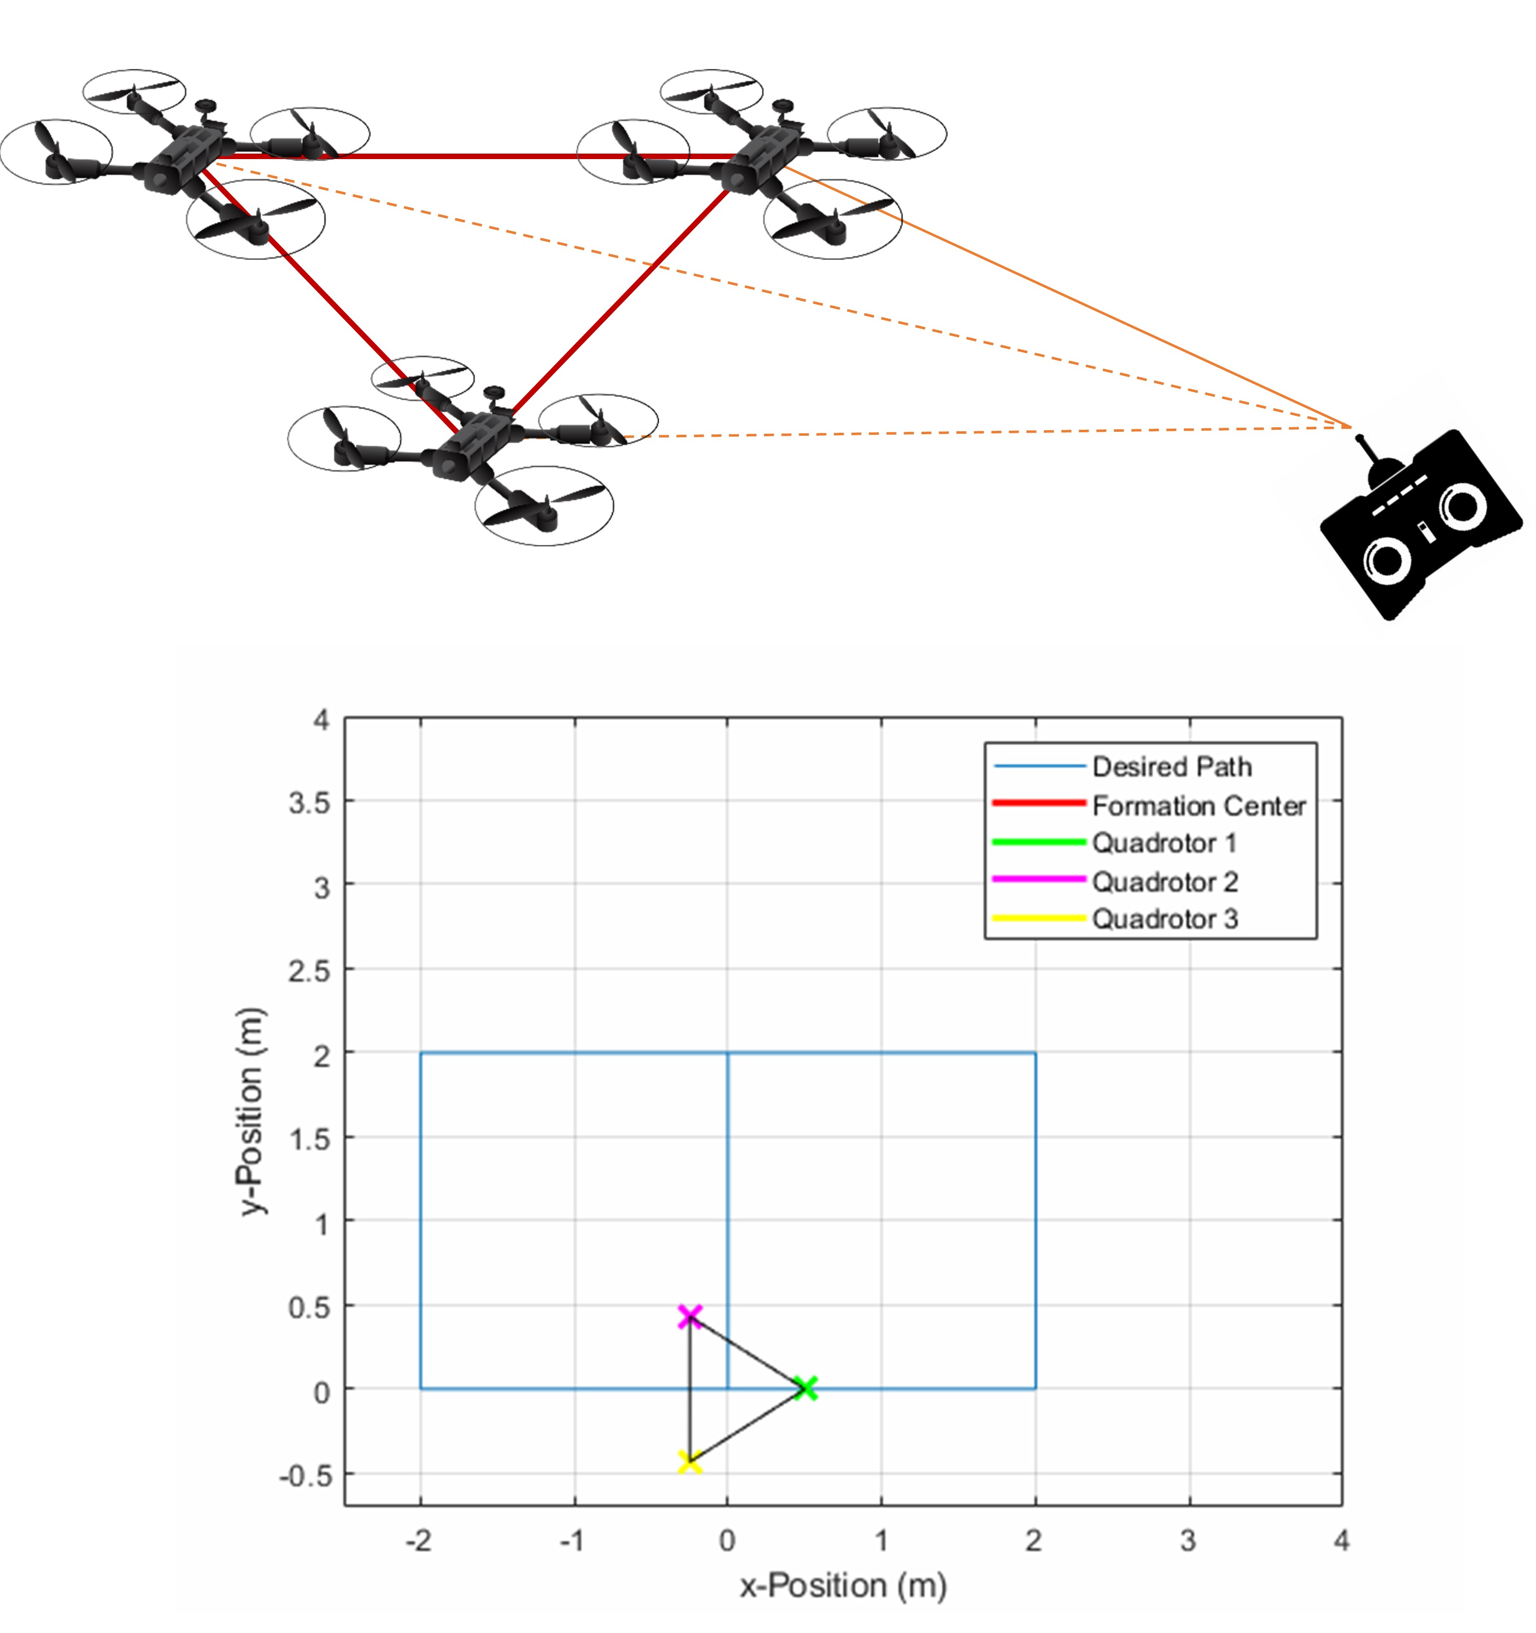
Project tasks
ROS 2 Gazebo Simulation for Drone Formations
Communications between agents
Implementation of formation control
Implementation of event based communications

Slide 4
Milestones
Drone control
Communication
Formation Control
State estimation

Slide 5
Timeline
Infrastructure setup - 2 Weeks until 28. November
Single drone simulated in Gazebo – 1 Month until 28. December
Multiple Drones simulated without communication – 2 Weeks until 11. January
Communication between Drones – 2 Weeks until 25. January
Implementation of Formation – 2 Weeks until 7. February
Estimation added and final optimization – 1 Month until 7. March
Documentation and Report writing – until 31. March

Slide 6
Responsibilities
Programming – everyone
Report - everyone
Project management – Belvin
Drone control – Sourav
Communication – Michael
Formation control – Christian
State estimation - Belvin

Slide 7
Presentation of Task and Project Plan
Drone Formation Control Simulator
Thank You For Your Attention!
Michael Faber,
Christian Grüneberg,
Sourav Salkoppalu Lingaraju,
Belvin Benny Thomas

