Slide 1
Drone Formation Control Simulator
Presentation of Intermediate Results
Michael Faber,
Christian Grüneberg,
Sourav Salkoppalu Lingaraju,
Belvin Benny Thomas
Autonomous Multisensor Systems Group
Institute for Intelligent Cooperating Systems
Faculty of Computer Science
Otto von Guericke University Magdeburg
09.01.2025

Slide 2

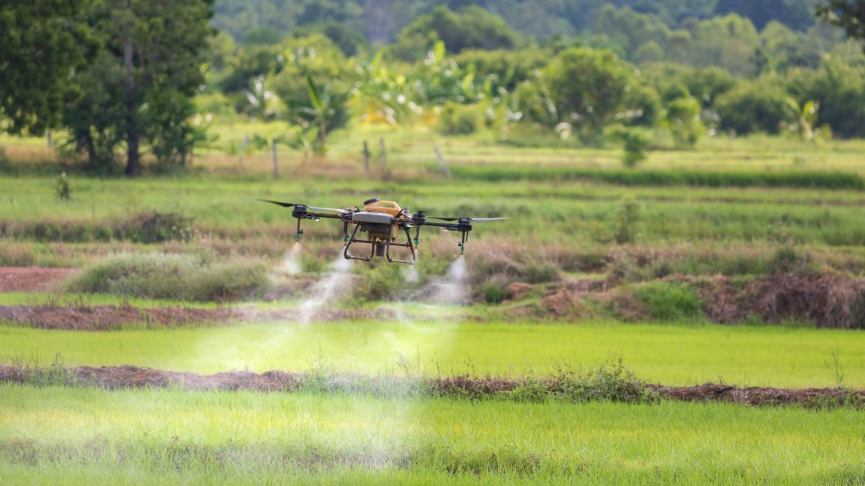

Motivation

Slide 3
Milestones
Single drone Simulation
Single drone Communication
Multiple drones Simulation
Multiple drones Communication
Formation Control
State estimation

Slide 4
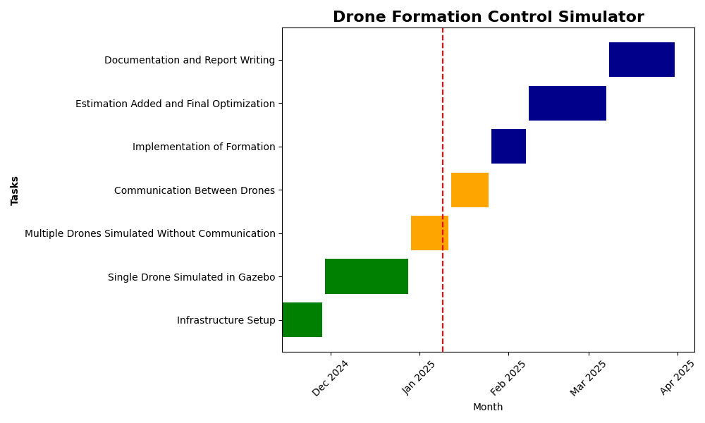
Timeline

Slide 5
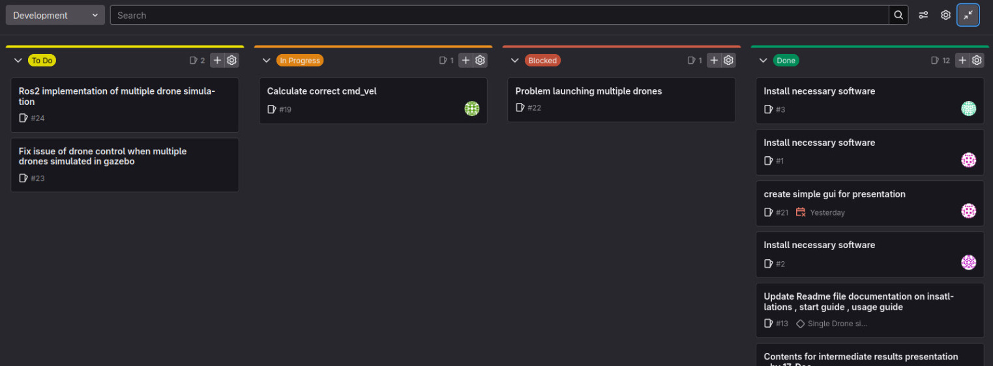
Organization
Used Git lab’s Issue Board to coordinate and assign tasks
Weekly meetings with Supervisor : Tuesday , 17.00
Weekly team meetings : Tuesday / Friday 16.00

Slide 6
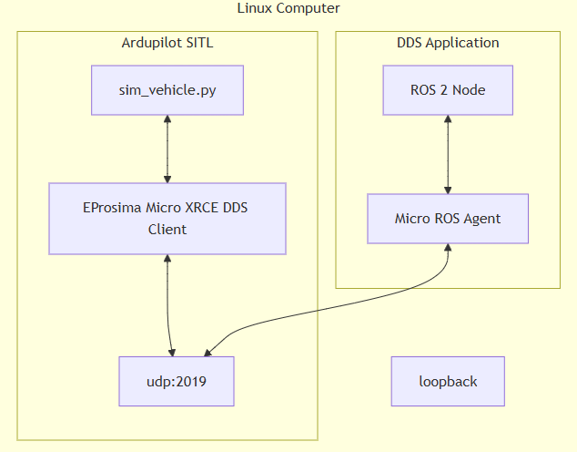
Communication

Slide 7
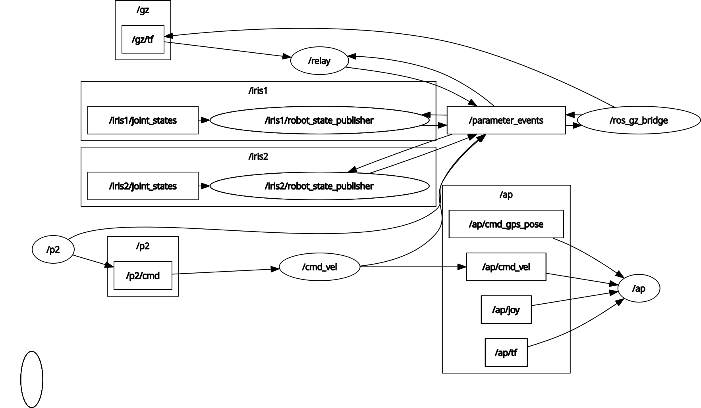
Nodegraph ROS2
Gazebo
Drones
Ardupilot SITL
Drone Formation Control

Slide 8
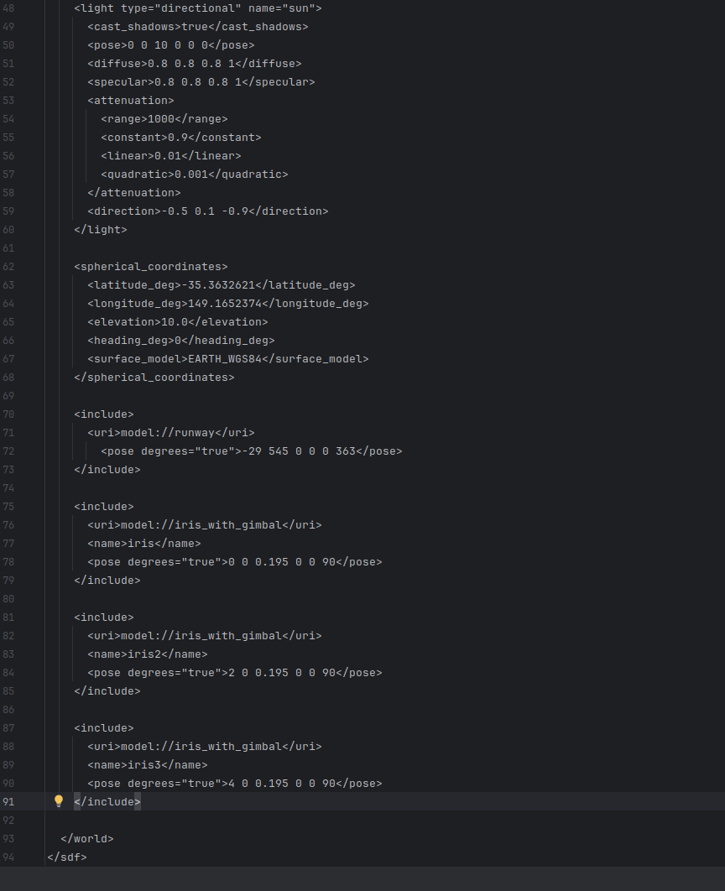
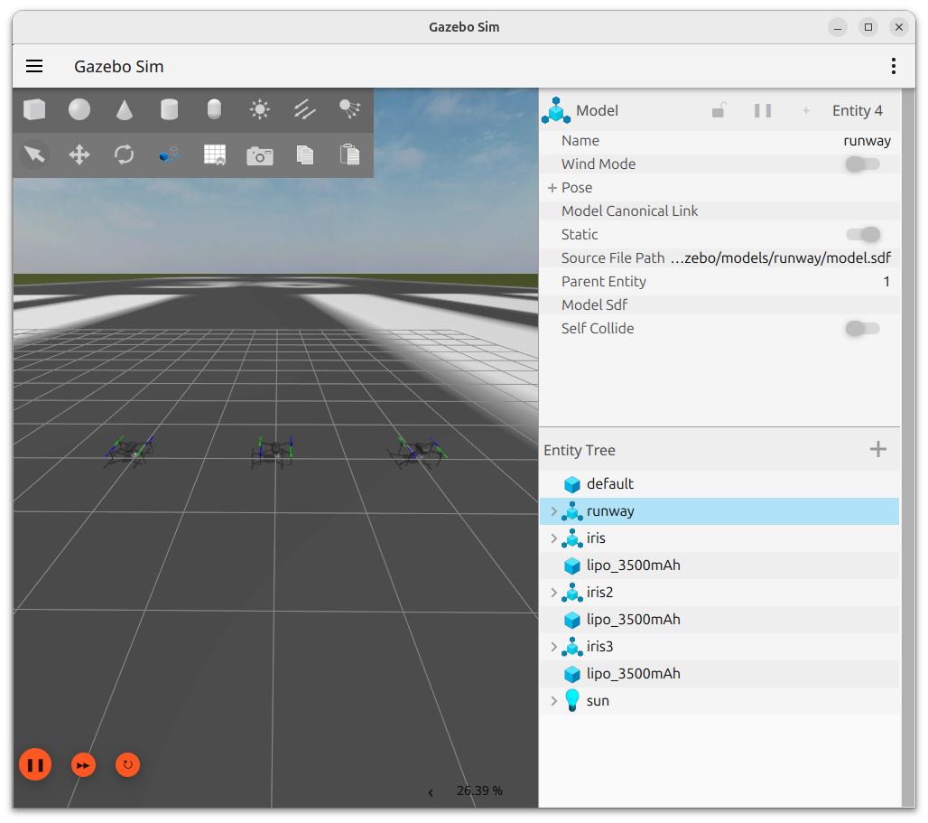
Gazebo World

Slide 9
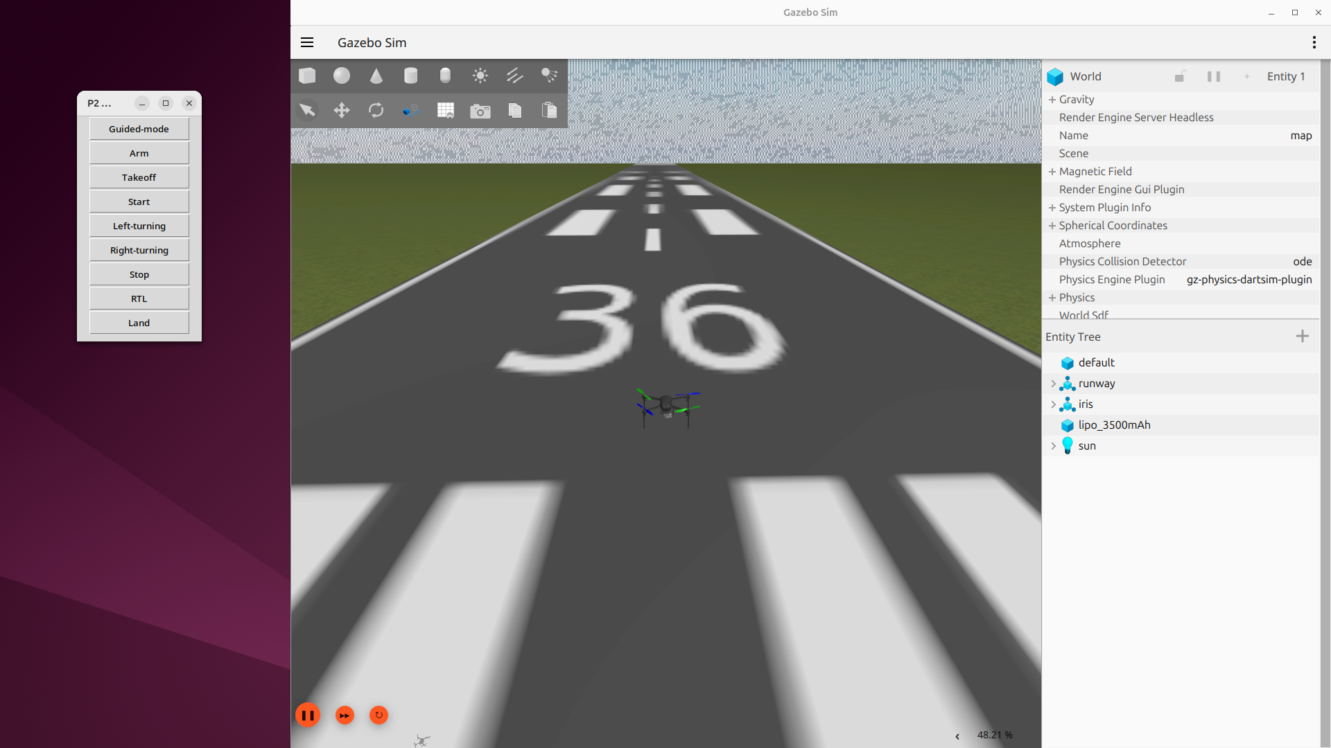
Results
Infrastructure setup and documentation
Single drone simulated in Gazebo
Single drone communication – GUI

Slide 10
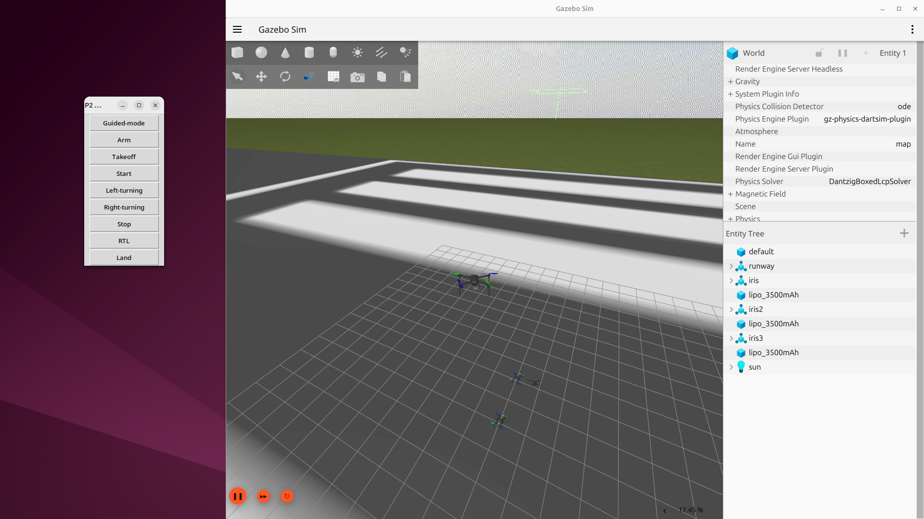
Results
Multiple drones simulated in Gazebo (w/o communication)

Slide 11
Problems Faced
Infrastructure Setup :
- ROS2 jazzy and Ardupilot integration
Drone Control & Integration in ROS2 :
- Mavproxy
Multiple Drones control with ROS2
Organization :
- Finding a time to meetup weekly outside of the supervisor meeting
- Downtime during exam phase Feb and March

Slide 12
Planned Final Results

Slide 13
Planned Final Results

Slide 14
Presentation of Task and Project Plan
Drone Formation Control Simulator
Thank You For Your Attention!
Michael Faber,
Christian Grüneberg,
Sourav Salkoppalu Lingaraju,
Belvin Benny Thomas

