Slide 1

Proposed Boost B-tree Library
Beman Dawes
May 17, 2011
Notes:
Preferred font sizes: 44/28

Slide 2
Today’s Objectives
Introduce B-trees (view from 36,000 feet)
Learn how to use the proposed B-tree library
Review status of the library
Get feedback on the library

Slide 3
B-tree basics (1 of 2)
A B-tree is a balanced multi-way tree
Every leaf node is the same distance from the root node.
Nodes have a fixed number of elements, some of which may be empty.
(It is not unusual for nodes to have hundreds of elements.)

Slide 4
B-tree basics (2 of 2)
Elements are ordered within nodes, nodes are ordered so that elements are ordered for the entire tree.
Complexity of insert, erase, and search is O(log₂ n) for comparisons
Insert, erase, and search touch O(h) nodes. h is the height of the tree; about log_{m}(n) where m is the average entries per branch node. h is typically a single digit number.

Slide 5
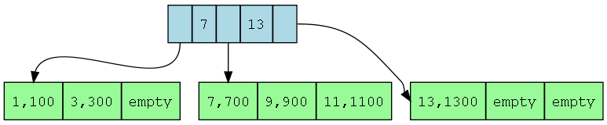

Slide 6
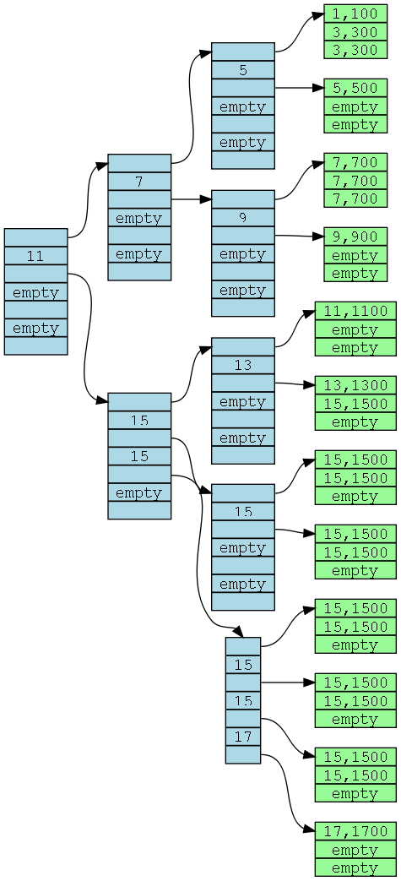

Slide 7
Bottom line
The B-tree's characteristics make it ideal for disk-resident indexes in general and ordered associative containers in particular.
No other serious contenders for general disk-resident search.
B-trees provide the indexing data structure for virtually all file systems, relational database search mechanisms, NoSQL structured data systems, and other disk-resident indexes.

Slide 8
B-tree background
  B-trees were invented by Rudolf Bayer; he never said what the B stands for. Comer and others say B-trees should be called Bayer trees in his honor.
  Bayer also invented the Red-Black tree for in-memory search, and the Universal B-tree for disk-resident multi-dimensional (e.g. spatial) search.
  Organization and Maintenance of Large Ordered Indexes, Bayer and McCreight, 1972, was the original paper.
  The Ubiquitous B-Tree, Douglas Comer, 1979, is a great read

Slide 9


Slide 10
Proposed Boost B-tree library
  Provides disk-resident associative containers as similar to standard library associative containers as reasonable
  The important headers are <boost/btree/set.hpp> and <boost/btree/map.hpp>
  They provide classes btree_set, btree_multiset, btree_map, and btree_multimap plus scaffolding
  Variable length (e.g. character strings) keys and/or mapped values are supported

Slide 11
Proposed Boost B-tree library (con’t)
  The library provides additional functionality in <boost/btree/support> that may be useful but can also just be ignored
  Data files are portable by default, assuming Key and T are types that yield portable data objects
  Performance is highly tunable
  Based on 30 years of experience with a C library I wrote and maintained

Slide 12
typedef btree_set<int> set_type;
set_type s("set.btr", flags::truncate);
s.insert(5);
s.insert(3);
s.insert(1);
for (set_type::iterator it = s.begin();
it != s.end(); ++it)
{
cout << *it << '\n';
}
// Output: 1
// 2
// 3

Slide 13
What is Boost B-tree NOT good for?
  Serialization; a B-tree isn't a Boost.Serialization replacement
  Sequential data; a B-tree is an associative container - ordinary files are a better choice for disk-based sequence containers.
  In-memory data; a Red-Black tree or a hash table (e.g. standard library associate containers) are usually better choices for in-memory use

Slide 14
Diffs from std associative containers
  More stringent requirements on Key and T
  Iterator invalidation rules closer to unordered associative containers than plain old associative containers
  [multi]map value_type is map_value<> rather than std::pair<>
  iterator and const_iterator are the same type, and it is a constant iterator
  Some member functions missing, some added

Slide 15
Requirements on Key, T
Types Key, T must work for binary input/output.
  They must be trivially copyable types (3.9, ¶9) so that objects can be memcopy’ed.
  In other words, std::is_trivially_copyable<> must be true for the type
  Objects of the type must be self-contained, and be position and process independent

Slide 16
Variable length keys / mapped values
std::pair<Key, T> as a map/multimap value_type doesn't work if the size of Key varies
Instead, the value_type is class map_value:
template <class Key, class T>
class map_value
{
public:
const Key& key() const;
const T& mapped_value() const;
std::size_t size() const; // dynamic size in bytes
};

Slide 17
typedef btree_map<int, long> map_type;
map_type bt_map("bt_map.btr", flags::truncate);
bt_map.emplace(2, -2);
bt_map.emplace(3, -3);
bt_map.emplace(1, -1);
for (map_type::iterator it = bt_map.begin();
it != bt_map.end(); ++it)
{
cout << " " << it->key() << " --> "
<< it->mapped_value() << '\n';
}
// Output: 1 --> -1
// 2 --> -2
// 3 --> -3

Slide 18
typedef btree_map<strbuf, strbuf> map_type;
map_type bt_map("bt_map.btr",flags::truncate);
bt_map.emplace("eat","comer");
bt_map.emplace("drink", "beber");
bt_map.emplace("be merry", "ser feliz");
for (map_type::iterator it = bt_map.begin();
it != bt_map.end(); ++it)
{
cout << " \"" << it->key() << "\" --> \"“
<< it->mapped_value() << "\"\n";
}
// Output: "be merry" --> "ser feliz"
// "drink" --> "beber"
// "eat" --> "comer"

Slide 19
class strbuf {
public:
strbuf();
strbuf(const char* s);
strbuf(const strbuf& s);
strbuf& operator=(const char* s);
strbuf& operator=(const strbuf& s);
std::size_t size() const;
const char* c_str() const;
bool operator==(const strbuf& rhs) const ;
// other relationals...
private:
boost::uint8_t m_size; // std::strlen(m_buf) for speed
char m_buf[max_size+1]; // '\0' terminated
};
std::ostream& operator<<(std::ostream& os, const strbuf& x);
inline std::size_t dynamic_size(const strbuf& x){return x.size();}
template<> struct has_dynamic_size<strbuf> : public true_type{};

Slide 20
bt_map.btr hex dump
00000000 bbbb bbbb 0100 0100 0000 0000 0000 0003 ;;;;............
00000010 0000 0080 0000 0004 0000 0001 0000 0001 ................
00000020 0000 0001 0000 0002 0000 0000 0000 ffff ................
00000030 ffff 626f 6f73 742e 6f72 6720 6274 7265 ..boost.org btre
00000040 6500 0000 0000 0000 0000 0000 0000 0000 e...............
00000050 0000 0000 0000 0000 0000 0000 0000 0000 ................
00000060 0000 0000 0000 0000 0000 0000 0000 0000 ................
00000070 0000 0000 0000 0000 0000 0000 0000 0000 ................
00000080 0000 002f 0862 6520 6d65 7272 7900 0973 .../.be merry..s
00000090 6572 2066 656c 697a 0005 6472 696e 6b00 er feliz..drink.
000000a0 0562 6562 6572 0003 6561 7400 0563 6f6d .beber..eat..com
000000b0 6572 0000 0000 0000 0000 0000 0000 0000 er..............
000000c0 0000 0000 0000 0000 0000 0000 0000 0000 ................
000000d0 0000 0000 0000 0000 0000 0000 0000 0000 ................
000000e0 0000 0000 0000 0000 0000 0000 0000 0000 ................
000000f0 0000 0000 0000 0000 0000 0000 0000 0000 ................

Slide 21
Design decisions for btree_map/multimap value_type
map_type design options
  map_type<Key, T>
  pair<const Key*, const T*>
map_type as value_type even if neither Key or T is variable length

Slide 22
Modifying mapped value
The btree_map/multimap implementation has to know when a node changes, so that nodes only get written to disk when changed. Non-constant iterators and mapped value types don't allow for that.
  itr->mapped_value() = new_value; // error
The fix is to provide:
  iterator update(iterator itr,
  const mapped_type& x);
And then write:
  bt.update(itr, new_value);

Slide 23
Use cases
  As an ordered associative data storage container; the actual app data is the key itself (set) or the mapped value (map)
  As an associative index into another file; the actual app data lives in that other file. Typically the B-tree is a map/multimap, with the mapped value being a record ID or file offset into the other file.
  If your design for a B-tree app seems to be fighting apparent B-tree limitations, consider (2) rather than (1)

Slide 24
String database class
template <class String, class ID>
class string_db
{
public:
typedef String string_type;
typedef ID id_type; // 0 indicates none
string_db(const path& p, flags f);
id_type insert(const string_type& s);
id_type erase(const string_type& s);
bool erase(id_type id);
id_type find(const string_type& s) const;
const string_type& find(id_type id) const;
};
Notes:
How is this implemented?

Slide 25
Tuning Performance
  Maximum cache size
  Node size
  Preload option
  Pack optimization
  Traits

Slide 26
Maximum cache size
The implementation caches nodes that are no longer in use. The maximum size of this cache can be controlled by the user:
void max_cache_size(std::size_t m);

Slide 27
Cache size: btree_map vs std::map (5,000,000 calls - 3,160,338 size)
cache size | Insert | find | iterate | erase
32 | 33.55 sec 8.66 ratio | 23.18 sec 6.50 ratio | 0.07 sec 0.37 ratio | 37.49 sec 8.48 ratio
2100 | 23.55 sec 6.10 ratio | 21.74 sec 6.02 ratio | 0.08 sec 0.41 ratio | 34.44 sec 7.97 ratio
4200 | 13.79 sec 3.53 ratio | 16.34 sec 4.56 ratio | 0.08 sec 0.40 ratio | 25.90 sec 5.81 ratio
8400 | 4.35 sec 1.12 ratio | 3.62 sec 1.00 ratio | 0.04 sec 0.23 ratio | 4.13 sec 0.93 ratio

Slide 28
Node size
btree_* constructors take an optional 3rd argument specifying the node size.
4096, the default, is clearly the sweet spot for Windows NTFS disks, and seems OK for Linux. But some other value might be much better for other operating systems or file systems. 512 was optimal for floppies and older file or operating systems.
libs/tools/bt_time.cpp can be used to experiment.

Slide 29
Node size: btree_map vs std::map (5,000,000 calls - 3,160,338 size)
Node size | insert | find | iterate | erase
512 | 5.54 sec 1.39 ratio | 6.08 sec 1.65 ratio | 0.07 sec 0.38 ratio | 6.25 sec 1.41 ratio
1024 | 4.83 sec 1.20 ratio | 5.25 sec 1.43 ratio | 0.06 sec 0.29 ratio | 5.33 sec 1.23 ratio
2048 | 4.30 sec 1.08 ratio | 4.03 sec 1.12 ratio | 0.05 sec 0.26 ratio | 4.29 sec 0.97 ratio
4096 | 4.45 sec 1.13 ratio | 3.67 sec 1.03 ratio | 0.04 sec 0.22 ratio | 4.16 sec 0.92 ratio
8192 | 5.20 sec 1.34 ratio | 3.42 sec 0.93 ratio | 0.04 sec 0.22 ratio | 4.45 sec 1.01 ratio
16380 | 5.84 sec 1.50 ratio | 2.70 sec 0.75 ratio | 0.04 sec 0.22 ratio | 4.59 sec 1.06 ratio

Slide 30
Preload option
flags::preload set in the btree_* constructor or open 2nd argument causes preloading of an existing B-tree file. This can cause a marked application speedup. Your mileage may vary.

Slide 31
Pack optimization

Slide 32
Traits

Slide 33
File Header
Each Boost.btree file begins with a header record.
Contents:
  Tree infrastructure data (page size, root page id, flags, etc.)
  User convenience data (c-str, user ints, etc.)
  Robustness data (record type, class UUID, etc.)

Slide 34
B-tree variations
  B-trees have many variations
  The B⁺-tree (pronounced “B plus tree”) stores key, mapped-value pairs in leaf nodes, as usual, but only keys in branch nodes.
  The Boost library, and most other practical B-tree implementations, use B⁺-trees, but refer to themselves with the generic B-tree name.
  Be warned that the Wikipedia articles on B-tree variants contain quite a few errors, as do other web based B-tree postings.

Slide 35
Variations NOT applied
Sequence links; Slower inserts, erases (actual tests), difficult to establish paternity chain for insert, erase, particularly with non-unique containers
Branch key prefix compression; KISS
Branch key suffix compression; KISS
Page full element redistribution on insert ; KISS
Merge at half empty on erase; see literature

Slide 36
Library status
  Available via git://github.com/Beman/Boost-Btree.git
  Some docs but very incomplete
  Build and test setups, via Jamfiles and a VC++ 10 setup
  Example and timing programs
  Tested on Windows with VC++ 10 and GCC/MinGW 4.5, and on Ubuntu Linux 11.4 with GCC 4.4
  No C++0x features yet

Slide 37
Testing with stl_test.cpp
  Performs operations on a std::map<int32_t, int32_t> and a btree_map<int32_t, int32_t>, and verifies the results are identical
  Lots of program options to set test conditions
  Has run as many as 5 billion operations without failure

Slide 38
Support headers, mini-libraries, and full-blown libraries
  Proposed Endian library
  Timer mini-library
  Simple fixed size c-string holder - fixstr.hpp
  Simple holder for variable length c-strings - strbuf.hpp
  random_string.hpp

Slide 39
Development targets
Formal review (Version 0.9)
First Boost release (1.0)
B-tree of B-trees (Version 1.1)
Shared modification by other threads and/or processes (Version ?)

Slide 40
Help wanted!
  Preview comments
  Feedback from early adopters
  Independently developed test program

Slide 41
Discussion
  Comments?
  Missing functionality?
  Concerns or issues?

Slide 42
Thank You!

