Slide 1
Aircraft Safety Analysis
Data-Driven Insights for Safer Aircraft Investments

Slide 2
Overview
This project analyzes aircraft accident data to provide insights into the safest aircraft to invest in. We explore accident trends, manufacturer risks, and survival rates.

Slide 3
Business Question
How can historical accident data help identify safer aircraft for investment and operation?

Slide 4
Data Processing
Filtered data for years after 2000 to focus on modern aircraft.
Grouped accidents by manufacturer and severity.
Calculated survival rates to assess safety.

Slide 5
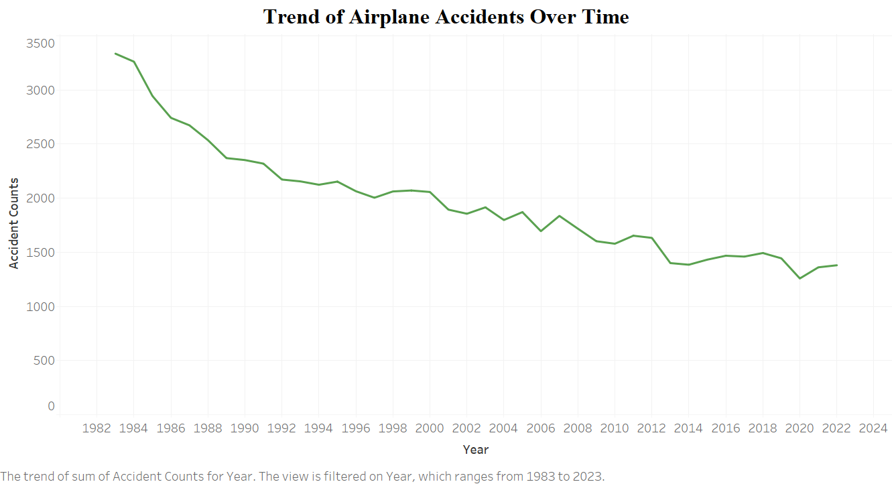
Trend of Aircraft Accidents Over Time

Slide 6
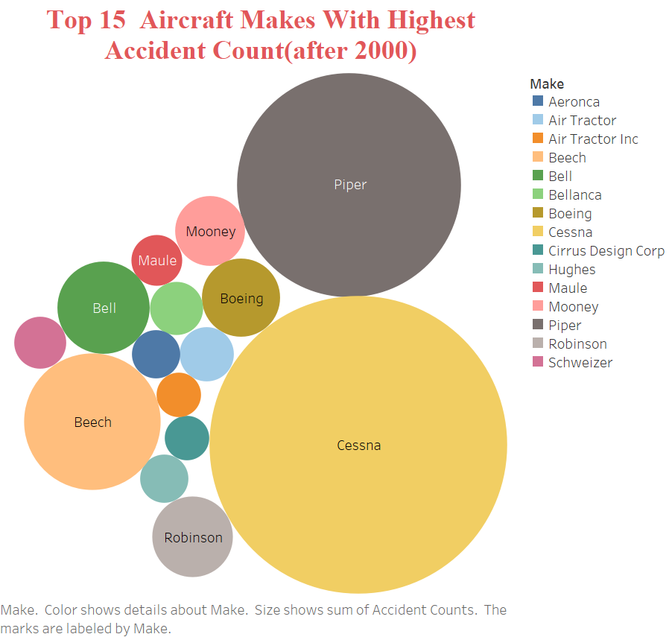
Top Aircraft Manufacturers by Accidents

Slide 7
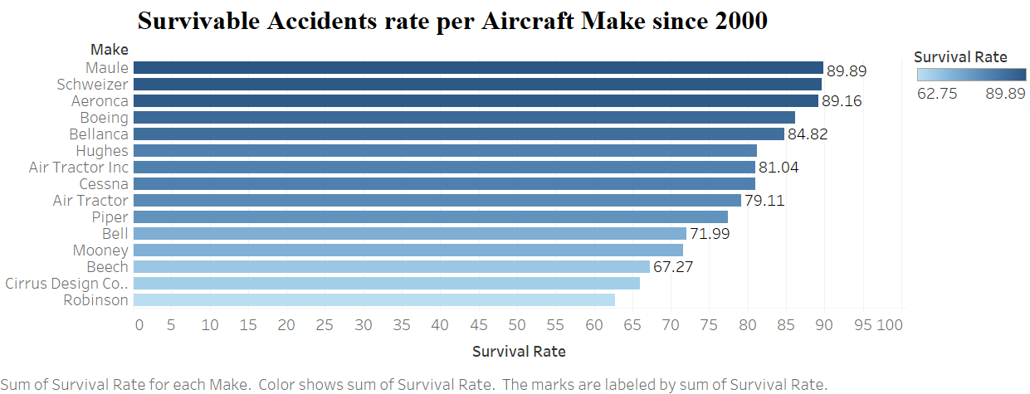
Survival Rates of Aircraft Models

Slide 8
Recommendations
- Prioritize aircraft with high survival rates.
- Invest in newer aircraft models with better safety features.
- Conduct further safety evaluations before purchasing.

