Slide 1
SUNFLOWER: A Trust Execution Environment on RISCV Based on Tagged Memory
Xu Jinyan
Lin Yizhu
Duan Yuxuan

Slide 2
Tag Memory
Basic Idea: Associate memory block with additional metadata(tag)
Existing Example:
HDFI: Virtually extend each memory unit with an additional tag defined by data flow (2016)
Loki：Hardware Enforcement of Application Security Policies Using Tagged Memory (2008)
Our Work:
Hardware-based tag, for fine-grained isolation
Control by user
Notes:
Our difference: hardware-based !!!!

Slide 3
Design Theory
Tag both text & data
In our work, we treat both text(code) and data as memory block and tag them. So when an instruction wants to visit some data, we can check the instruction’s tag and the data’s tag to decide whether this fetch instruction is legal or not.
Besides, there is a special tag for text, which will act as an entry point from N-mode to trusted mode.

Slide 4
Design Theory -- Tag Policy
2 bits tag for one word -- 4 different tags:
N-tag, TU-tag, TS-tag, TC-tag(entry point)
How to Use
TS to Trusted OS Services, TC to their entries;
TU to User Secure Functions & Data;
TC to User Secure Function Entries;
Notes:
Tag isolation policy for the memory accesses
read (r), write (w), fetch or execute (x) as well as the horizontal
transitions TUenter/TSenter (e) and TUleave/TSleave (l).

Slide 5
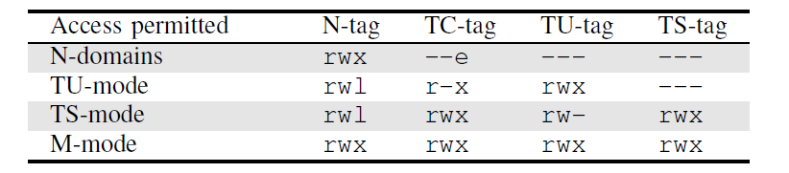
Design Theory -- Tag Policy
Tag isolation policy
Notes:
Tag isolation policy for the memory accesses
read (r), write (w), fetch or execute (x) as well as the horizontal
transitions TUenter/TSenter (e) and TUleave/TSleave (l).

Slide 6
Design Theory -- Tag Policy
OS
Code
Code
N
Data

Slide 7
Design Theory -- Tag Policy
OS
Tag Server
TC
Code
Trust Code
TC
Code
Trust Code
N
Data
Trust Data

Slide 8
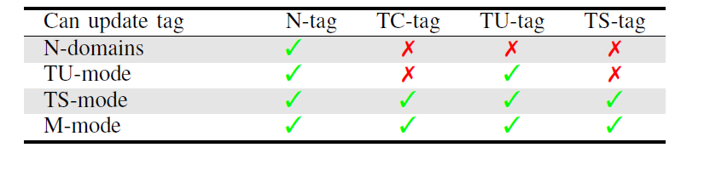
Design Theory -- Tag Policy
Tag Update Policy
Notes:
Tag update policy, permitting (3) or refusing (7)
tag updates from certain security domains.

Slide 9
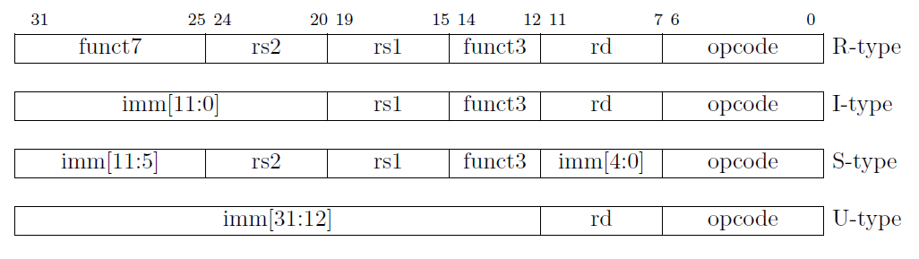
DETAILS – Tag-aware Instructions
Checked Load/Store Instruction
riscv-tools/ riscv-opcodes / opcodes-custom
LCT（Load with Check Tag）
E.g. lwct ut, a1, 0(a0)
SCT（Store with Check Tag）
E.g. swct n, ut, a1, 0(a0)
Tag[1:0]
Tag[1:0]

Slide 10

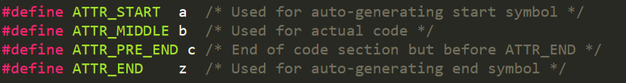
DETAILS – Add Tag
Secure Function & Data
Use link.ld to set them in a section of memory
And mark their starting and ending address.
Notes:
We pack every function user want to protect into punches of memory.
And pack them all into enclave.text or enclave.data one by one, using SORT_BY_NAME.
Note that when we define section, we set the beginning address noted as letter ‘a’, the ending address noted as letter ‘z’, hence all functions’ address are between ‘a’ and ‘z’.
Finnaly, we just tag this enclave section after user call trusted os service.

Slide 11
DETAILS – Trust Server
Boot
OS
User
Boot
Tag Server
OS
User
Notes:
We pack all trusted os services into the api we could call from user mode.
And we can just use one line code to create an enclave, which means the secure functions and data are tagged and in protection.

Slide 12




Demo
Simulators are used on hardware simulation
Running FreeRTOS
Spike

Slide 13
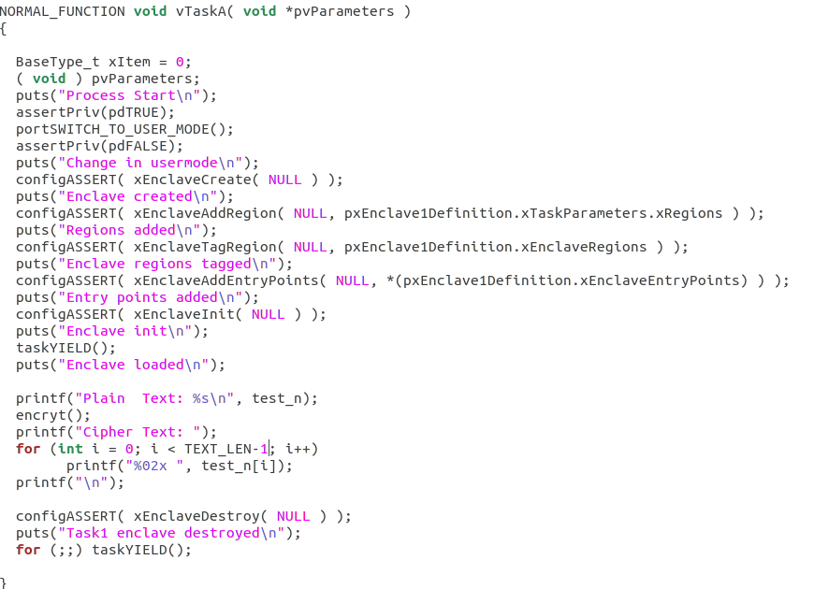
Demo
Create Enclave
Add Region
Tag Region
Add Entry Points
Init Enclave
Run
Destroy Enclave

Slide 14
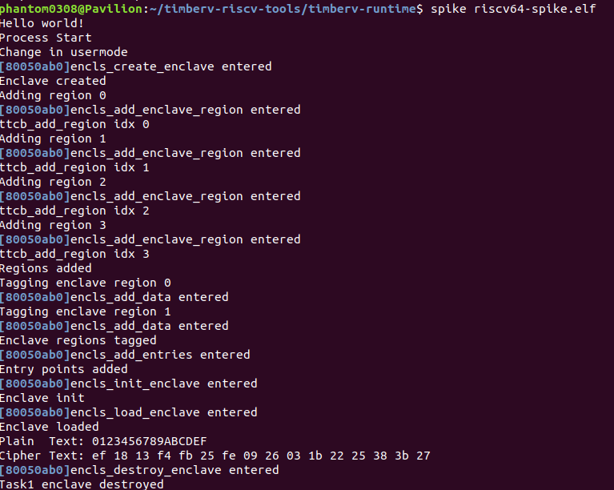
Demo

Slide 15
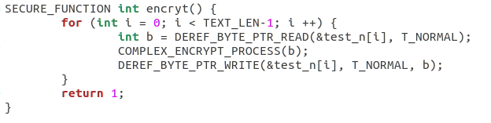
Demo
Key is tagged with TU-tag.
Try to access it from N-mode, the process will fail.
Encrypt plaintext into ciphertext

Slide 16
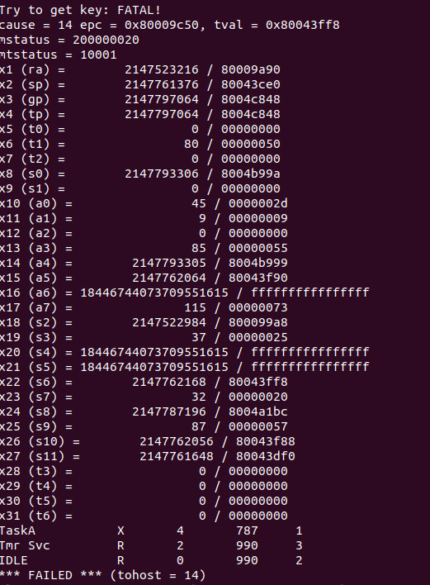
Demo

Slide 17
THANKS

