Slide 1
TIMBER-V: Tag-Isolated Memory Bringing Fine-grained Enclaves to RISC-V
Samuel Weiser Mario Werner
Ferdinand Brassery Maja Malenko
Stefan Mangard Ahmad-Reza Sadeghiy

Slide 2
Tagged Memory
HDFI：Virtually extend each memory unit with an additional tag,
defined by data flow (2016)

Slide 3
Design Goals
G1 Security
(i) strong memory isolation (ii) secure entry points
(iii) secure communication (iv) attestation and sealing
G2 Flexibility
(i) fine-grained (ii) dynamically reconfigurable isolation boundaries
G3 Compatibility
Support existing os and apps without modification
G4 Low Overhead
(i) cost of tagged memory (ii) performance overhead of switching security domains
G5 Real-time

Slide 4
Tagged Instruction
Tagged Memory
Hardware
Memory Protected Unit
TIMBER-V
Software

Slide 5
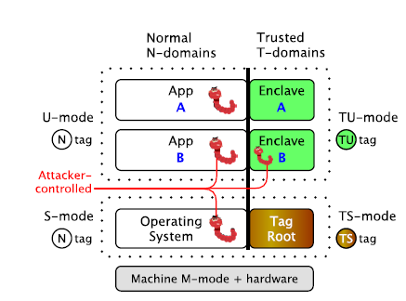
TagRoot: Trust Manager
Trusted OS Services
TagRoot
Trusted Enclave Services

Slide 6
Trusted OS Service
In-Process !
Enclave ManagementIn-Process
Create: Enclave Control Block(ECB)
create-enclave → add-region → add-data → add-entries → init enclave
Cleanup: destroy-enclave
Load: load to MPU slots → mark as runnable
Interrupt: save context → clear up → resume
transparent
Enclave Identity(EID)
Sequence of trusted OS services calls + their parament -------> EID
SHA256

Slide 7
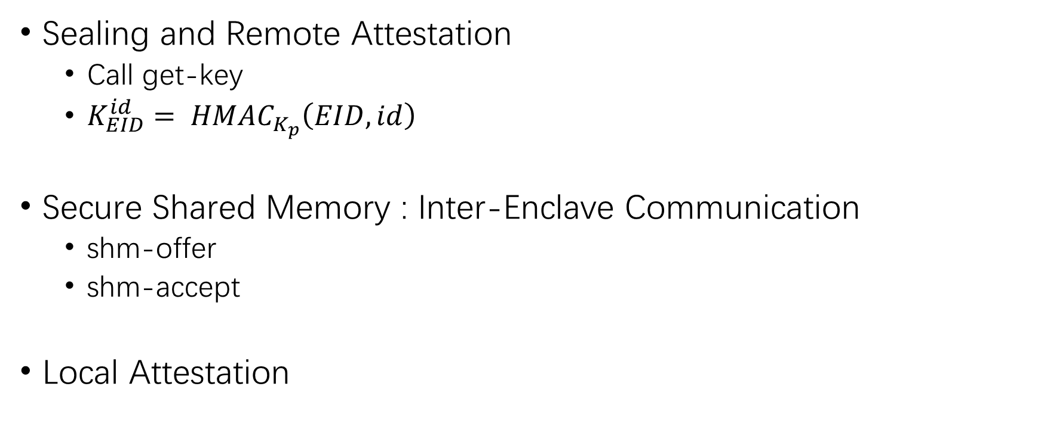
Trusted Enclave Services
Sealing and Remote Attestation
Call get-key
$K_{EID}^{id}= {HMAC}_{K_{p}}\left(EID, id\right)$
Secure Shared Memory : Inter-Enclave Communication
shm-offer
shm-accept
Local Attestation

Slide 8
Security Analysis
OS manipulation during loading? → load-time attestation(EID)
Interruption leakage? → secure interruption
Shared memory misuse? → mutual authentication
TagRoot’s integrity? → isolation via TS-tag

Slide 9
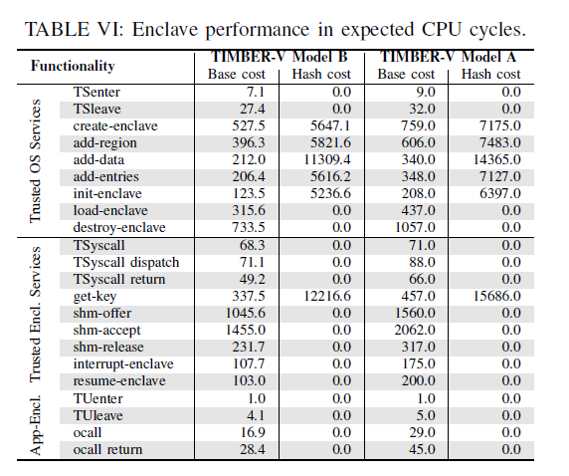
Evaluation
Performance
TagRoot code size

