Slide 1
Advanced Query Design with Power BI Desktop
Notes:
This module introduces the core concepts of creating and executing queries in Power BI Desktop. Students will learn how to leverage the query features of Power BI Desktop to import data from a variety of sources including databases, Excel spreadsheets, web pages and SharePoint lists. Students will also discover how to design queries to clean up, transform and reshape data during the import process by learning about all the different type of query operations available in the Power BI Desktop query builder. The module also examines the use of query parameters and powerful transform operations such as merging columns and appending rows from multiple data sources. The module concludes by explaining to students how to design queries to convert an OLTP database design into an OLAP data model that is better suited for data analysis and reporting in a Power BI Desktop project.

Slide 2
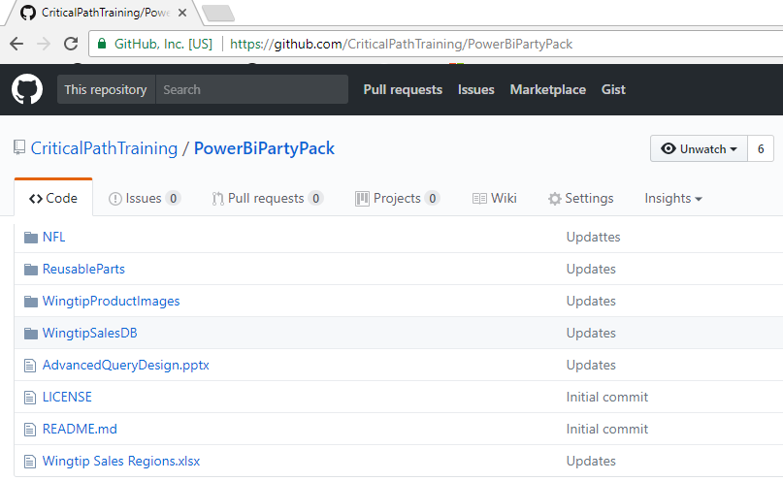
Slides and Demo Files Download
https://github.com/CriticalPathTraining/PowerBiPartyPack

Slide 3
Agenda
Walking Before We Run
Extracting Data from Unstructured Text
Extracting Data from SharePoint
Importing OLTP Data Into a Star Schema
Working with Function Queries

Slide 4
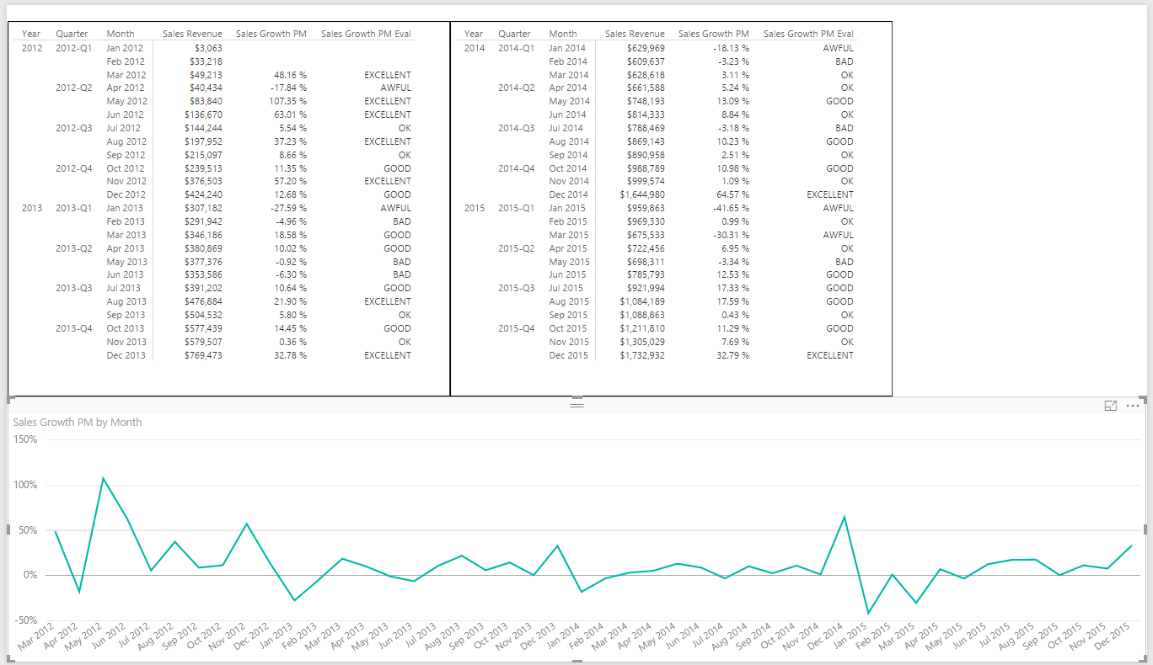
Deciding What To Measure
You Must Determine Measurable Objectives
Financial (revenue, expenses, profit margin, etc.)
Business processes efficiency
Customer Satisfaction Levels
Notes:
When you begin to create any type of custom solution with Power BI to monitor the health and report on business processes, it is important to take a step back in the initial design phase and clearly determine what you’re going to measure. This provides an opportunity to define what type of business analysis and visualizations your custom BI solution will need to provide. For example, one custom solution might just need to track sales revenue in order to calculate commission for sales people. Another custom solution with different requirements might need to analyze expenses and profit in addition to sales revenue. Determining high-level goals and capabilities is an important thing to do before getting into the nuts and bolts of beginning to extract and transform data.

Slide 5
Defining Grain Statements
Grain statements should be defined in initial design phase
Grain statements helps determine requirements for BI queries
Grain statements can be created & understood by business users
Example grain statements for BI project at Wingtip Toys
What was the total sales revenue over the last 4 years?
What was the sales revenue by year, quarter and month?
What was the sales revenue by region, state, city and zip code?
What was the sales revenue by category, subcategory and product?
What was the growth in sales revenue from month to month in 2013?
What was profit margin for each product by year, quarter and month?
Have their been any products with significantly decreasing profit margin?
Notes:
There’s a popular technique for determining what you need to measure and what data you will need to acquire to make those measurements. This technique involves authoring a set of grain statements. What's valuable about grain statements is that they can easily be written by business users with little or no technical experience. However, once you have clearly written a set of grain statements, technical people can use those grain statements to determine what data needs to be imported as well as what queries and reports need to be generated.
The slides above display examples of grain statements that might be used in a custom solution to analyze sales data. If you read through each of these grain statements, you should have a great head start in designing the queries you’ll need to import data into a new Power BI desktop project.

Slide 6
Power BI Desktop is an ETL Tool
ETL process is essential part of any BI Project
Extract the data from wherever it lives
Transform the shape of the data for better analysis
Load the data into dataset for analysis and reporting
CSV
File
Power BI Desktop
Power BI Desktop Project (PBIX)
Dataset
Excel
Workbook
OLTP
Database
Notes:
Every custom BI solution works with some type of data. Some custom solutions require integrating data from multiple data sources into a single dataset for analysis. Early in the lifecycle of a Power BI desktop project, you must discover where the data you need lives and then you must decide how you are going to import it into a dataset that will eventually be used for data analysis and reporting. This is the project lifecycle phase that is often called the "ETL" phase because it involves extracting data, transforming data and then loading data.
Power BI Desktop is a self-service ETL tool for business users. It has the ability to extract data from a variety of data source. However, the real value of Power BI Desktop is that you can perform many types of transforms to better shape the data just before it's loaded.

Slide 7
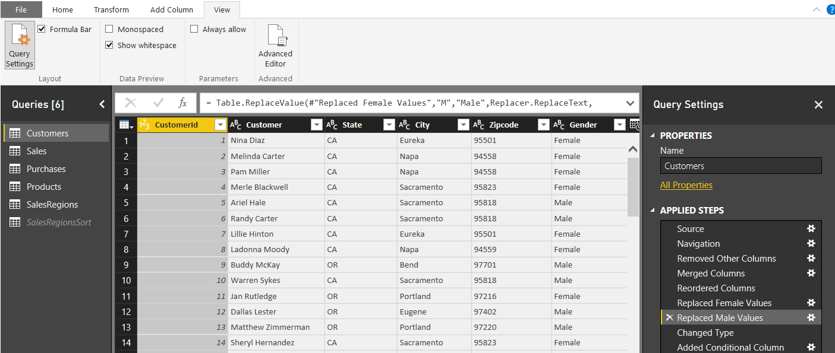
Query Steps
A query is created as a sequence of steps
Each step is a parameterized operation on the data
Each step has formula which can be viewed/edited in formula bar
Query starts with Source step to extract data from a data source
Additional steps added to perform transform operations on data
You can replay query operations one by one by clicking on steps
step formula bar
sequential list of steps for query
Notes:
As you learned in the previous module, every query in Power BI Desktop is defined as a sequence of steps. The Query Editor window displays the Applied Steps section for the query that is currently selected in the Queries list on the left. If you click on a step in the Applied Steps list, you can see how the step is defined behind the scenes using M code in the step formula bar. If the step formula bar is not currently visible in the Query Editor window, navigate to the View tab in the ribbon and check the Formula Bar checkbox in the Layout ribbon group. Once you check the Formula Bar checkbox, you should be able to see the M code that has been generated for the selected step in the Applied Steps list.
Most queries begin with the Source step which is used to extract the underlying data from a specific data source. After the Source step, other steps are added to clean up bad data and to perform transforms as required to reshape the data for analysis and reporting.
Note that you can use the Applied Steps list to debug the logic you have built into a query. You can do this by initially clicking on the first step in the Applied Steps list and then clicking on later steps one by one. When you do this, the Query Editor window will display what the query output looks like after each step. This provides you with the opportunity to see how the entire query will execute in a step by step fashion. If you right-click on a step in the Applied Steps list, you will see a set of menu commands to rename or delete the step as well as to move the step forwards or backwards in the sequence of steps. Some types of steps provide you with the an Edit Settings command which displays a custom dialog box to edit the steps settings. Other types of steps do not provide this capability.

Slide 8
Basic Query Steps (You Should Already Know)
Rename column
Convert column type
Format column values
Reorder columns
Replace column values
Expanding related column
Merging columns
Splitting columns
Notes:
This slide above lists some of the more command operations that can be added as applied steps to a query when working within the Query Editor window. For example, you might want to rename a column so the column name in the query output is different than the name of the underlying column in the database from where you are importing it. You also might want to convert a column data type, format column values or reorder columns as they appear in the query output.
Some of the common operation listed in the slide above can be more complicated. For example, expanding related column allows your query to perform a logical join between two or more underlying tables. Merging columns allows you to combine the values from two columns into a single column and splitting columns make it possible to separate values from a single column into two or more columns.

Slide 9
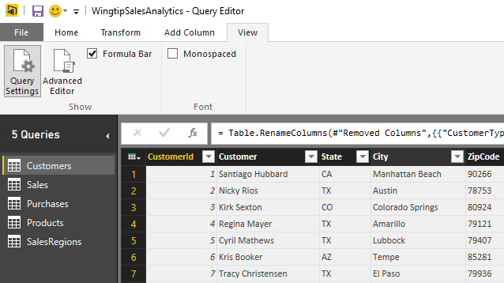
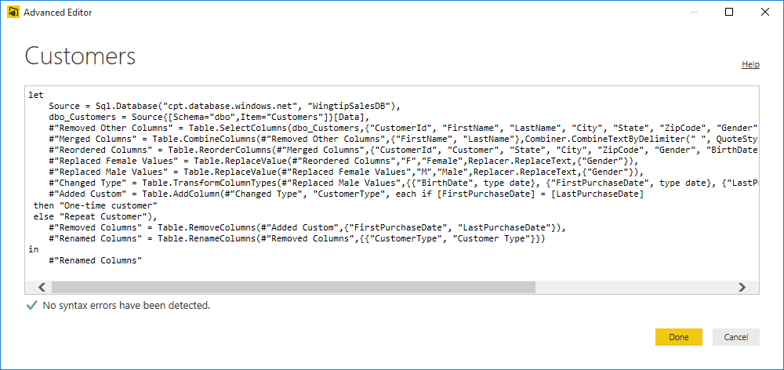
Advanced Editor
Power BI Desktop based on "M" functional language
Query in Power BI Desktop saved as set of M statements in code
Query Editor generates code in M behind the scenes
Advanced users can view & modify query code in Advanced Editor
Notes:
Behind the scenes, Power BI Desktop saves and executes each query you create using a batch of code written in a functional programming language known as M. Microsoft originally created the M programming language and an associated query execution engine for the Power Query add-in that was created for Microsoft Excel 2013 and Microsoft Excel 2010. Now that Microsoft has discontinued its use of “Power Query” as a technology brand name, they continue to use the M programming language to support the authoring and the execution of queries in Microsoft self-service BI products such as Microsoft Excel 2016 and Power BI Desktop. It’s important to note that the Power BI platform can also execute M code to run a query from within the Microsoft cloud when you have configured a dataset for manual refreshing or automated scheduled refreshing.
The user interface experience of Power BI Desktop goes to great lengths to hide M code from you while you are designing and debugging your queries in the Query Editor window. Some people using Power BI Desktop will like that all the M code is hidden out of sight by default. Other more technical users might like the fact that they can view the underling M code for a query and even make direct edits to the M code when it’s the best way to solve a problem.
The step formula bar displays one line of M code at a time. The step formula bar also allows you to make direct changes to the M code for whatever query step is currently selected. However, you can also view and modify the batch of M code for an entire query code using the Advanced Editor dialog. The Advanced Editor dialog can be opened using the Advanced Editor button in the View tab of the ribbon.

Slide 10
Understanding Query Input and Output
PBIX project is container for data sources and queries
Queries created and saved within scope of Power BI project
Queries can pull data from local files
Queries can pull data from external content sources
Queries main purpose is to load imported data into data model
PBIX Project
CSV
File
Data Source
query1
Data Source
query2
External Database
col1 | col2 | col3
bob | 23 | 45
mary | 43 | 74
col1 | col2 | col3
bob | 23 | 45
mary | 43 | 74
col1 | col2 | col3
bob | 23 | 45
mary | 43 | 74
Notes:
When working with Power BI Desktop, you will create and save queries within the scope of the current project. Each query must have at least one data source to use as its input. You can create a query from an external data source such as a CSV file, an Excel workbook, a SQL Server database, an Azure SQL database, a SharePoint list or an Online Service.
Remember that the main purpose of creating queries in Power BI desktop is to import external data to create a base set of tables in your project’s data model. Because of this, a new query is always configured to load its output into a new table generated in the data model for the current project. However, you don’t always want every query to generate an output table in the project’s data model. There are some scenarios in which you will create a query whose sole purpose is to be used as a input for another query. In cases such as these, you can disable a query’s Enable Load property so it does not generate a table in the data model of the current project. While a query with its Enable Load property disabled will not generate an output table, the query can still be used as input to other queries in cases where you want to merge columns or append rows from two different queries to combine content from multiple data sources.

Slide 11
Scraping Data from a Web Page

Slide 12
Understanding Queries vs Data Modeling
Typical project workflow with Power BI Desktop
Design queries to generate set of base tables
Perform data modeling tasks on base tables
Some tasks can be done in query or data model
Prefer to accomplish tasks in query if possible

Slide 13
Query Composition
Query can serve as source for other queries
Allows for creation of reusable base queries & query composition
Complexity can be hidden in base queries
Reference command creates new query based on another query
PBIX Project
Data Source
query1
External Database
col1 | col2 | col3
bob | 23 | 45
mary | 43 | 74
query2
query3
table1
table2
col1 | col2 | col3
bob | 23 | 45
mary | 43 | 74
sue | 32 | 47
fran | 41 | 55
col1 | col2 | col3
bob | 23 | 45
mary | 43 | 74
sue | 32 | 47
fran | 41 | 55
Notes:
When working with Power BI Desktop, you create and save queries within the scope of a PBIX project file. Each query must have at least one data source to use as its input. Most queries you create will be based on an external data source. However, you can also create a query which uses the output of another query as it’s data source. This is done by executing the Reference command on a query which creates a new query whose data source is the query on which you ran the Reference command.
By using the Reference command to create a query whose input is based on another query, you can take advantage of a design technique known as query composition. The key concept is that you can create reusable logic in one query and then share that logic across several other queries. That helps to reduce the redundant logic you need to maintain across the queries in the Power BI desktop project.

Slide 14
Combining Queries
Query can be merged or appended with another query
Merge operation allows you combine columns from two tables
Append operation allows you to combine rows from two tables
Two queries are combined into single output for loading
Load settings of main query determines where output is loaded
Secondary query acts as source for main query
Secondary query be can created with connection-only load setting
Data Source
Data Source
Data Source
query2
Data Source
main query
query2
main query
query3
Data Source
query output
query4
Data Source
col1 | col2 | col3
bob | 23 | 45
Oft | 43 | 74
sue | 32 | 47
fran | 41 | 55
query output
Notes:
Power BI Desktop allows you to combine to queries. Combining queries means that you are combining two data sources into a single table as the queries output. Power BI Desktop supports two combine operations which are merge and append. A merge operation is used when you need to combine columns in from two tables into a single table. An append operation is used when you need to combine rows from two tables into a single table.
Consider that combining two queries produces a single output. Yet each of the queries involved has its own Power BI Desktop load setting. You configure the load setting of the main query to determine where to load the result of the merge/append operation. However, the secondary query which is only being used as the source in another query doesn't usually need to load its output anywhere in the workbook. When you are creating a query whose sole purpose is to be used as a source for a merge or append operation in another query, you can disable loading by configuring the load setting as a "connection-only" query.
What if you need to append together rows from more than one table? That's not a problem. A main query can include more than one append operation as shown in the diagram above on the right. This means a single query can append together rows from as many source tables as necessary.

Slide 15
Appending Multiple Datasources into a Single Output Table

Slide 16
Agenda
Walking Before We Run
Extracting Data from Unstructured Text
Extracting Data from SharePoint
Importing OLTP Data Into a Star Schema
Working with Function Queries

Slide 17
Extracting Data from Unstructured Text

Slide 18
Agenda
Walking Before We Run
Extracting Data from Unstructured Text
Extracting Data from SharePoint
Importing OLTP Data Into a Star Schema
Working with Function Queries

Slide 19
Extracting Data From SharePoint

Slide 20
Agenda
Walking Before We Run
Extracting Data from Unstructured Text
Extracting Data from SharePoint
Importing OLTP Data Into a Star Schema
Working with Function Queries

Slide 21
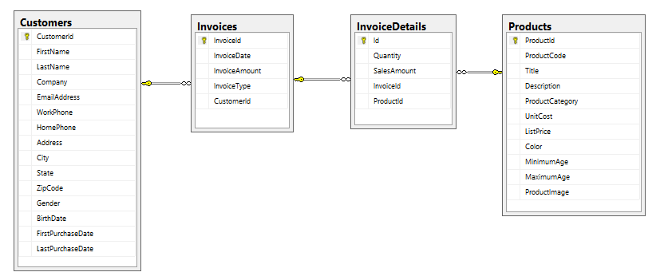
Sample OLTP Database: WingtipSalesDB
Online Transaction Processing (OLTP) System
Used for real-time data access and transaction-based data entry
Optimized for faster transactions (e.g. inserts, updates & deletes)
Tables normalized to reduce/eliminate redundancies
Table schemas can be hard for business users to understand
Notes:
Online Transaction Processing (OLTP) databases are used for databases that have high transaction rates. The data model of tables in this type of database is optimized to speed up transactions for operation such as inserting, updating and deleting records. Tables in an OLTP-style database are usually normalized to reduce or eliminate any redundancies.
Another noteworthy issue is that OLTP systems are often not designed to track historical data. For example, imagine a customer living in California makes a number of purchases over a 5 year period and then the customer moves to Florida. If you run a query to determine sales revenue by state, you will likely find that all the historic purchases for the customer are attributed to the new state Florida and not the state where the purchases were made which is California.
There are several common design issues you face when building BI projects on top of an OLTP database. First, they are not designed with data analysis as a primary objective. Therefore, you must often execute complex queries in a reporting solution which join tables together to properly analyze the data. Moreover, the execution of these complex queries might perform poorly since the indexing scheme configured for an OLTP database is typically optimized for greater transaction throughput instead of faster query performance. Also, the table schema for an OLTP-style database is often complicated and non-intuitive when access directly by the average business user.
Over the next few modules, you will take import the data from the WingtipSalesDB database and reshape it with querying and data modeling techniques to change the design from an OLTP design to an OLAP design that is much better suited for data analysis and reporting.

Slide 22
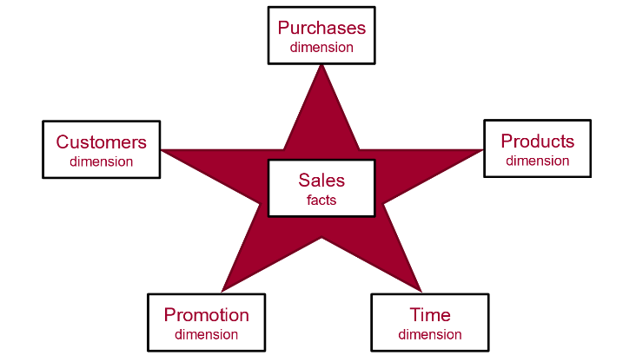
Data Modeling using a Star Schema
OLAP Modeling often based on Star Schema
Tables defined as fact tables or dimension tables
Fact tables related to dimension table using 1-to-many relationships

Slide 23
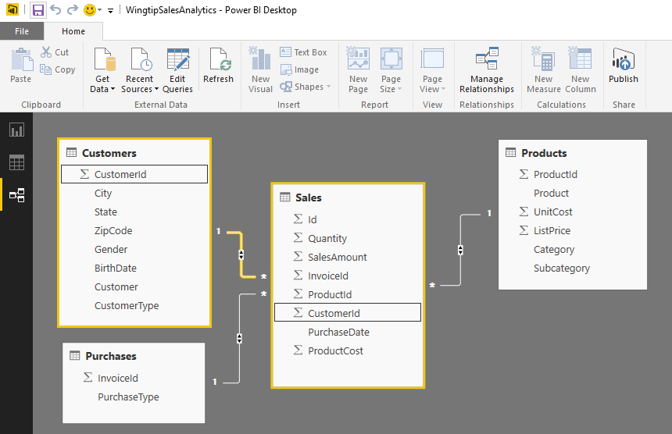
Designing Queries to Build a Star Schema
Converts OLTP Data Model to OLAP Data Model
Sales table is modeled as a OLAP Fact Table
Other tables are modeled as OLAP Dimension tables
Requires pulling CustomerId column into Sales table
All dimension tables should be directly related to fact table

Slide 24
Using Power BI Desktop to Import Data into a Star Schema

Slide 25
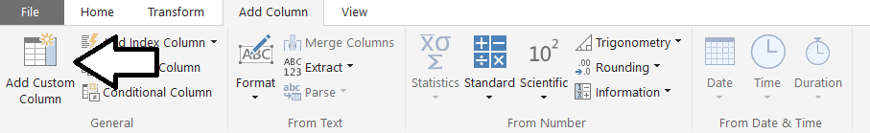
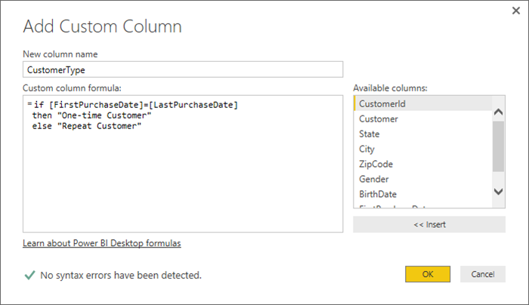
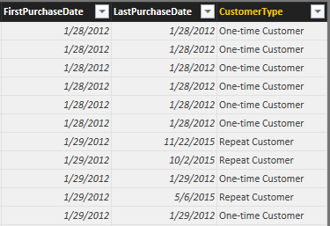
Adding a Custom Column
Custom column provide custom logic
Logic must be written in M programming language

Slide 26
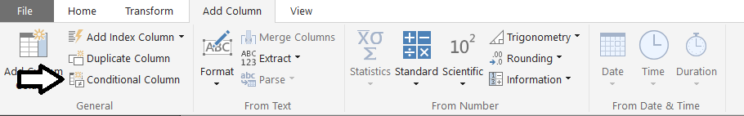
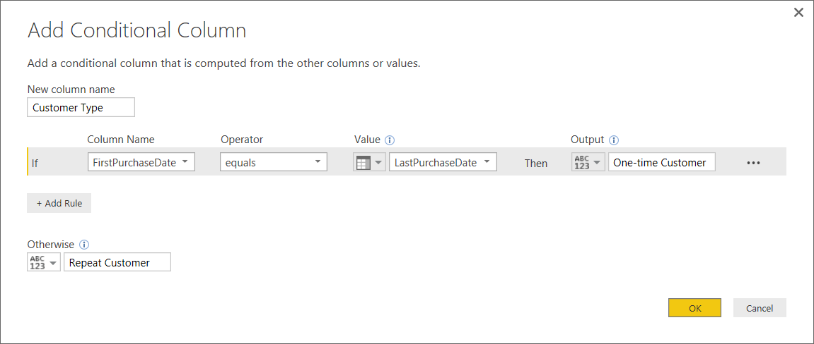
Adding a Conditional Column
Abstracts away need to write M code

Slide 27
Creating Conditional Columns

Slide 28
Agenda
Walking Before We Run
Extracting Data from Unstructured Text
Extracting Data from SharePoint
Importing OLTP Data Into a Star Schema
Working with Function Queries

Slide 29
Appending Data from Multiple Sources using Function Queries

Slide 30
Summary
Walking Before We Run
Extracting Data from Unstructured Text
Extracting Data from SharePoint
Importing OLTP Data Into a Star Schema
Writing Query Steps by Hand in M
Working with Function Queries

Slide 31

Critical Path Training https://www.CriticalPathTrainig.com
PBI365: Power BI Boot Camp – 4 Days
Audience is Business Users, Analysts and Data Professionals
Provides hands-on introduction to the Power BI platform
Focuses on build solutions using Power BI Desktop
Query design, data modeling and report and dashboard design
Apps and App Workspaces
Learn about “import” vs “connect to” with Excel workbooks
PBD365: Power BI Developer Boot Camp – 4 Days
Audience is Professional Developers
Teaches developing custom visuals with TypeScript and D3
Teaches R programming and integrating R with Power BI
Teaches using the Power BI APIs and Power BI Embedded
Just Added: Coverage of developing custom data connectors

