Slide 1


UK Road Accidents 2005 - 2015
Team: Dataholics
Hannes Kastenhuber
Victor Bonilla
Ben Baxter
Aiden Aslam
Konstantinos Kompogiannopoulos
Lux Elangeswaralingam
December 2019
Notes:
1

Slide 2
Agenda
Introduction
Aims
Data Preparation
Modelling Results
Evaluation and Conclusion

Slide 3
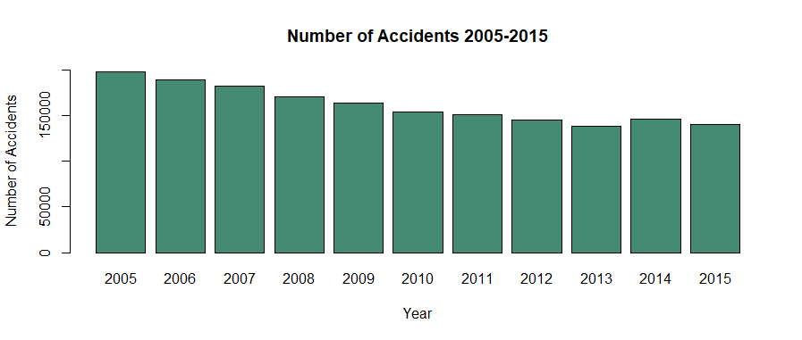
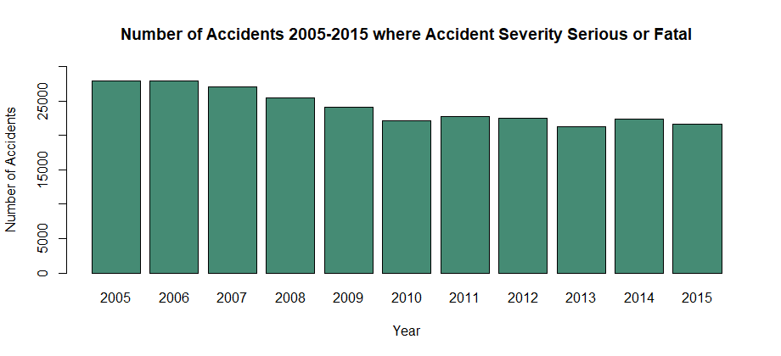
Introduction
Why did we pick this dataset?
What is the current challenge for the UK Government?
How can the UK Government use its data to improve road safety?

Slide 4
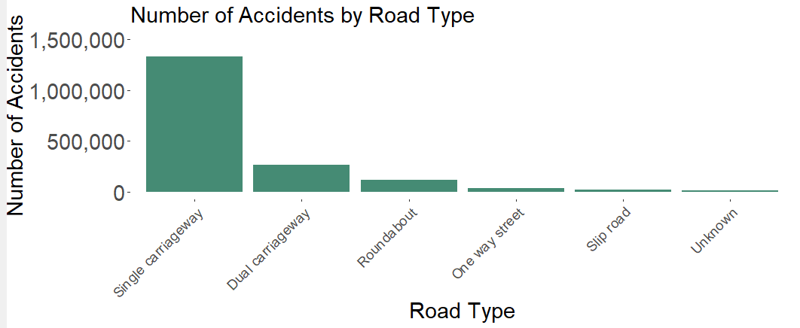
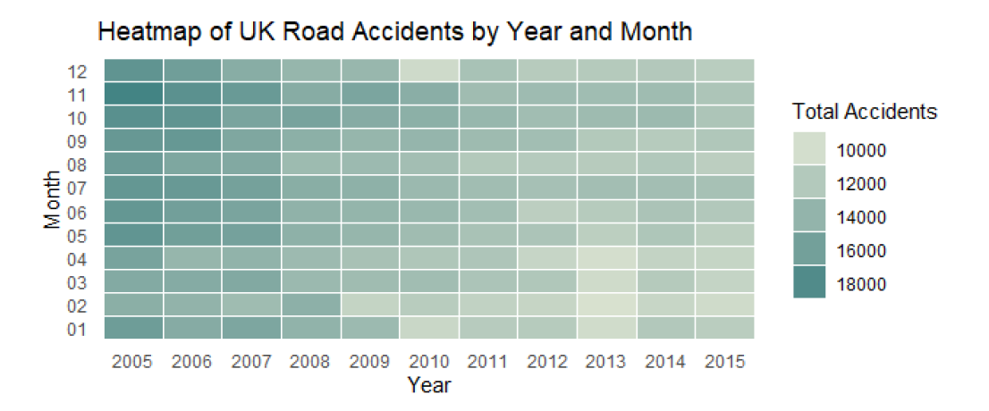
Aims
Hypothesis 1: Environmental factors and accident severity
Hypothesis 2: Seasonality of the number of accidents
Hypothesis 3: Age of the Driver and Accident Characteristics

Slide 5
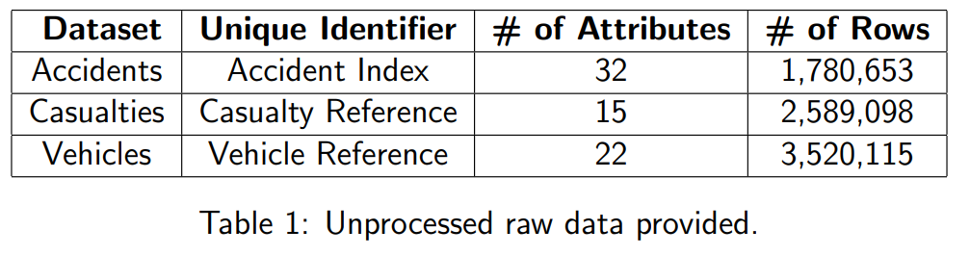
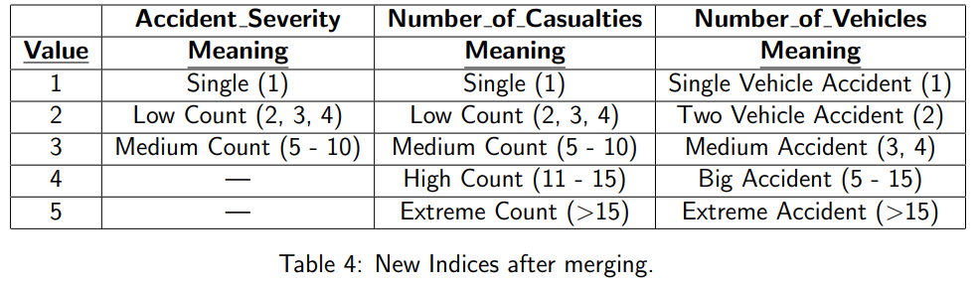
Data Preparation
Usability of Data
Selecting Data
Aggregating Data
Key Challenges

Slide 6
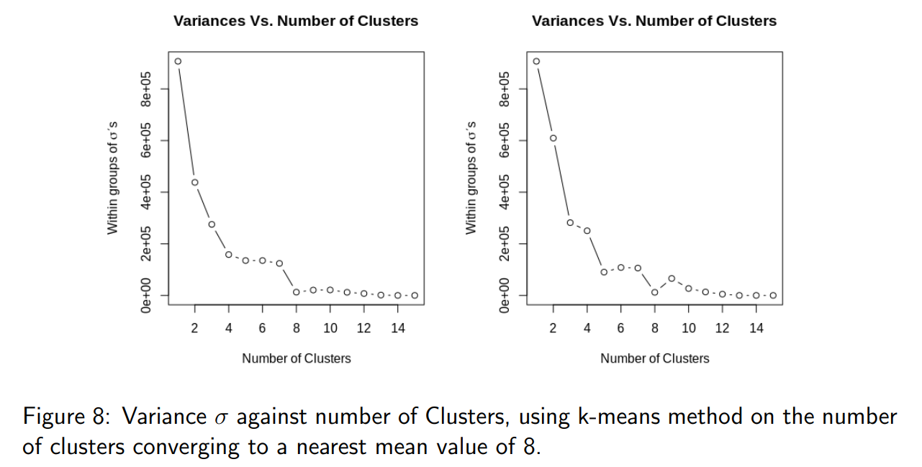
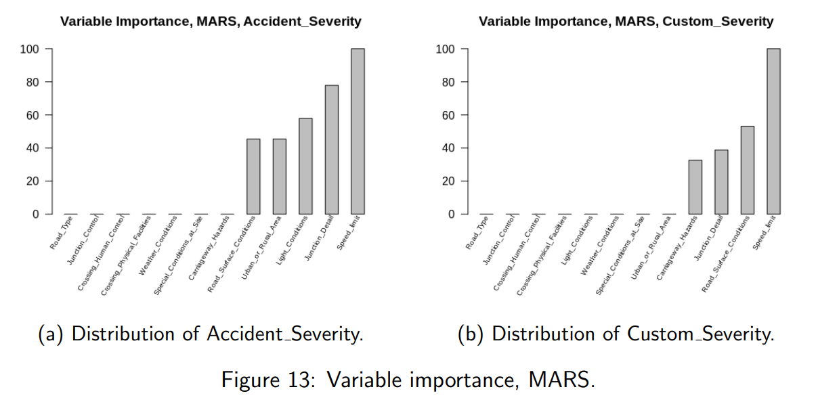
Modelling Results (1/3)
Hypothesis 1: Environmental factors and accident severity

Slide 7
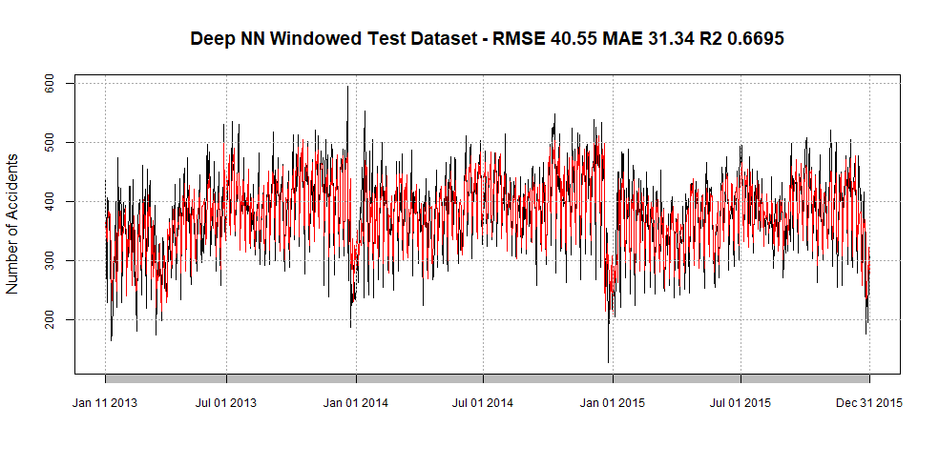
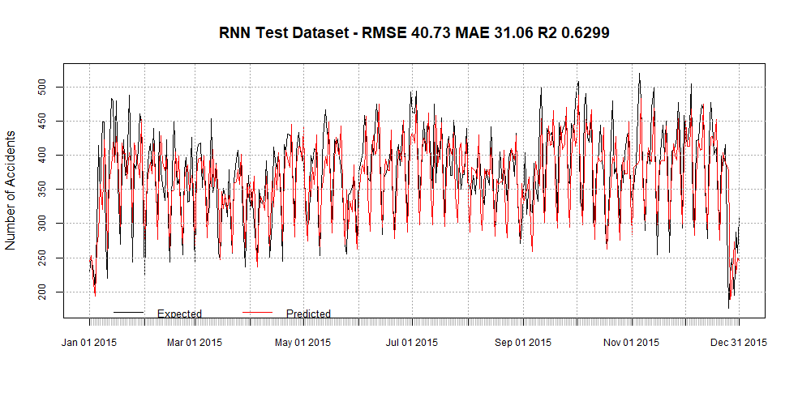
Modelling Results (2/3)
Hypothesis 2: The number of accidents depends on the date, the day of the week and the time of the day

Slide 8
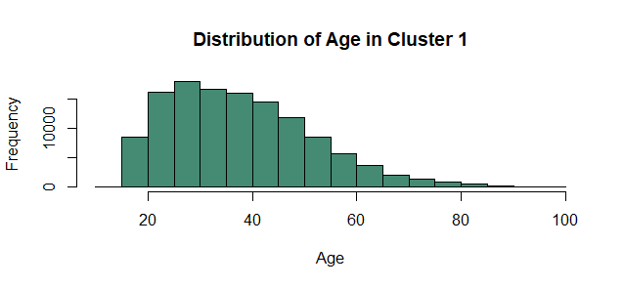
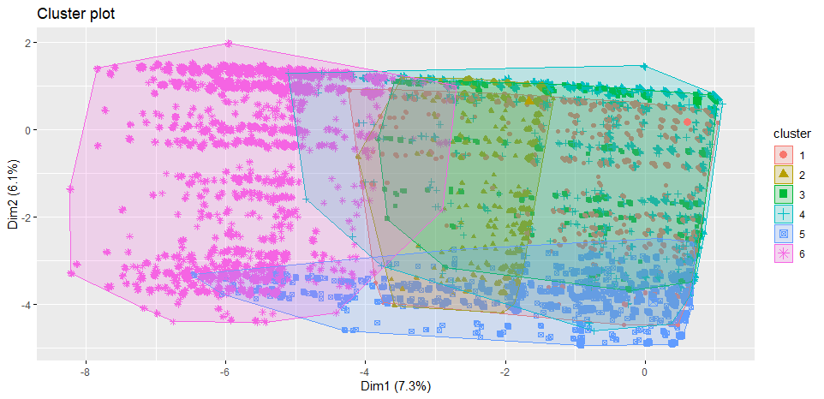
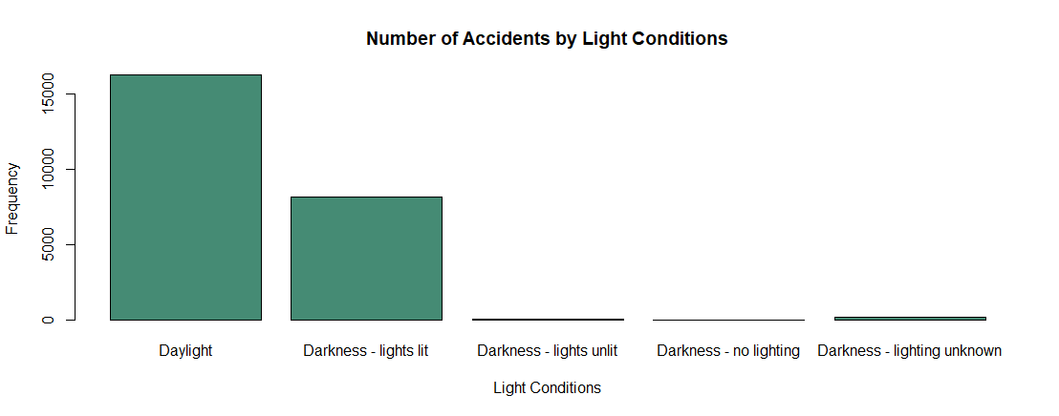
Modelling Results (3/3)
Hypothesis 3: Age of the Driver and Accident Characteristics
London
London with accident severity fatal or serious

Slide 9
Evaluation and Conclusion
We have gained useful insights
How can the UK government use this data to improve road safety?
What could have gone better?
Future Work

Slide 10

Questions?

