Slide 1
JavaScript
objects & the dom
JSON

Slide 2
HTML objects
Each HTML element is represented as a JavaScript object
<a>
<form>
<button>
<image>
<input>checkbox
<input>text
<option>
<select>
<table>
<textarea>
…
For a complete list of objects and their properties, see http://www.w3schools.com/jsref/default.asp

Slide 3
HTML Object properties
An HTML Object has several properties:
value – the text that is associated with an object
name – the name of the element
id – the id of the element; a unique value
innerHTML - the HTML in between object tags
type – the type of object
classname – the style class of the object
disabled - a boolean indicating whether or not an object is enabled
An object's id is often the same as its name, but not always.
<input type="text" name="fname" id="fname"
style="color:#0000FF" value="First Name">

Slide 4
Get element by id
id is a property of an HTML object
The id attribute of any element on the page is unique, and so can be used to retrieve a specific object from the page:
getElementById('elementName')
HTML:
<button id='btnClick'>Click Me</button>
JavaScript:
document.getElementById('btnClick')
→ This gets the element, which might then be assigned to a variable
DON'T use the same id for more than one object!
We could also use a variable here

Slide 5
accessing object properties
<input type="text" name="firstname" id="fname" value="First Name">
Get the object
var txt = document.getElementById('fname');
Access its properties
document.write(txt.type); //→ text
document.write(txt.name); //→ firstname
document.write(txt.id); //→ fname
document.write(txt.value); //→ First Name

Slide 6
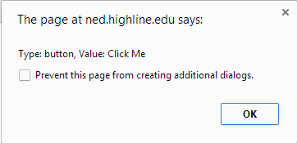

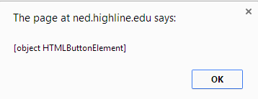
<body>
<button id='btnClick' >Click Me</button>
<script>
var btn = document.getElementById('btnClick'); alert(btn);
alert('Type: ' + btn.type + ', Value: ' + btn.innerHTML);
btn.style.backgroundColor = 'lightblue';
</script>
</body>
</html>

Slide 7
modifying object properties
<input type="text" name="firstname" id="fname" value="First Name">
Get the object
var txt = document.getElementById('fname');
Modify its properties
txt.disabled = true;
txt.value = "Enter your First Name";

Slide 8
<head>
<title>Disable Demo</title>
<script>
/* Called when all the HTML on the page has finished rendering.
Hence, when this is called the button and paragraph exist.
*/
window.onload = function() {
//Set up disable button
var btnDisable =
document.getElementById('btn-disable');
btnDisable.onclick = disable;
}
function disable(){
document.getElementById('fname').disabled = true;
}
</script>
</head>
<body>
<input type='text' id='fname' name='fname' value='First Name'>
<button id='btn-disable'>Disable Text Field</button>
</body>
ex6-8a.html

Slide 9
Try It
Add a second button to the previous example that clears the text in the textbox when it is clicked.
Hint: Set the text box's value property to the empty string.

Slide 10
<head>
<title>Clear Text Demo</title>
<script>
window.onload = function(){
var btnClear =
document.getElementById('btn-clear');
btnClear.onclick = clear;
}
function clear(){
document.getElementById('fname').value = '';
}
</script>
</head>
<body>
<input type='text' id='fname' name='fname'
value='First Name'>
<button id='btn-clear'>Clear Text Field</button>
</body>
ex6-8b.html

Slide 11
Changing object style
Define the style
Change the style of the object in JS
<style>
.morphStyle {
border: thick solid red;
padding: 3em;
background: black;
color: white;
}
</style>
p1.className = 'morphStyle';
For more on the DOM Style object, see http://www.w3schools.com/jsref/dom_obj_style.asp
Notes:
className replaces all replaces with the one class. This is problematic. jQuery has addClass.

Slide 12
<head>
<style>
.morphStyle {
border: thick solid red;
padding: 3em;
background: black;
color: white;
}
</style>
<script>
window.onload = function()
{
var btnMorph = document.getElementById('btn-morph');
btnMorph.onclick = morph;
}
function morph()
{
var p = document.getElementById('p1');
p.className = 'morphStyle';
}
</script>
</head>
<body>
<button id='btn-morph'>Morph</button>
<p id='p1'>This is a paragraph</p>
</body>
ex6-04.html

Slide 13
inner html
innerHTML is between HTML tags, e.g.
<p id='p1'>This is innerHTML</p>
<button id='btn'>innerHTML</button>
JS can be used to modify the innerHTML
var p = document.getElementById('p1');
p.innerHTML = 'Yowza!';

Slide 14
<head>
<script>
window.onload = function() {
var p = document.getElementById('p1');
p.onclick = changeMe;
}
function changeMe() {
var p = document.getElementById('p1');
p.innerHTML = 'Yowza!';
}
</script>
</head>
<body>
<p id='p1'>Click Me</p>
</body>
ex6-4.html

Slide 15
Try it
In the document <body>
Create an anchor that has an href and an id
Write a JavaScript program that
Gets the anchor by id
Displays an alert that displays the href and innerHTML
Changes the href and innerHTML
<body>
<a href='http://zoo.org' id='zooLink'>Zoo Time</a>
<script>
var link = document.getElementById('zooLink');
alert(link.href);
link.href = 'http://pdza.org';
link.innerHTML = 'Visit the Zoo';
</script>
</body>
ex6-02.html

Slide 16
get elements by tag name
Used to retrieve elements by type, e.g. <a> or <input>
function growImg()
{
var images = document.getElementsByTagName('img');
for(var i in images)
{
//do something with the image
}
}
This gets every <img> on the page and returns them as an array.
This loops through the array, so we can access each element.
Notes:
Should use a style here.

Slide 17
<head>
<style>
.big {
width:300px;
}
</style>
<script>
window.onload = function() {
var btnGrow = document.getElementById('btn-grow');
btnGrow.onclick = growImg;
}
function growImg() {
var images = document.getElementsByTagName('img');
for(var i in images) {
images[i].className = 'big';
}
}
</script>
</head>
Add a Shrink button that shrinks every image on the page
ex6-03.html
<body>
<button id='btn-grow'>Grow</button>
<p><img width='100px' src='images/lobsters.jpg'></p>
<p><img width='100px' src='images/pigs.jpg'></p>
<p><img width='100px' src='images/frog.jpg'></p>
<p><img width='100px' src='images/superman.jpg'></p>
<p><img width='100px' src='images/toco-cat.jpg'></p>
<p><img width='100px' src='images/witch.jpg'></p>
</body>

Slide 18
Using this
this refers to the current object
<head>
<style>
.yellow {
background: yellow;
}
</style>
<script>
window.onload = function() {
var p = document.getElementsByTagName('p');
for(var i in p) {
p[i].onclick = highlight;
}
}
function highlight() {
this.className = "yellow";
}
</script>
</head
<body>
<p>paragraph 1</p>
<p>paragraph 2</p>
<p>paragraph 3</p>
</body>
Get all the paragraphs
Loop through the paragraphs
Assign the highlight function
to the onclick event for each
paragraph
this refers to whichever paragraph was clicked
ex6-06.html

Slide 19
try it
Create a page with three buttons
Define a CSS class called btnColor that sets background color and text color
Change the color of the clicked button
ex6-06b.html

Slide 20
Javascript events
onclick()
onsubmit()
onmouseover()
onmouseout()
onchange()
ex6-07.html
Notes:
We should be registering these events

Slide 21

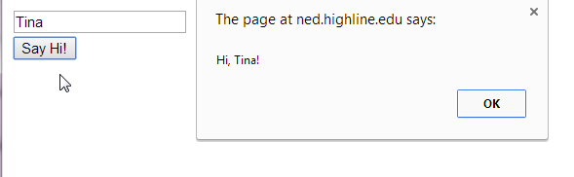
review
Create a page with a button and text input.
When the user clicks in the text field, clear the text.
When the button is clicked, display an alert with "Hi, name!", where name is pulled from text input.

Slide 22
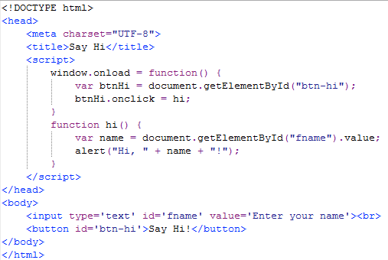
on click
This gives us the text that is typed into the first name input field
ex6-1.html

Slide 23
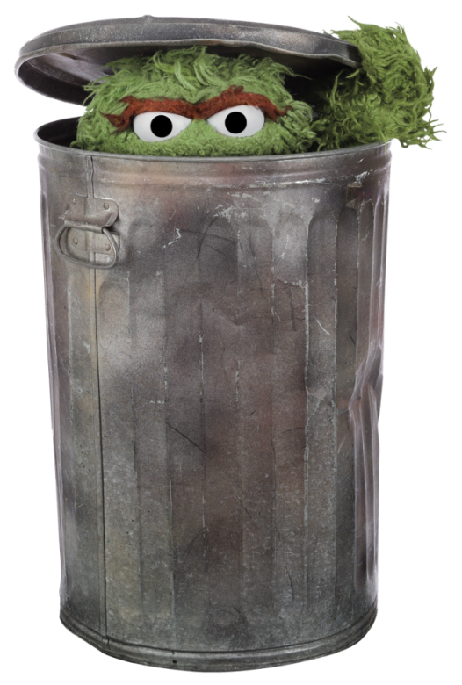
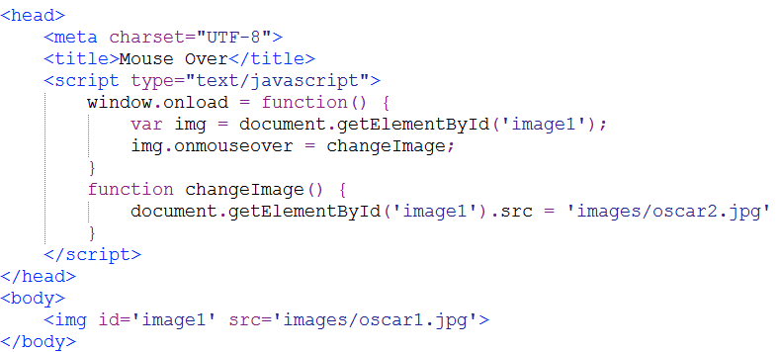
on mouse over
ex6-2.html
See if you can modify this program
so that the image changes back to the original when the user mouses out.

Slide 24
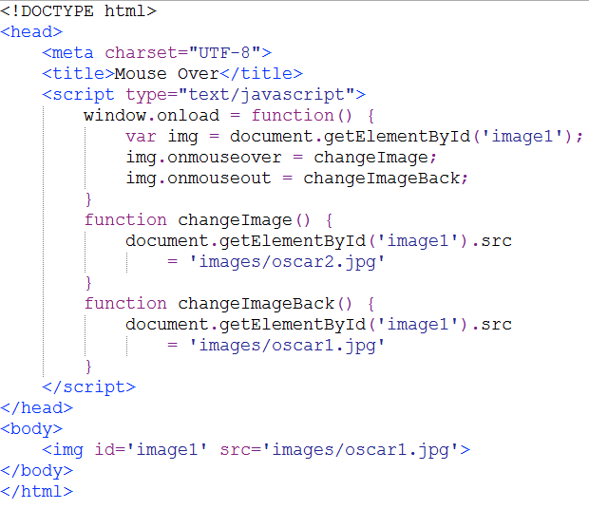
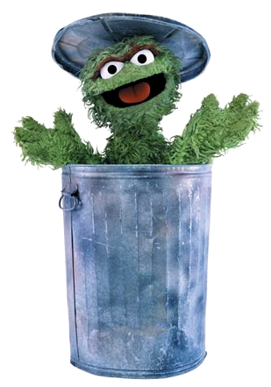
on mouse out
ex6-3.html

Slide 25
<head>
<script>
var p;
window.onload = function() {
var txtEvent = document.getElementById('txt-event');
txtEvent.onclick = fnClick;
txtEvent.onmouseover = fnMouseOver;
txtEvent.onmouseout = fnMouseOut;
txtEvent.onchange = fnChange;
p = document.getElementById('output');
}
function fnClick() {
p.innerHTML += "Click<br>";
}
function fnMouseOver() {
p.innerHTML += "Mouse Over<br>";
}
function fnMouseOut() {
p.innerHTML += "Mouse Out<br>";
}
function fnChange() {
p.innerHTML += "Change<br>";
}
</script>
</head>
This variable has class scope: it is visible to every function within the script.
<body>
<input type='text'
id='txt-event'></input>
<br>
<p id='output'></p>
</body>

Slide 26
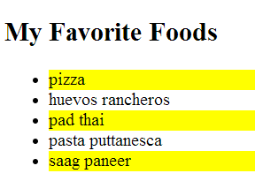
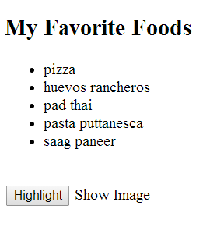
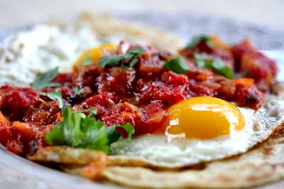
pair program
Create a bulleted list of your favorite foods, a Highlight button, and a Show Image link.
When the user clicks on the button, highlight every other item in the list. (Hint: use the background property.)
When the user moves the mouse over the link, display an image.
ex6-6.html

Slide 27
The Document Object Model (DOM)
An interpretation of an HTML page as a model, or tree
Each page element is referred to as a node
The DOM "tree" can navigated or altered
With the DOM, JavaScript can:
Add, remove or alter the HTML elements and attributes in the page
Change the CSS styles in the page
React to HTML events in the page

Slide 28
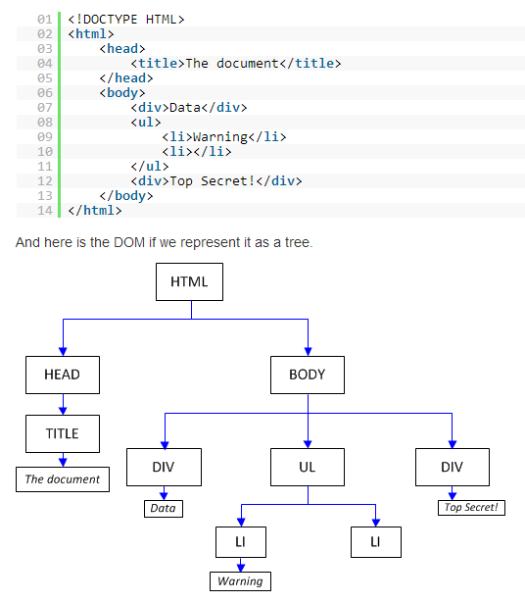

Slide 29
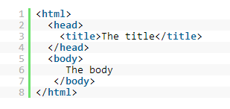
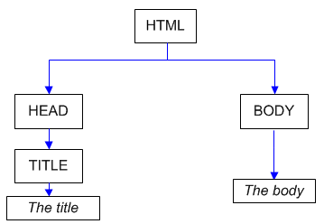
Try It!

Slide 30
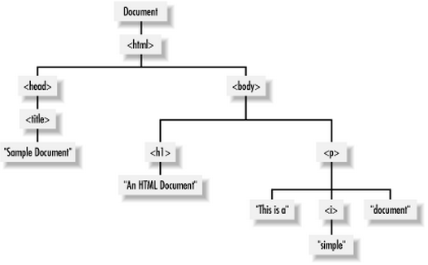
One More
<html>
<head>
<title>Sample Document</title>
</head>
<body>
<h1>An HTML Document</h1>
<p>This is a <i>simple</i> document.</p>
</body>
</html>

Slide 31
dom manipulation
Create a new paragraph:
var $p1 = $("<p>");
Add text to the new paragraph:
$p1.text("Hello!");
Add the paragraph to the page:
$("body").append($p1);
Remove the paragraph from the page:
$p1.remove();

Slide 32
try it
<!DOCTYPE html>
<head>
<title>Manipulating the DOM</title>
</head>
<body>
<script src="https://ajax.googleapis.com/ajax/libs/jquery/ 1.11.1/jquery.min.js"></script>
<script>
//Create a new paragraph:
var $p1 = $("<p>");
//Add text to the new paragraph:
$p1.text("Hello!");
//Add the paragraph to the page:
$("body").append($p1);
</script>
</body>
</html>
Add an <h3> to the body that says "Shopping List".
Add a <ul> to the body.
Add three <li>s to the list.

Slide 33
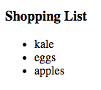
//Add a header to the page
var $title = $("<h3>");
$title.text("Shopping List");
$("body").append($title);
//Make a list
var $list = $("<ul>");
//Make list items
var $item1 = $("<li>");
var $item2 = $("<li>");
var $item3 = $("<li>");
$item1.text("kale");
$item2.text("eggs");
$item3.text("apples");
//Add list items to list
$list.append($item1);
$list.append($item2);
$list.append($item3);
//Add the list to the body
$("body").append($list);
ex6-9.html

Slide 34
JSON: Javascript object notation
An object in JavaScript is simply a collection of related variables.
A JSON object is represented with curly braces.
The curly braces contain key-value pairs, separated by commas.
Key names and string values must be in double quotes.
var student = { "name": "Jose Ramirez",
"sid": "998-76-2342",
"gpa": 3.7
};

Slide 35
JSON: Javascript object notation
Accessing object data:
document.write (student.name + "<br>");
document.write (student.sid + "<br>");
document.write (student.gpa + "<br>");

Slide 36
objects
We can have more than one layer of data.
var student2 = { "name": { "first": "Jazmyne",
"mi": "L.",
"last": "Richards" },
"sid": "880-33-2244",
"address": { "street": "123 Oak Place",
"city": "Auburn",
"state": "WA",
"zip": "88042" },
"email": "jrichards@mail.greenriver.edu"
};
document.write (student2.name.first + " " + student2.name.mi + " " + student2.name.last);
ex6-10.html
Add statements to print the rest of the student's information.

Slide 37
an array of objects
We can also define an array of objects. An array is represented with square brackets.
var students = [{ "name": { "first": "Bob",
"mi": "M.",
"last": "Dole" },
"sid": "111-22-3333"
},
{ "name": { "first": "Condoleeza",
"mi": "L.",
"last": "Rice" },
"sid": "333-44-5555"
},
{ "name": { "first": "Barack",
"mi": "H.",
"last": "Obama" },
"sid": "444-55-6666"
}];}
ex6-10.html

Slide 38
traversing the array
Now we can iterate through the array…
var students = [{ "name": { "first": "Bob",
"mi": "M.",
"last": "Dole" },
"sid": "111-22-3333"
},
…
{ "name": { "first": "Barack",
"mi": "H.",
"last": "Obama" },
"sid": "444-55-6666"
}];
for (var i in students) {
document.write (students[i].name.first + " " +
students[i].name.mi + students[i].name.last + "<br>");
}
ex6-10.html

Slide 39
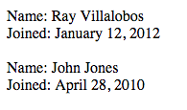
try it
Create an array of users using JSON. Here's an sample user:
Iterate through the list of users and print the name and joined date for each one.
{
"firstName": "Ray",
"lastName": "Villalobos",
"joined": {
"month": "January",
"day": 12,
"year": 2012
}
}
ex6-11.html

Slide 40
reading json data from a file
[
{
"firstName":"Ray",
"lastName":"Villalobos",
"joined": {
"month":"January",
"day":12,
"year":2012
}
},
{
"firstName":"John",
"lastName":"Jones",
"joined": {
"month":"April",
"day":28,
"year":2010
}
}
]
Create the data file: users.json
Remember, square brackets represent an array, while curly braces represent an object.
[ array ]
{ object }
users.json

Slide 41
the foreach loop
The JavaScript foreach() method calls a function for each element in an array.
var names = ["Bach", "Brahms", "Schubert", "Mozart"];
names.forEach(function (name) {
document.write(name + "<br>");
})
Bach
Brahms
Schubert
Mozart

Slide 42
reading json data from a file
Create the script
<script src="https://ajax.googleapis.com/ajax/libs/ jquery/1.11.1/jquery.min.js"></script>
<script>
$.getJSON("users.json", function (users) {
users.forEach(function (user) {
document.write ("Name: " + user.firstName + " " + user.lastName + "<br>");
document.write ("Joined: " + user.joined.month
+ " " + user.joined.day + ", "
+ user.joined.year + "<br><br>");
});
});
</script>
ex6-12.html

Slide 43

pair program: books

