Slide 1
BetterFit
Calorie Tracking Application

Slide 2
Other Apps
Gripes
5 items a day
Re-Add daily items
Inspirations
Split food items by meals
Display sectioned information

Slide 3
PROJECT GOALS
GOAL 1
GOAL 2
GOAL 3
GOAL 4
Allow users to add many items
Display in a way that made sense
Give useful information
Custom goal and statistics

Slide 4





Tech Stack

Slide 5
Demo

Slide 6



What I would Change
Mongo DB for Users
Use a different framework other than Spring Boot

Slide 7

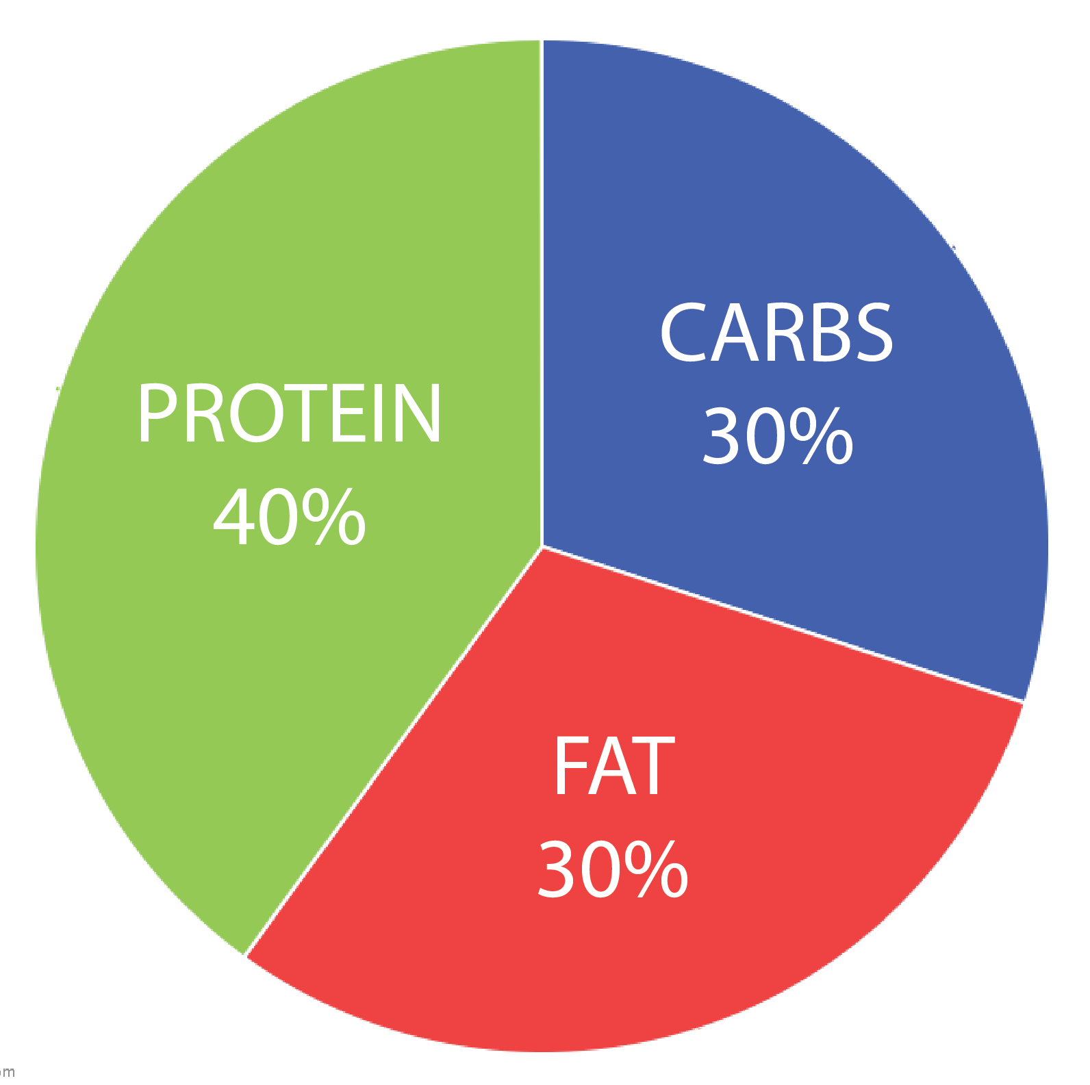
What is Next
Char.js
Workout routines
Workout Challenges
Trial Run
Barcode Scanner

