Slide 1
Big Mountain Pricing Analysis
Springboard Guided Capstone 1
Ben Chretien, December 7th, 2025

Slide 2
Problem Identification
Big Mountain currently charges ~$81 per lift ticket.
Leadership wants to know if this price reflects the resort’s value.
Need to assess whether the market could support a higher price.
Explore how improvements or run closures would impact revenue.

Slide 3
Recommendation
Data suggests Big Mountain could support a price ~$2 higher.
Raising the price to $83 is supported by model predictions.
Best improvement scenario: adding 1 chairlift + increased vertical drop improves revenue most.
Run closures result in decreased ticket price and revenue — should be avoided or tested carefully.

Slide 4
Modeling Results - Approach
Built baseline: average ticket price as initial benchmark.
Created linear regression model using preprocessing pipeline.
Evaluated with 5-fold cross-validation.
Built Random Forest model with imputation + scaling pipeline.
Selected Random Forest as the winning model due to higher accuracy.

Slide 5
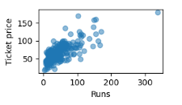
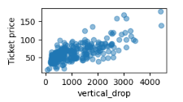
Modeling Results (cont.) - Key Relationships
Ticket price rises with key resort features such as runs and vertical drop.
These relationships indicate that Big Mountain may be underpriced given its feature set.

Slide 6
Modeling Results (cont.) - Model Performance
Linear model showed moderate accuracy; test performance slightly higher than CV.
Random Forest performed significantly better and was more stable.
Random Forest chosen as final model for scenario analysis.

Slide 7
Scenario Results: New Chair + Vertical Drop
Adding 1 chair + 150 ft vertical increases predicted ticket price by ~$1.99.
Annual revenue impact ≈ 5 × expected visitors × $1.99.
Strongest improvement scenario tested.

Slide 8
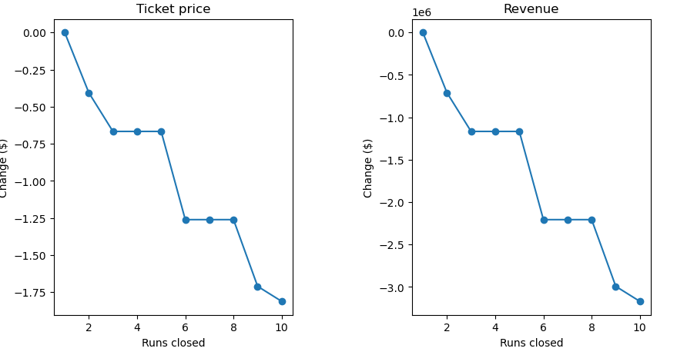
Scenario Results: Run Closures
Closing runs decreases ticket price and revenue.
Impact becomes sharply negative beyond ~5 closures.
Closure testing should be tested only during off-peak conditions.

Slide 9
Conclusion & Next Steps
Big Mountain is likely underpriced given its features.
Supported increase: $81 → $83.
Add 1 lift + increase vertical: strong ROI potential.
Avoid closures where possible.
Recommend building a simple internal tool for analysts to test scenarios themselves.

