Slide 1


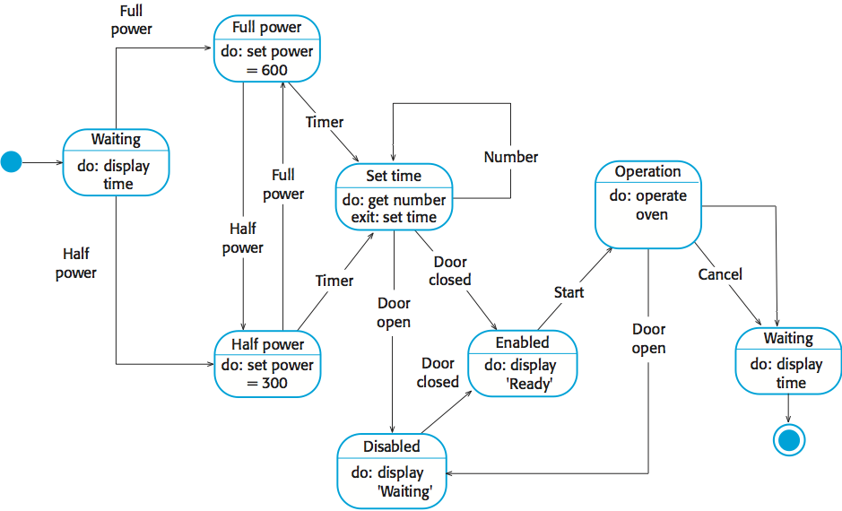
Research: A short summary of your research providing key related works; Be critical. Use appropriate citation.
UFCFXK-30-3: Digital Systems Project
Student name: Benjamin Ell-Jones
Project Title: Puzzle Game VR
A QR Code link to your video submission
Abstract:
The puzzle game DSP project included a game developed in unity that allows the user to play two puzzles, the first being the 8 Queens puzzle, which is a chess based puzzle and 2048. This involves moving cubes around a 4*4 grid and adding matching cubes together to get a larger and larger up to 2048, at that point you win the game. The final aspect is to create a website to display score data in a leader board format.
Key requirements:
Provide key requirements with short description if required.
Functional
The tool must blah blah
The tool must blah blah blah
The tool should blah blah blah
The tool should blah blah blah
The tool would blah blah blah
Non-functional
The tool must blah blah blah
The tool must blah blah blah
The tool should blah blah blah
The tool should blah blah blah
The tool would blah blah blah
Implementation artefacts (if any)
Can include other diagrams that verify the implementation process (e.g. class diagram etc.)
or
A screenshot of your GUI or ‘code output so far’ or similar
Aims and objectives:
A very short description of the aims of the project and an outline of the objectives.
Create the 8 Queens puzzle
Create 2048
Create a website to display score data
Create a REST API to allow communication between the headset and webserver.
Testing
Details regarding your testing strategy
Design, Implementation & Testing
Planning and Management: This section will include your planning and management.
State Diagram
References: References and citations should be in UWE Harvard style

