Slide 1

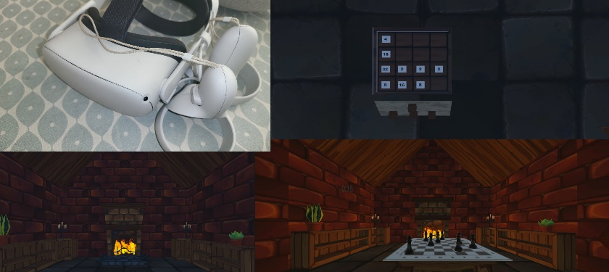
Puzzle Game VR
By Benjamin Ell-Jones

Slide 2
Recap of Aims and Objectives
Research
Research VR, its concepts, applications, and associated technologies.
Research
Research game engines and web frameworks.
Identify
Identify appropriate requirements for the game.
Identify
Identify an appropriate methodology to use when developing the game.
Create
Create a fully working VR Puzzle Game for the Quest 2.
Create
Create a website to display score data in leader boards for both puzzles.
Create
Create a REST API to allow communication between the headset and webserver.
Evaluate
Evaluate the project, including the report and the developed program.

Slide 3
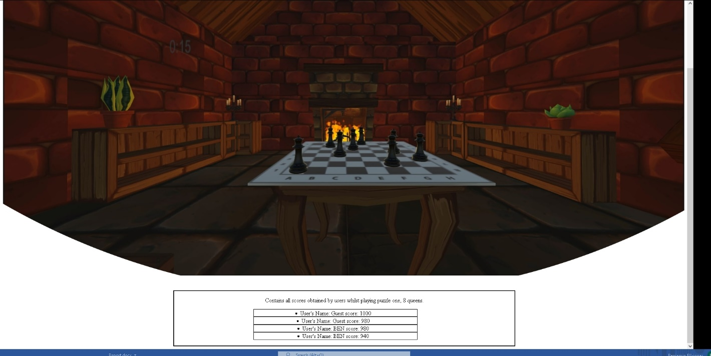
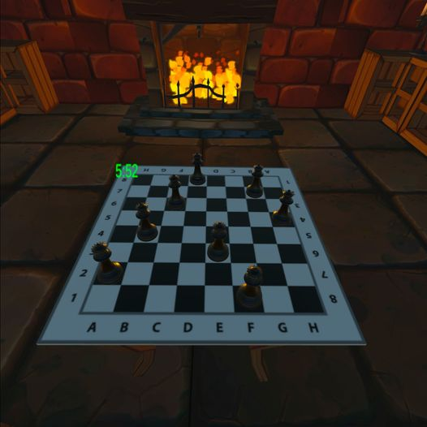
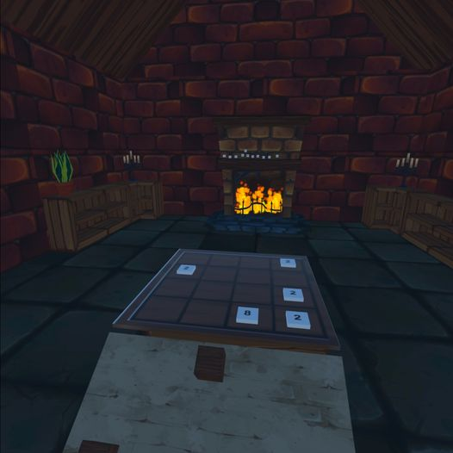
What I Accomplish?
All Aims and objectives set out at the start of the project were achieved !!
Including but not limited to:
Created a fully playable VR puzzle game with 2 puzzles
Puzzles including 8 Queens and 2048
Created a website to display score data for both puzzles in a leader board format.

Slide 4
Why I Produced This Project
I Chose to do this project to:
To experiment with and further my understanding of VR, a rising technology.
To further my understanding and abilities to produce game with a game engine, in this case, unity.
Further my understanding of web technologies and frameworks.

Slide 5
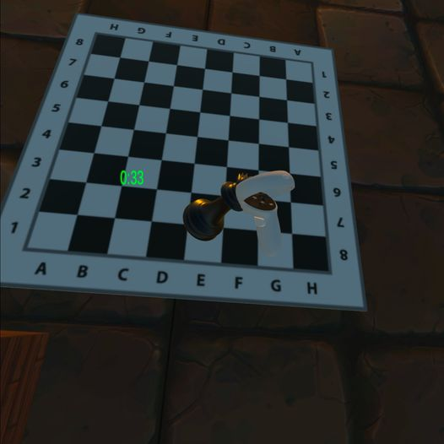
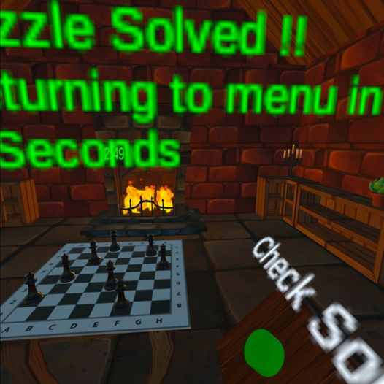
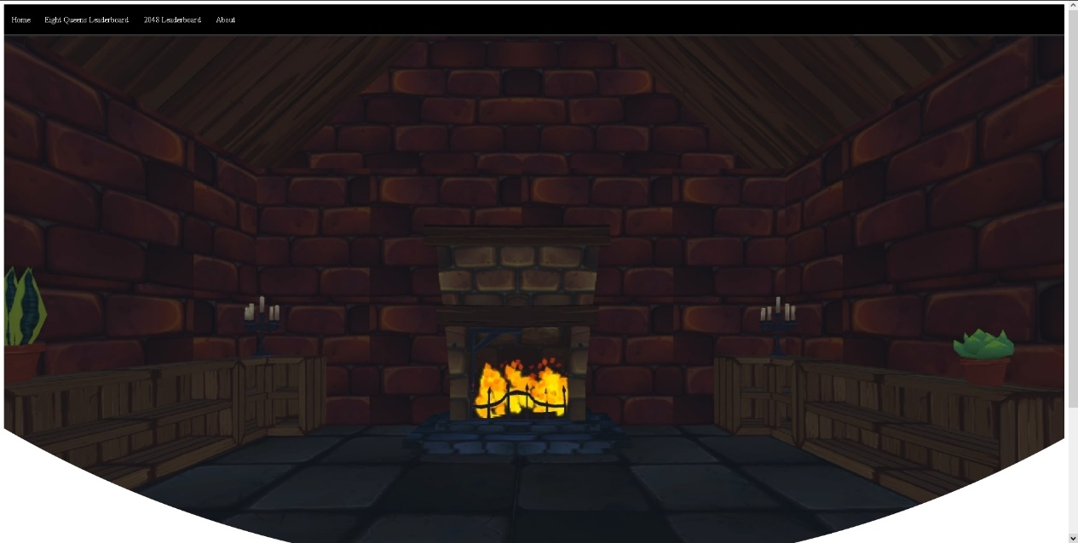
Project Images:

Slide 6
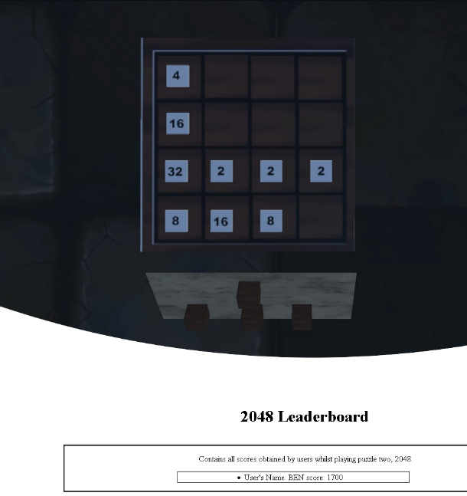
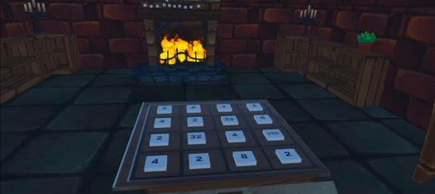
I Will Now Demo The Game And Website

