Slide 1

How to get a girl
By a guy who’s only ever had one girlfriend
An application to practice dating

Slide 2
What is the game?
Text based dating simulation
Goal is to get your partners number
Chat/flirt with them to increase their flirt score
You can ask them out at any time however they will only accept if their flirt score is above 50. Then you win
If you ask them out and their flirt score is not high enough you will lose

Slide 3
How does it work?
Multiple choice response to your partners questions. Answers may raise, lower or not effect the score.
The user must be aware of the dates interests as that may how much a choice is worth or whether is it a positive or negative response
At the start of the game the user will be get to choose their attributes and these level of attributes will effect whether an answer will have a positive or negative response.
The user must infer whether and answer is a good idea or not
The change will be displayed to the screen after each turn and along with the total flirt score

Slide 4

Feature 1 – base game

Slide 5
Base game
Users will be provided with a question from their date and will be given a number of responses
Users choose from the options using the arrow keys and enter keys
Answer's responses can be positive negative or neutral.
Pick answers you think will be positive and try to increase the flirt score to the point that when you ask for their number they will say yes.

Slide 6
Feature 1 – Choice of attributes

Slide 7
Feature 1 – Choice of attributes
At the start of the game the player will be give 20 points and the player will choose how to allocate them.
Strength
Intelligence
Charisma
Levels of attributes will affect whether certain options are a good idea. (e.g trying to do a backflip to impress your partner with a 2 in strength is probably not a great idea)

Slide 8
Feature 2 – Partners interests

Slide 9
Feature 2 – Partners interests
At the start of the game your partner will have some randomly generated interests
Interests effect the number of points you receive for a response or whether you get any points at all
Interests will be hidden once the game has started so you will have to remember them

Slide 10
Feature 2 – Example
“Do you watch anime?”
1. “Eww No!”
2. “SASSKUUUEEEE”
3. “Does Rick and Morty count?”
4. “Not much”
If you pick option 2 and your partner has the trait ”loves anime” they will love that response. If they don’t then they will dislike that response.
If you pick option 1 and they don’t have that trait they won’t like it that much. If they do have the trait “loves anime” then they will HATE that response

Slide 11
Development and build issues

Slide 12
Challenges
Lot of challenges
Biting off more than I can chew/ deciding to do something and then learning how to do it
Running out of time to do all the things

Slide 13
Ethical issues
I wanted it to be “Hey do you want to get out of here?” rather than “Hey can I get your number” but that’s not appropriate
Originally just wanted to have the partner only be a girl so that more of the troups fit (e.g buying them a drink, asking for their number) But inclusivity is important

Slide 14
Favorite parts
After the issue with it being just on a date with a girl I made the option for the player to pick whether they would like to meet a boy, girl or just unspecified . This choose whether the name for the partner is a (usually) Male, female or unisex
At the end of the game, if you manage to get their number they ask you one… final… question. “What’s my name?” Get this right and you win, mess it up and it’s all over. (forgetting names is a common issue in my life)

Slide 15
Code and logic overview

Slide 16
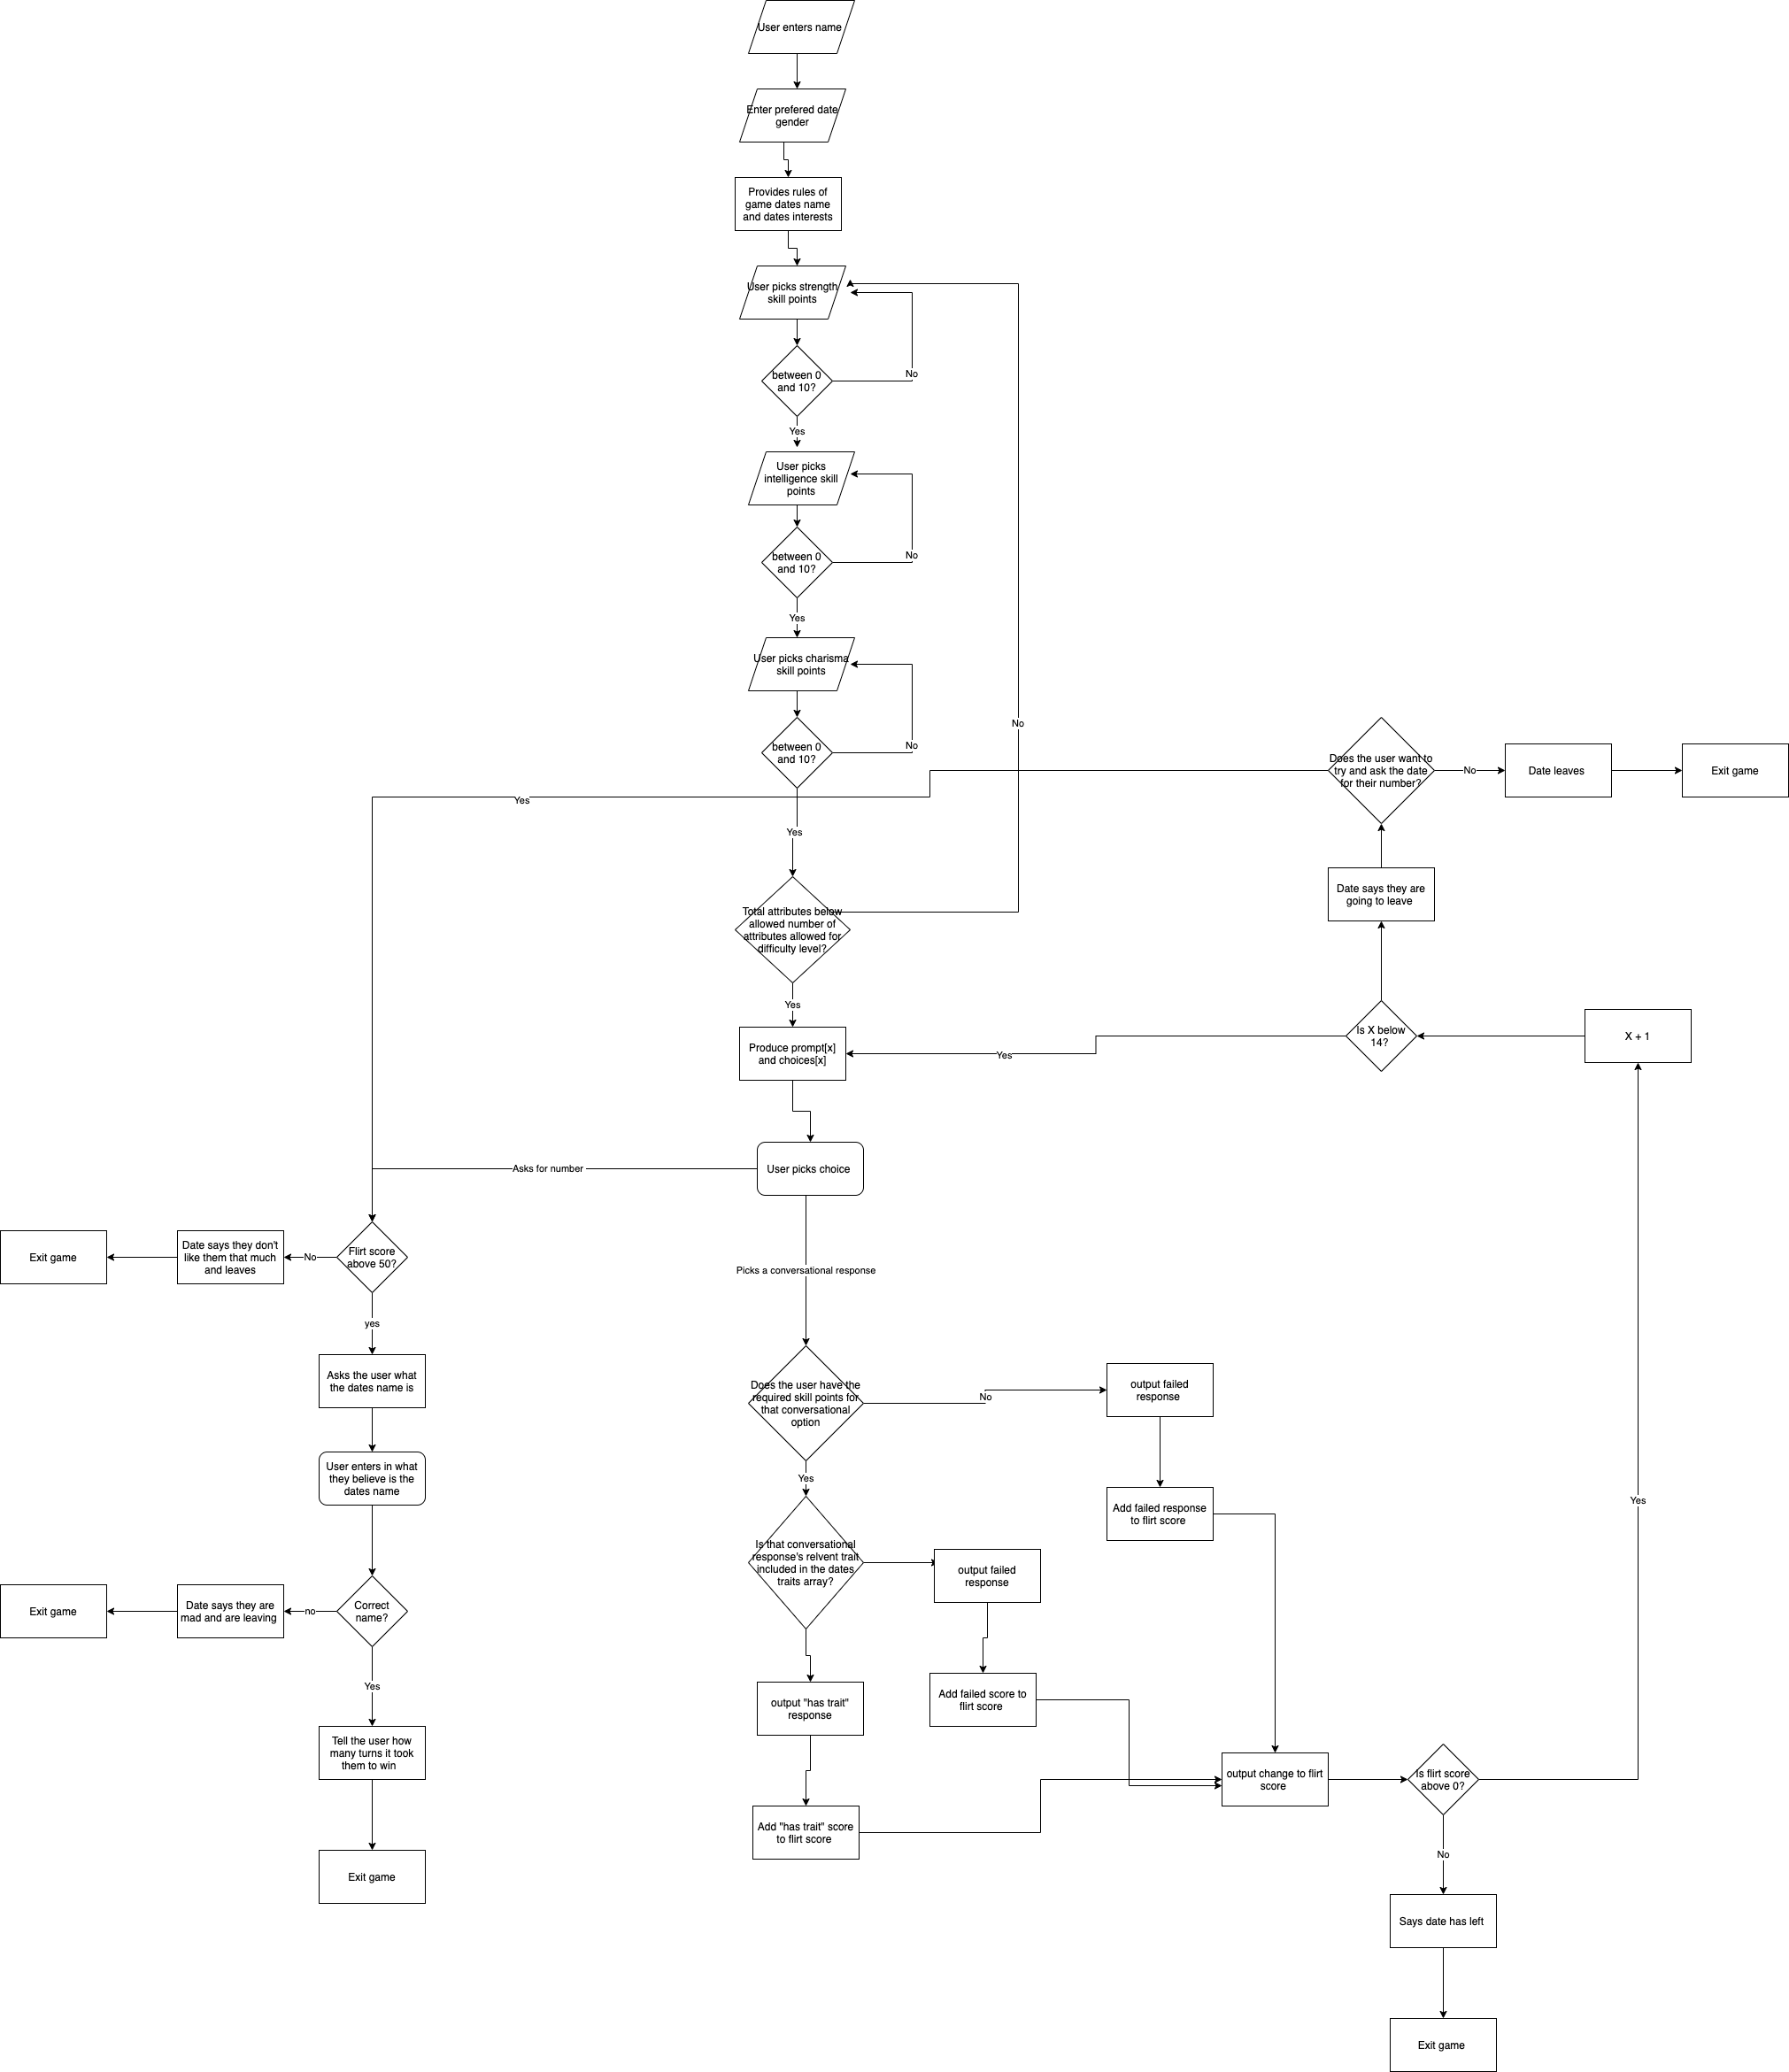

Slide 17
Link to flow chart
https://viewer.diagrams.net/?highlight=0000ff&edit=_blank&layers=1&nav=1&title=Flowchart.png#R5V1bk5s4Fv41rnnqFJj7Y%2Fo2M1WZTHazW5M8bamNbJjGlgPY7p5fv5IAG3TEJW1A2J2HtJG5WOf6naOjw8y4W7%2F8GqNt8AfxcTSba%2F7LzLifzek%2Fx6Z%2F2MhrPqLN9WxkFYd%2BNlYa%2BBr%2Bg%2FNBLR%2FdhT5OKiemhERpuK0OLshmgxdpZQzFMTlUT1uSqPrULVphMPB1gSI4%2Blfop0E26lraafw3HK6C4sm6ln%2BzRsXJ%2BUASIJ8cSkPGw8y4iwlJs0%2FrlzscMeoVdMmue6z59vjDYrxJu1xgf7mz7U8Iax%2B%2F%2F3n3%2Bd%2F%2F%2BrZ0%2F7zJ2bNH0S6fcP5j09eCAtinBMkPSZwGZEU2KHo4jd7GZLfxMXuMRo9O53wiZEsHdTr4N07T15y7aJcSOhSk6yj%2FFk4lnx17dmkgn9ivmKxxGr%2FSE2IcoTTcV5mFcp6vjucdL%2F1CQvqIuZYLqJfzJpfOG8%2FUqrdIyC5e4PyqMnHbbqQJN0pRvMIpuBH9UJrPaYjz7if46EyCj%2FglTL%2Bxyz%2BYupMffy99d%2F%2BS35sfvJYOvuA4pDTAcT5WKxEZQ7KhW32V%2FNj%2BFX7Wfhwe%2F07%2B5wWv0Y3r5VaCE7yBZMY4IuYIkuEa3USsL8kwgGR8icmeG1U6t13E%2F5IlM7VojZmpRikf22SHaOOXBumPxDFO0gSIV1V4DkGY4q9bxFl1oL6ho8LvcZzil0Z%2BFL5FpGuhcYeTmdaLk4KSiba1ehZWiP%2BzlNbdaSjhhk4m00KrOPxeqBo7OGkhPyrUsJPKySduQZWT6qZnjqNzRydcoA5nXGtcEKSqdP5uwRRqG5P1Np1Zty8z6%2F6oYIuAhAuqYsWwIDcj6JNVIZluq1an4xRKRAwXz8wKoQzw0cklVEyYdnCZSbZkk%2BB3BWBESTesNwIY8UbWfDCVkZoGB3JbHSMFrr3NKs67WkVHO1M0zlMzaKu%2BzRjzKS00HfBgeEPkuVVJ1M0RLZGUQRISTVs2W0VunGjK7hhN9eV2LXMSfDpFQVb3GKhv0AbEpNVeGYPIhOt9sASpEMHYW2NsZ%2BQY24JB9seE45EliVnAtFs%2F0QB2bqM1s4qbp2R75NBE4EhrUGy54%2BAWISo2RLTRVSZuxDuZ%2BrhCUTidklB8JpPieaviFzxvFw6vb%2BE4C7nYc0D6VwwTE9dBe7v3gOIs2lsw1%2FEYhTHTzGRBYp44eiJ79pdGJMYj4EockPXTLhklVXRjGoK5cSGkdCWI0h0KUdreJJBKDVR4kyB7g%2FgJSinBvg8XlzbavBKn7lHK5DpBr8z3pwFm8%2FTJ5hf2u6PwGWeja%2F4HscH1bhHMikxPhNFeYqZGUANbF9TAUx1ZeVNaf%2BpFD%2ByuIZhnKfWdMN2SY1kqufT%2FXcKQrHbI5DcbExYGQiUybFpCnsoYUYblpITZgc2FIUB7pLWwG1Ow5u7I1tyGsOX7pUHGglntkNHpm6vn6QlcibwjccyKNnKbMjWY6CiHiZeWeGwXXnMYwyLCxNENC0w9SmEi4qHRGvlHOJiNMFAYblatySMFKNFRjhLtaVS39KkGDrTh8qnbSk02JPx%2FsssqKDEgBy7UG%2FbL0l284ZUiHDgS8lyKhgiXog2UcvVSL%2BJKz1It9RNZzCgWJo4HfFnitErRuDDxs8oy4mKVLjAcrkvUuIyPcYxeS6dt2QlJ%2FYNApZLlCIWabRfY1Qvoh%2Bw39LoAD6EGy2N3WMv4hJ5wVBUaFIWrDf28wBte0nfLFDFcoOhj%2FsU69P1MPnES%2FoOe%2BP2Y2OTEpDe3blkdTPFMoMnHit%2F84tmRamURq1esekugfZgbbk6Nt8pYcQpZLhM8SL2EDvNSSiOZCWu6uG5oelYnRe%2BNVYBTTzg9YEz9IFvBzHGg3keaXKImgA%2B1kg8Moq44%2FJlPwwV2F%2FD2uotzS306SrghSHh%2FhRfymutJ8GkKUGUY%2FgKsYtrdTNjZWMXIH9QZq5jVC4bBKtD3XStWca8BqxTm4LqwyjimHHjXocEKrGe5DLRiapZitALz29MW8Xa0MkyyFoh4x%2BKv3kQcmqP3CleGYTCAK3NxV8JQcKV4cme4MrdGSK3o0DJcK17JdOviAQssS7kCwGJ2Nfs1oLP3NYfGn3lxAESXrJONCkD0aRRT1fm1%2BZiO7VwR7rpm4A4Thxtm9UFGs1sTT6e%2Fq%2FkCyUTG8INwOfFq%2FWDNuu2F%2BUHIsCvwg11L7vWxKjQbf2Z57Z2kfKczStM4fNpl1ZhUMfjyO4roX8xcY7EPKevqUDn5dFK2ZckPl8twsYtSNq8I75mSqfWqANFLluENiVfVxSCyv3X4Sy7Ckqu1pEWKfOrn7gk8j%2FCXXPbTQPjeYYkIRZ2OqwO9uQmYj%2F89q3nj1eO1nRp%2BSbK57zGfTRojXjQUbhbRzudWitUKCdXn%2FCxuyzKAotZcGdXNrbasVk5qrsSMSG9aY8D4SeWGxF70xph3NFiGUoMl2VRx%2BXCpM%2B3PNm7nif0c0P6eYLChJUB7fByL8Y9dGHNDkzyH%2FBlFYJbjozoLRrbs45Qsz7FfS6vlEfuP9ceCq%2FPXhmSrhfzEscp0G39mifBkl253THSXKIy4hJ%2FaI%2FVRbHuW6JpCusJS3uHFuOT9uA0S2UV0lWZ7DZiz%2FOj7crnN6seX1W3mkxNmW7JpaFxhluzNv3RhlqRs5FNXmrIxIOGPdngRoM1qskJsCV1UPOVCbEI8d%2BFCbHYFE%2Ba5q%2FLnEb4BTFBJ%2FbFj%2FapvA3SMxU%2BDFWs9viGuAmJvzH6wcmM0jfLlU2sxZXUmZtel57PBSE2CTPDRujZcQ9hGAgCY065RRTudSfoNQFflSN68OvBjds3WW%2BdWpJ5HeBhCNQWho4uq6B8c5Rs8rWlAnDr%2FYGct%2FBs8BD%2BSd%2B7vRfILDqlyG4Ymmjcxdzaw2ygIUB8dT9o7iO7BVd5JQNLC8%2BIXR6yufaYtpUlKSaNMRYsjdb129RZzNzDPGrpz927ZPKHTjena4xo2WFPBV4yXNT0klRd7OkJTcs%2BBpmzc1kCXttukXSe6Zqyzvq%2Bq7JgFM9ZfsxY%2FftbwJwvkIrxMJ%2BCCHVuAMOq76Uva9j688MKP7AVE06PZXHk2VNJeqkKz0Wl0406vSxRUTMU0EnsK6Zp6IsH0yMQESX1TWmcarnUC%2BwMLkDN8qbQcpjpifnHktK0DzW5dzHJxOxScmlK5%2FPbaB6qIdpX62dF0tys409gANbACyk9UuvDtwNieh3PsRVLF%2FgTd5DFcC7obNaYTPI8uaSU9akznXF0VktP5HWhKq5AcmI5o6N66IrxTa5Zz5d38JxC0iA1wb2T1oKPCKBdWQ198rtXpWojkKl2Lc6exZem8l5oNxrCGF9r0jmBvDEEvjY5LSD%2FdCkPcAqy37BmGF2jNF4CpiFcMs2nY7d6L4eIwuFuD2o4YXHeLZfVCfGZTx%2BAwwSDbh3FA2ZYv5kKzOefd0JPn46l5PrXYiYFD9jff3Kp4OQB4W1nzB6m7HW6fqjuNtEWPxtvtGv24c6XeFkY%2FOXosXvWkHB26QF7HfL13A88mlIk8ZWcnRCRZNZsdsdLAZItYI%2F0V%2B%2FzfzKhyH3d6QxNosh9lJYWP5UsBoZMAbdlHSjgURTR4X8Vozfxhqc6n8l2pAKjN8i7DF%2BznlmOYbXAMkyhnmiyMh0x74IiEzjXGS5ztQsw93gpTExxfKcPmAsPU12l7MFBtULJtuODvSUtSOuNVyt7rJ24efRd8c9TzDXqQDnyjLKL3DqmOLfB74Z1oJE3la2yeDKy28m4RoDhM1ui98k19IYIHV8QAj0i4aM%2BInuIMfZSITaj%2BnqvXgKvbLe91LWq0lXbp8GByVMTPvO3M6d2n7Lc94SjE%2B%2BK9p9I3oiqWcFBuYg9Y6kUPY8K2KJ1yR3ROwR%2FEZxm4h%2F8D

Slide 18
Code run through
main.rb

Slide 19
Any questions?

