Slide 1
RDBMS
MySQL, PostgreSQL and SQL SERVER
<> Ben Hassine Imèn </>

Slide 2
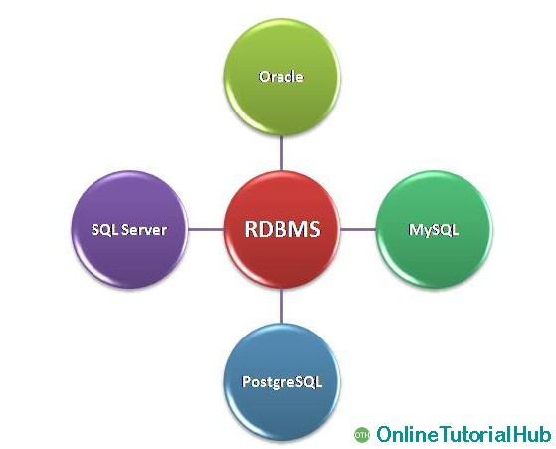
Relational Database Management System "RDBMS"
A relational database management system (RDBMS) is a database management system (DBMS). RDBM stores data in the form of tables, with most commercial relational database management systems using Structured Query Language (SQL) to access the database.

Slide 3
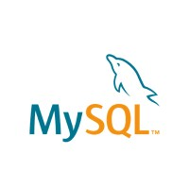
MySQL

Slide 4
What’s My SQL?
MySQL is a relational database management system (RDBMS) based on SQL (structured Query Language).,and works primarily on the relational database model. It makes database administration easier and more flexible.

Slide 5
Why use MySQL?
Here, are some important reasons for using MYSQL:
Supports features like Master-Slave Replication, Scale-Out
It supports Offload Reporting, Geographic Data Distribution, etc.
Very Low overhead with MyISAM storage engine when used for read-mostly applications
Support for Memory storage engine for frequently used tables
Query Cache for repeatedly used statements
You can easily learn and troubleshoot MySQL from different sources like blogs, white papers, and book

Slide 6
Disadvantages of using MySQL
Transactions related to system catalog are not ACID compliant.
Some time A server crash can corrupt the system catalog.
No pluggable authentication module preventing centrally managed account.
No support for roles so it is difficult in maintaining privileges for many users.
Stored procedures are not cacheable.
Tables used for the procedure or trigger are always pre-locked.

Slide 7
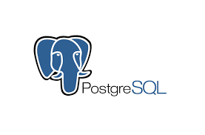
Postgre SQL

Slide 8
What is PostgreSQL?
Postgre is an object-relational database management system (ORDBMS). It was developed at the Computer Science Department in the University of California. Postgres pioneered many concepts.
Postgre is an Enterprise-class relational database system. It is easy to setup and installs. It offers support for SQL and NoSQL. It has a great community which happy to serve you when you are facing issues while using PostgreSQL.

Slide 9
Why use PostgreSQL?
Main reasons for using PostgreSQL are:
Offers useful features like Table partitioning, Point in Time Recovery, Transactional DDL, etc.
Ability to utilize 3rd party Key Stores in a full PKI infrastructure.
Developers can modify open source code as it is licensed under BSD without the need to contribute back enhancements.
Independent Software Vendors can redistribute it without the fear of being "infected" by an open source license.
Users and Roles can be assigned Object level privileges.

Slide 10
Disadvantages of using PostgreSQL
The current external solutions require a high learning curve.
No upgrade facility for major releases.
The data need to be exported or replicated to the new version.
Double storage is needed during the upgrade process.
indexes cannot be used to directly return the results of a
query.
Query execution plans are not cached.
Bulk loading operations may become CPU bound.
Sparse Independent Software Vendor support.

Slide 11
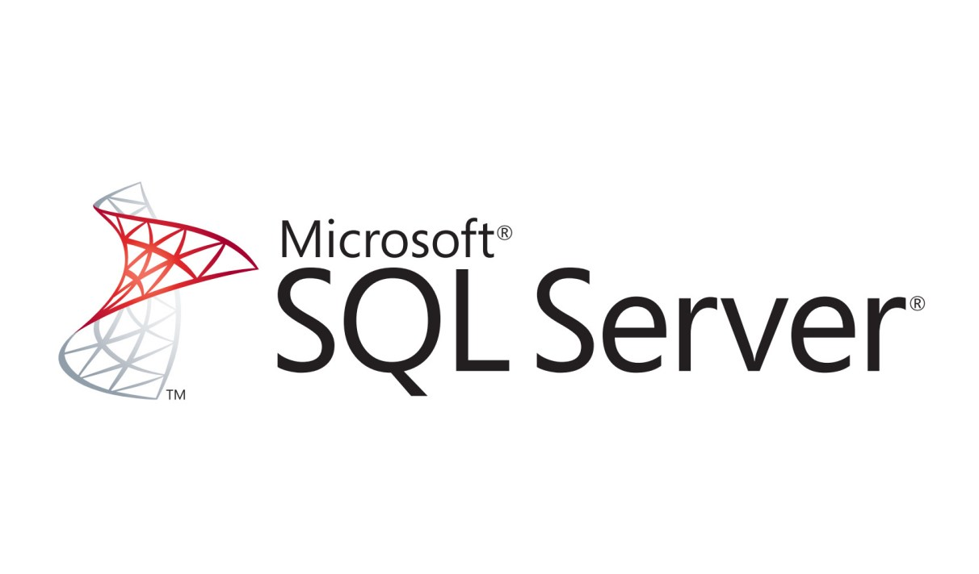
SQL Server

Slide 12
What is SQL Server?
SQL SERVER is a relational database management system (RDBMS) developed by Microsoft. It is primarily designed and developed to compete with MySQL and Oracle database.
SQL Server supports ANSI SQL, which is the standard SQL (Structured Query Language) language. However, SQL Server comes with its own implementation of the SQL language, T-SQL (Transact-SQL).

Slide 13
Why use SQLServer?
easy to manage databe
Integration with other Microsoft products
Very good performance in general under windows
Extensive security options
Data compression and backups
Free Express version

Slide 14
Disadvantages of using PostgreSQL
Complex performance tuning. Query optimization and performance tuning can be difficult for data specialists who don’t have deep, specialized knowledge.
Lack of native support for source control. The closing point of our list of pros and cons of Microsoft SQL Server is related to source control.

Slide 15
Conclusion
So to find the best solution to store, organize and process your data, the right choice is made following a deep comparison of functionalities, use cases, ecosystems of flexibility, profitability and innovation.

