Slide 1
Road Traffic Fine Management Process: Event Log Analysis & Prediction
BUSINESS INFORMATION SYSTEMS Paolo Ceravolo
BEHNAM NAJAFLOO
Master student in Computer Science, University of Milan
2025

Slide 2
Problem Statement & Objectives
Methodology Overview
Event Log Insights
Process Discovery: Alpha vs. Inductive vs. Heuristic Miner
Predictive Modeling: Balancing Class Imbalance
Key Findings & Recommendations

Slide 3
Background
Problem Statement
Inefficiencies in traffic fine management (delays, unpaid fines)
Objective
Analyze event logs to map workflows and predict outcomes (payment vs. escalation)
Dataset
Road Traffic Fine Management Process.xes (publicly available log)

Slide 4
Methodologies Overview
Tools
PM4Py
Sklearn
Matplotlib
Seaborn
Process Mining Pipeline
Log Filtering
Process Discovery
Validation
Machine Learning Pipeline
Feature Engineering
Class Balancing
Random Forest Modeling

Slide 5
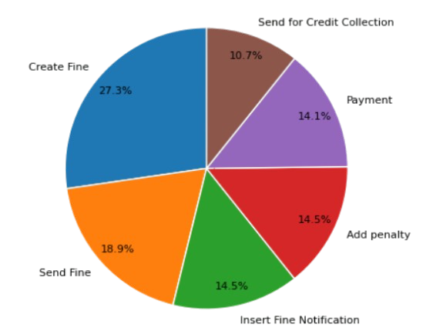
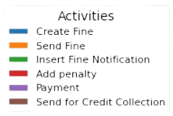
Event Log Insights
Activity Frequency

Slide 6
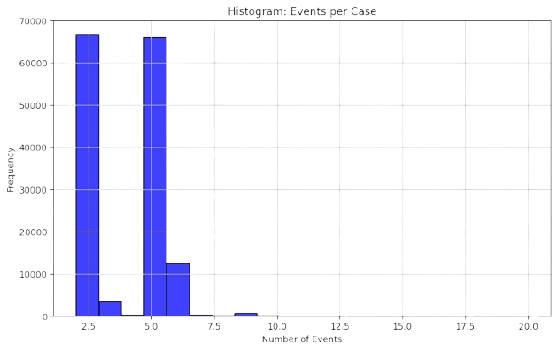
Event Log Insights
Events per Case

Slide 7
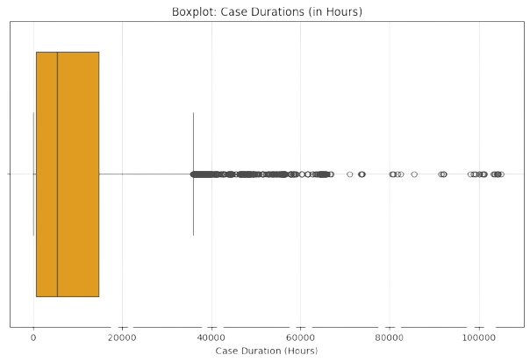
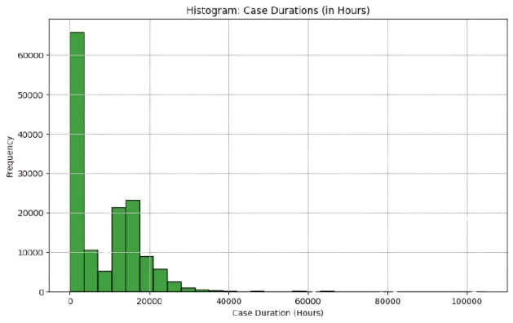
Event Log Insights
Case Duration Analysis

Slide 8
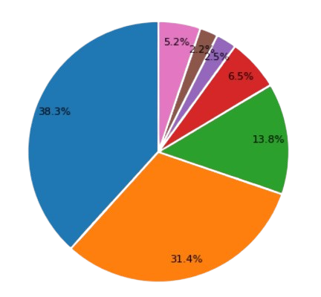
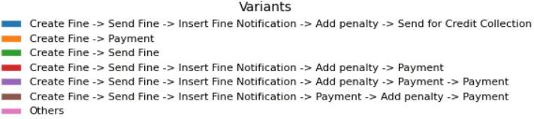
Event Log Insights
Analyzing variant sequence frequently
Top 6

Slide 9
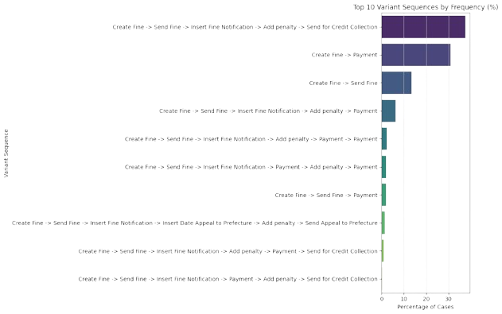
Event Log Insights
Analyzing variant sequence frequently
Top 10

Slide 10
Log Filtering and Preprocessing
Activity | Frequency
Create Fine | 83,614
Send Fine | 83,602
Insert Fine Notification | 79,860
Add penalty | 79,860
Send for Credit Collection | 59,013
Payment | 31,230
Insert Date Appeal to Prefecture | 4,188
Send Appeal to Prefecture | 4,141
Only those traces that contained at least three events.
Only those activities that occurred at least 1000 times.
Traces that became empty were discarded, ensuring that every remaining trace contributed valuable information to the analysis.
The log contains 83,614 cases, and the activity set was reduced accordingly.

Slide 11
Process Discovery
Extracting process models using three well-known discovery algorithms:
Alpha Miner
Inductive Miner
Heuristic Miner

Slide 12
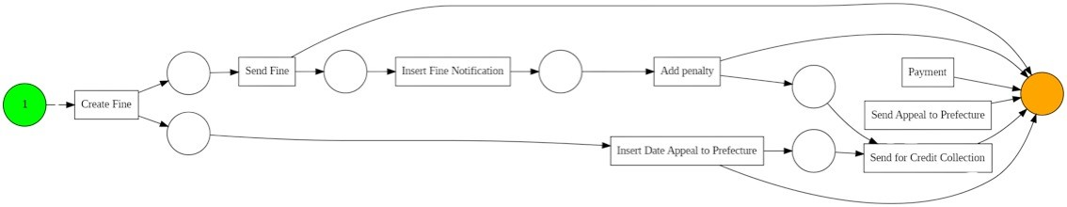
Discovery Techniques Alpha Miner
Detecting strict ordering relations between activities. | Capture the basic sequential flow of activities. | Struggles with complex constructs like loops, concurrency, or noise, which are prevalent in real-world logs.

Slide 13
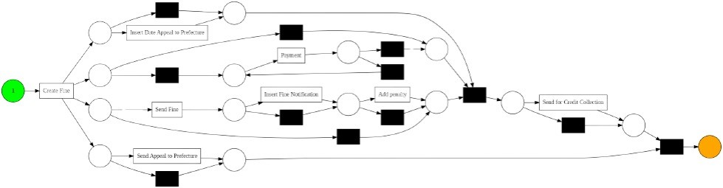
Discovery Techniques Inductive Miner
Deal with noise and complex constructs more effectively | Produces block-structured Petri nets, to ensures proper start and end points as well as deadlock-free execution. | The most interpretable and aligned with business logic, capturing the dominant paths and alternative branches.

Slide 14
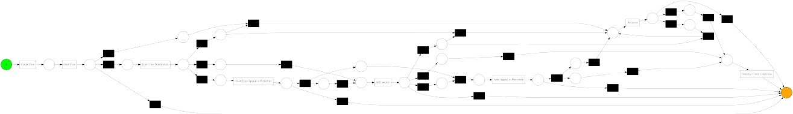
Discovery Techniques Heuristic Miner
Emphasizes the most frequent paths and dependencies. | More detailed than Alpha Miner and highlighted common behavior. | Occasionally included rare paths that may not be semantically meaningful.

Slide 15
Discovery Techniques on Activity-Filtered Log
The filtering is based on:
The presence of the "Payment" activity.
To ensuring:
Only cases involving payment processing were retained.
This approach helped:
Reduce noise from unrelated behaviors.
Allowed a clearer view of the process paths leading to or involving payments.

Slide 16
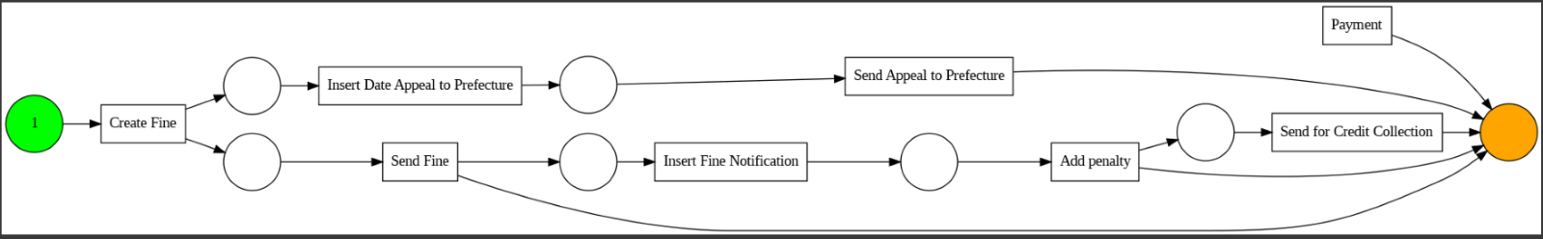
Discovery Techniques Alpha Miner on Activity-Filtered Log
Reduces Complexity | Highlights Key Paths | Clarifies Decision Points | Improves Interpretability

Slide 17
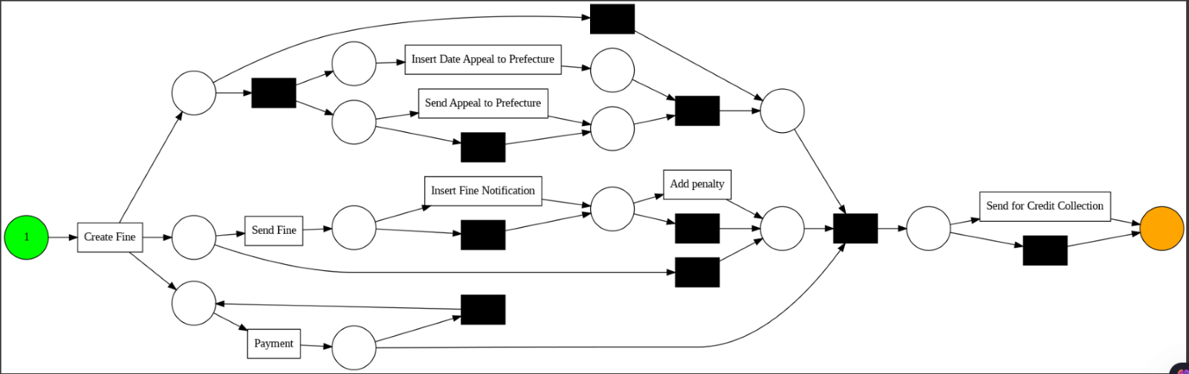
Discovery Techniques Inductive Miner on Activity-Filtered Log
Increased Precision with Structure | Parallel and Optional Paths | Payment Path Visibility | Improved Soundness

Slide 18
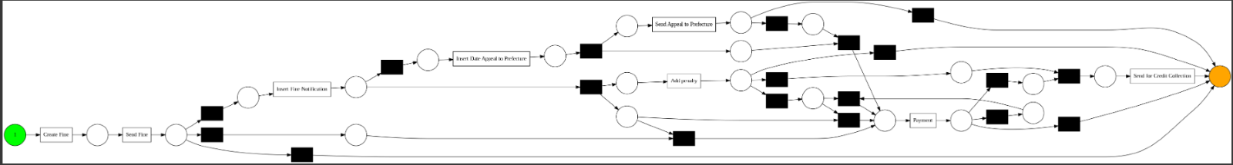
Discovery Techniques Heuristic Miner on Activity-Filtered Log
Rich detail from noisy behavior | Visible complexity and decision points | Insight into behavior frequency | Realistic but harder to interpret

Slide 19
Performance Comparison
Miner | Fitness | Generalization | Execution Time
Alpha Miner | 0.76 | 0.27 | 0.88 s
Inductive Miner | 1.00 | 0.52 | 0.46 s
Heuristic Miner | 0.97 | 0.52 | 1.63s
Miner | Transitions | Places | Simplicity (Interpretation)
Alpha Miner | 8 | 8 | Most simple and compact model; very easy to understand but may miss complex behaviors.
Inductive Miner | 20 | 16 | Balanced; captures more process behavior while still maintaining moderate complexity.
Heuristic Miner | 35 | 27 | Most complex model; likely to capture detailed and noisy behaviors, harder to interpret.

Slide 20
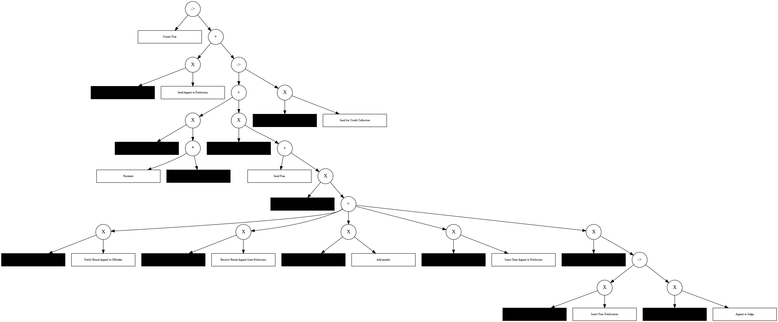
Process Tree
Provides a block-structured model, where each node corresponds to an operator (sequence, choice, parallelism), and the leaves are the actual activities.

Slide 21
Observation
Dominant Process Flow
Rare Appeal Behavior
Escalation Due to Non-Payment
Impact of Log Filtering
Model Performance & Quality
Alpha Miner
Execution time (0.88s).
Limited expressiveness and adaptability, particularly for handling noise or infrequent paths.
Inductive Miner
The fastest (0.46s).
Good balance of fitness, and simplicity Ideal for structured processes like this.
Heuristic Miner
Slower (1.63s).
Handled complexity well.
More robust against noise and minor variants.

Slide 22
Modeling and Evaluation
A model to predict the final outcome of a case based on historical event patterns.
How can we develop a predictive model that identifies all possible final outcomes of a traffic fine case

Slide 23
Data Preprocessing and Feature Engineering
Sort Events by Timestamp
Ensures events are ordered within each case
Group by Case
Groups all events belonging to the same case
Flatten Multi-Index Columns
Converts multi-level column names.
Calculate Case Duration
Computes the total duration of each case in days.
Define Target Variable
Uses the last event in the sequence as the target (Payment or Send for Credit Collection).
Feature Engineering
Key Features Created:
Event Sequence: List of activities in order ( ["Create Fine", "Send Fine", ...]).
Start/End Times: First and last timestamps of the case.
Aggregated Values: Summed monetary values and penalty points.
Resource Diversity: Unique count of org:resource (departments or employees)

Slide 24
Final Output Structure
Column | Description | Example Value
case:concept:name | Case ID | Case123
concept:name_<lambda> | Event sequence | ["Create Fine", "Send Fine"]
time:timestamp_min | Start time of the case | 2023-01-01 09:00:00
time:timestamp_max | End time of the case | 2023-01-05 14:30:00
amount_sum | Total fine amount | 150.00
duration_days | Case duration in days | 4
target | Last event (prediction target) | Payment

Slide 25
Initial Model Training (Random Forest)
class | Activity Name (Final Event) | precision | recall | f1-score | support
0 | Create Fine | 0.21 | 0.12 | 0.15 | 101
1 | Payment | 0.92 | 0.92 | 0.92 | 25
2 | Send Fine | 0.52 | 0.41 | 0.46 | 480
3 | Insert Fine Notification | 0.17 | 0.14 | 0.15 | 14
4 | Add penalty | 0.97 | 0.98 | 0.97 | 12819
5 | Insert Date Appeal to Prefecture | 0.14 | 0.08 | 0.11 | 12
6 | Send Appeal to Prefecture | 0.90 | 0.86 | 0.88 | 636
7 | Receive Result Appeal from Prefecture | 0.98 | 0.98 | 0.98 | 4155
8 | Send for Credit Collection | 1.00 | 1.00 | 1.00 | 11832
accuracy |  |  | 0.97 | 30074
macro avg | 0.65 | 0.61 | 0.62 | 30074
weighted avg | 0.97 | 0.97 | 0.97 | 30074

Slide 26
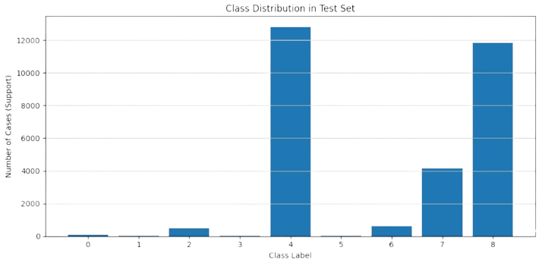
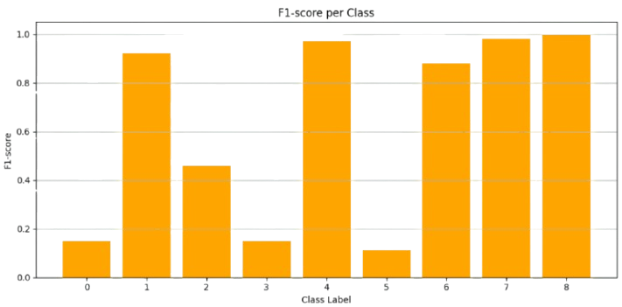
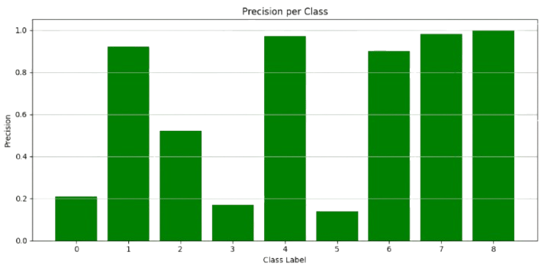
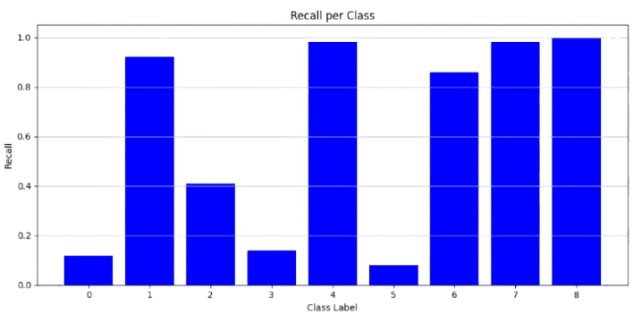
Initial Model Training (Random Forest)

Slide 27
Balancing Strategies and Performance
Class Weighting
class_weight='balanced'
SMOTE Oversampling
Upsampling minority classes
Hybrid
(SMOTE + Class Weights)

Slide 28
Class Weighting | SMOTE Oversampling | Hybrid
class | Activity Name (Final Event) | precision | recall | f1-score | support
0 | Create Fine | 0.20 | 0.27 | 0.23 | 101
1 | Payment | 0.91 | 0.84 | 0.88 | 25
2 | Send Fine | 0.50 | 0.99 | 0.67 | 480
3 | Insert Fine Notification | 0.12 | 0.14 | 0.13 | 14
4 | Add penalty | 0.99 | 0.95 | 0.97 | 12819
5 | Insert Date Appeal to Prefecture | 0.00 | 0.00 | 0.00 | 12
6 | Send Appeal to Prefecture | 0.83 | 0.85 | 0.84 | 636
7 | Receive Result Appeal from Prefecture | 0.98 | 0.98 | 0.98 | 4155
8 | Send for Credit Collection | 1.00 | 1.00 | 1.00 | 11832
precision | recall | f1-score | support
0.18 | 0.43 | 0.26 | 101
0.78 | 0.84 | 0.81 | 25
0.50 | 0.99 | 0.66 | 480
0.04 | 0..21 | 0.07 | 14
0.99 | 0.94 | 0.97 | 12819
0.04 | 0.17 | 0.06 | 12
0.71 | 0.78 | 0.75 | 636
0.98 | 0.97 | 0.97 | 4155
1.00 | 0.99 | 0.99 | 11832
precision | recall | f1-score | support
0.18 | 0.43 | 0.26 | 101
0.78 | 0.84 | 0.81 | 25
0.50 | 0.99 | 0.66 | 480
0.04 | 0..21 | 0.07 | 14
0.99 | 0.94 | 0.97 | 12819
0.04 | 0.17 | 0.06 | 12
0.71 | 0.78 | 0.75 | 636
0.98 | 0.97 | 0.97 | 4155
1.00 | 0.99 | 0.99 | 11832
accuracy |  |  | 0.97 | 30074
macro avg | 0.61 | 0.67 | 0.63 | 30074
weighted avg | 0.98 | 0.97 | 0.97 | 30074
 |  | 0.96 | 30074
0.58 | 0.70 | 0.62 | 30074
0.97 | 0.96 | 0.97 | 30074
 |  | 0.96 | 30074
0.58 | 0.70 | 0.62 | 30074
0.97 | 0.96 | 0.97 | 30074

Slide 29
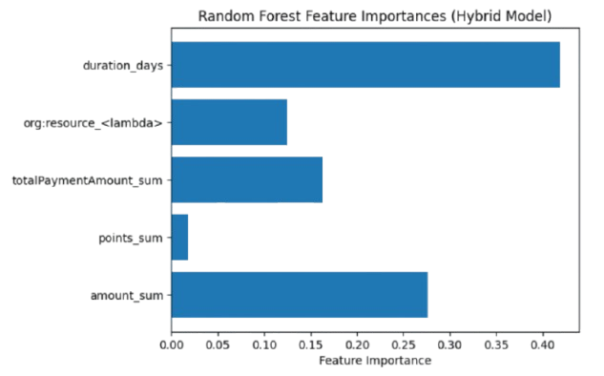
Feature Importance

Slide 30
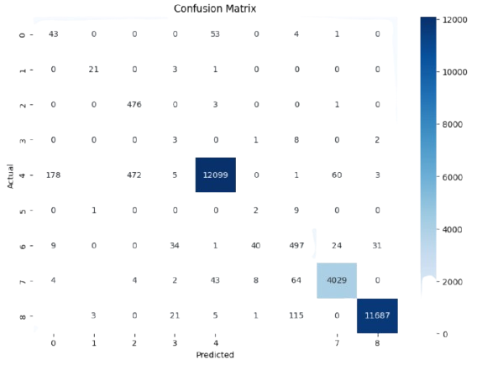
Confusion Matrix

Slide 31

Conclusion
The process mining pipeline involving event log analysis, process discovery—Alpha Miner, Inductive Miner, and Heuristic Miner—, feature engineering, and predictive modeling. The Inductive Miner offered a balanced trade-off between model quality and discovery time.
The log was filtered for proper process discovery.
A set of meaningful features was engineered.
Using a Random Forest Classifier, the model achieved high predictive performance with reasonable scores on the test set.

