Slide 1

WellCo Churn
Author: Ben Remez
Date: October 2025

Slide 2
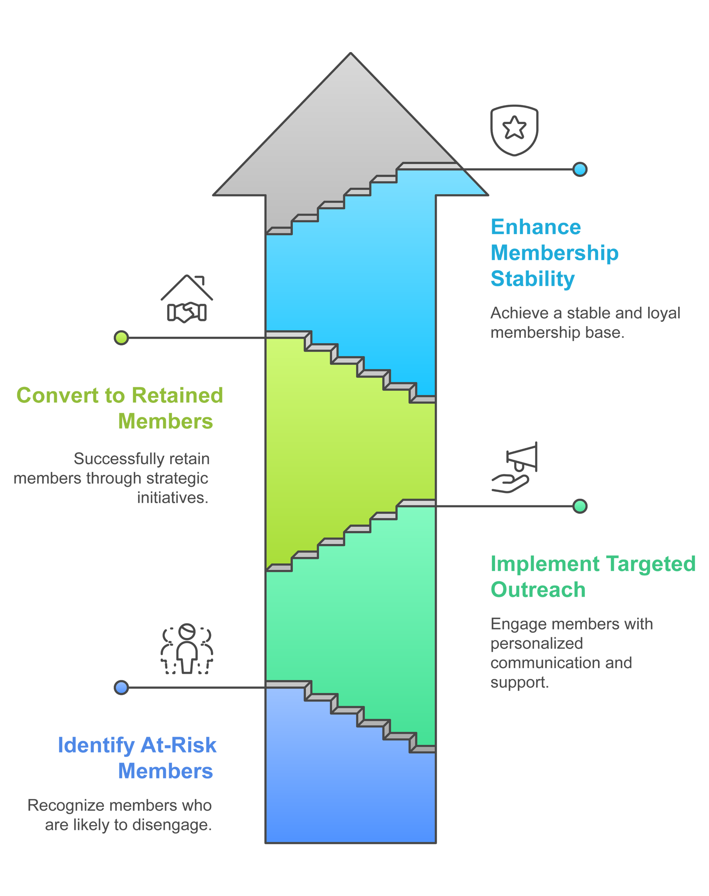
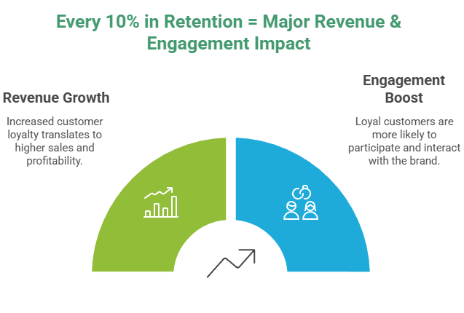
Reducing Member Churn with Predictive Analytics
Our goal: Identify at-risk members early and guide proactive outreach that keeps them engaged.

Slide 3
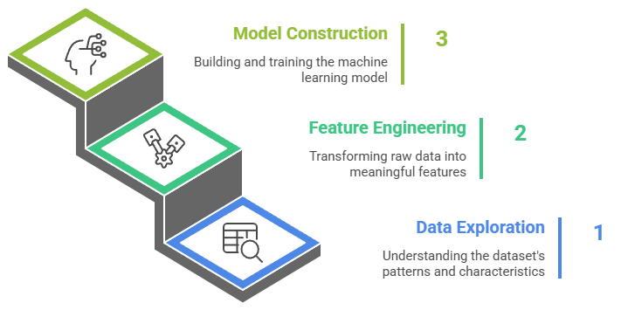
How We Build The Churn Model
Data Sources: App usage, web visits, claims, and churn labels.
Feature Engineering: Engagement frequency, tenure, topic mix (sleep, stress, nutrition), recency of activity, ICD flags.
Training setup: Control-only data (to avoid treatment leakage), evaluated on holdout set.
Models: Logistic Regression (interpretable baseline) + HistGradientBoosting (non-linear booster).

Slide 4
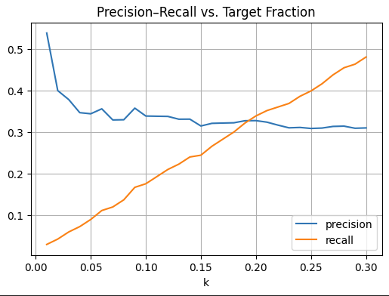
From Prediction to Action
Optimal targeting range: Top 5-10% of members.
Captures ~35% of churners while maintaining 2x lift vs. baseline.
Provides a ranked outreach list (top_n_members.csv) for the retention team.
Calibrated and interpretable for deployment in weekly scoring pipeline.

Slide 5
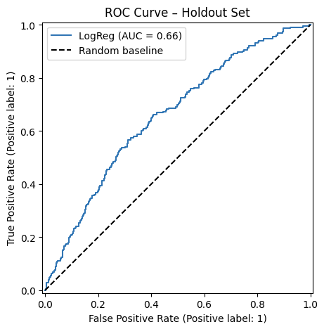
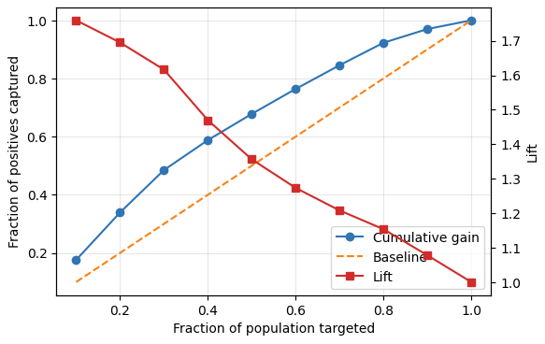
Predictive Performance and Stability
Metric | LogReg
ROC-AUC | 0.657
PR-AUC | 0.297
Precision@10% | 0.36
Recall@10% | 0.18
The model can identify the 10% of members most at risk, capturing ~18% of churners - enough to meaningfully reduce dropout if targeted.

Slide 6
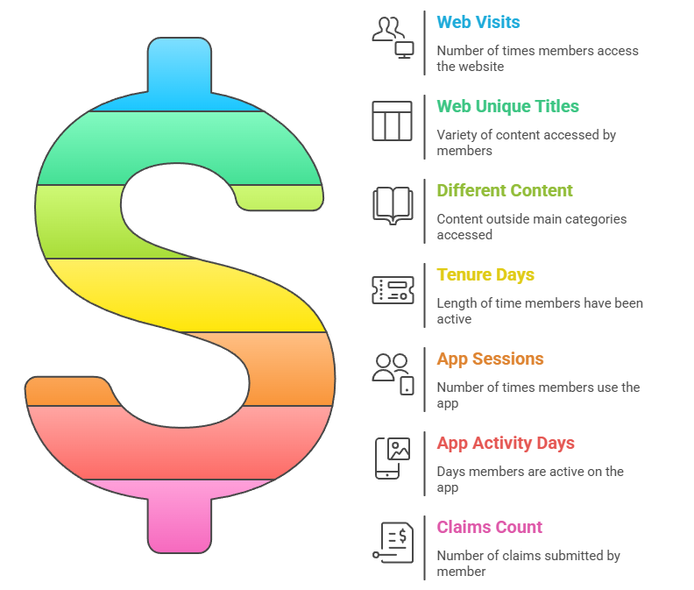
What Drives Members to Stay or Leave?

