Slide 1

They’re Back!
Modern tools for developing static sites.
Brian Rinaldi - @remotesynth

Slide 2

Who Am I?
I’m from Boston

Slide 3

Who Am I?
I’m a Content & Community Manager at Telerik

Slide 4
Background
Notes:
Before we look at what static site generators are, it’s good to understand where they came from and what problems they solve

Slide 5
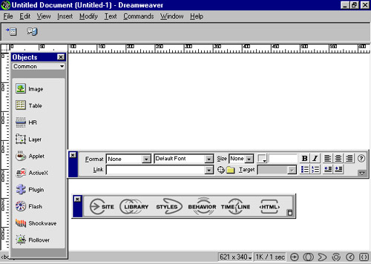
The Early Days

Slide 6

The Early Days
Notes:
Maintaining large sites with static pages was time consuming and tedious. Templates were difficult to create and use.

Slide 7

Content Manage All the Things!
Notes:
To solve these problems we hooked everything up to enterprise CMS systems

Slide 8
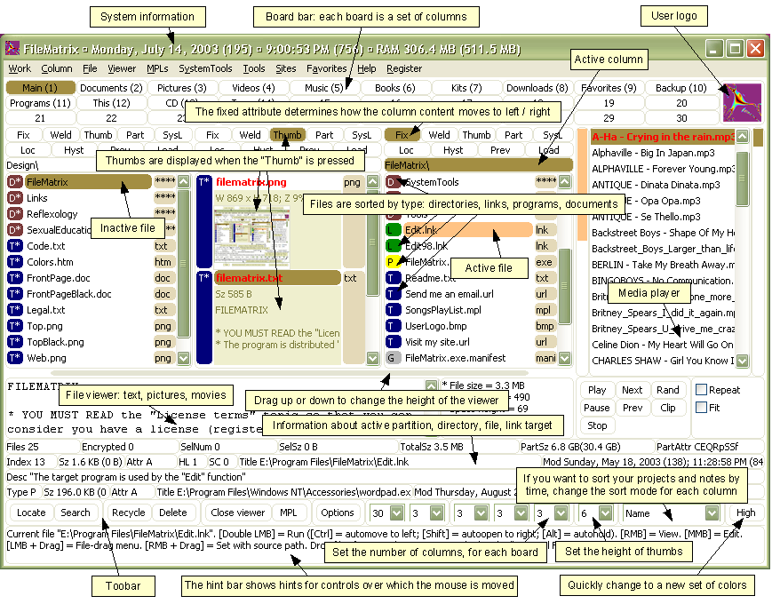
Content Manage All the Things!
Notes:
Which in many cases led to overly complex, one size fits all solutions for a simple problem.

Slide 9
How are Static Site Engines Different?
Manage content and data with no databases
Easy to customize (templating support)
Extensible tooling (plugins)
Ease of authoring (Markdown, HTML, etc.)
Simple build and deployment processes

Slide 10
Dynamic Content
Comments (Disqus)
Forms/Feedback (Wufoo, Google)
Calendars (Google)
Data (Parse.com, Telerik Backend Services)
http://modernweb.com/2013/12/16/moving-to-static-and-keeping-your-toys/

Slide 11
These Tools are Built for Developers

Slide 12
How I’m Evaluating
Documentation
Getting Started/Setup
Language Support
Templating (using defaults)
Creating Content
Dynamic/custom data
Extensibility
Project Health assessment

Slide 13

384 Existing Static Site Engines*
Source: https://staticsitegenerators.net/

Slide 14
Let’s Get Started

Slide 15

Our Sample Project
Available on GitHub at:
https://github.com/remotesynth/Static-Site-Samples

Slide 16



Which Engines We’ll Review

Slide 17
Getting Started

Slide 18
Getting Started
Ruby-based
No official Windows support (but a workaround is available)
> sudo gem install jekyll

Slide 19
Getting Started
Create a new project:
Start the server (automatically watches for changes):
> jekyll new projectname
> cd projectname
> jekyll serve

Slide 20
Templating & Content
Liquid template engine: https://github.com/Shopify/liquid/wiki
Markdown (with YAML front-matter)
Other options are available as plugins

Slide 21
Custom Data
YAML Front Matter
Global and/or per Post
Custom Variables
Data files support: YAML, JSON, CSV

Slide 22

Overview
Overall:
Getting Started
Templating & Content
Custom Data
Documentation
Extensibility
Language Support

Slide 23
Which Engines We’ll Review

Slide 24
Getting Started

Slide 25
Getting Started
Ruby-based
Works on Windows with RubyInstaller
> sudo gem install middleman

Slide 26
Getting Started
Create a new project:
Add LiveReload to Gem file
Activate LiveReload in the config.rb
Install the bundle and start the server
> Middleman init projectname
gem "middleman-livereload", "~> 3.3.0"
activate :livereload
> Bundle install
> middleman

Slide 27
Getting Started
Create a new blog project:
Generate an article
> middleman init MY_BLOG_PROJECT --template=blog
middleman article TITLE

Slide 28
Templating & Content
Erb Templating (a Ruby standard library): http://ruby-doc.org/stdlib-2.2.0/libdoc/erb/rdoc/
Middleman also ships with support for the Haml, Sass, Scss and CoffeeScript
Markdown (with YAML or JSON front matter)
Other options are available as plugins

Slide 29
Custom Data
Set Variable in config.rb (global)
YAML Front Matter (per post)
Custom Variables
Data files support: YAML or JSON

Slide 30
Overview
Overall:
Getting Started
Templating & Content
Custom Data
Documentation
Extensibility
Language Support

Slide 31
Which Engines We’ll Review

Slide 32
Getting Started

Slide 33
Getting Started
JavaScript-based
> sudo npm install -g harp

Slide 34
Getting Started
JavaScript-based
> sudo npm install -g harp

Slide 35
Getting Started
Create a new project:
Use a boilerplate
> harp init projectname
> harp init projectname -b harp-boilerplates/hb-blog

Slide 36
Templating & Content
Jade templating
EJS, Sass, LESS, CoffeeScript also supported
Posts/Pages can be Markdown (GitHub flavored Markdown) or Jade
JSON metadata required
Separate file: _data.json
Supports custom variables

Slide 37
Custom Data
In JSON via via _data.json file
Global or per post/page

Slide 38

Overview
Overall:
Getting Started
Templating & Content
Custom Data
Documentation
Extensibility
Language Support

Slide 39

My Feelings About Jade

Slide 40
Overview
Overall:
Getting Started
Templating & Content
Custom Data
Documentation
Extensibility
Language Support
(with EJS)

Slide 41
Deployment
As static pages to any web server
GitHub pages
Azure
Heroku
Amazon S3
Harp Platform

Slide 42
Repo & Article
Article (covers Jekyll, Harp and Roots)
http://developer.telerik.com/featured/comparing-static-site-engines/
Slides and Samples
https://github.com/remotesynth/Static-Site-Samples
Useful Lists
https://staticsitegenerators.net/
http://www.staticgen.com/

Slide 43

Contact Info
@remotesynth
brian.rinaldi@telerik.com
May 3-5, Boston

Slide 44

Questions?

