Slide 1

WILD TOMORROW SURVEY ANALYSIS REPORT
KEVIN OBOTE

Slide 2
Content:
1. Introduction
2. Methodology
3. Analysis Findings
4. Interpretation and Discussion
5. Recommendations
6. Conclusion

Slide 3

The introduction provides a concise overview of the analysis conducted on a conservation survey administered by lessons in conservation.
It outlines the purpose and scope of the survey, focusing on assessing participants' knowledge, attitudes, and perceptions related to conservation topics.
The significance of the survey findings is emphasized, highlighting their importance in informing decision-making processes and guiding future conservation education initiatives within the organization.
Introduction

Slide 4
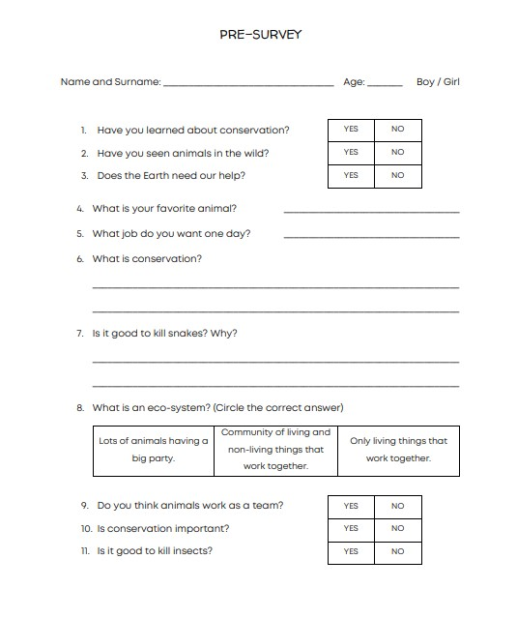
Methodology
Data was collected through survey.
The survey data underwent cleaning to eliminate inconsistencies
A systematic and thorough approach was taken to analyze the survey data and derive meaningful insights

Slide 5
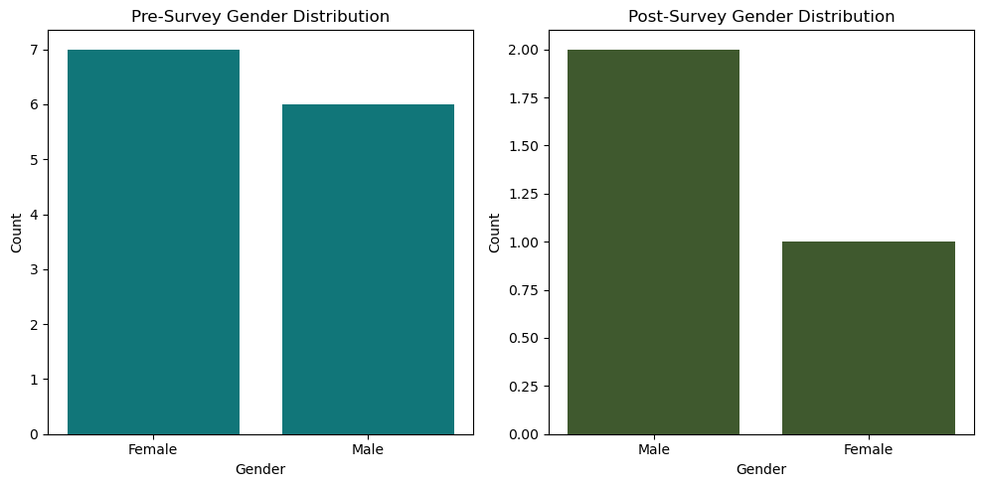
Analysis FINDING : GENDER DISTRIBUTION
The analysis examines the distribution of genders among survey respondents, highlighting any changes or trends observed before and after the survey administration.

Slide 6
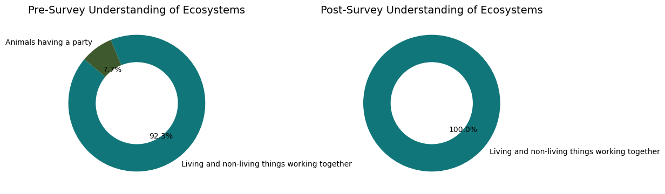
Analysis FINDING : Understanding of Ecosystems
This section evaluates respondents' understanding of ecosystems and assesses any shifts in comprehension levels following the survey.
Notes:
Pie chart

Slide 7
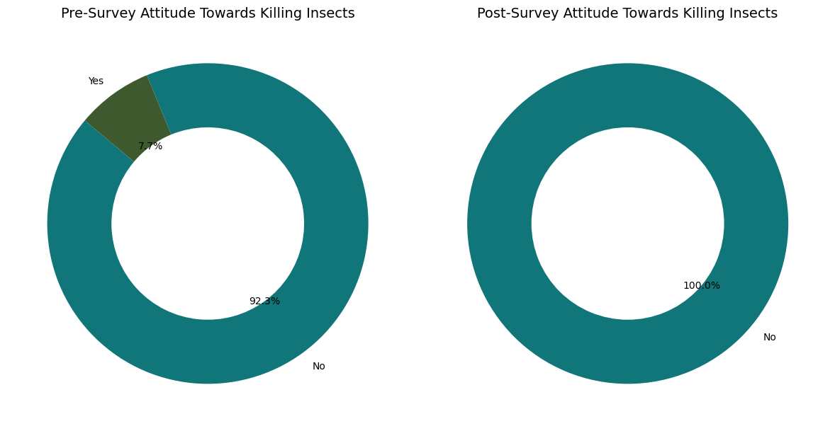
Analysis FINDING :Ecosystems Attitude Towards Killing Insects
The analysis explores respondents' attitudes towards killing insects and examines any variations in viewpoints pre- and post-survey.
Notes:
isualization:
Pie chart illustrating the percentage of respondents who correctly understand the concept of ecosystems before and after the survey.
Summary:
This section evaluates respondents' understanding of ecosystems and assesses any shifts in comprehension levels following the survey. The pie chart provides a visual representation of the proportion of respondents who demonstrated a correct understanding of ecosystems before and after the survey. By comparing the percentages before and after the survey, we can determine if there has been any improvement or change in respondents' comprehension of ecosystems. This analysis helps in gauging the effectiveness of conservation education efforts in enhancing participants' understanding of ecological concepts.

Slide 8
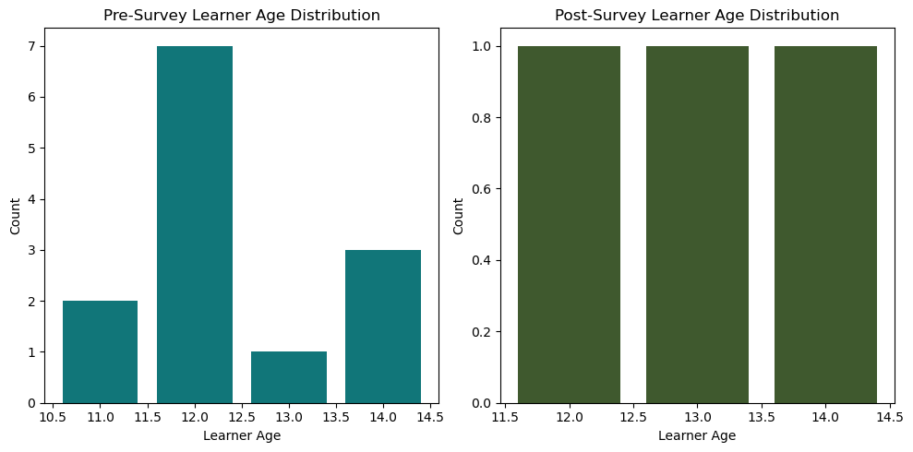
Analysis FINDING :AGE DISTRIBUTION
This section examines the age distribution of survey participants, identifying any changes or patterns in age demographics over time
Notes:
Visualization: A histogram depicting the distribution of participant ages before and after the survey.
Summary: This section examines the age distribution of survey participants, identifying any changes or patterns in age demographics over time.

Slide 9
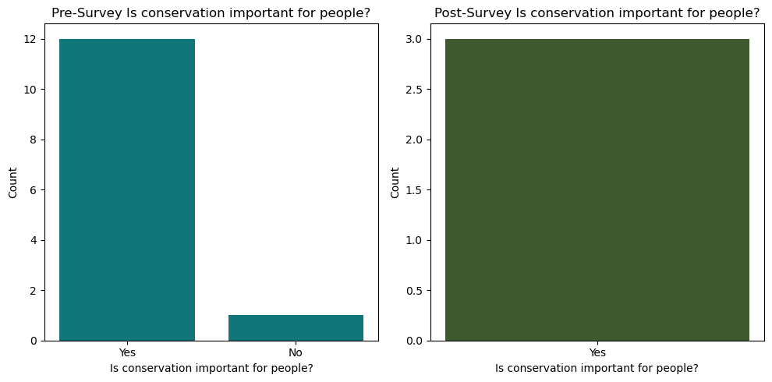
Analysis FINDING :AWARENESS OF CONSERVATION IMPORTANCE
This section examines the age distribution of survey participants, identifying any changes or patterns in age demographics over time

Slide 10

Interpretation and RECOMMENDATIONS
The analysis of survey findings provides valuable insights into conservation education, revealing trends and shifts in attitudes.
Tailored educational programs are essential to address knowledge gaps effectively.
However, it's crucial to acknowledge survey limitations, such as biases in demographics and contextual factors affecting interpretation.

Slide 11
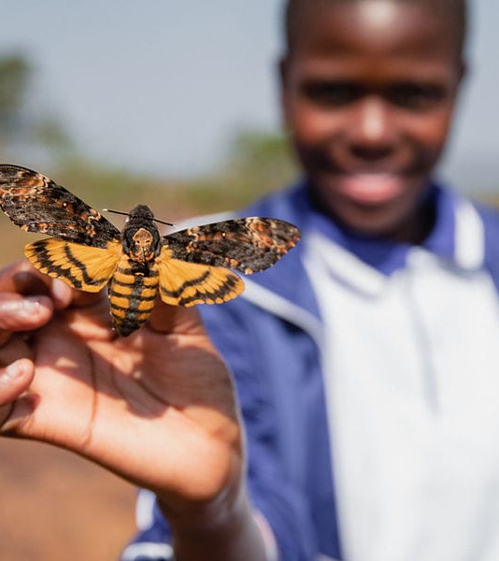
Conclusion
The analysis emphasizes the vital role of conservation education in raising awareness and promoting action for environmental conservation. Addressing challenges and capitalizing on opportunities can significantly contribute to biodiversity conservation efforts.
Key Findings Summary:
Insights include attitude shifts, knowledge variations among demographics, and the significance of targeted interventions.
Importance of Monitoring and Evaluation:
Regular assessment ensures the relevance and impact of conservation education programs, allowing for continuous improvement in addressing conservation challenges.
Thank You!

