Slide 1
TMB 计算方法
16年调研结果：
癌种 | 样本类型 | 检测方法 | 芯片 | 检测突变 | 排除
CRC | FFPE | 目标序列捕获测序 | MSK-IMPAC | 所有非沉默突变 | germline alterations（BC）、 CNV、SV
NSCLC | TISSUE | 全外显子 | 无 | 所有体细胞 非同义突变 | 无
Urothelial carcinoma | FFPE | 目标序列捕获测序 | Foundation ONE | 所有可编码的、短的、可变的改变个数， 包括碱基替换、indel 、同义突变 | germline alterations &功能性突变
LC | FFPE | 目标序列捕获测序 | 未知 | 体细胞的编码碱基替换和indel | 无
Ⅳ期实体瘤 | TISSUE | 目标序列捕获测序 | FoundationONE &Guardant360 &Caris Life Sciences | 总基因组变化、（预测或非预测的）恶性\良性突变、VUS、其他 | 同义突变
Melanoma | TISSUE | 全外显子 | 无 | 所有体细胞 非同义突变 | Gernline alternations (BC)
主要参考文献：
Tumor mutational load predicts survival after immunotherapy across multiple cancer types.
Tumor mutational burden (TMB) standardization initiatives Recommendations.
当时只考虑非同义突变的原因说明：
a. 当时主要参考MSK,不加同义突变；b.考虑到TMB与新抗原的关系，没有加同义突变；c.基于对WES数据的评估，发现不加同义突变R2值也很好。

Slide 2


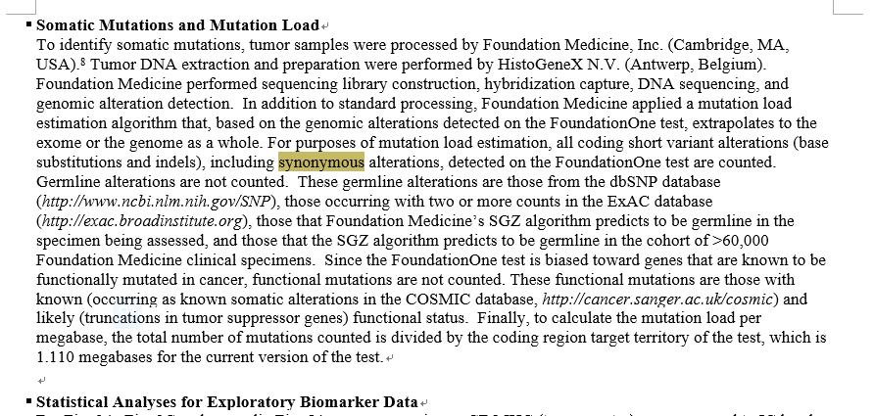
04
TMB算法描述
BGI TMB 算法
采用大panel产品的肿瘤突变过滤方法，同时考虑 SNP 和 Indel
突变纳入频率限为≥0.9%的可信突变
纳入同义突变，同时去除driver突变
不同研究中TMB对于同义突变的处理
癌种 | 样本类型 | 检测方法 | 芯片 | 检测突变 | 排除
CRC | FFPE | 目标序列捕获测序 | MSK-IMPAC | 所有非沉默突变 | germline alterations（BC）、 CNV、SV
NSCLC | TISSUE | 全外显子 | 无 | 所有体细胞 非同义突变 | 无
Urothelial carcinoma | FFPE | 目标序列捕获测序 | Foundation ONE | 所有可编码的、短的、可变的改变个数， 包括碱基替换、indel 、同义突变 | germline alterations &功能性突变
LC | FFPE | 目标序列捕获测序 | 未知 | 体细胞的编码碱基替换和indel | 无
Ⅳ期实体瘤 | TISSUE | 目标序列捕获测序 | FoundationONE &Guardant360 &Caris Life Sciences | 总基因组变化、（预测或非预测的）恶性\良性突变、VUS、其他 | 同义突变
Melanoma | TISSUE | 全外显子 | 无 | 所有体细胞 非同义突变 | Gernline alternations (BC)
“Synonymous mutations are counted in order to reduce sampling noise. While synonymous mutations are not likely to be directly involved in creating immunogenicity, their presence is a signal of mutational processes that will also have resulted in nonsynonymous mutations and neoantigens elsewhere in the genome. Non-coding alterations were not counted.
考虑加入同义突变的证据：
1 很多公开发表的文献，支持加入同义突变。
2 Foundation Medicine考虑同义突变。
3 国内竞品公司，多数支持加入同义突变。
©2019 BGI All Rights Reserved.

Slide 3
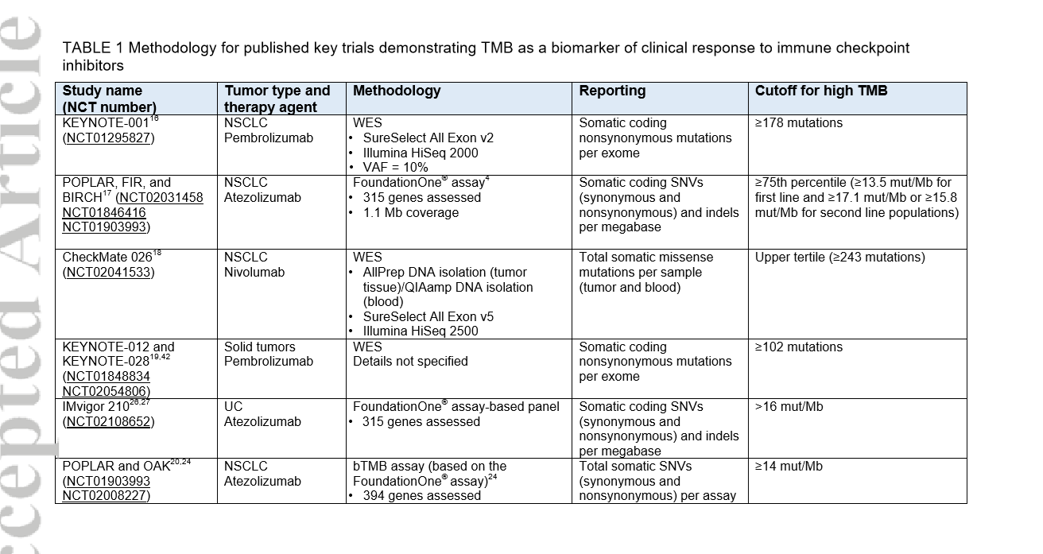
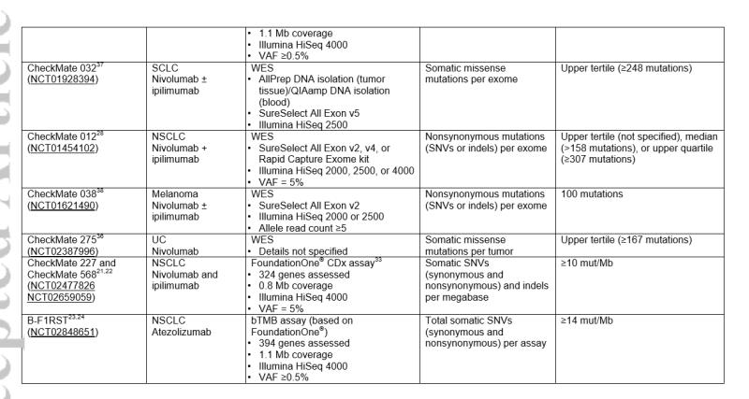
18年调研结果：
备注1：考虑加入同义突变的理论依据:参考文献：Analysis of 100,000 human cancer genomes reveals the landscape of tumor mutational burden.
“Synonymous mutations are counted in order to reduce sampling noise. While synonymous mutations are not likely to be directly involved in creating immunogenicity, their presence is a signal of mutational processes that will also have resulted in nonsynonymous mutations and neoantigens elsewhere in the genome. Non-coding alterations were not counted.”即“计算同义突变是为了减少采样噪声,具体的, 虽然同义突变不直接参与产生免疫抗原，但它们的存在也是突变过程的信号。
备注2：考虑加入同义突变的理论依据:FM是考虑同义突变的。Atezolizumab in patients with locally advanced and metastatic urothelial carcinoma who have progressed following treatment with platinum-based chemotherapy: a single arm, phase 2 trial
现在考虑加回同义突变的原因说明：
a. 最最主要的是为了解决TMB=0的问题；b. 其他公司多数包含同义突变；c.同义突变是TMB的一个背景信号;d.FM是考虑同义突变的；
说明：是否加入同义突变都是合理的，只要建立自己的一套完整体系就好.

Slide 4
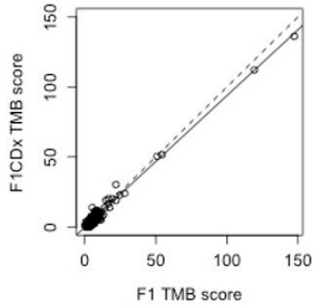
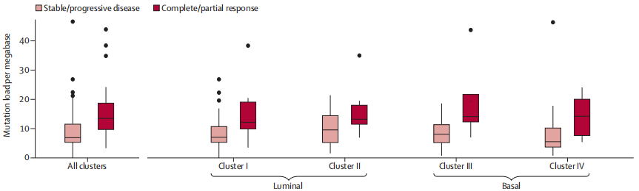
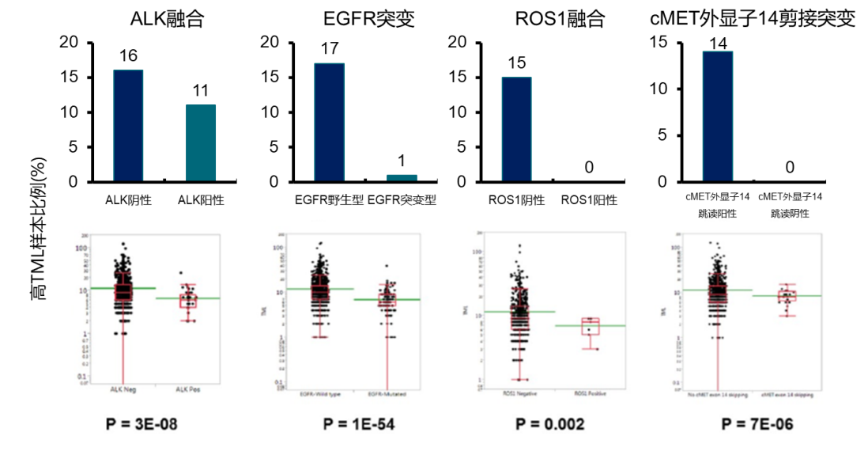
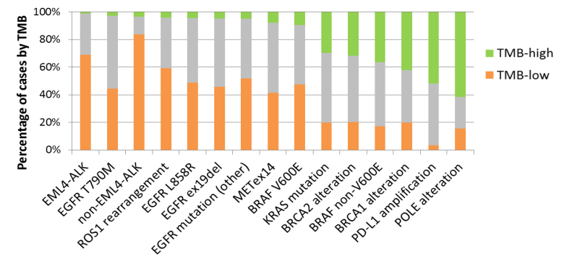
04
TMB算法描述
关于 driver 基因的去除的说明
Atezolizumab in patients with locally advanced and metastatic urothelial carcinoma who have progressed following treatment with platinum-based chemotherapy: a single-arm, multicentre, phase 2 trial
FoundationOne CDx™ (F1CDx)
Since the FoundationOne test is biased toward genes that are known to be functionally mutated in cancer, functional mutations are not counted. These functional mutations are those with known (occurring as known somatic alterations in the COSMIC database, http://cancer.sanger.ac.uk/cosmic) and likely (truncations in tumor suppressor genes) functional status.
Tumor mutational burden (TMB) is measured by counting all synonymous and non-synonymous variants present at 5% allele frequency or greater, and filtering out potential germline variants according to published databases of known germline polymorphisms including Single Nucleotide Polymorphism database (dbSNP) and Exome Aggregation Consortium (ExAC). Additional germline alterations still present after database querying are assessed for potential germline status and filtered out using a somatic-germline/zygosity (SGZ) algorithm. Furthermore, known and likely driver mutations are filtered out to exclude bias of the data set.
因panel设计思路，会富集功能性突变、无法精确反应基因组随机突变情况
排除COSMIC记载的突变
排除抑癌基因截断突变
FM报证产品，去除driver mutations
该算法下，仍存在TMB=0的情况
NSCLC中驱动基因突变与TMB低水平相关
TMB-H与靶药相关突变可能互斥
TMB-H/L两组间伴有驱动基因变异
存在药物相关的癌基因突变患者多为TMB-L
TMB-H患者则多为BRCA1/2失活改变，POLE突变及PD-L1扩增
©2019 BGI All Rights Reserved.

Slide 5
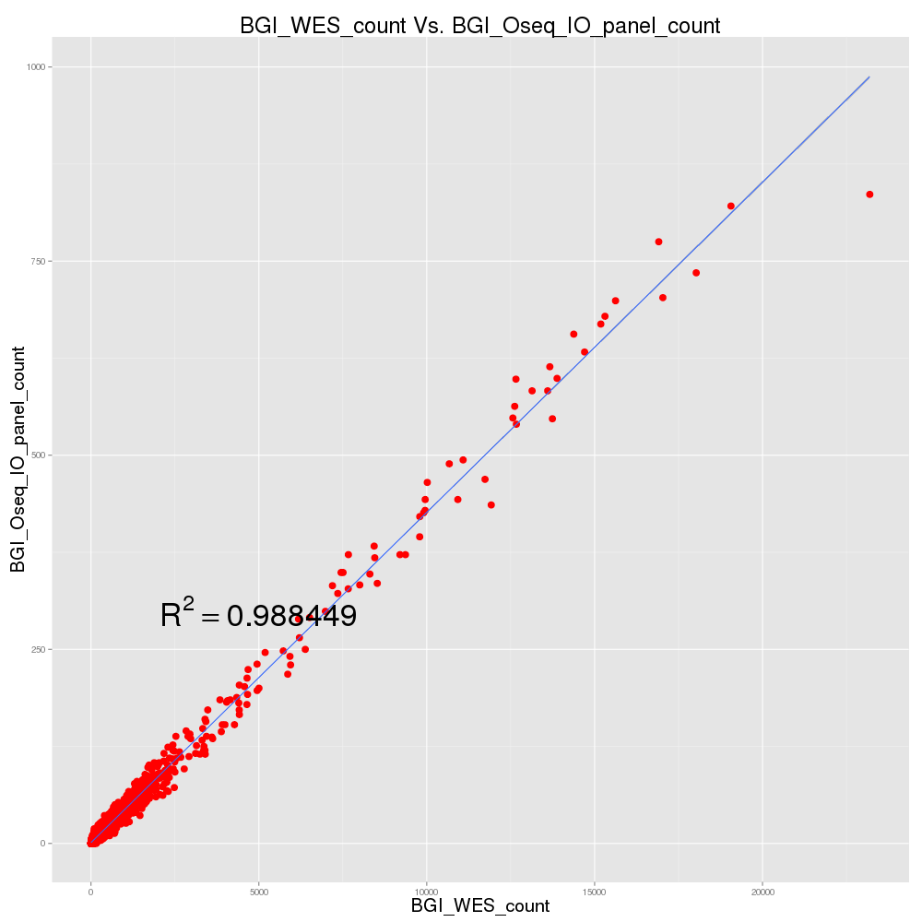
基于TCGA数据，采用BGI TMB算法考察WES-TMB与panel-TMB的一致性（相关性）
样本类型 | 样本例数 | BGI-TMB标准下 相关系数 | 样本类型 | 样本例数 | BGI-TMB标准下 相关系数
ACC | 89 | 0.988154213 | LUSC | 453 | 0.915506411
BLCA | 387 | 0.94682634 | MESO | 77 | 0.8231599
BRCA | 730 | 0.945841361 | OV | 62 | 0.747238885
CESC | 285 | 0.968986923 | PAAD | 117 | 0.586457518
CHOL | 36 | 0.977789369 | PCPG | 150 | 0.385671786
COAD | 275 | 0.985536237 | PRAD | 411 | 0.878110774
DLBC | 33 | 0.878987375 | READ | 87 | 0.955356393
ESCA | 181 | 0.957030069 | SARC | 224 | 0.955811375
GBM | 299 | 0.870277611 | SKCM | 352 | 0.97029788
HNSC | 465 | 0.940692811 | STAD | 383 | 0.984273542
KICH | 55 | 0.976486596 | TGCT | 129 | 0.529303802
KIRC | 357 | 0.832065318 | THCA | 388 | 0.588902896
KIRP | 254 | 0.633179079 | THYM | 86 | 0.943355308
LGG | 483 | 0.618358861 | UCEC | 400 | 0.982263863
LIHC | 354 | 0.911298824 | UCS | 56 | 0.952311426
LUAD | 461 | 0.963121622 | UVM | 80 | 0.858840389
之前Oseq的芯片范围

Slide 6
Panel(1.5%)和WES的TMB一致性

Slide 7
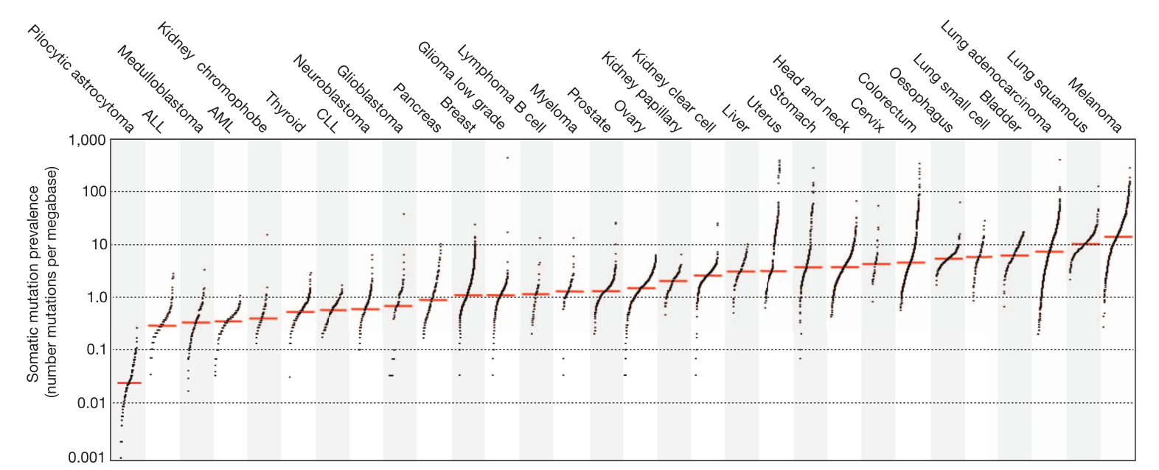
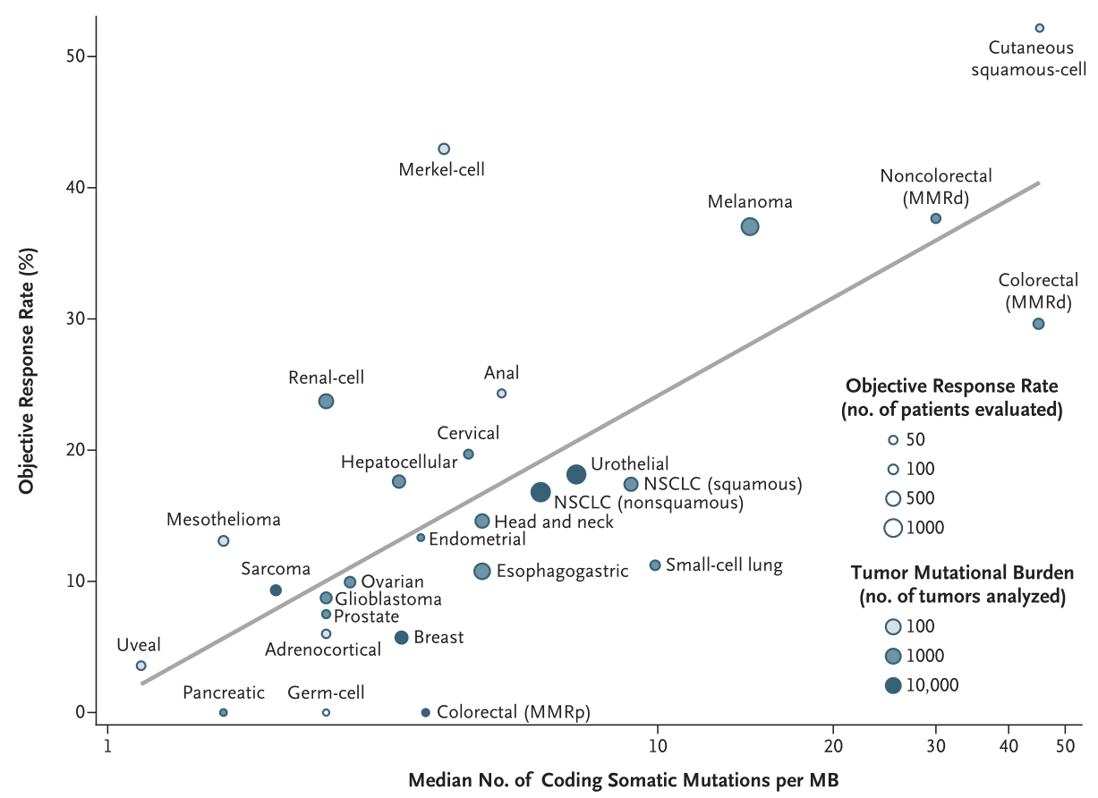
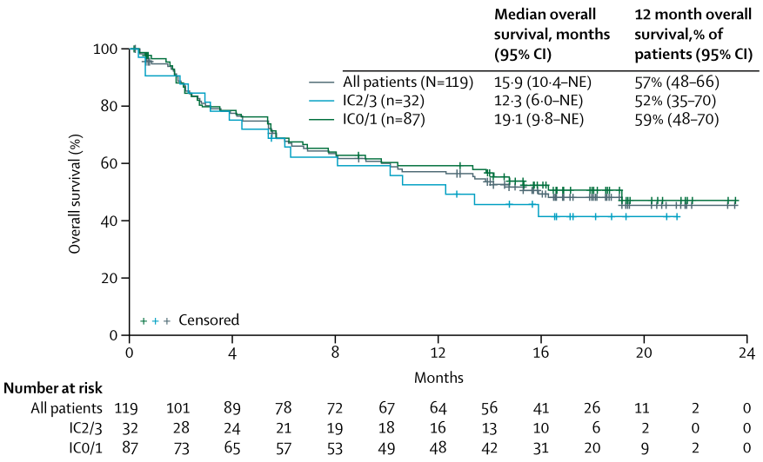
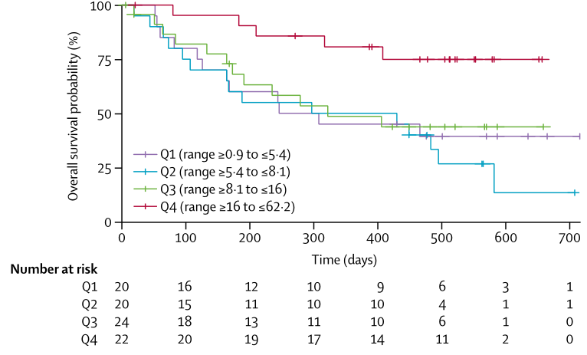
04
TMB
TMB原理和概念建立
TMB虽然是近年流行起来的概念，但突变负荷的统计观念由来已久
不同癌种的中位值突变数目与其免疫治疗用药有效性呈正相关。总体来说，突变数量多的癌种，客观缓解率往往更高
部分药物（如Atezolizumab）疗效与PD-L1表达没有显著相关性，而患者总的突变负荷可以对用药效果进行良好的评价
©2019 BGI All Rights Reserved.

