Slide 1
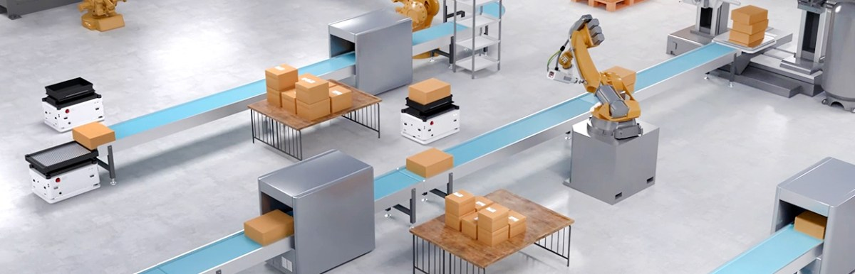
物聯網應用設計 期末專題
智慧化無人載具物流系統
組員:王昱健、葉舜斌

Slide 2
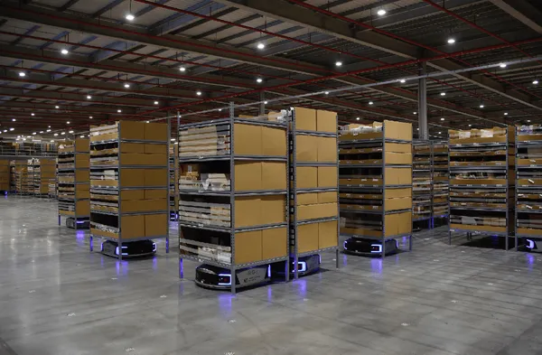
打造倉儲之智慧物流，藉由機械手臂及無人載具實現全自動化之倉儲存取及運輸
我們希望可以結合過去所學之無人載具相關技術及知識，應用於這次物聯網期末專題中。現今生活中，智慧倉儲與智慧物流在物聯網中，與無人載具有著最直接的關係，並且有許多實際的應用案例。
智慧倉儲最主要的功能之一，就是可以自動存取所需要之物品。我們計劃使用機械手臂搭配鏡頭，透過鏡頭掃取視覺標籤，確認存取物品並前往夾取；物流方面則是使用無人載具運送物品，為了降低成本我們使用循跡方式作為最簡單之路線規劃，順利將物品送達目的地。

Slide 3
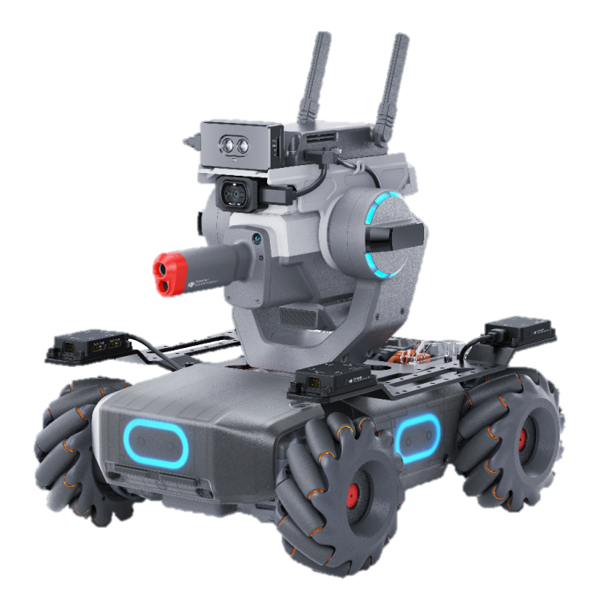
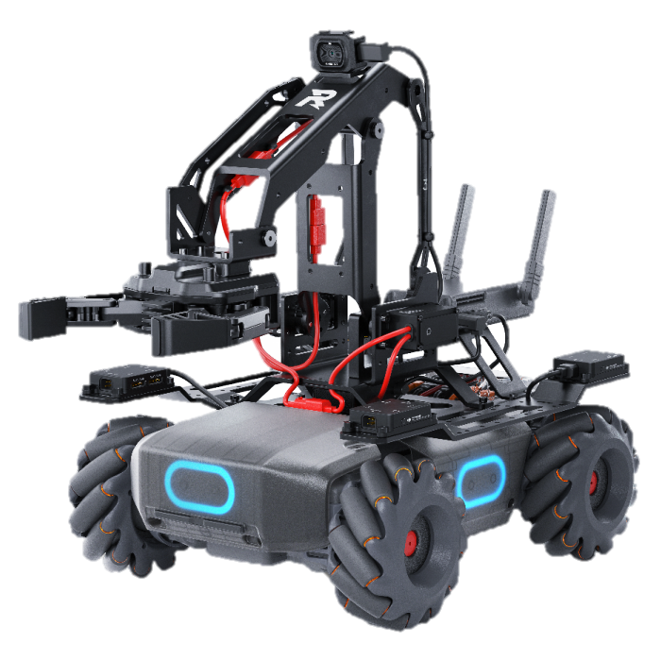
Robomaster EP
Robomaster EP為DJI設計的一款先進的教育機器人。
使用基於Python語言Robomaster SDK進行控制，提供運動控制，飛行控制，智慧識別，燈效設置，資料推送，視頻流和音訊流等API接口
麥克納姆輪：由 4 個各含 12 個輥子的麥克納姆輪構成，可進行高精準度的全向運動。
機械手臂：配備強大的伺服馬達系統，實現精確靈活的操作。
兩軸機械雲台：雲台轉動範圍可達 540° x 65°，配搭 FPV 相機，讓機器人擁有廣闊視野。
紅外線深度離感測器：可在 0.1 ~ 10 m 的測距範圍內達到約為量程 5% 的高測量精準度。

Slide 4
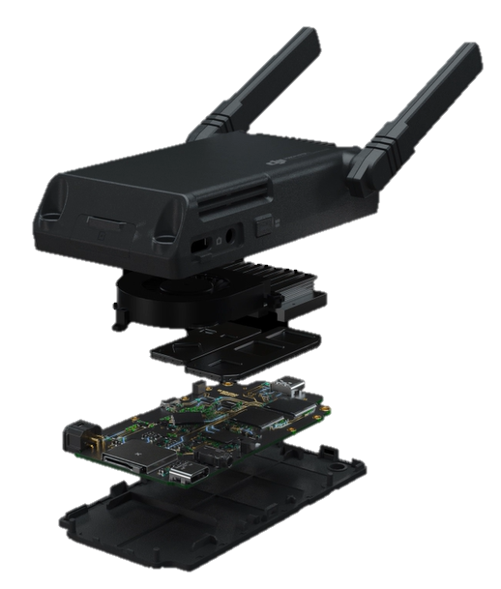




智慧中控
擁有強大運算能力的智能中控，同時支援低延遲高清圖像傳輸、AI智慧演算、平行編程開發等功能。
連線方式支援Wi-Fi和路由器連接，實現無縫資料傳輸和遠端控制。
支援外接 Micro:Bit、Arduino、樹莓派等第三方開源硬件，同時支援通過人工智能晶片平台 Jetson Nano 和 SDK 進行模型訓練和場景識別。

Slide 5


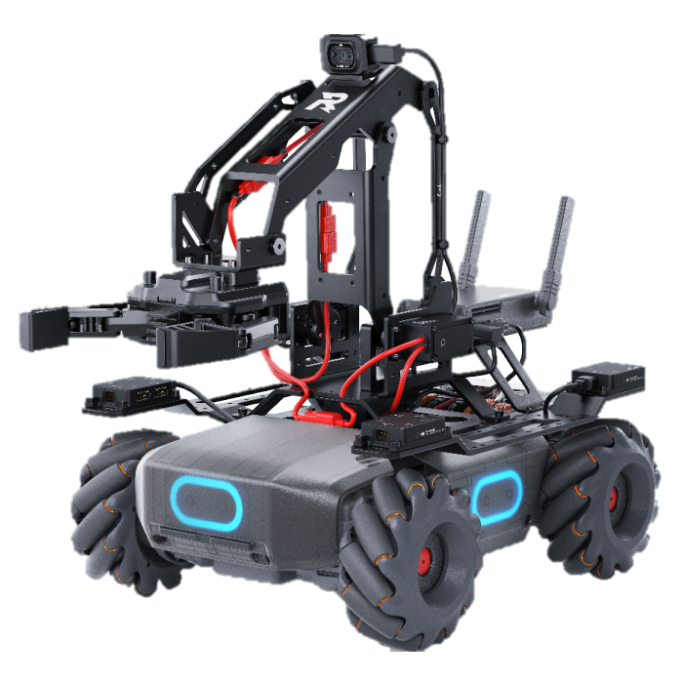
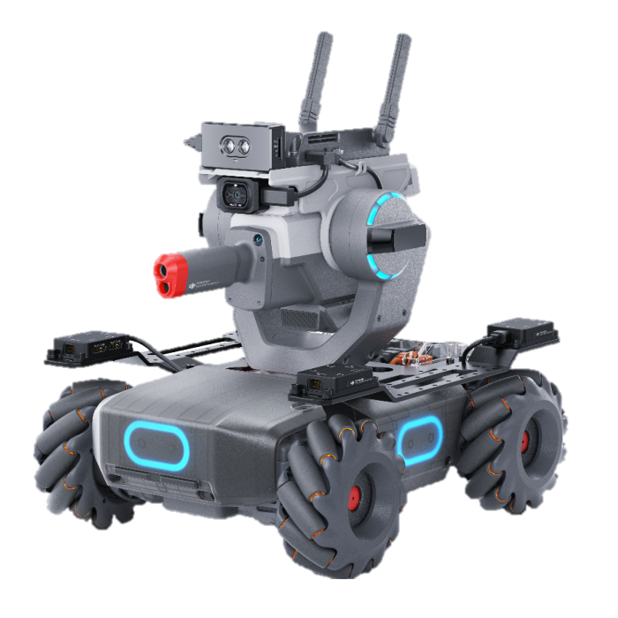

實驗流程圖：
DATA
機械手臂根據目標資訊選擇路線
機械手臂於路線中夾取物品
載具讀取視覺標籤
確認目標物品
將目標資訊傳輸給機械手臂
5

Slide 6
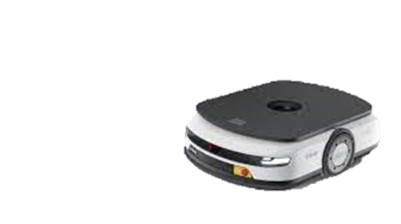
實驗流程圖：
DATA
手臂迴轉
返回載具旁
超音波檢測物品是否放置
載具沿指定地面標記路線前進
機械手臂夾取貨物
放置於載具上
貨物送達指定地點
6

Slide 7
程式流程圖：
偵測是否有圖示
初始化 Robot1(cargo) & Robot2(arm)
Start
Robot1 依照路線行駛
(循跡)
否:繼續循跡
否:繼續循跡
是:讀取圖示上之任務號碼
距離目標是否小於50cm
Robot2 移動至物品前
並夾取物品
Robot2 依照路線行駛前往指定地點(循跡)
Robot1停止循跡
停在指定位置
Robot2 接收任務
是
偵測是否有圖示
Robot2 回程
(循跡)
Robot2 停於出發點並將物品移至Robot1
Robot1 回到起點
(循跡)
End
是
否:繼續循跡

Slide 8
程式：
Import 所需的函數庫
import cv2 from robomaster import robot, vision import numpy as np import time
定義函數，分別是儲存標示、線及距離數據
markers = [] def on_detect_marker(marker_info): number = len(marker_info) for i in range(0, number): x, y, w, h, info = marker_info[i] markers.append(MarkerInfo(x, y, w, h, info)) line_list = [] def on_detect_line(line_info): global line_list line_list = [PointInfo(x, y, ceta, c) for x, y, ceta, c in line_info[1:]] distance_data = None def sub_data_distance(sub_info): distance = sub_info distance_data = distance[0] print("tof1:{0}".format(distance[0]))
定義class來儲存標示訊息
class MarkerInfo: def __init__(self, x, y, w, h, info): self.x = x self.y = y self.w = w self.h = h self.info = info @property # 計算左上角的座標點 def pt1(self): return int((self.x - self.w / 2) * 1280), int((self.y - self.h / 2) * 720) @property # 計算右下角的座標點 def pt2(self): return int((self.x + self.w / 2) * 1280), int((self.y + self.h / 2) * 720) @property # 計算中心點 def center(self): return int(self.x * 1280), int(self.y * 720)

Slide 9
循跡主程式，分別有cargo-marker、 arm-distance及arm-marker三種模式
def track_line(ep_robot, mode): ep_vision, ep_camera, ep_chassis, ep_gripper, ep_sensor, ep_gimbal = configure_robot(ep_robot) ep_camera.start_video_stream(display=False) try: if mode == "cargo-marker": configure_marker_execute(ep_vision, ep_chassis, ep_camera, ep_gimbal, "cargo") elif mode == "arm-distance": configure_distance_execute(ep_vision, ep_chassis, ep_camera, ep_gimbal, ep_gripper, ep_sensor) elif mode == "arm-marker": configure_marker_execute(ep_vision, ep_chassis, ep_camera, ep_sensor, "arm") except Exception as e: print("91 An error occurred: %s", e) ep_chassis.drive_speed(x=0, y=0, z=0, timeout=0.5) time.sleep(1) finally: ep_vision.unsub_detect_info(name="line") cv2.destroyAllWindows() ep_camera.stop_video_stream() ep_robot.close()
如果在執行過程中發生了任何異常，track_line函數會捕獲這個異常，並且停止機器人的移動。最後，無論是否發生異常，都會取消對線條的檢測，關閉所有的視窗，以降低不必要的資源。

Slide 10
執行視覺標記識別和線條追蹤
def configure_marker_execute(ep_vision, ep_chassis, ep_camera, ep_gimbal, mode): pid = PIDController(Kp=27, Ki=0, Kd=2.5) x_val = 0.5 while True: img = ep_camera.read_cv2_image(strategy="newest", timeout=0.5) frame_width = img.shape[1] ep_vision.sub_detect_info(name="marker", callback=on_detect_marker) print("line 125") for j in range(0, len(markers)): cv2.rectangle(img, markers[j].pt1, markers[j].pt2, (255, 255, 255)) if markers: stop_and_reposition(ep_chassis) ep_chassis.move(x=0, y=0, z=180, z_speed=45).wait_for_completed() break print("line 139") ep_vision.sub_detect_info(name="line", color="blue", callback=on_detect_line) if mode == "cargo": process_lines_cargo(ep_chassis, img, pid, x_val, frame_width, line_list) elif mode == "arm": process_lines_arm(ep_chassis, ep_gimbal, img, pid, x_val, frame_width, line_list) print("line 142") cv2.imshow("Line", img) if cv2.waitKey(1) & 0xFF == ord(' '): stop_and_reposition(ep_chassis) break

Slide 11
定義PID控制器
class PIDController: def __init__(self, Kp, Ki, Kd): self.Kp = Kp self.Ki = Ki self.Kd = Kd self.prev_error = 0 self.integral = 0 def compute(self, setpoint, current_value): error = current_value - setpoint self.integral += error derivative = error - self.prev_error self.prev_error = error return self.Kp * error + self.Ki * self.integral + self.Kd * derivative
定義class來儲存點的訊息
class PointInfo: def __init__(self, x, y, theta, c): self.x = x self.y = y self.theta = theta self.c = c @property def pt(self): return int(self.x * 1280), int(self.y * 720) @property def color(self): return 255, 255, 255

Slide 12
執行距離感測和視覺識別功能
def configure_distance_execute(ep_vision, ep_chassis, ep_camera, ep_gimbal, ep_gripper, ep_sensor): pid = PIDController(Kp=27, Ki=0, Kd=2.5) x_val = 0.1 while True: img = ep_camera.read_cv2_image(strategy="newest", timeout=0.5) frame_width = img.shape[1] ep_sensor.sub_distance(freq=5, callback=sub_data_distance) ep_vision.sub_detect_info(name="line", color="blue", callback=on_detect_line) ep_gimbal.moveto(pitch=-50, yaw=0).wait_for_completed() process_lines_arm(ep_chassis, ep_gimbal, img, pid, x_val, frame_width, line_list) if distance_data is not None: print("distance_data : None") else: if distance_data <= 50: print("distance_data < 50") stop_and_reposition(ep_chassis) ep_chassis.move(x=0.05, y=0, z=0, xy_speed=0.01).wait_for_completed() break cv2.imshow("Line", img) if cv2.waitKey(1) & 0xFF == ord(' '): stop_and_reposition(ep_chassis) break

Slide 13
處理視覺識別系統獲取線條
def process_lines_cargo(ep_chassis, img, pid, x_val, frame_width, line_list): if line_list: recent_points = line_list[:-6] avg_x = int(np.mean([p.pt[0] for p in recent_points])) avg_y = int(np.mean([p.pt[1] for p in recent_points])) setpoint = frame_width // 2 control_signal = pid.compute(setpoint, avg_x) / 100 ep_chassis.drive_speed(x=x_val, y=0, z=control_signal) for point in line_list: cv2.circle(img, point.pt, 3, point.color, -1) cv2.circle(img, (avg_x, avg_y), 5, (0, 255, 0), -1)
def process_lines_arm(ep_chassis, ep_gimbal, img, pid, x_val, frame_width, line_list): if line_list: recent_points = line_list[:-6] avg_x = int(np.mean([p.pt[0] for p in recent_points])) avg_y = int(np.mean([p.pt[1] for p in recent_points])) setpoint = frame_width // 2 control_signal = pid.compute(setpoint, avg_x) / 100 ep_gimbal.drive_speed(pitch_speed=0, yaw_speed=control_signal) ep_chassis.drive_speed(x=x_val, y=0, z=control_signal) for point in line_list: cv2.circle(img, point.pt, 3, point.color, -1) cv2.circle(img, (avg_x, avg_y), 5, (0, 255, 0), -1)

Slide 14
執行指定的任務
def execute_task(robot, task): ep_chassis, ep_servo, ep_gimbal = robot.chassis, robot.servo, robot.gimbal if task == "1": ep_chassis.move(x=0, y=0, z=90, z_speed=45).wait_for_completed() elif task == "2": ep_chassis.move(x=0, y=0, z=0, xy_speed=0).wait_for_completed() elif task == "3": ep_chassis.move(x=0, y=0, z=-90, z_speed=45).wait_for_completed() else: stop_and_reposition(ep_chassis) print("No get task") time.sleep(0.5) ep_servo.moveto(index=1, angle=-10).wait_for_completed() ep_servo.moveto(index=2, angle=-35).wait_for_completed() ep_gimbal.moveto(pitch=-50, yaw=0).wait_for_completed() time.sleep(0.5)

Slide 15
夾起貨物
def catch_and_return(robot): ep_chassis, ep_gripper, ep_servo, ep_gimbal = robot.chassis, robot.gripper, robot.servo, robot.gimbal print("catch") ep_gripper.close(power=10) time.sleep(1.5) ep_gripper.pause() time.sleep(0.5) print("Gripper closed") ep_servo.moveto(index=2, angle=-95).wait_for_completed() ep_servo.moveto(index=1, angle=80).wait_for_completed() print("Finish") time.sleep(2) ep_chassis.move(x=0, y=0, z=180, z_speed=45).wait_for_completed() ep_gimbal.moveto(pitch=-50, yaw=0, pitch_speed=100, yaw_speed=100).wait_for_completed() time.sleep(0.5)

Slide 16
回到起始點，並將貨物移至無人車上
def execute_task_back(robot, task): ep_chassis, ep_gripper, ep_servo, ep_gimbal = robot.chassis, robot.gripper, robot.servo, robot.gimbal if task == "1": ep_chassis.move(x=0, y=0, z=-90, z_speed=45).wait_for_completed() elif task == "2": ep_chassis.move(x=0, y=0, z=0, xy_speed=0).wait_for_completed() elif task == "3": ep_chassis.move(x=0, y=0, z=90, z_speed=45).wait_for_completed() else: stop_and_reposition(ep_chassis) print("No get task") time.sleep(0.5) ep_chassis.move(x=0.2, y=0, z=0, xy_speed=0.7).wait_for_completed() time.sleep(0.5) ep_servo.moveto(index=1, angle=-10).wait_for_completed() ep_servo.moveto(index=2, angle=-55).wait_for_completed() ep_gripper.open(power=10) time.sleep(2) ep_gripper.pause() time.sleep(1) ep_servo.moveto(index=2, angle=-95).wait_for_completed() ep_servo.moveto(index=1, angle=80).wait_for_completed() time.sleep(0.5) ep_chassis.move(x=-0.5, y=0, z=0, xy_speed=0.7).wait_for_completed() ep_chassis.move(x=0, y=0, z=180, z_speed=45).wait_for_completed() print("The End from Arm Robot")

Slide 17
主程式，依照流程圖依序執行上述的函數，完成任務
如遇到錯誤則會跳出錯誤通知 "Emergency stop!"
if __name__ == "__main__": try: robot1 = robot.Robot() robot1.initialize(conn_type="sta", sn="3JKDH6C001462K") robot2 = robot.Robot() robot2.initialize(conn_type="sta", sn="3JKDH5D0017578") track_line(robot1, "cargo-marker") task = markers[0].info if markers else None markers.clear() print("task:", task) # task = "2" execute_task(robot2, task) print("go to specify place") track_line(robot2, "arm-distance") print("arrived specify place") catch_and_return(robot2) print("catch_and_return") track_line(robot2, "arm-marker") print("arm_robot come back") execute_task_back(robot2, task) track_line(robot1, "cargo-marker") print("The End") except KeyboardInterrupt: print("Emergency stop!") finally: robot1.close() robot2.close() print("All robots closed")

Slide 18
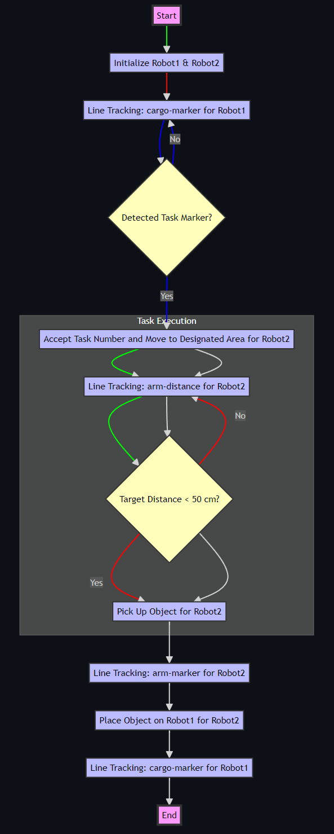
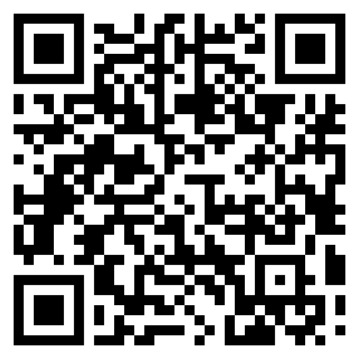
Mermaid流程圖
Code on GitHub

Slide 19
Q&A

Slide 20
THANKS FOR LISTENING

