Slide 1

OSRS Best-in-Slot Item Tracker
Ben Puryear

Slide 2
Original Proposal
View item prices
Predict trends (up/down)
Incorporate blog information into predictions
Use Google Cloud to host and deploy my application
Dashboard for important items
Notes:
View Item prices
predict trends (Simple up/down)
Incorporate blog info
Google Cloud
Dashboard for important Items

Slide 3
Original Proposal
View item prices
Predict trends (up/down)
Incorporate blog information into predictions
Use Google Cloud to host and deploy my application
Dashboard for important items
Notes:
As all projects like these, there were a few changes made to it
I bit off a bit more than i could chew with a few things.
but things arent just being removed from this proposal...
there are also things being added

Slide 4
Original Proposal
View item prices (Only three BIS items)
Predict trends (individual steps up to a week in the future)
Incorporate detailed historical data into predictions
Use Streamlit to host and deploy my application
Dashboard for important items
Revised
Notes:
I specialized on three items to perfect their models
Instead of predicting an up or down for the next delta, it predicts 30 instances in the future. (30 deltas)
not only can i few recent data, but also historical data
streamlit (shoutout trevor)

Slide 5

Modifications made to original proposal
Only 3 Items
General model vs hyper-focused model
3 model per item!
No incorporation of blog posts
Couldn’t really find an effective way to implement them
Not many important blog posts relating to items
Mostly focused on the new Prayer Books
Not just predicting a simple “Go Up” vs “Go Down”
Wanted more than that
Two of my deployed models still use it, but my main one does not
Not using Google Cloud
Streamlit / GitHub Pages
Notes:
Althrough there are only 3 items, this meant that i can generate hypoerfocused models for them!
Items are extremely different, variation in price, quantity, usage leading to demand, etc.
Blog posts prooved to be a bit of a problem because they really havent done many recently. They have been focusing on developing and encorperating feedback for the next few updates.
Optionally:
The first ever new skill, first ever new prayer book, and a new most difficult quest with 4 new repeatable bosses have kept them very busy.
Now that i was focusing on just three items, i felt it was appropriate that i do more than just an up and down
Also i ended my friendship with google cloud, Streamlit is now my friend

Slide 6
Deployment Costs / Budget
None! :)
Models trained locally then uploaded
Streamlit
GitHub Actions / Pages
Notes:
none!
trained locally
streamlit
github actions/pages

Slide 7
Future Work
Over the summer:
Look back into using blog posts after the release of the new prayer book
Expand to include more than the 3 BIS items
Possibly the new items released alongside Desert Treasure 2 this summer
Even further: Open Source!
The OSRS community thrives on Open-Source applications, with the most popular repos receiving around 5 PRs every day
Notes:
Summer:
Blog posts -> prayer book
Expand to be more than BIS Items
Indexs -> A Melee Weapon index or a mage weapon index

Slide 8
Sources and Credit
TensorFlow tutorials
Time series forecasting tutorial
OSRS Wiki Team / RuneLite Team
Help with API usage and given access to historical data
Notes:
credits
Tensorflow tutorials focusing on time series
someone in this class actually mentioned the exact tutorial series i used
Wiki and runelite team for helping me with API questions

Slide 9
Walkthrough of what I did since my last presentation
Changed how I handled data
JSON
Machine Learning
Notes:
Changed how i handled data
json
You might have remembered that last time i was up here i was asking for tips on how to implement machine learning as im pretty new to machine learning

Slide 10
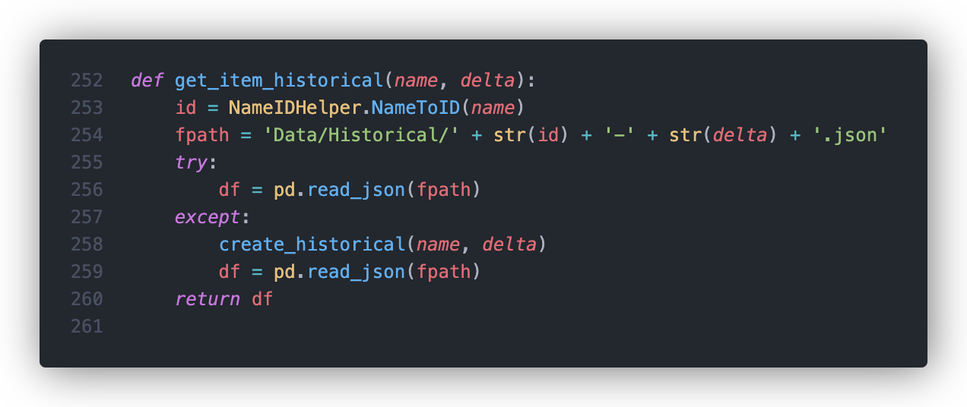
How I handled Historical Data
Check if the item data is already stored locally (On the server)
If not, create it
Notes:
Getting an individual items historical data
stored in files denoted with: Historical-ID then delta

Slide 11
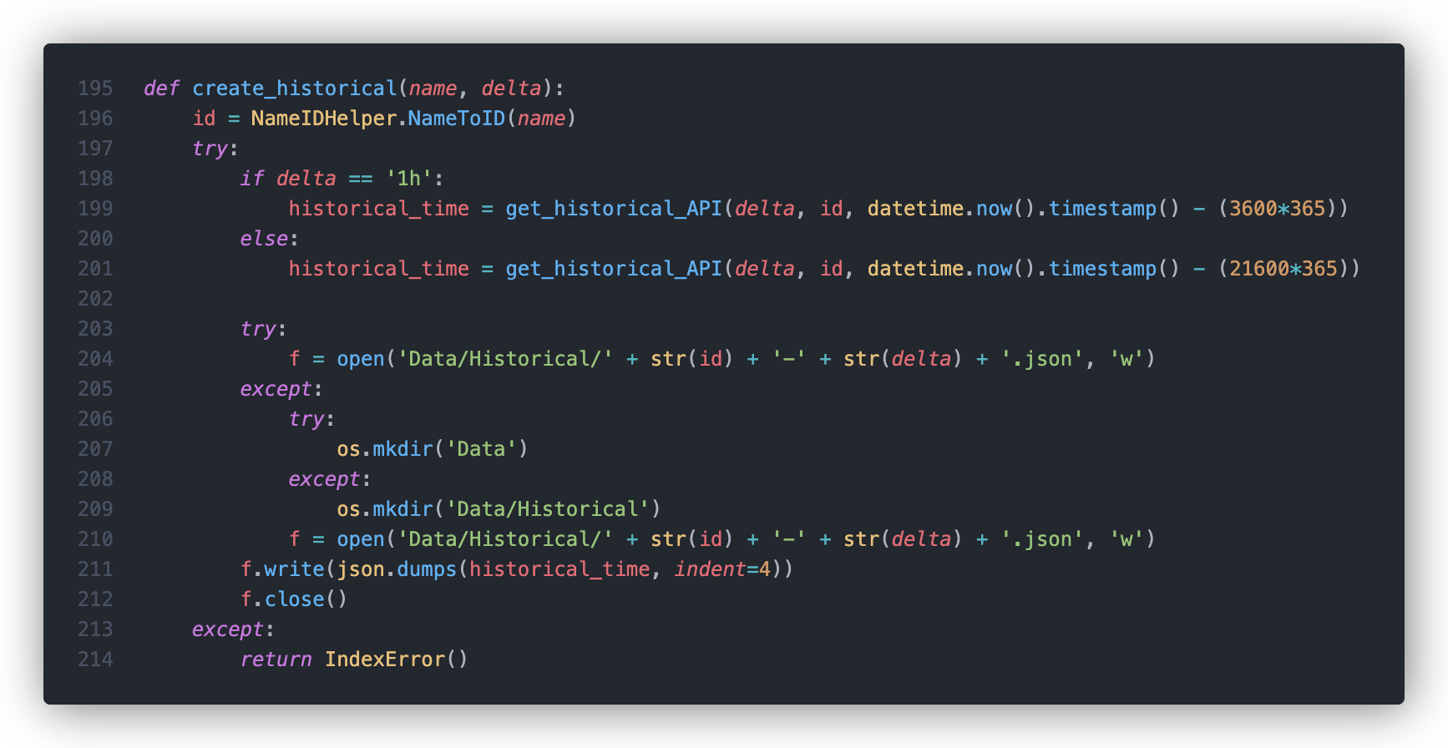
Check if the complete (all items) data is already stored locally (On the server)
Notes:
So now i would need to generate the historical data for the item, so first i check if i have all the items data

Slide 12
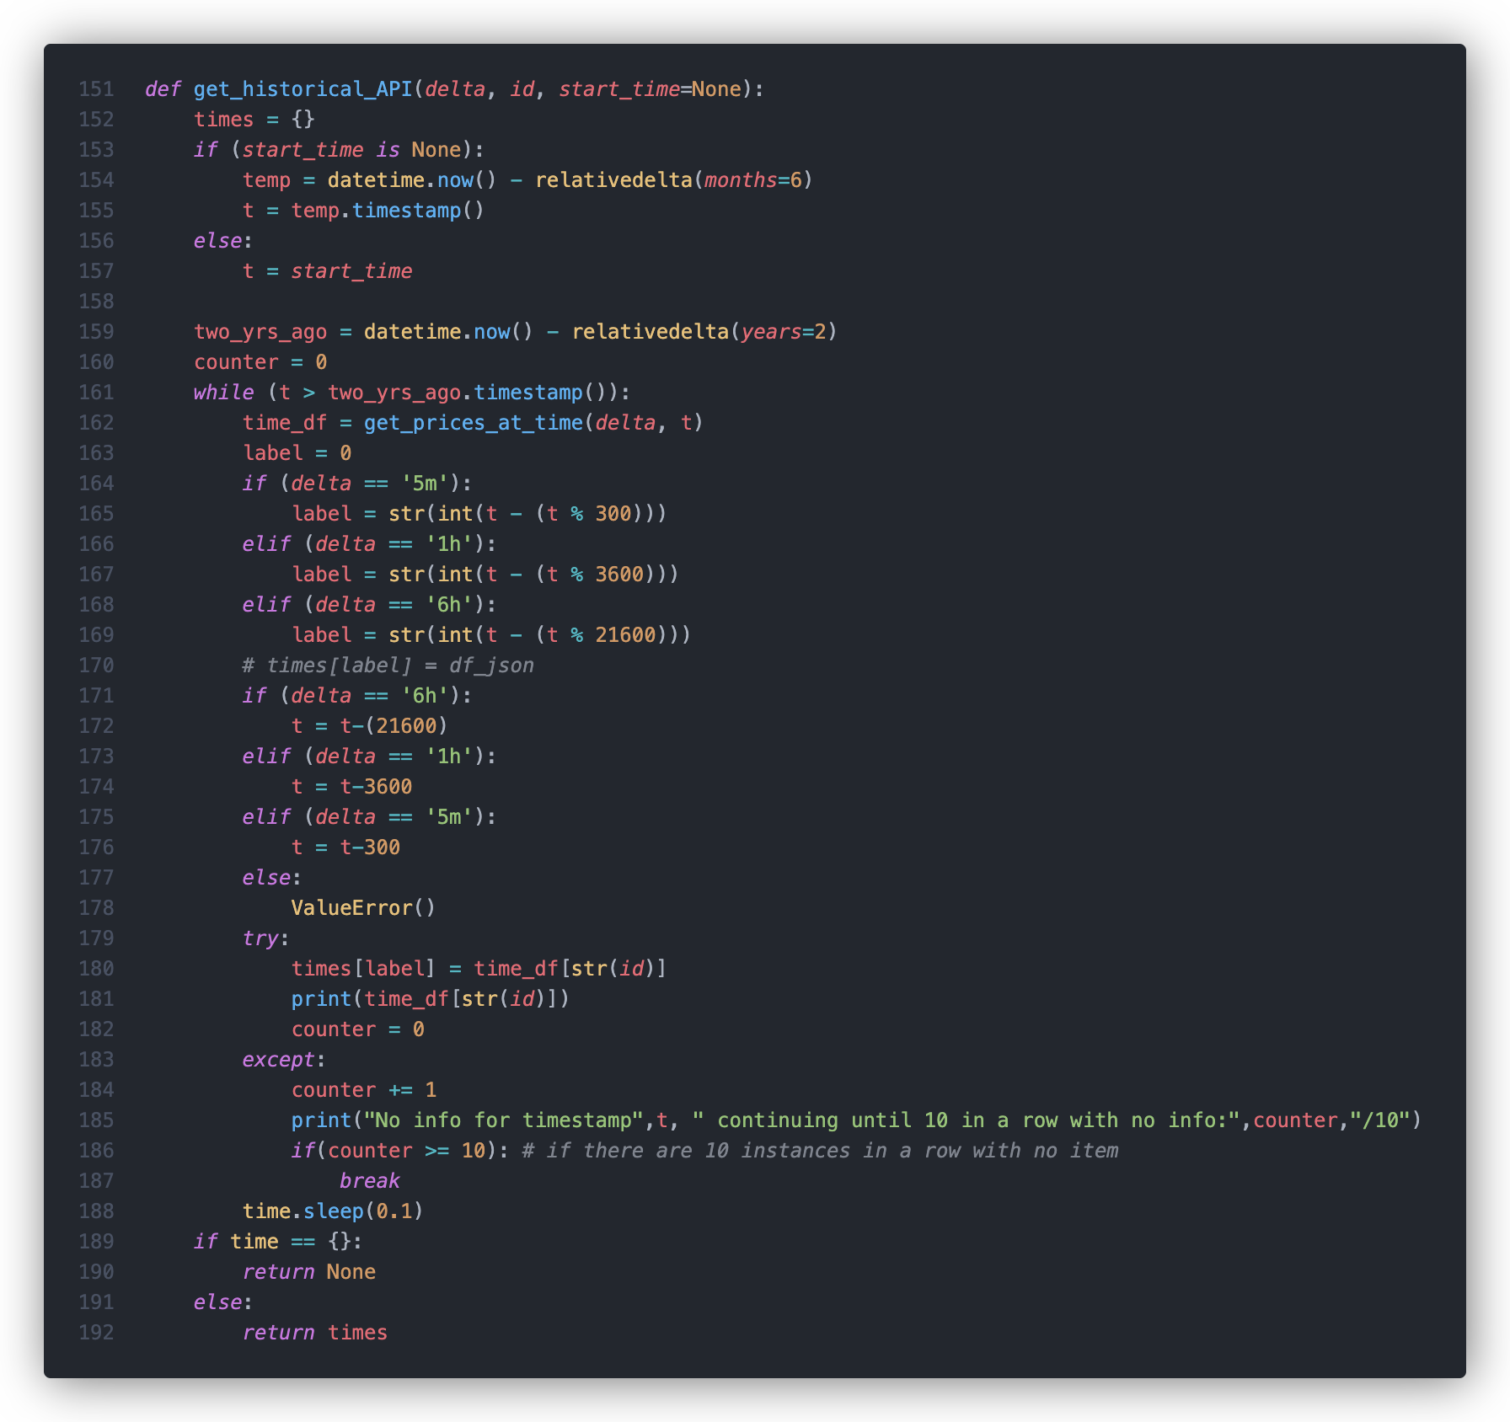
Request ALL data at a given time x amount of times
Notes:
Sequentially requests all data at a given time, going back 2 years.
can go back further, but only by a few months
API is relatively new,
the data is out there, but it used a different API, very dated

Slide 13
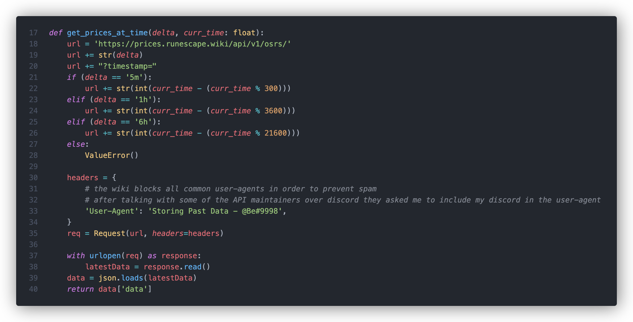
Getting all prices at a time
Notes:
Note the user agent
contact with the wiki team

Slide 14
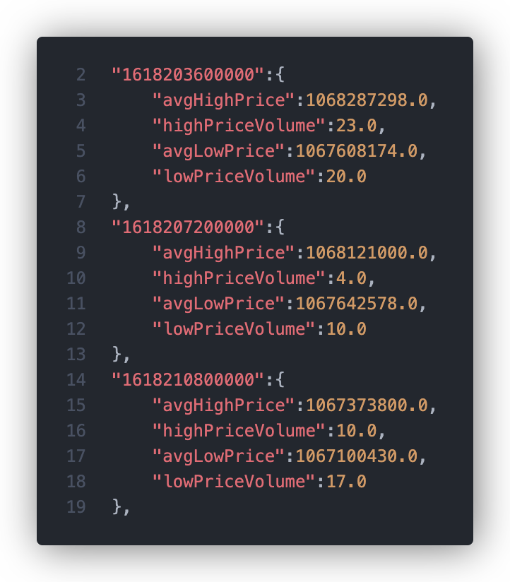
Notes:
Twisted bow:
1hr delta
stored in timestamps

Slide 15
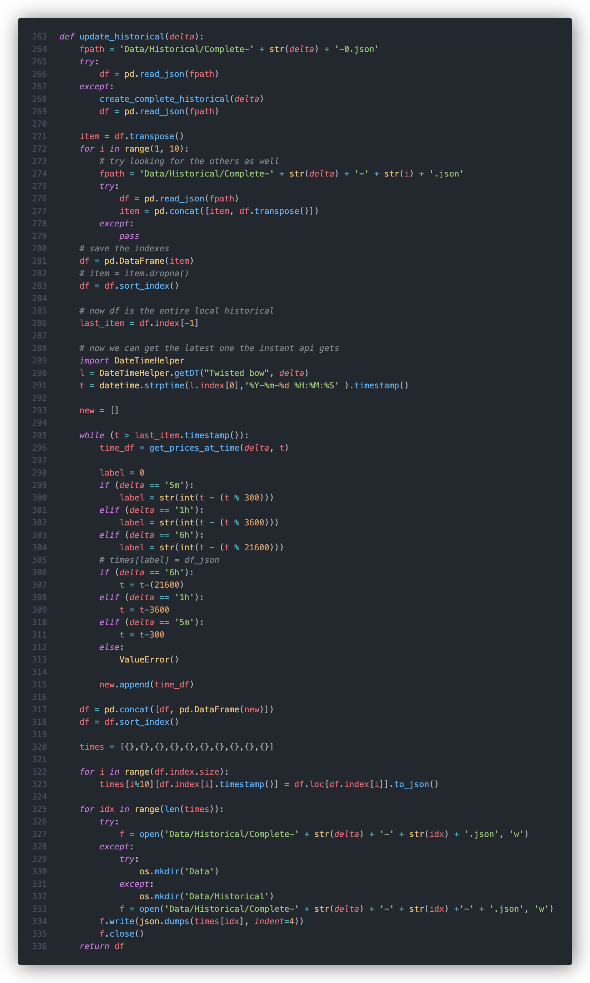
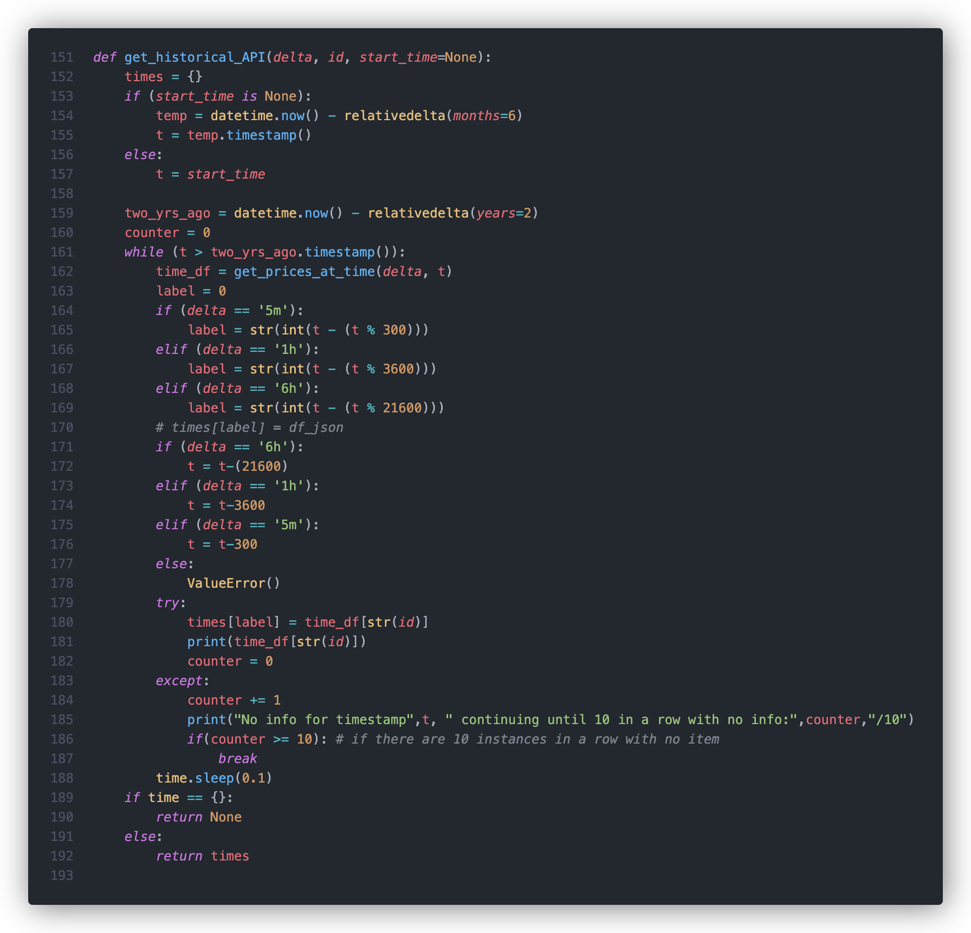
Other Historical Functions
Many, many other old versions of functions
Using API instead of local data
(Old Approach)
Updating Local Data
Notes:
Skip if low on time

Slide 16
Predicting
3 Models (In the order I made them)
Linear
Worst, but my introduction to Keras and TensorFlow
Multi-Step Dense
Multiple Dense layers
My introduction to reshaping inputs and outputs
Conv1D
The best out of these three
The one I focused the most on
Notes:
Linear
bad but first
MSD
reshaping
Con
best
focus

Slide 17
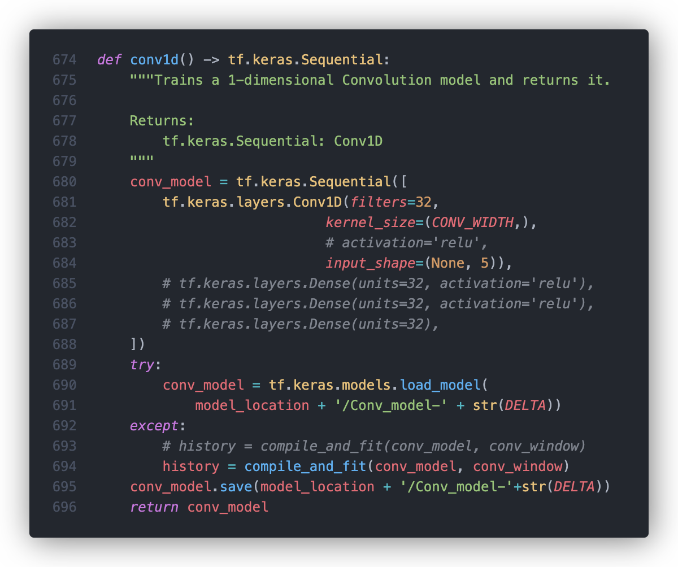
Conv1D
Simple Conv1D
I tried many variations

Slide 18
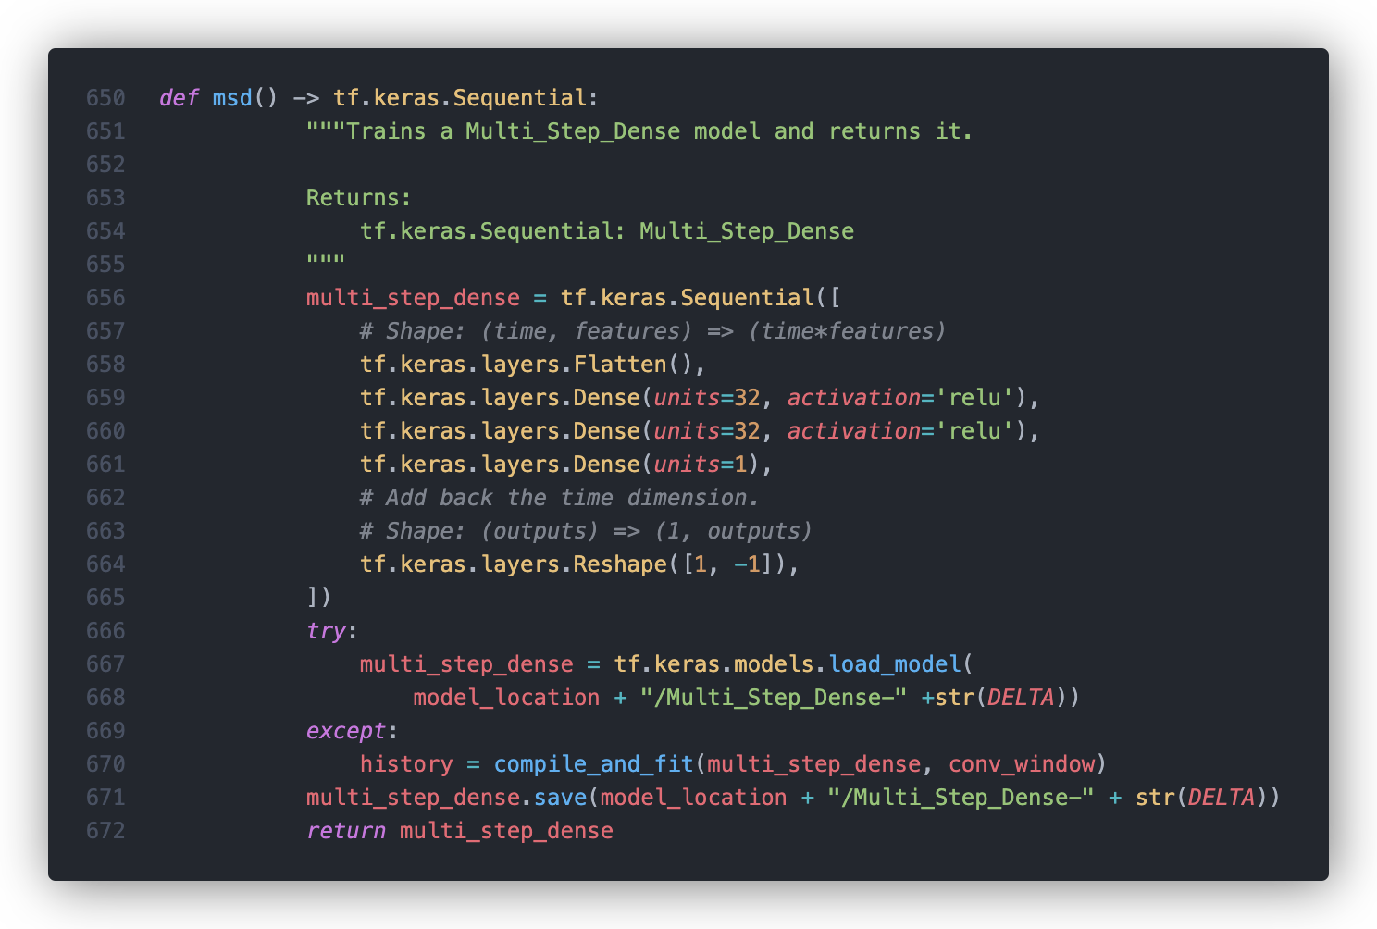
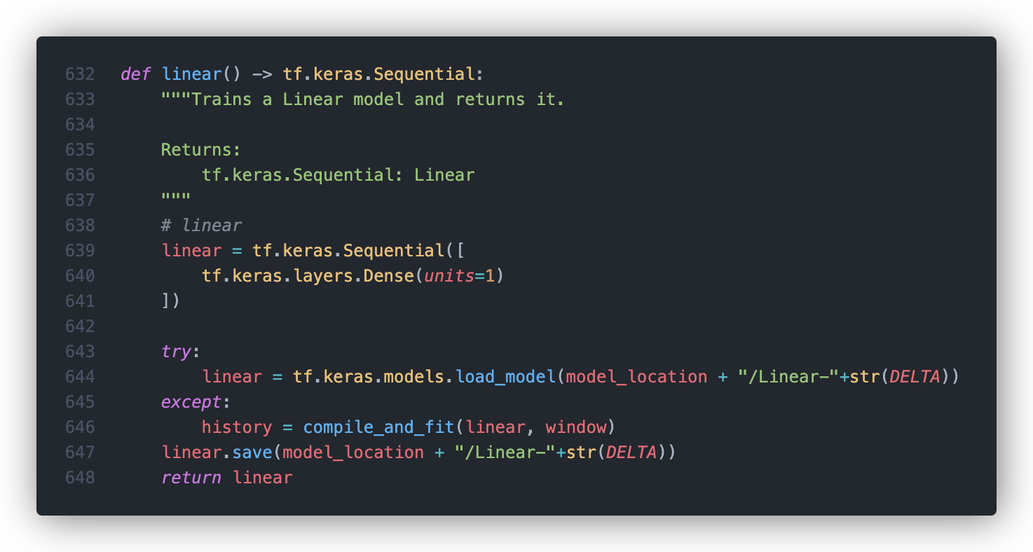
Multi-Step Dense / Linear
MSD
Simple
Multiple Dense layers
Reshape
Linear
Very simple
Designed it once, never came back to it because I moved onto better things
Notes:
Skip if low on time

Slide 19
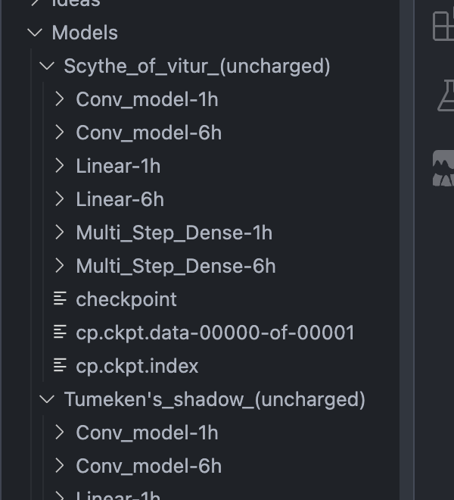
Storing the models
Notes:
Here is a screenshot of what the servers file system looks like.

Slide 20
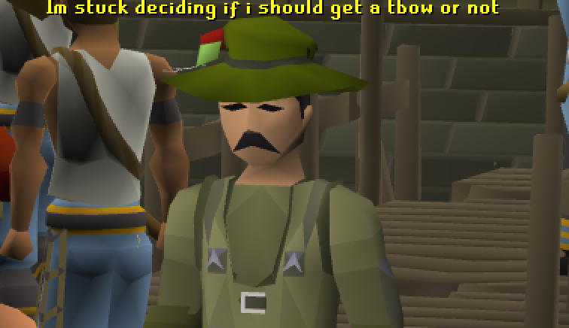
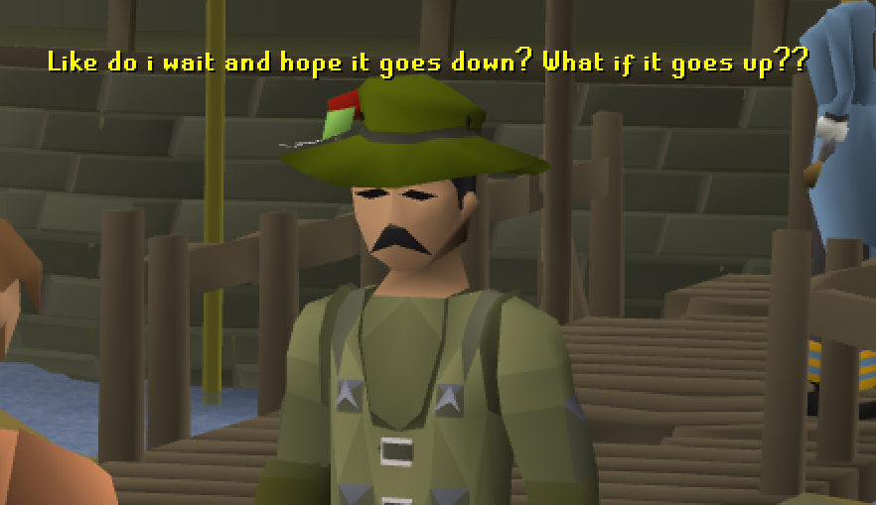
Applications
Deciding when to buy an item
Knowledge of historical market trends
(its not the end of the world)
Merching items
Notes:
So this is cool, but what are the applications

Slide 21

Demo!
Many ways to get to this site!
GitHub pages hosted URL: https://ben10164.github.io/CPSC325-Project/
Streamlit URL: https://ben10164-cpsc325-project-app-fsfsa9.streamlit.app
Notes:
Dont forget the dashboard!!

