Slide 1
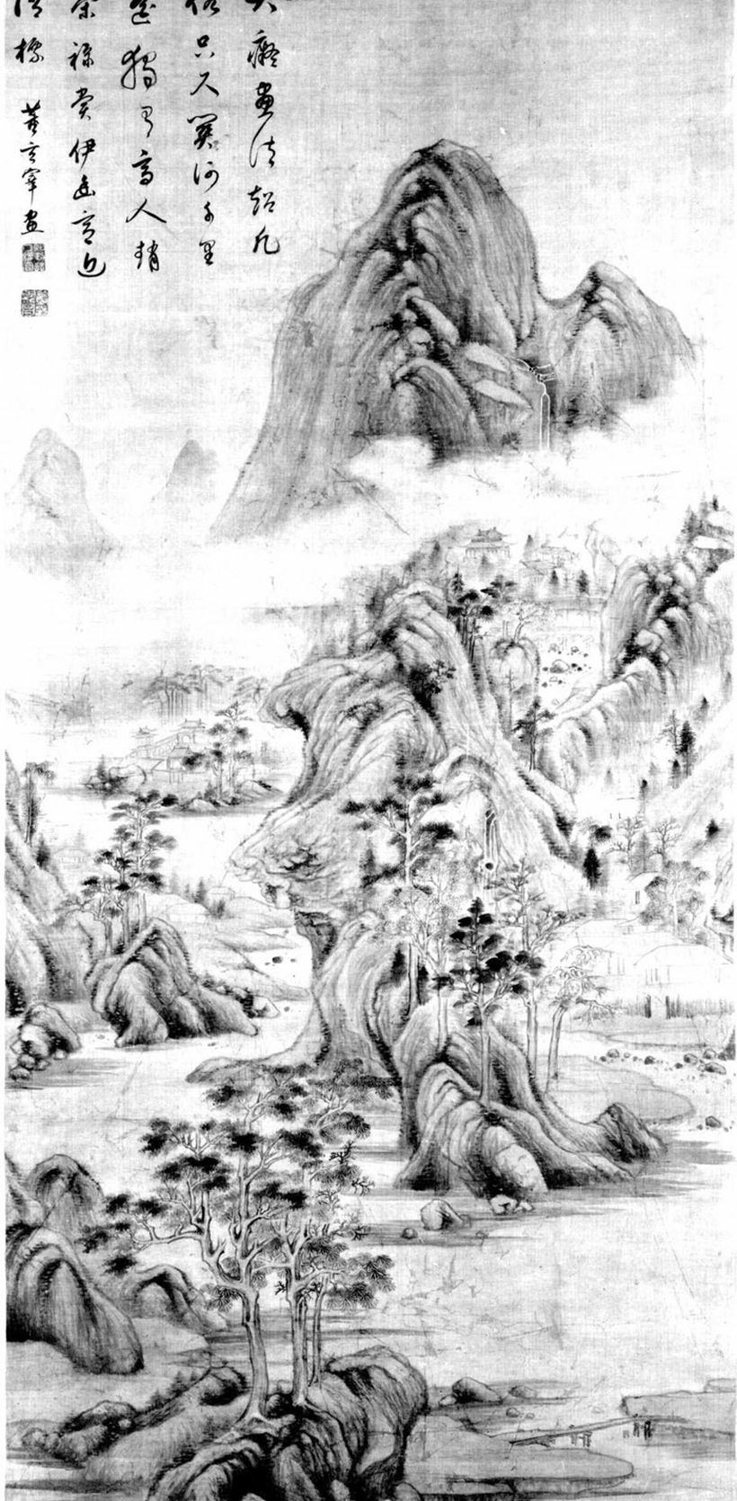
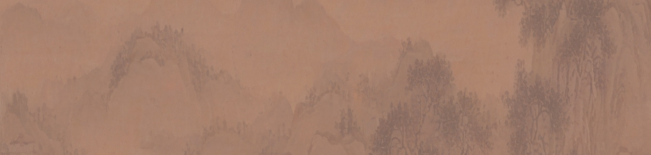
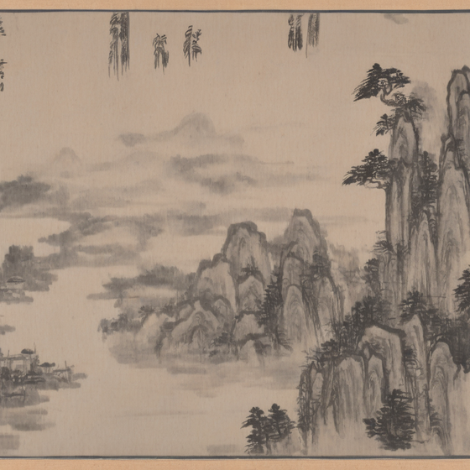

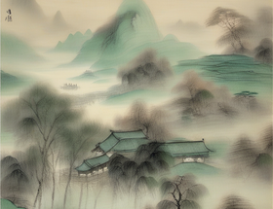
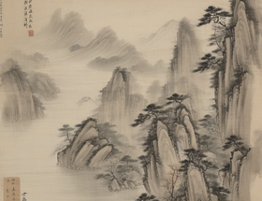



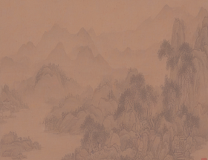
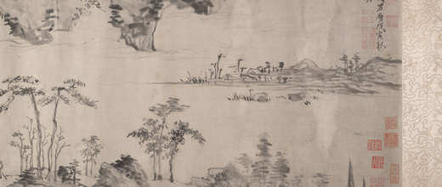
A
Chinese landscape painting as a structured cultural visual language
B
Why generic diffusion models are insufficient
C
Our culture-aware hierarchical diffusion framework
spatial hierarchy
1. structure confusion
×
1. Structured text prompt
Generated painting (Output)
山
foreground and background are mixed.
Misty mountains, river, pavilion, poetic blank space, ink-wash style
Background
clear depth ordering of mountains, water, and objects.
○
blank space
intentional emptiness creates breath and meaning.
2. Hierarchical structure map
2. blank space treated as background
×
lineart
SDXL + LoRA + Hierarchical Adapter + Style Prompting
empty regions are either overfilled or awkward.
Midground
quantized depth
墨
brush-and-ink rhythm
varied brushwork, ink intensity, and textures convey vitality.
blank-space mask
saliency mask
✓
controllable composition
3. style drift
×
✓
meaningful blank space
景
poetic atmosphere
inconsistent brushwork and mixed styles.
evokes emotion and literary associations.
3. Style reference
✓
stable style
✓
high fidelity
Foreground
法
composition
arrangement follows principles of balance and harmony.
!
Generic text-to-image models may mimic surface style, but often fail to preserve composition, blank-space organization, and stylistic consistency.

