Slide 1
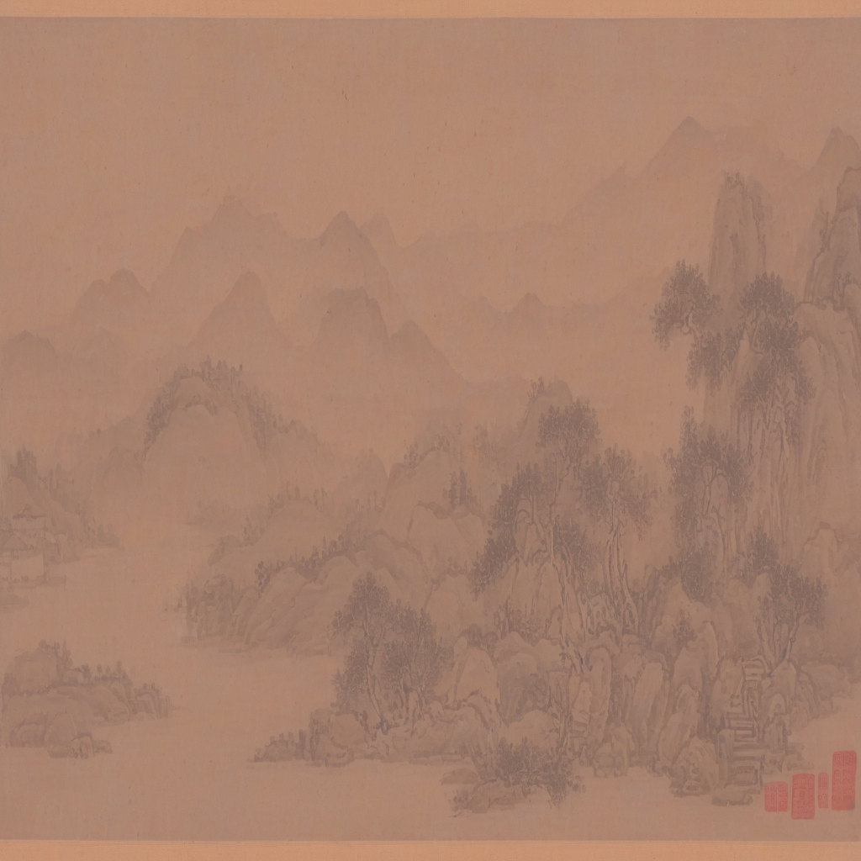
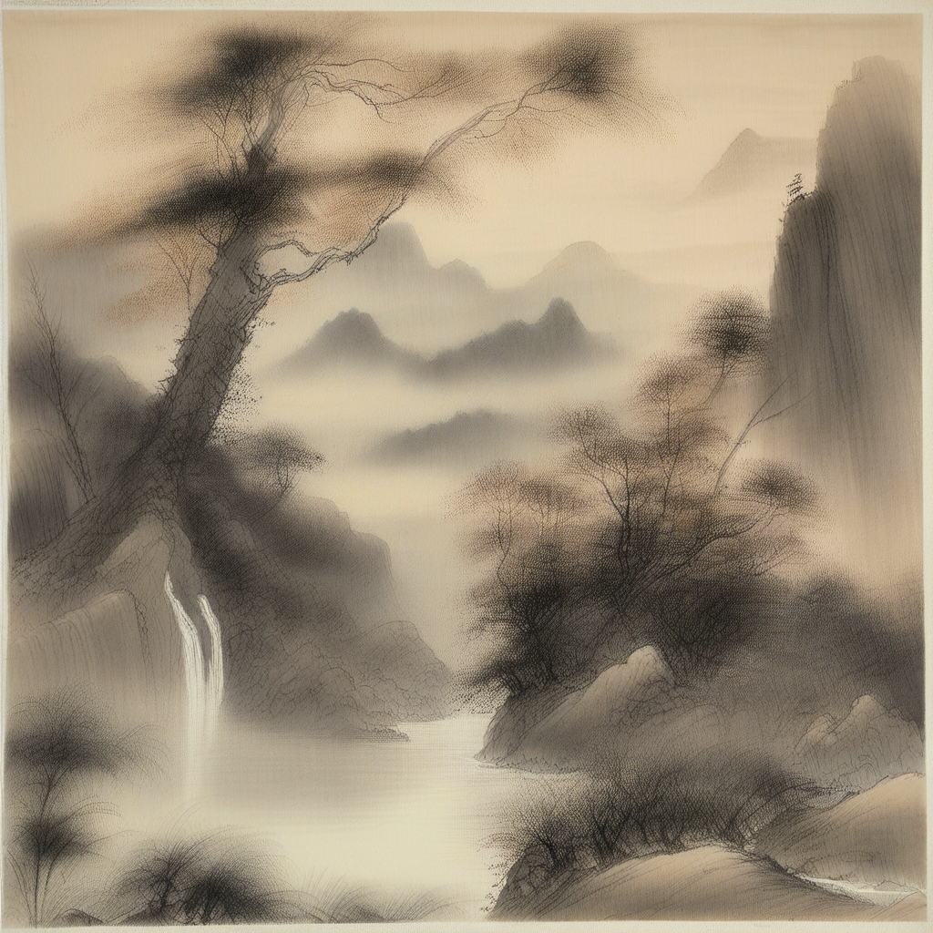
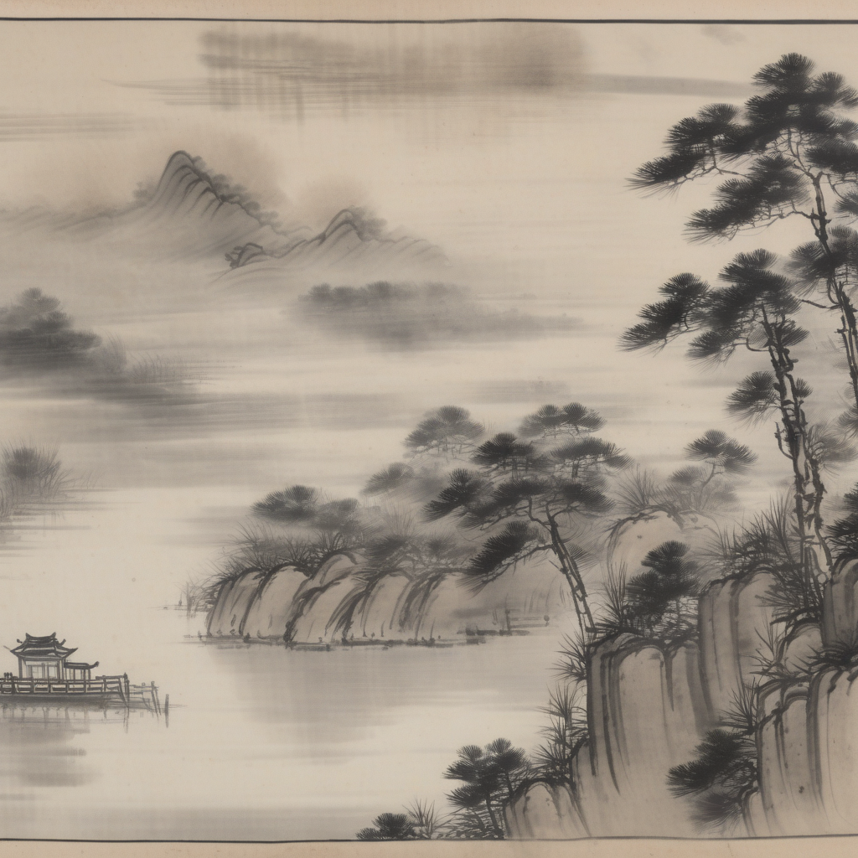
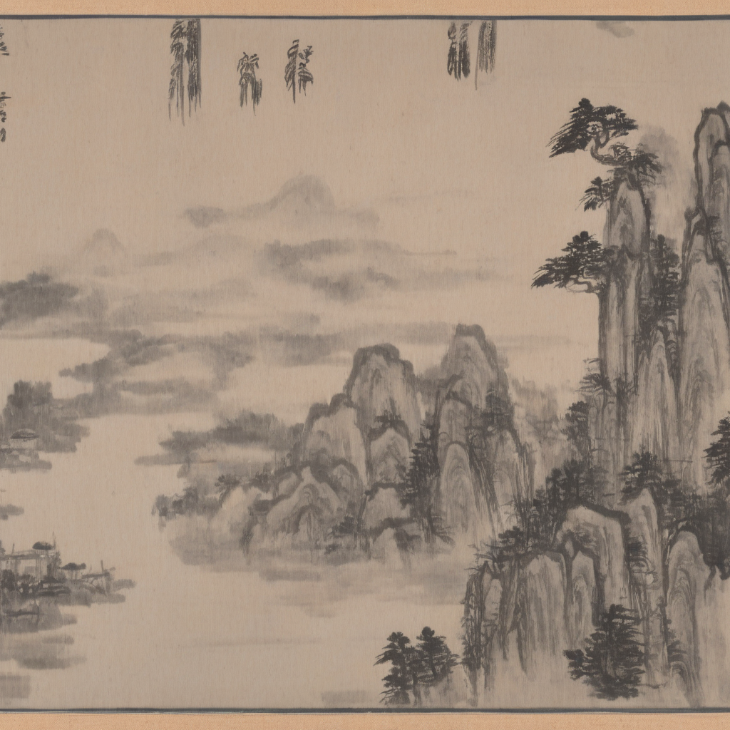
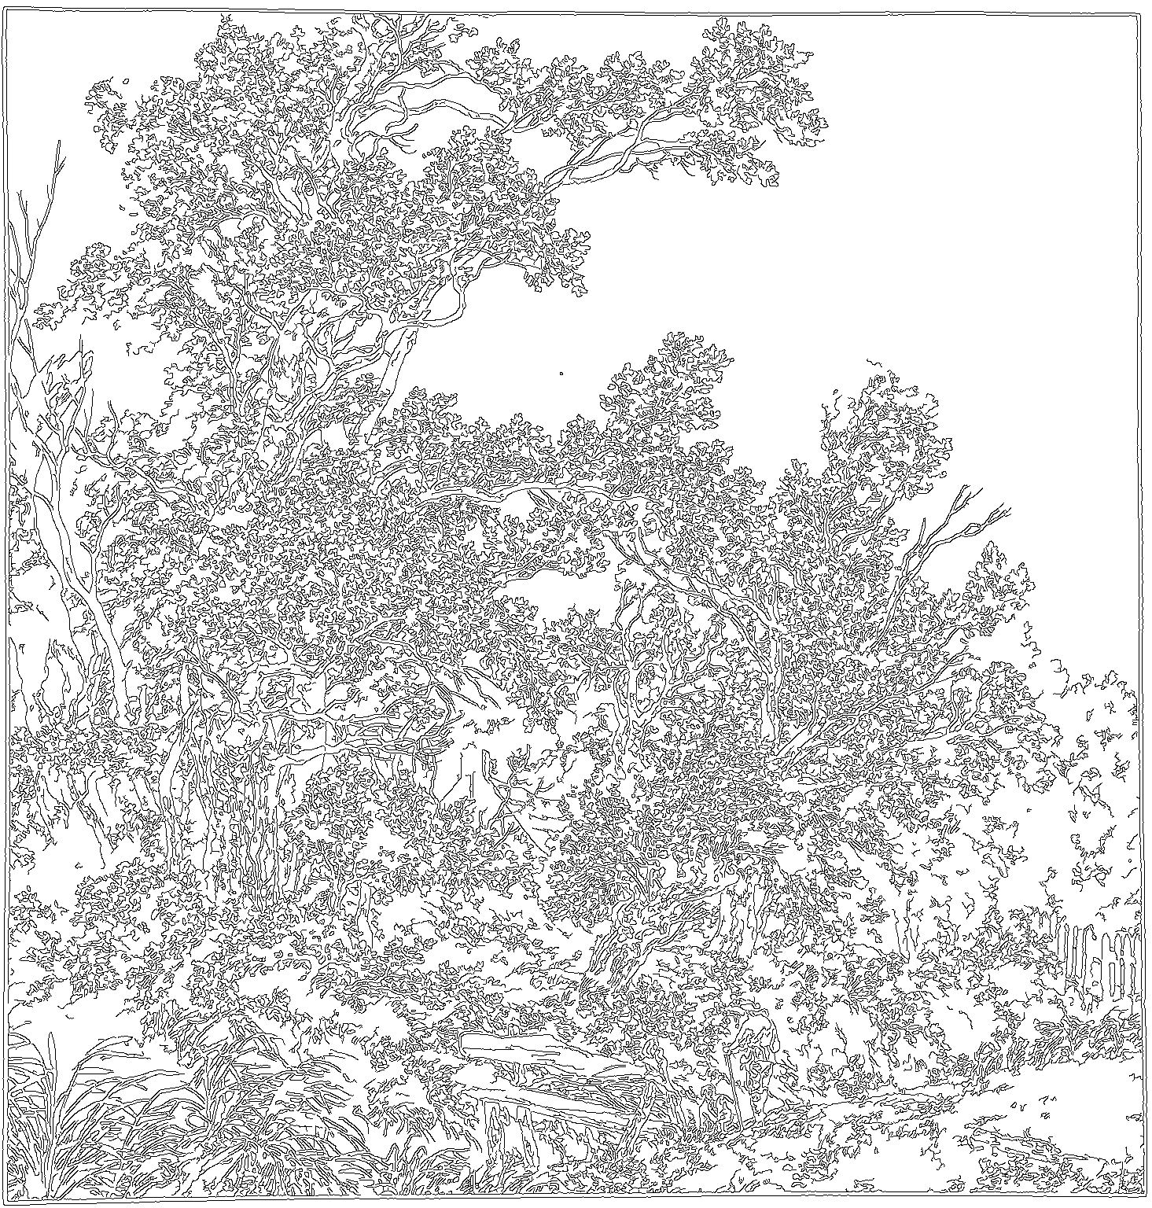
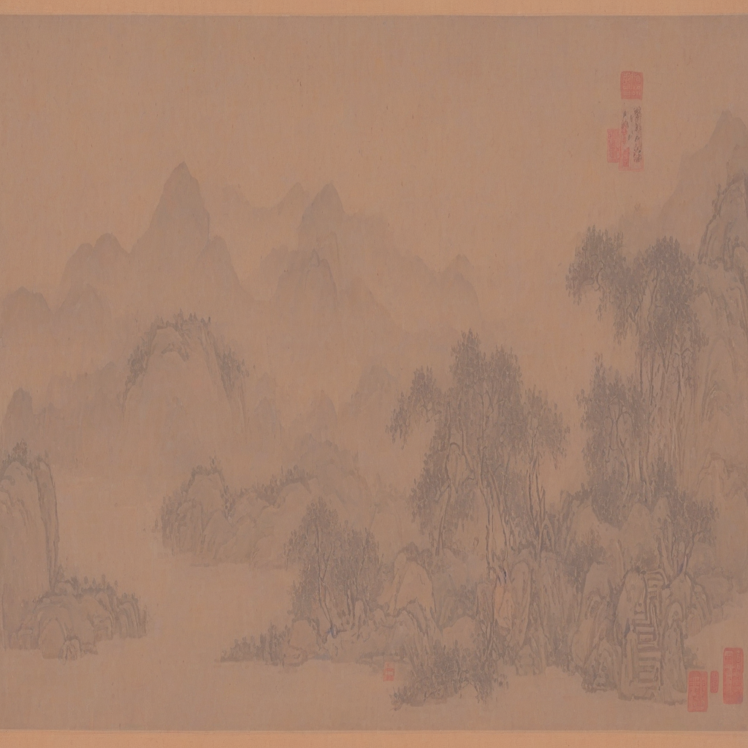
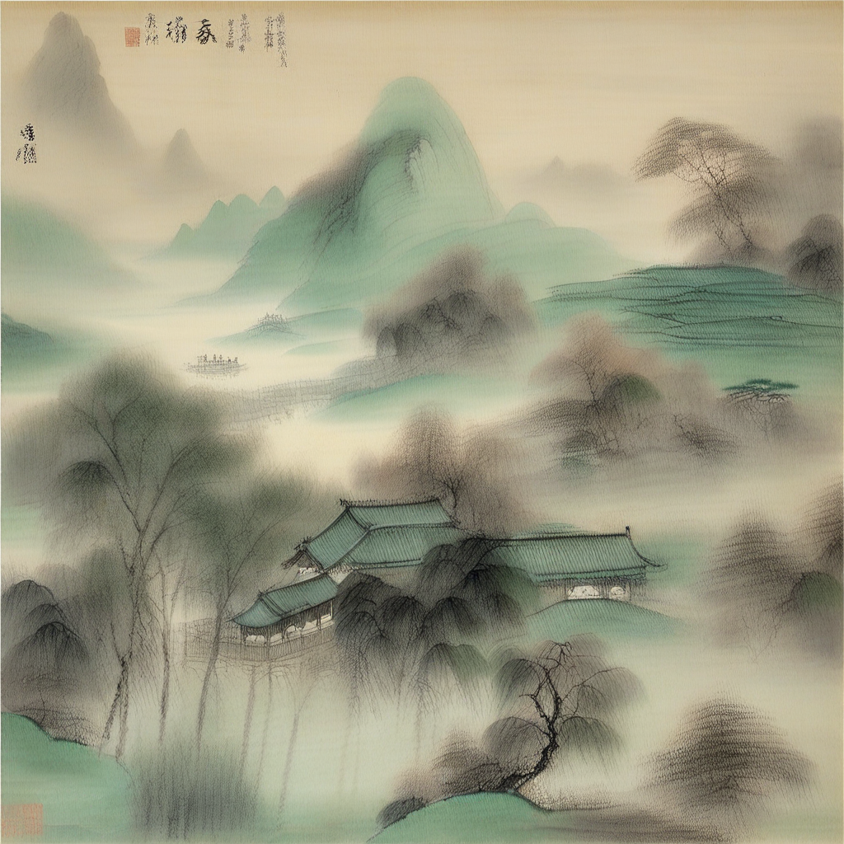
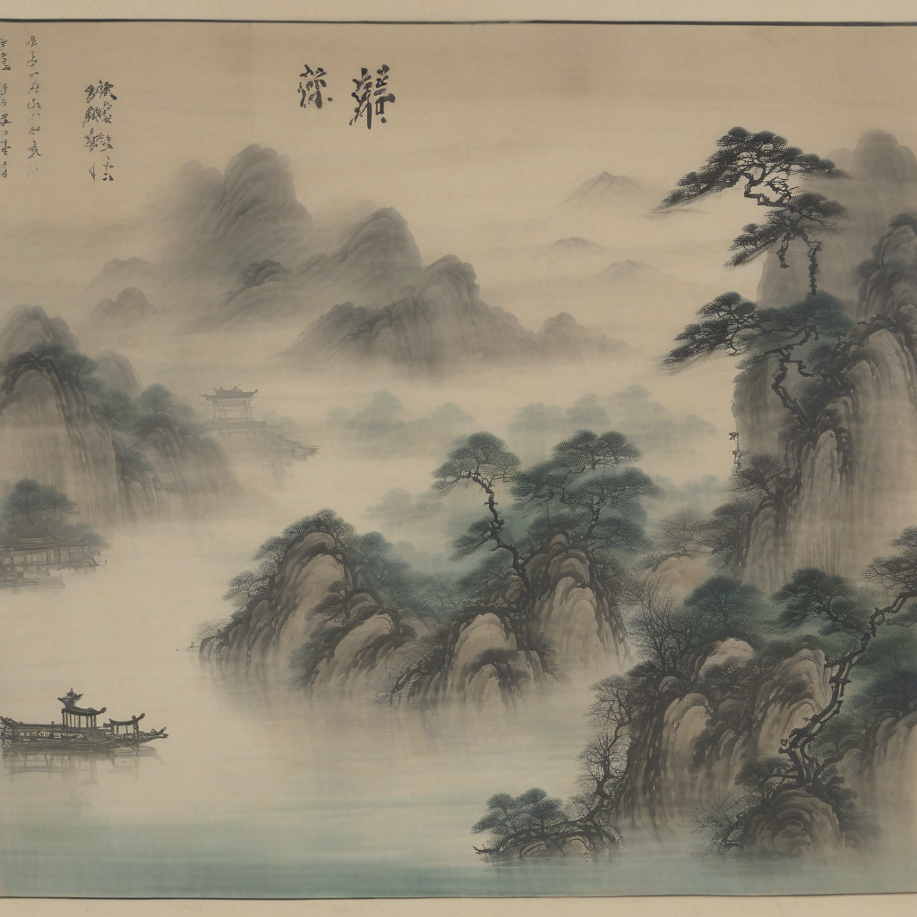
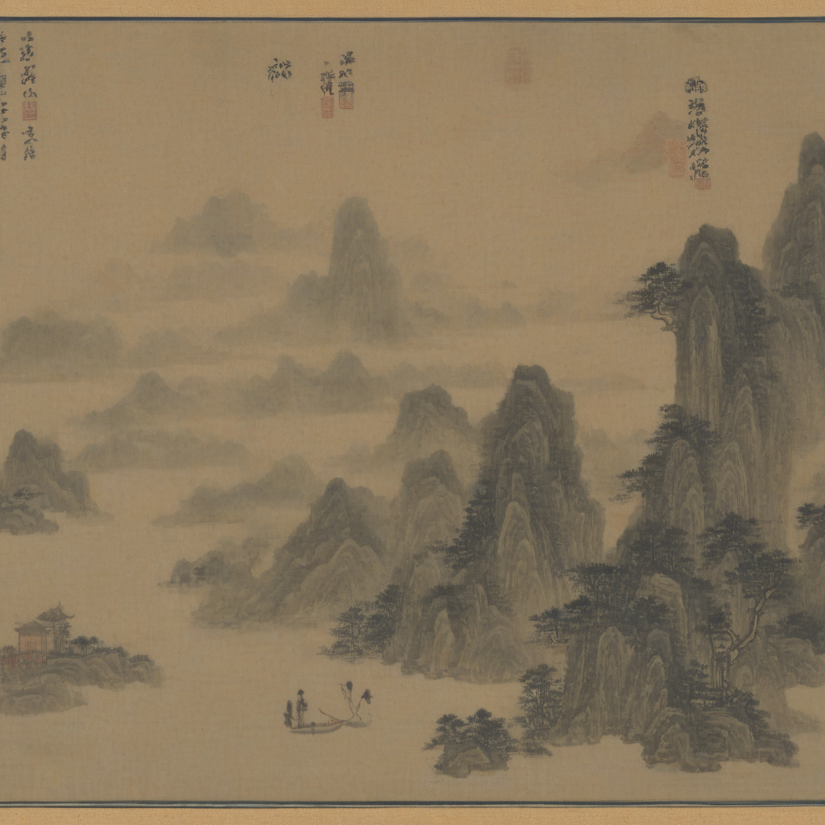
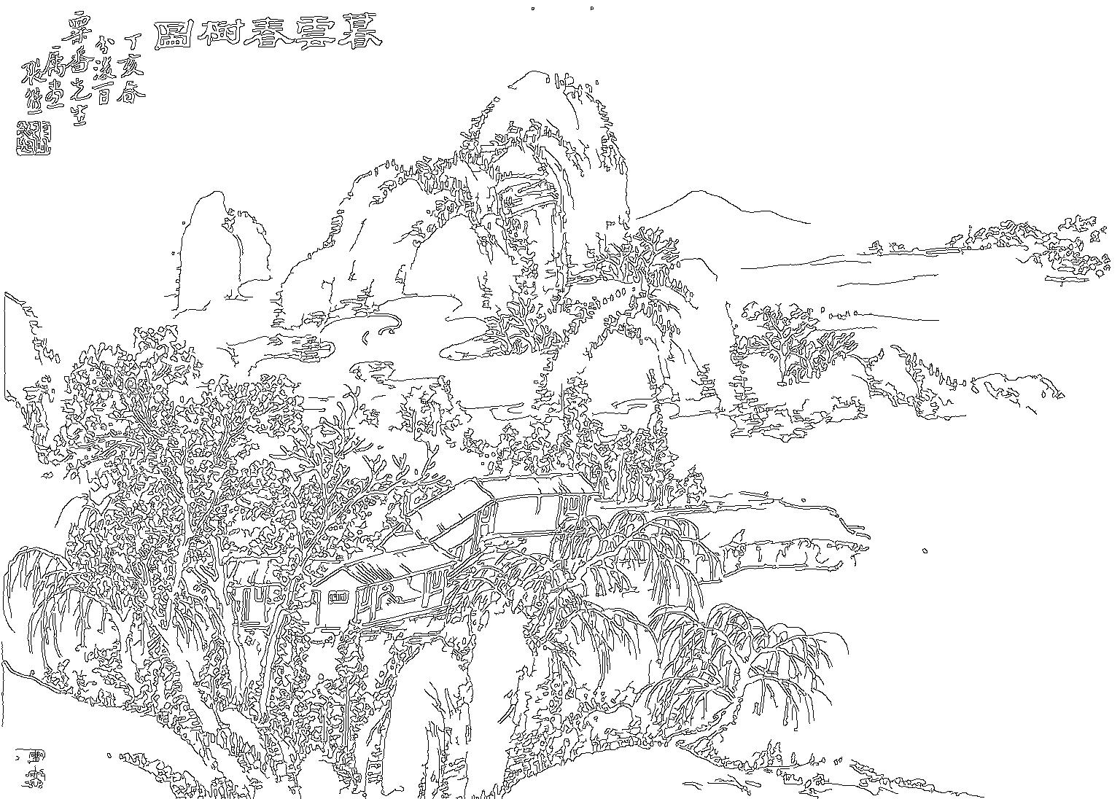
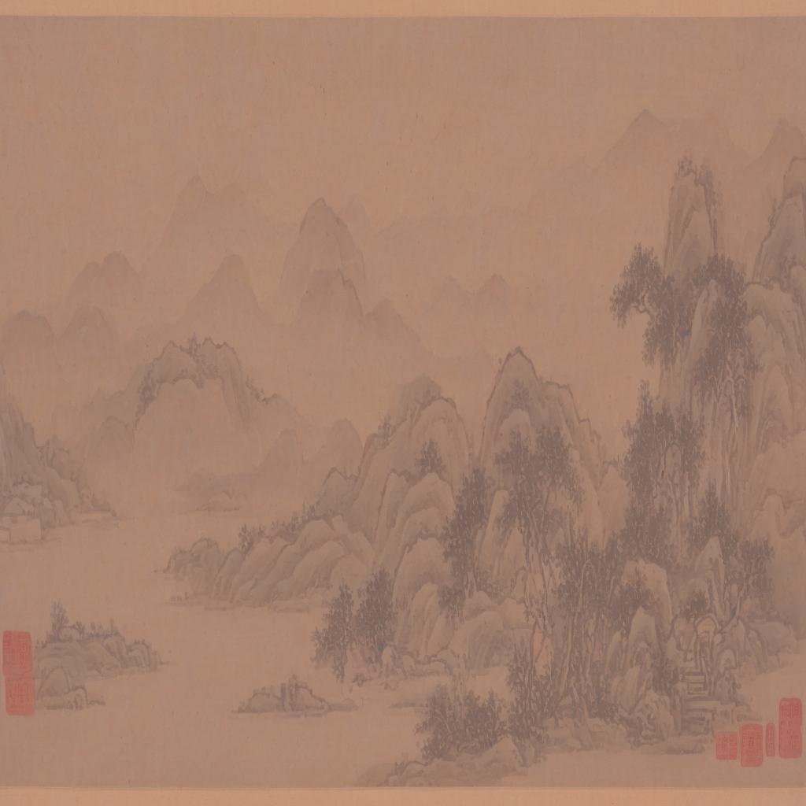
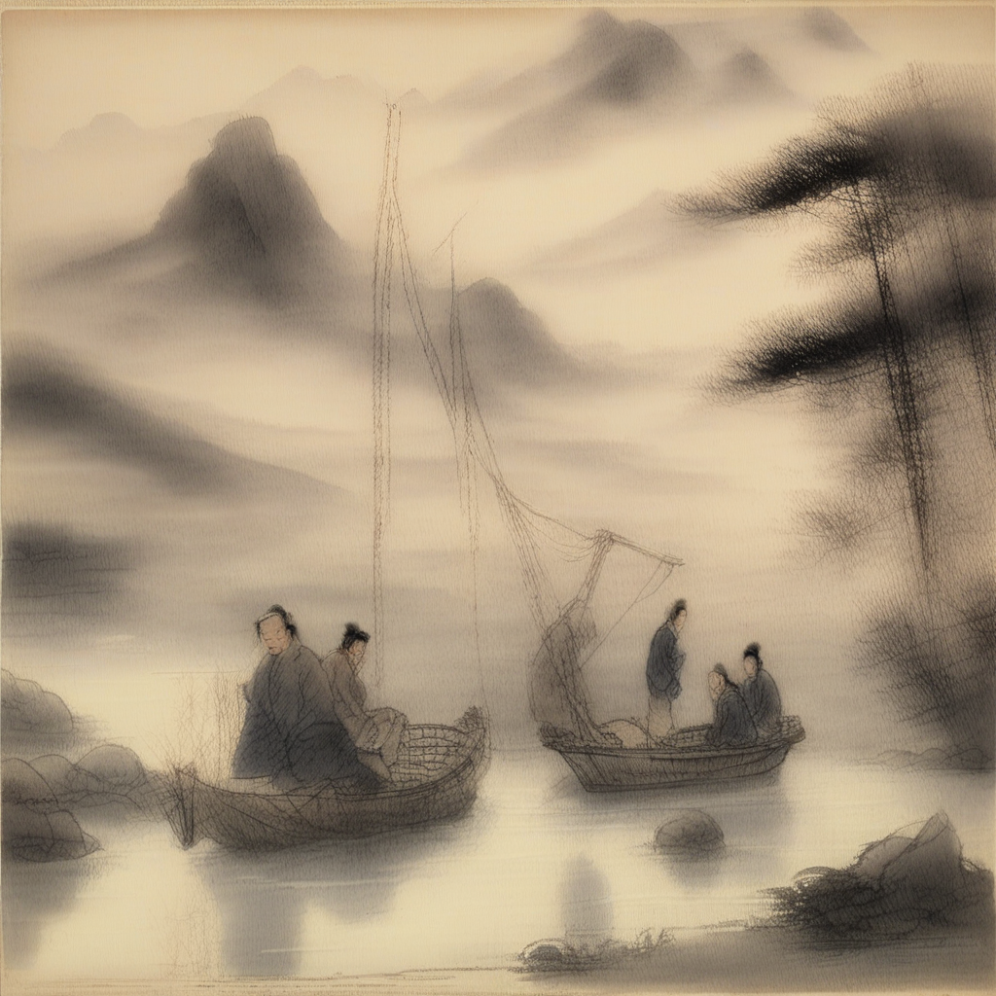
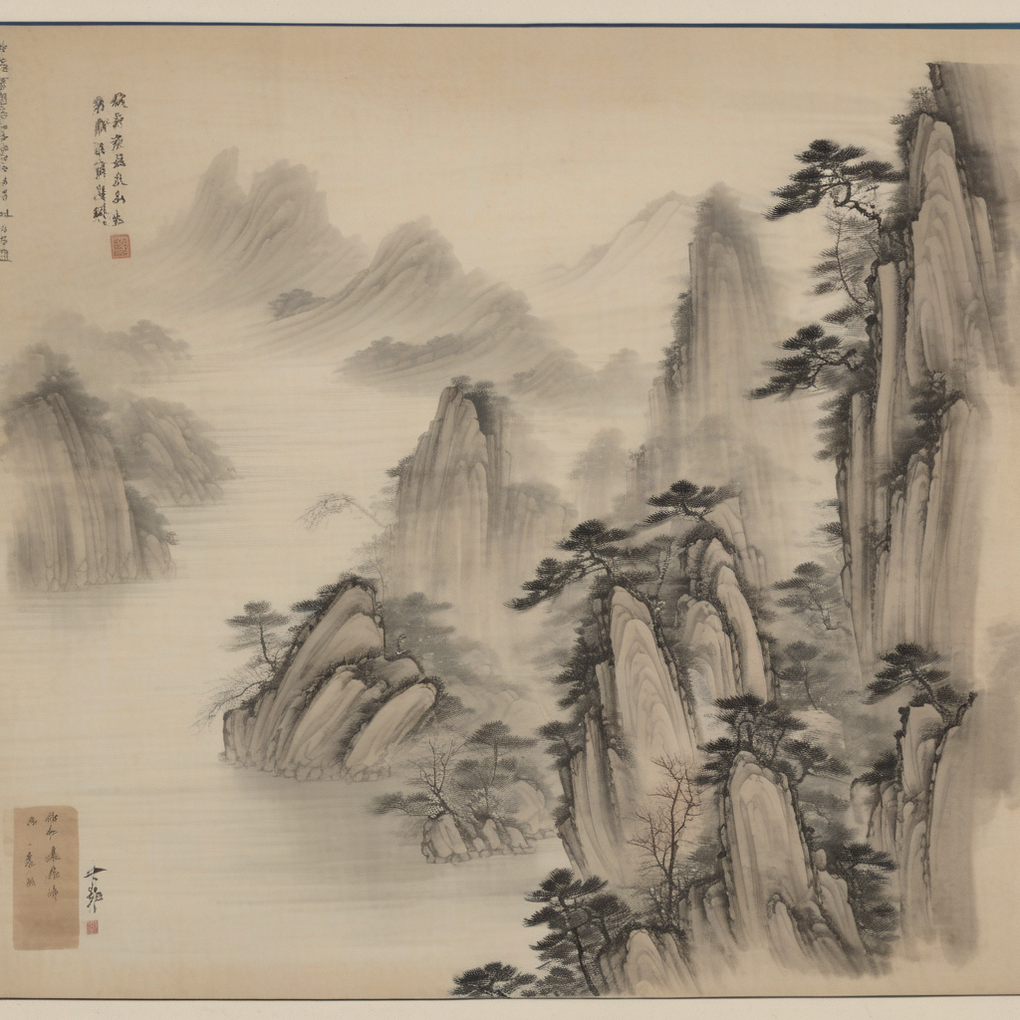
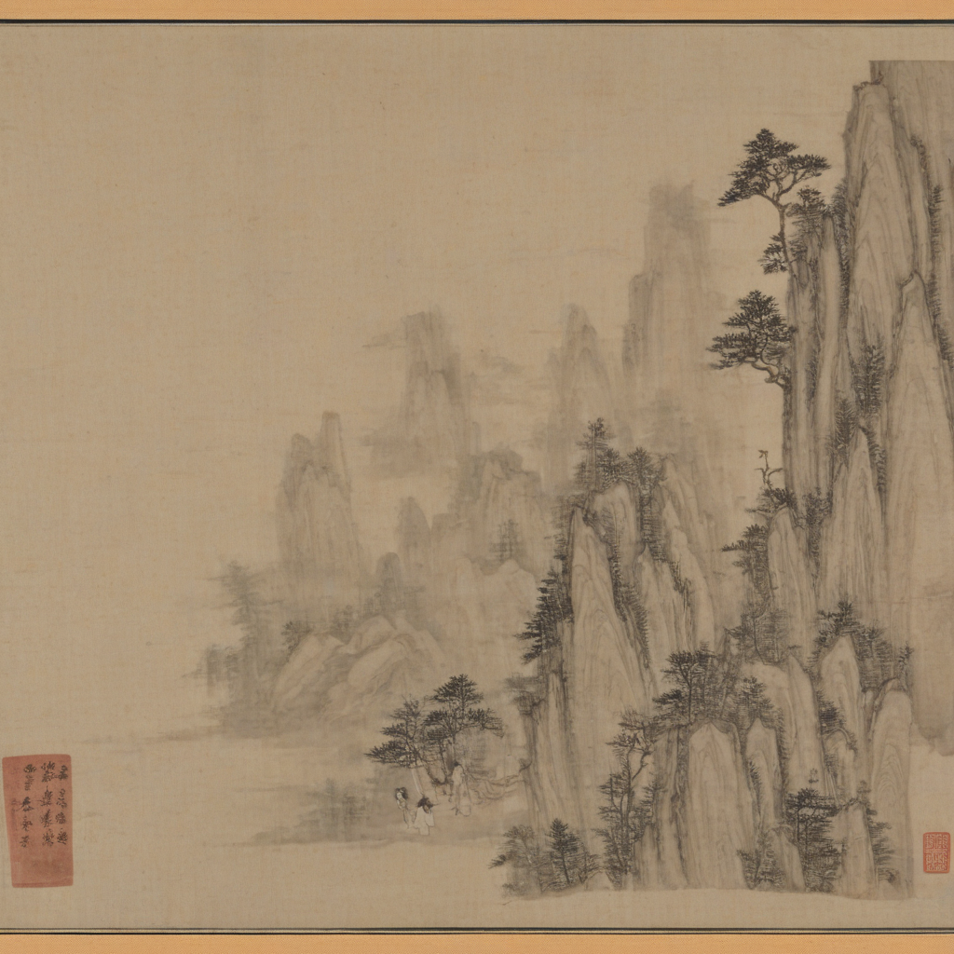
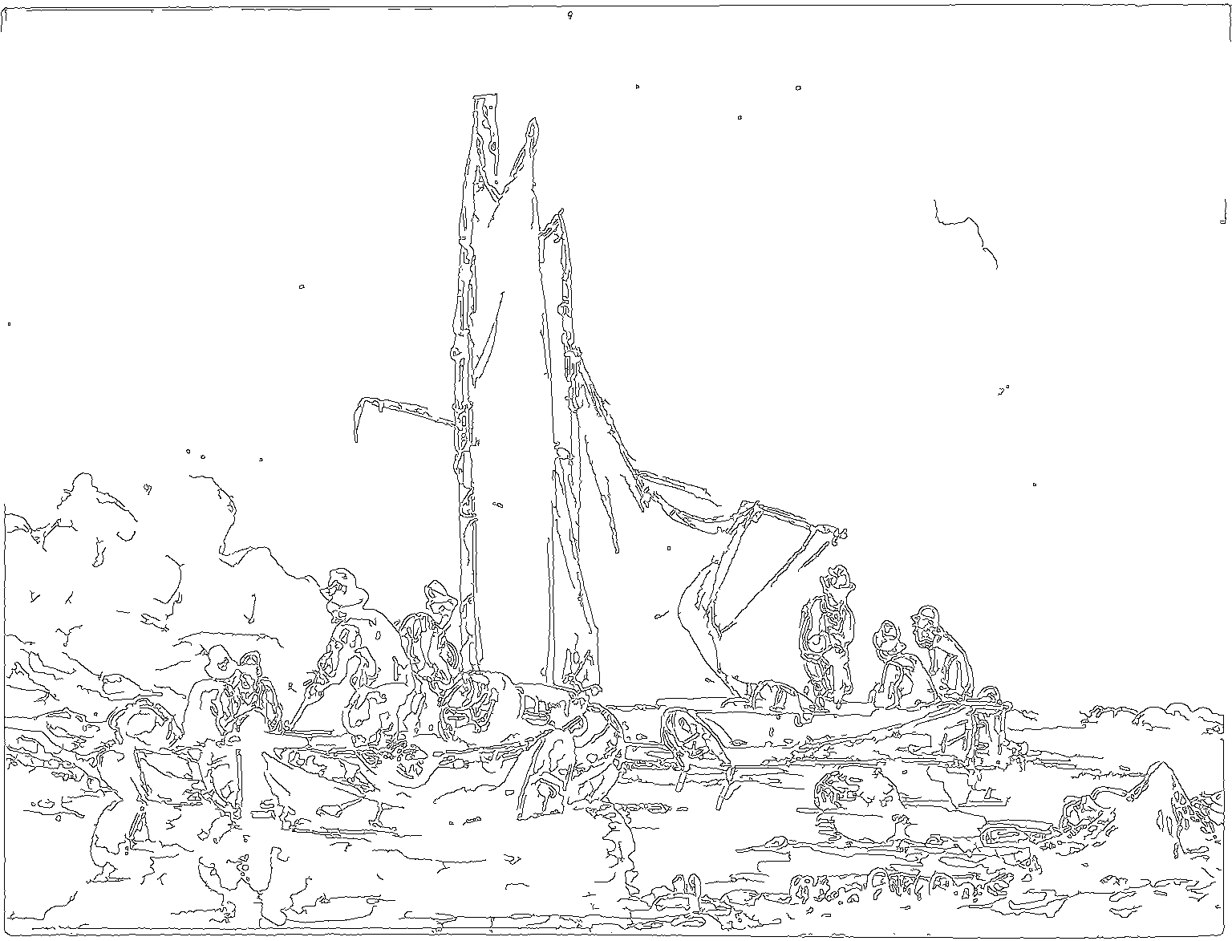
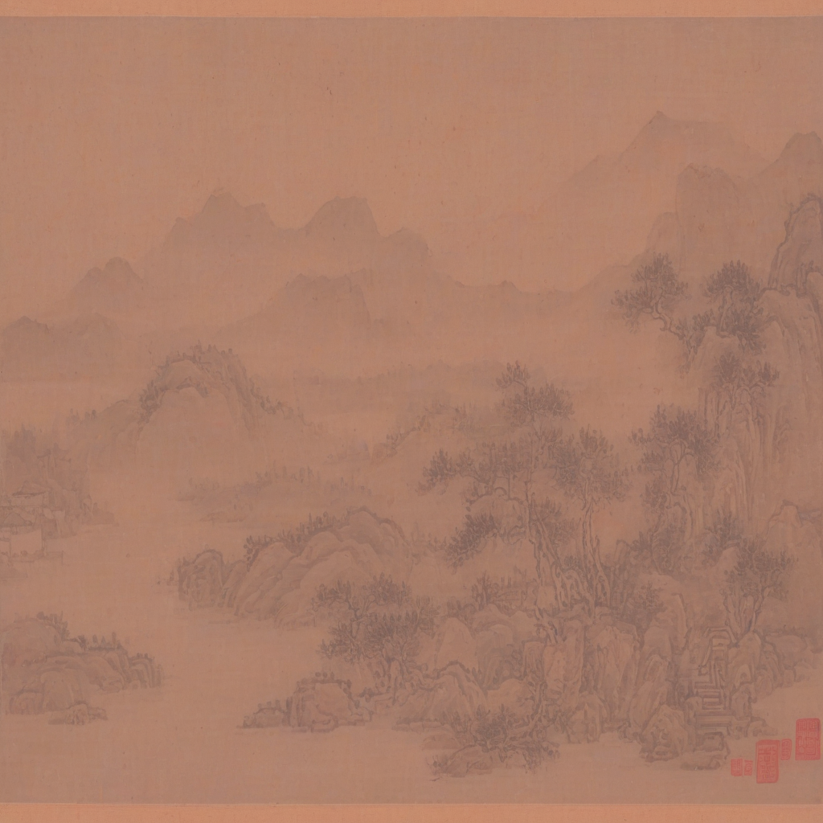
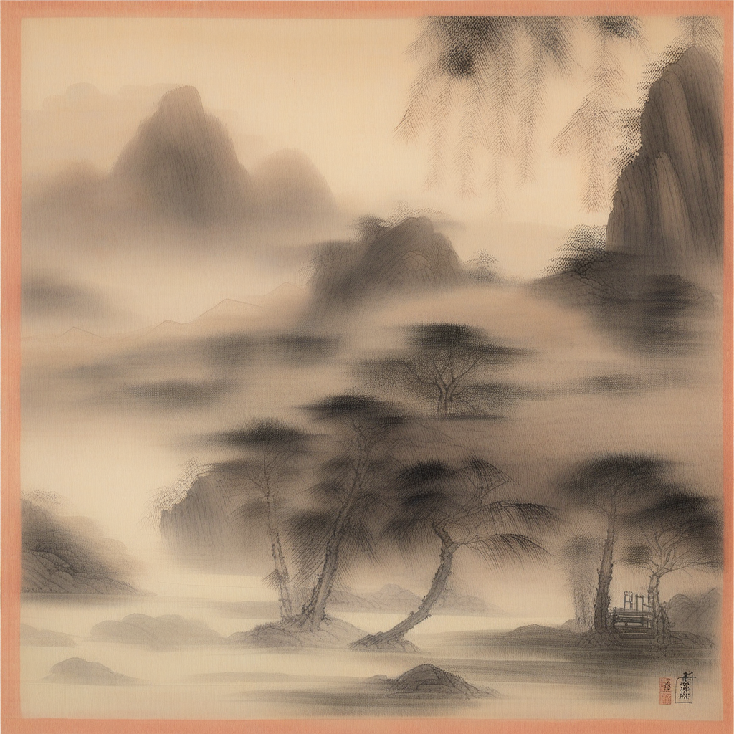
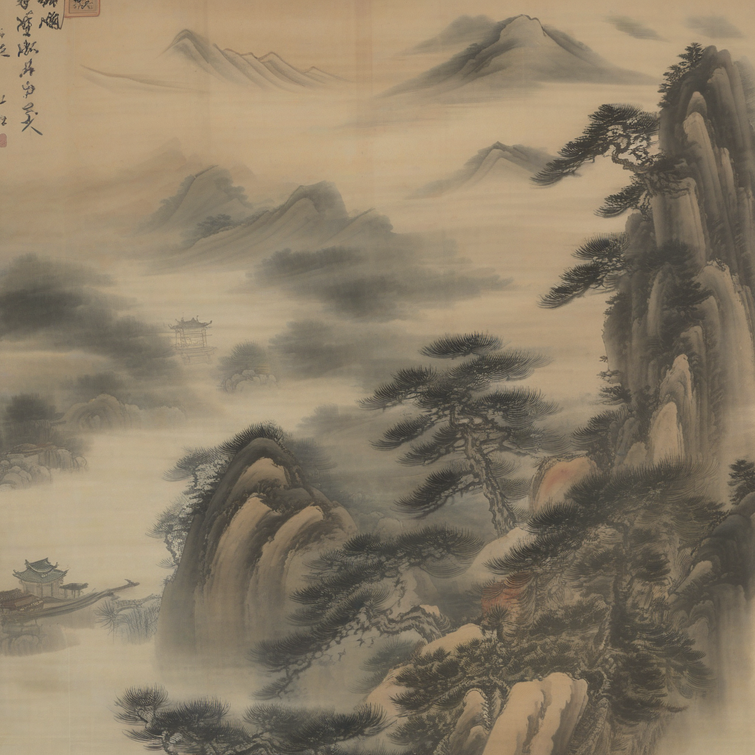
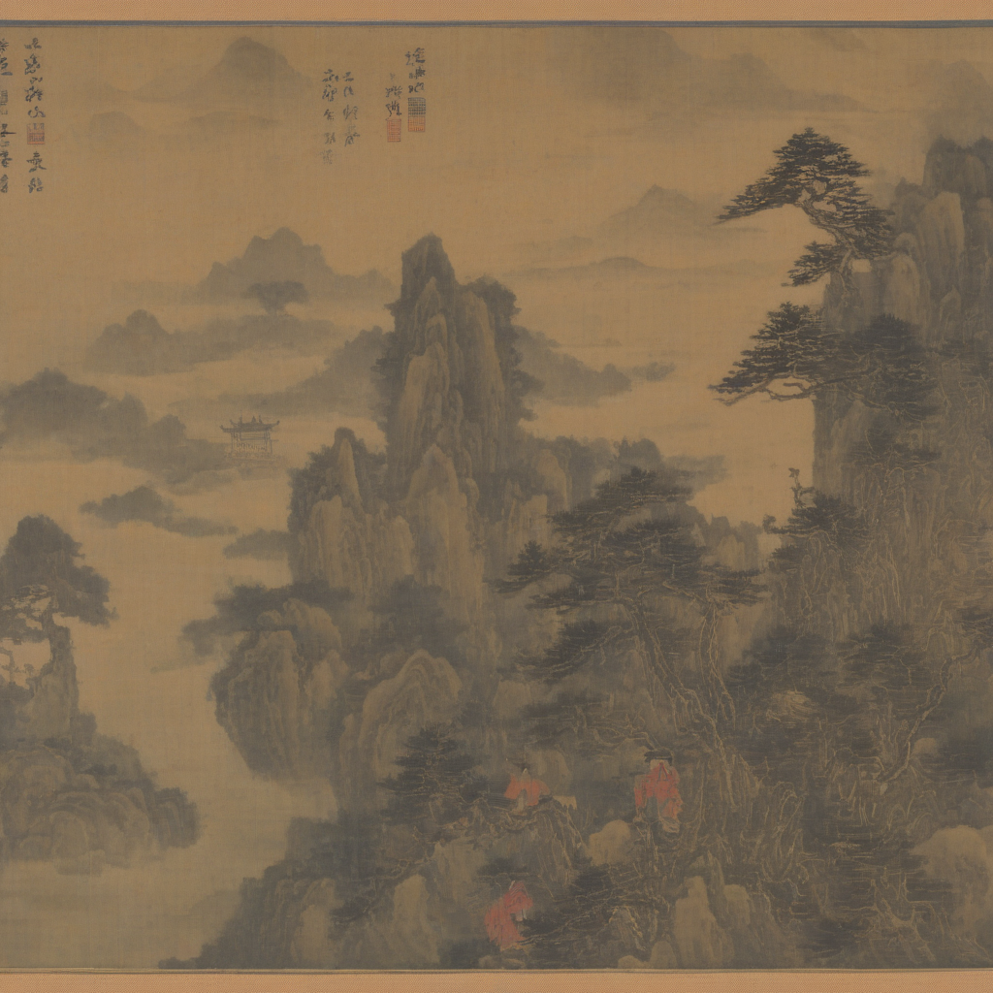
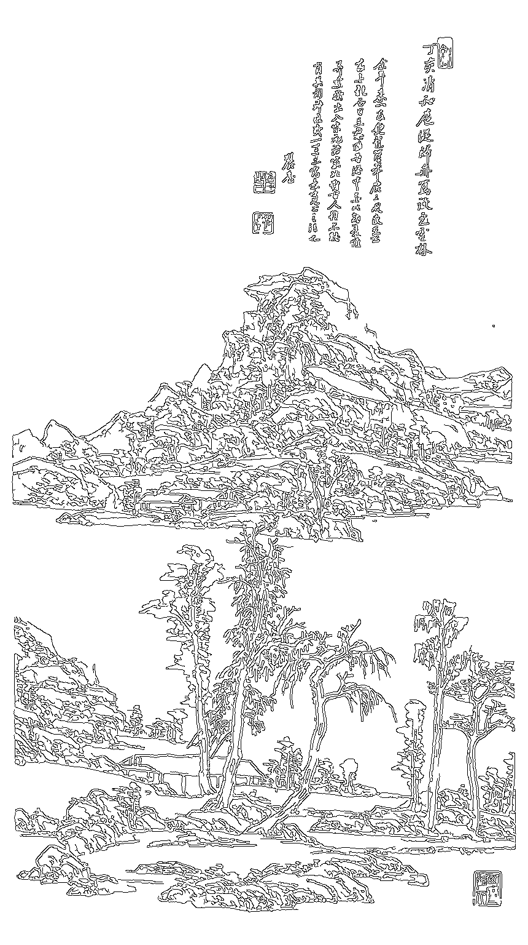
Prompt / condition
LoRA-only
ControlNet
IP-Adapter only
Ours
Misty mountains with river pavilion
style: ink wash
weak layout
rigid contour
style drift
balanced output
Blue-green landscape with layered peaks
style: blue-green
loose hierarchy
hard edges
layout drift
coherent style
Ink-wash river valley with blank space
style: freehand ink
weak blank
stiff strokes
space drift
controlled blank
Light-red autumn distant mountains
style: light red
unstable tone
rigid shape
soft layout
balanced tone

Slide 2
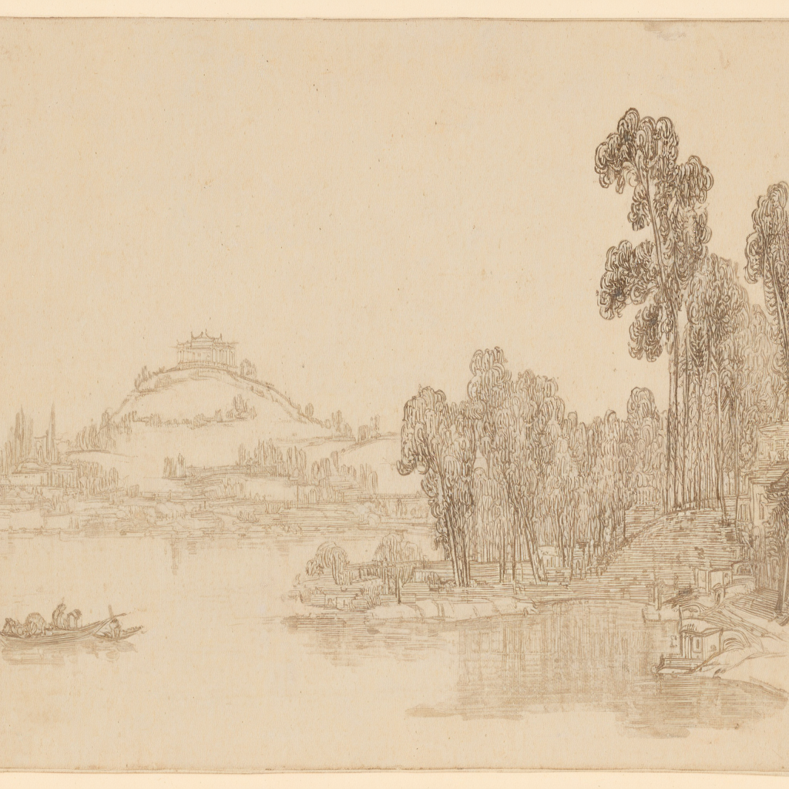
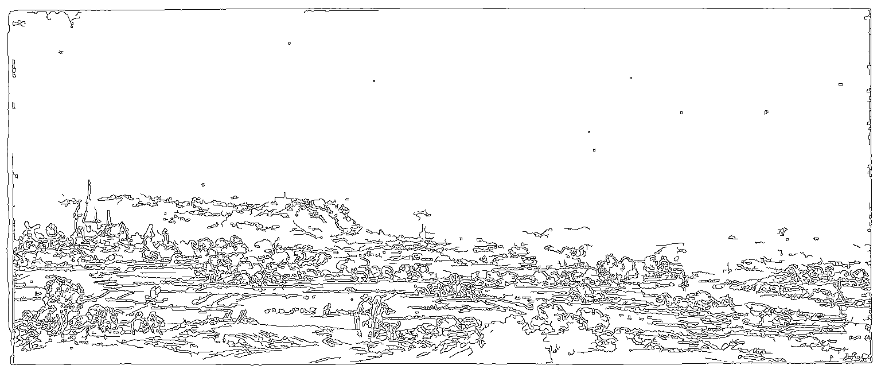
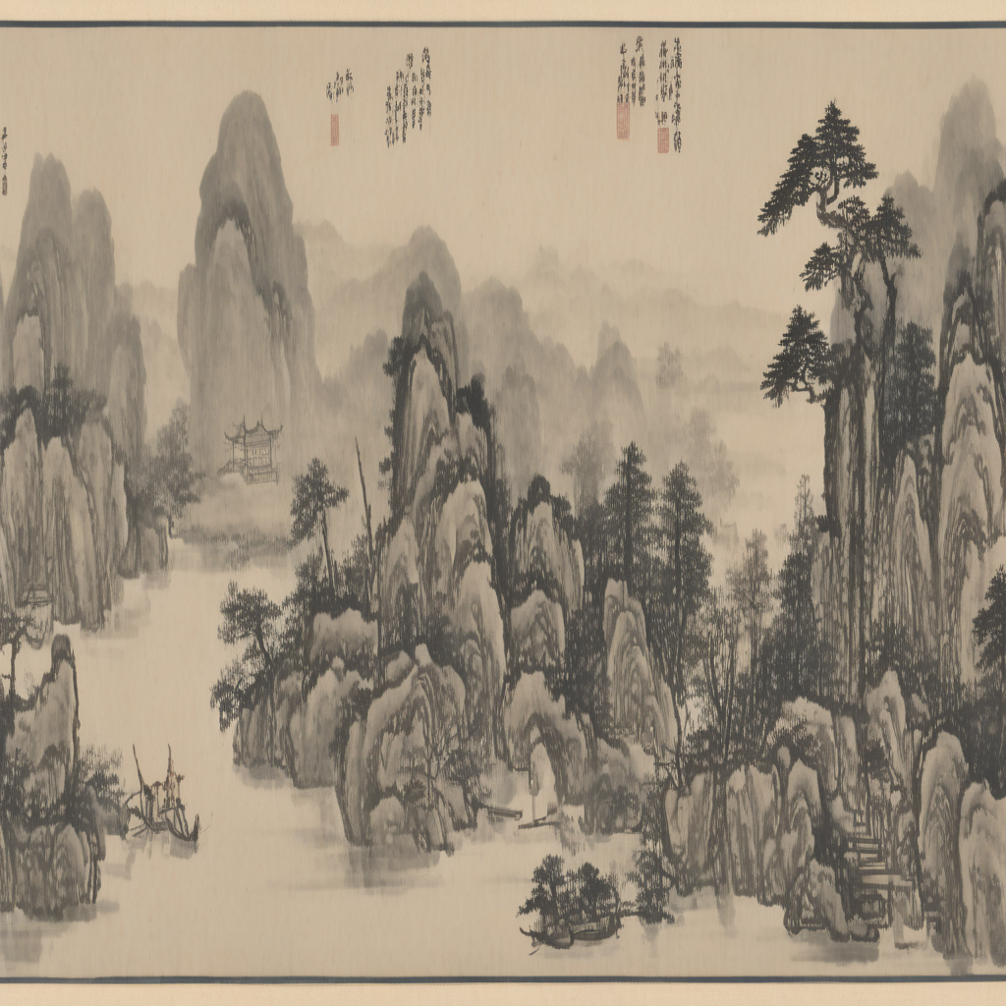
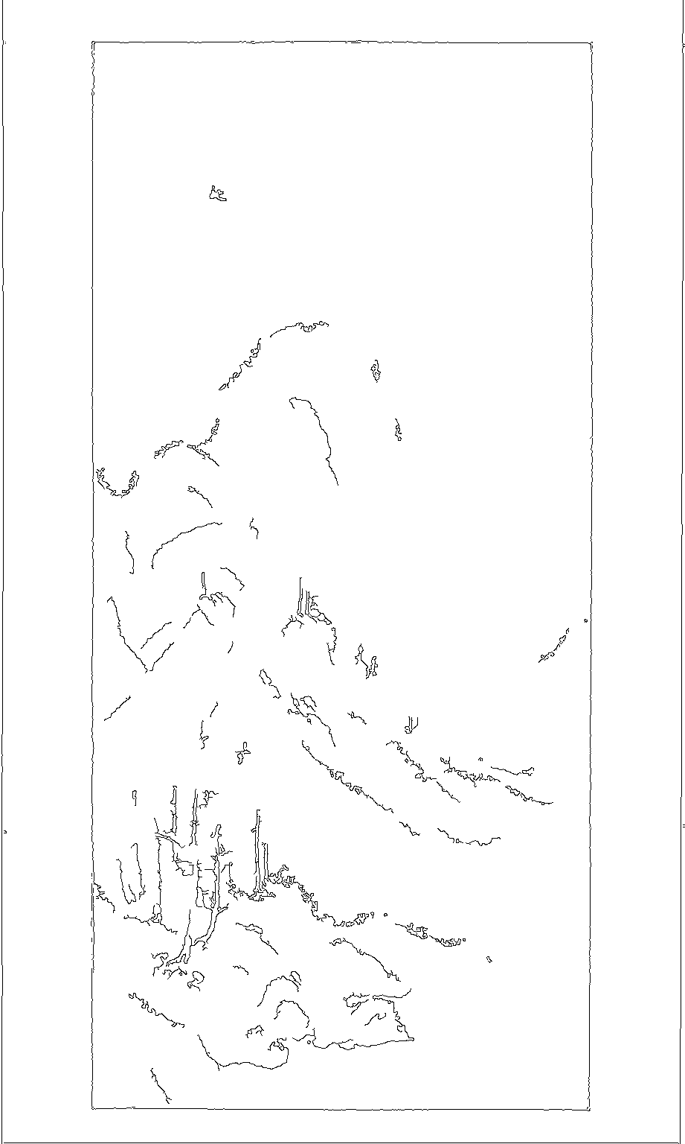
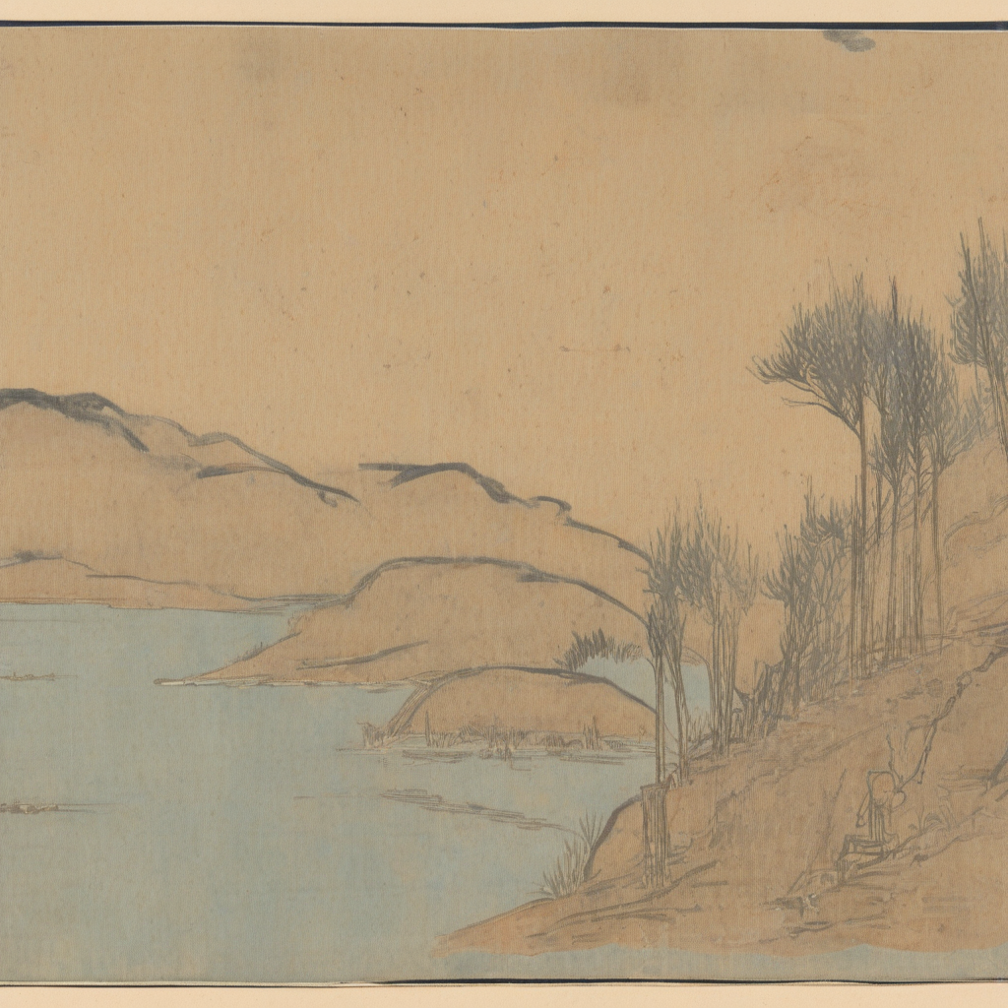
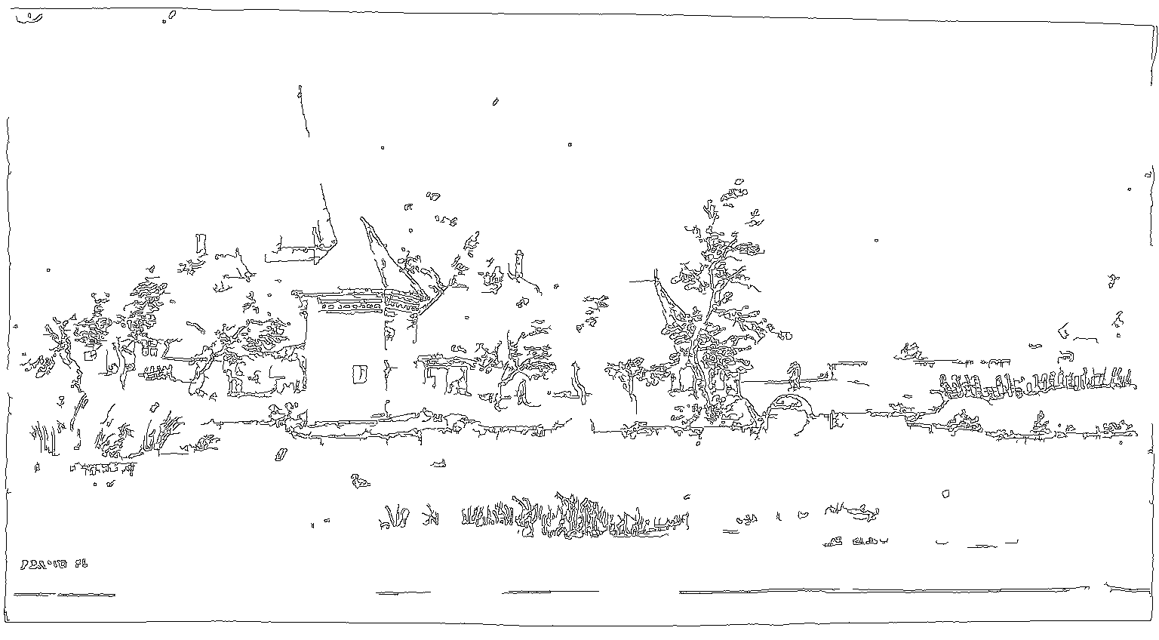
Figure 5. Structure Controllability Visualization
Unified prompt: Chinese landscape painting; pine trees and waterside pavilion; misty distant mountains; ink wash; ample poetic blank space.
Input structure
Generated output (Ours)
Case A: Large upper blank space
test #000685
blank space
blank space
low composition
low composition
Case B: Dominant central peak
test #000673
spatial hierarchy
main peak
spatial hierarchy
main peak
Case C: Left-heavy mountain mass
test #000740
left mass
left mass
open right
open right
Case D: Lower-right foreground
test #000001
depth layers
depth layers
foreground
foreground

