Slide 1
Proposed Additions to Stack Overflow
Images taken from Stack Overflow

Slide 2
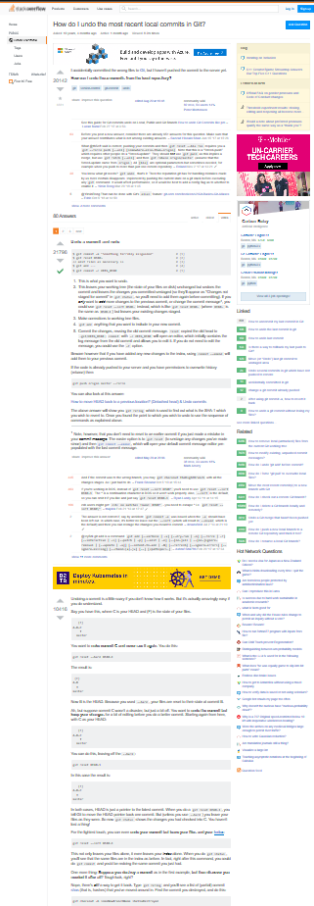
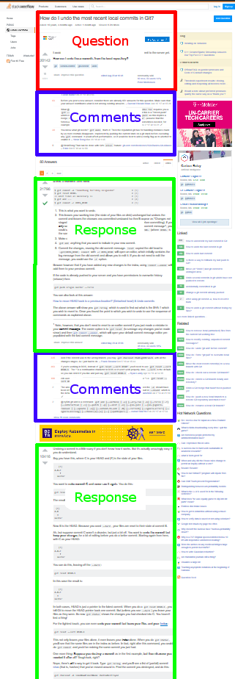
The Problem
This is how much space less than two of sixty-five responses (to a short question) take up
With already too much space being utilized, users of Stack Overflow are protective of their space
When newer programmers, or newer users, seek to answer questions, if it’s not helpful to a given user, they’re told so
This arises out of preserving space, but contributes to the “elitism” of Stack Overflow

Slide 3
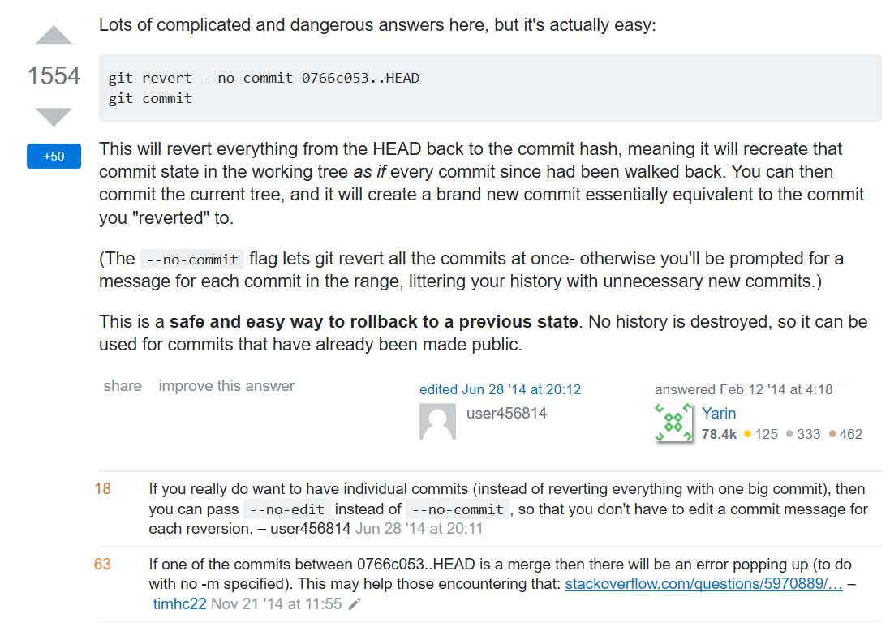
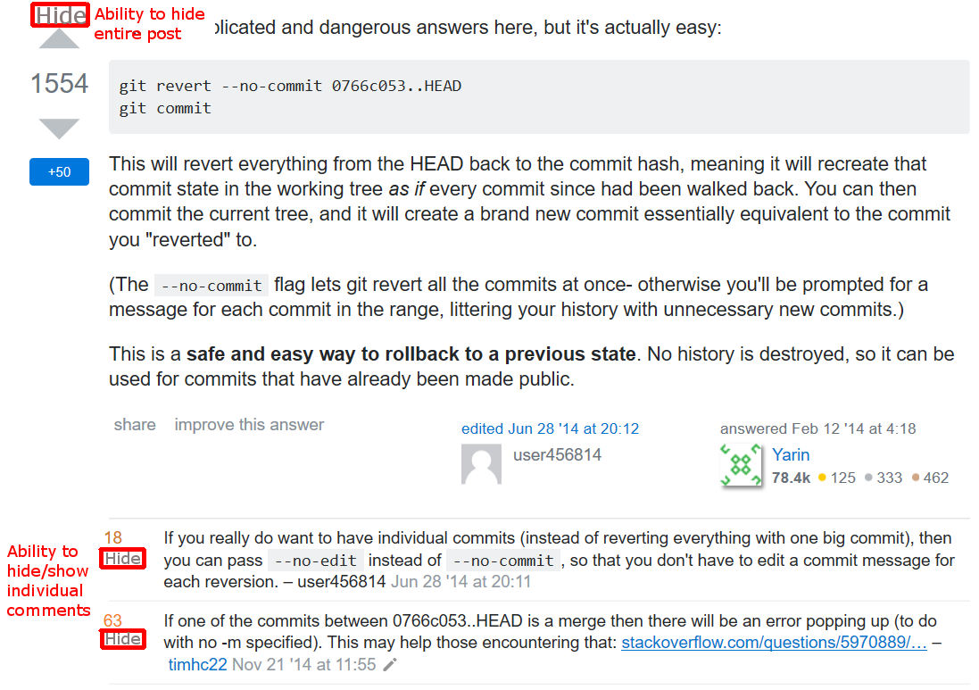
Solution: Hiding Responses
Current
Proposed

Slide 4
Solution: Hiding Responses
The ability to hide comments and responses would allow users to condense pages considerably
Would lessen the amount people are attacked for “gratuitous” responses or comments
Users can hide information, so no reason to call out others for it not being helpful to them
If top answer is not helpful for users, they can easily narrow down their focus on more helpful information more quickly

Slide 5
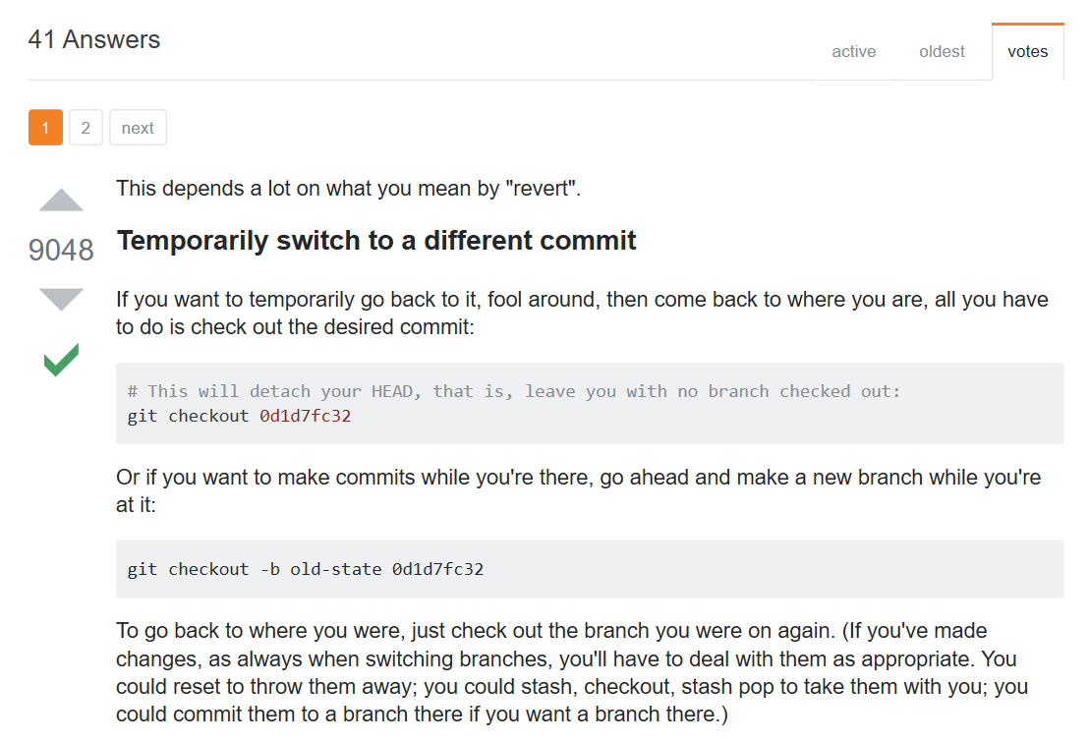
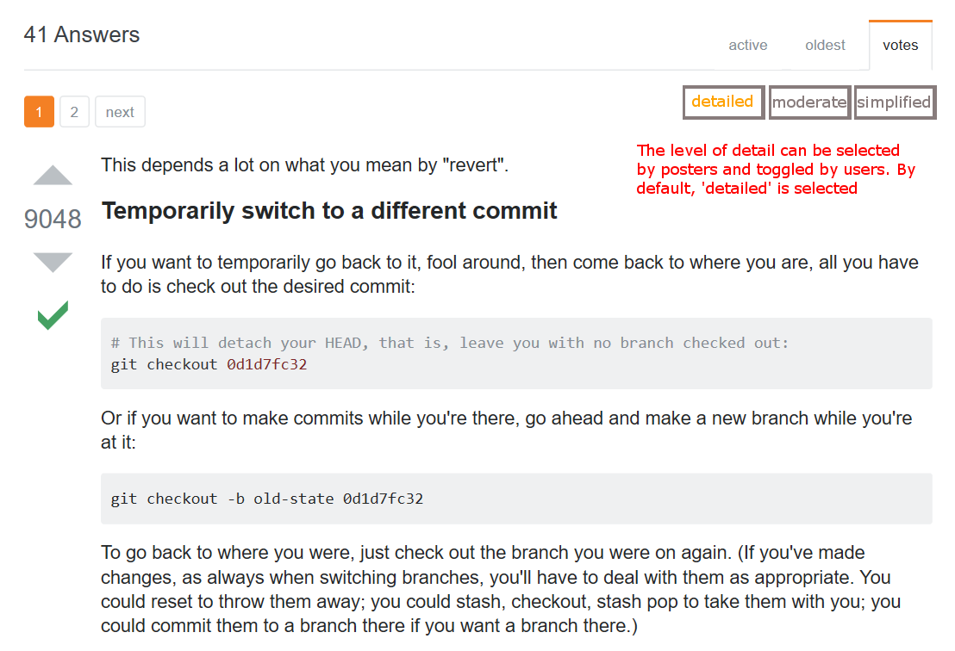
Solution: Specificity Track
Current
Proposed

Slide 6
Solution: Specificity Track
Lowers threshold for users to contribute
Still maintains quality of information users expect from Stack Overflow
Provides varying levels of detail that are helpful for different users
Additional means of filtering information and making page more concise

Slide 7
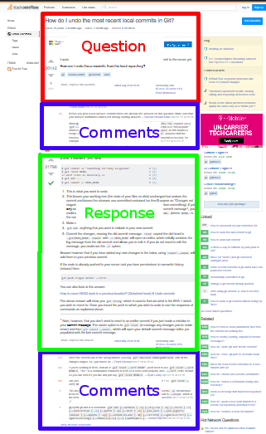
Solution
Hiding responses makes comment sections shorter, and can hide unnecessary responses
Filtering to tracks allows responses to not clutter the page for users who won’t find them helpful
With more space, users won’t be criticised unduly for posts
With more information and a more concise view, Stack Overflow becomes a stronger point of reference for everyone

Slide 8
Thank you!
Contact:
Ben Fickes
fickes.b@husky.neu.edu
302-750-3364

