Slide 1
Anonymous, accountable authentication for VANETs
Zero-knowledge proofs at the roadside, revocation and identity escrow on Hyperledger Fabric, measured on an 802.11p channel
Mechanism and results
Notes:
One sentence: vehicles authenticate without revealing who they are, liars get revoked by two independent RSUs, and only a threshold of RSU organisations can unmask a revoked vehicle.

Slide 2
Five properties the system must give at once
Authentication
Privacy
Misbehaviour detection
Only registered vehicles get a ticket; every safety message is signed
RSUs and the ledger see unlinkable pseudonyms, never identities
Plausibility checks on every BSM at the RSU
Revocation
Accountability
Two different RSUs must report before a pseudonym is revoked
t = 2f+1 RSU organisations can unmask a revoked vehicle; the TA alone cannot
Notes:
Most schemes give two or three of these. The point of the project is to give all five and show the cost on a realistic channel.

Slide 3
Who does what
Vehicle
5 pseudonym key pairs + Merkle paths
ZK proof to authenticate
Signs every BSM
RSU (9)
Verifies proofs, issues 30 s tickets
Checks every BSM, runs detector
Holds one escrow key share
Fabric ledger
Merkle root, policy, auths
Reports, revocations
Trace votes — no identities
802.11p radio
key shares
RSUs read the ledger locally; a write is visible to other RSUs after the commit (~0.5 s)
Trusted Authority
Registers pseudonyms
Encrypts identity, splits key
Cannot unmask alone
Simulation: SUMO 1 km² grid, 9 RSUs (450 m grid, 300 m service range), IEEE 802.11p 6 Mb/s, ns-3 or the calibrated lite backend.

Slide 4
One vehicle's journey through the protocol
1
2
3
4
5
6
7
Register
Beacon
ZK auth
Ticket
Signed BSMs
Handover
New pseudonym
Merkle root of all pseudonyms on the ledger; identity escrowed (AES-GCM + Shamir)
RSU signs a fresh nonce every 100 ms
Schnorr proof bound to nonce, RSU, service + Merkle membership
RSU signs a 30 s ticket, records it on the ledger, PREAUTHs neighbours
10 Hz, pseudonym signature; full ticket once a second, 8-byte digest otherwise
Ticket + signature to the next RSU, accepted via ledger or PREAUTH
Every 3 sessions, for unlinkability
The proof: R = r·G (precomputed), c = H(R ‖ Y ‖ rsu ‖ nonce ‖ time ‖ service ‖ pid ‖ class), s = r + c·x. RSU checks s·G = R + c·Y. It learns only that the sender owns a registered key, and the proof cannot be replayed elsewhere.
Notes:
Authentication never waits for a block: ledger reads are local, the ticket is immediate, and neighbours get PREAUTH over the 2 ms backbone.

Slide 5
From a lying BSM to a fully excluded vehicle
1
Detect
2
Report
3
Revoke
11 plausibility checks per BSM (range, position jump, speed vs path, acceleration, rate, replay, sybil…)
K = 3 flagged BSMs out of the last 10 → RSU reports the pseudonym with an evidence hash
Ledger revokes when 2 different RSUs reported — one RSU cannot revoke anyone
4
Trace
5
Unmask
6
Exclude
RSU opens a trace request; RSU organisations approve it on the ledger
t = 2f+1 RSUs release key shares only for an approved trace; TA decrypts
TA revokes all 5 pseudonyms of that vehicle
Notes:
Separation of power: RSUs can revoke (two must agree) but don't know who it is; the TA can decrypt only with t RSU shares after an auditable on-ledger approval.

Slide 6
Headline results (60 vehicles, 6 attackers, 3 seeds)
2.0 ms
1.6 ms
99 %
0
authentication latency (median, incl. ZKP)
handover latency (median)
attackers reported (all 6 attack types)
honest vehicles revoked
BSM delivery ratio 0.951, channel busy 4.1 % at RSUs, 145 security bytes per BSM.
First lying BSM → report: median 0.77 s; report → revocation visible: 3.8 s (mean over attacks).
Lite 802.11p backend, mock ledger (500 ms commit), 120 s runs, mean of 3 seeds. Source: docs/results/.

Slide 7
Final run: ns-3 radio and real Hyperledger Fabric
350 ms
1.60 ms
40 %
3.9 s
Fabric commit, median (p95 547 ms)
authentication latency, median
handovers accepted before the ledger record was visible (PREAUTH)
first lie to identity revealed and all pseudonyms revoked
60 vehicles, 3 seeds | Ours | ECDSA | Central
Auth / handover latency, median | 1.60 / 1.06 ms | 1.08 / 0.94 ms | 21.9 / 21.8 ms
BSM delivery / channel busy | 0.991 / 8.3 % | 0.992 / 6.7 % | 0.992 / 6.7 %
Attackers reported / revoked, honest revoked | 100 / 100 %, 0 | 100 / 100 %, 0 | 100 / 100 %, 0
All six attacks on Fabric: 5 of 6 types fully revoked (const_pos 67 %, the two-RSU rule); 0 honest vehicles revoked; 45 runs, 0 ledger errors.
Fabric 2.5.9, 2 organisations, Raft orderer, 500 ms batch timeout, TA + 9 RSU identities; ns-3 802.11p; grid, 120 s, 10 % attackers.

Slide 8
Authentication stays at a few milliseconds as traffic grows
What is inside the number
Radio airtime, MAC queueing, and measured crypto: prove 0.04 ms, verify 0.08 ms, sign 0.08 ms.
No ledger wait: the ticket is issued before the commit lands.
Handovers succeed 99 % of the time; 31 % were accepted through backbone PREAUTH before the ledger record was visible.

Slide 9
Ticket digest halves the security overhead of every BSM
Same idea as the IEEE 1609.2 certificate digest. The digest is inside the signed payload and maps only to a ticket the RSU verified itself.

Slide 10
Every attack type is caught within about a second
const_pos is the hard case: a constant offset is only implausible once it crosses the radio range, and a car seen by one RSU only is reported but not revoked.

Slide 11
How many RSUs must agree? Speed against trust
K = 1 revokes fastest but lets any single (possibly compromised) RSU revoke anyone. We keep K = 2: no single RSU can revoke.

Slide 12
Against the baselines: privacy and accountability for ~1 ms
 | Ours | Basic ECDSA PKI | Central
Security bytes / BSM | 145 | 72 | 72
Channel busy at RSUs | 4.1 % | 3.3 % | 3.3 %
Issuer cannot link pseudonyms | yes | no | no
No single party can unmask | yes | no | no
No online authority per request | yes | yes | no
Same roads, radio, attackers and detector for all three. ECDSA is ~0.7 ms faster and its BSMs are smaller; the central authority pays a 20 ms backbone round trip on every request. Detection and revocation numbers are equal by construction (same detector and ledger), so they are not a comparison point.
Property rows are design properties, not measurements. Full IEEE 1609.2 SCMS also splits linkage across authorities, at the cost of more online infrastructure.

Slide 13
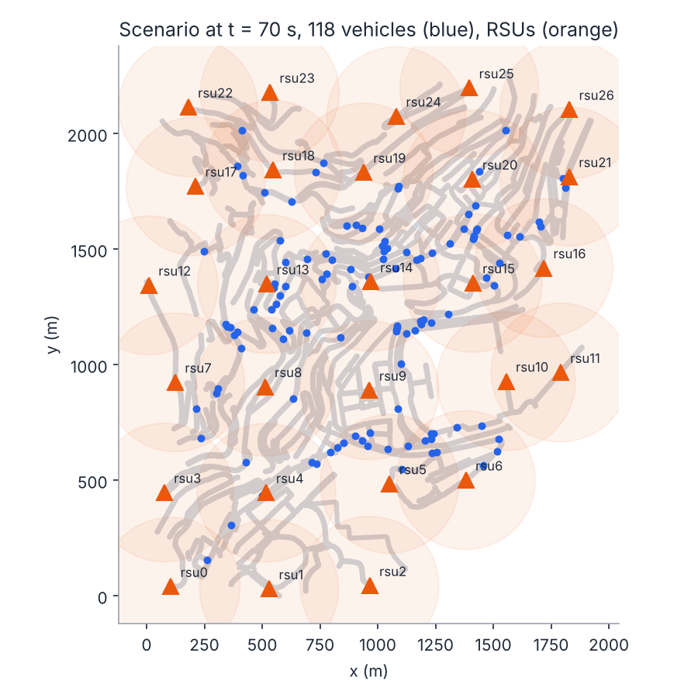
On a real city: central Monaco from OpenStreetMap
 | 60 veh | 120 veh
Auth latency, median | 1.96 ms | 2.41 ms
ECDSA / central | 1.29 / 22.2 ms | 1.40 / 22.3 ms
Handover success | 98.6 % | 99.0 %
BSM delivery ratio | 0.961 | 0.919
Attackers reported / revoked | 100 / 100 % | 100 / 100 %
All 6 attack types (100 vehicles): 100 % reported, 100 % revoked, 0 honest vehicles revoked.
New on the real map: hairpins and U-turns make the heading check flag a few honest cars; K-of-W reporting and the two-RSU rule stop every one of them before revocation.
1.9 × 2.3 km, 437 junctions, 27 RSUs. OSM data © OpenStreetMap contributors via the MoST scenario (Codecá & Härri, 2017).

Slide 14
What we fixed to get trustworthy numbers
Change | Before | After
Experiments run the real protocol | stand-in stub protocol | real ZKP protocol everywhere
Time to first report | counted from attack start: 14–31 s | from first lying BSM: 0.2–1.1 s
Pseudonym change vs. ghost check | own pseudonym change flagged as overlap | same radio ignored; 0 honest flags
Leaving vehicles in lite radio | slid toward parking spot, flagged 'range' | jump held; no false range flags
Ticket in every BSM | 333 B per BSM | 190 B per BSM (digest)
Parallel experiment sweeps | runs failed at random (scenario build race) | scenarios built once, no failures
All changes are covered by tests (89 passing). Details: docs/HOW_IT_WORKS.md, section 8.

Slide 15
Limitations and next steps
Limitations we state up front
Next steps
Traffic is SUMO random trips (real roads for Monaco, not recorded traffic).
Detector tuned on generated data; VeReMi NextGen not yet run; heading check fires at real-map U-turns.
const_pos seen by one RSU only is reported but not revoked (the two-RSU rule).
The RSU that sees a pseudonym change can link old and new pid.
Evaluate the detector on the VeReMi NextGen test split.
RSSI / angle-of-arrival check for constant-offset attacks.
Monaco on ns-3 + Fabric (27 RSUs needs a chaincode trace threshold above 10).
Fabric throughput at city scale (more peers, more organisations).

Slide 16
Anonymous to everyone, accountable to a quorum
Millisecond authentication, 190-byte signed BSMs, every attack type reported, no honest vehicle revoked.
Reproduce: python experiments/run.py --config experiments/configs/compare_bsm_ticket.json

