Slide 1

Smart Beta Investment Solutions
February 2018 – Data as of January 2017
Document intended exclusively for Professional Investors and Eligible Counterparties within the meaning of European Directive 2014/65/EU of 15 May 2014 (the “MiFID Directive”) or Institutional investors acting as principal.
n Switzerland, it is solely for the attention of qualified investors, as defined in Swiss applicable laws and regulations.

Slide 2









A stronger firm, a greater reach
Europe’s largest asset manager by assets under management and in the top 10 globally ⁽¹⁾ | No.1 publicly traded asset manager in Europe and the 5th largest in the world in terms of market capitalization ⁽²⁾ | 1.4 trillion euros in assets under management ⁽³⁾
Global coverage and local expertise, with offices in 37 countries in Europe, Asia, the Middle-East and the Americas | 6 main investment hubs ⁽⁴⁾ | 5,000 highly-skilled and experienced team members and market experts ⁽²⁾
A strong client-centric entrepreneurial culture and a dedication to teamwork | A full range of expertise in the areas of fixed income, equities, real and alternative assets, multi-assets and treasury across public and private markets | Uniquely positioned to provide high-quality service to over 100 million retail, institutional and government entities worldwide
1. Source IPE “Top 400 asset managers” published in June 2017 and based on AUM as of December 2016.
2. Market capitalization as of April 29, 2017.
3. Amundi figures as of September 30, 2017.
4. Boston, Dublin, London, Milan, Paris and Tokyo.
Smart Beta - Investment Solutions

Slide 3
A comprehensive range of investment strategies
Amundi + Pioneer Investments AuM: €1,400 bn as of 30/09/2017 ⁽¹⁾
Innovative and high-performing products, solutions and services that cover the entire spectrum of investment strategies
Widely-recognized know-how in Smart Beta, ETF, real estate, alternative assets, structured and guaranteed solutions, discretionary asset management solutions, global fixed income and global equities
Strong product expertise in European, US fixed income and Emerging Market debt
Breakdown of AuM by asset class⁽¹⁾
(1) Source: Amundi & Pioneer Investments pro forma combined figures as of end December 2016.

Slide 4
A client-centric service model
Over 100 million clients worldwide, with a diversified base of retail, institutional and government entities
Extensive experience and close partnerships with
wealth managers, distribution platforms, and retail networks in Europe, Asia-Pacific and North America to offer customized products, innovative services and value-added investment advice
A comprehensive expertise and a research driven investment culture
to provide holistic and objective investment solutions, combined with high quality service, to our institutional and corporate clients
Breakdown of AuM by client segment ⁽¹⁾
(1) Source Amundi & Pioneer Investments pro forma combined figures as of end December 2016.

Slide 5
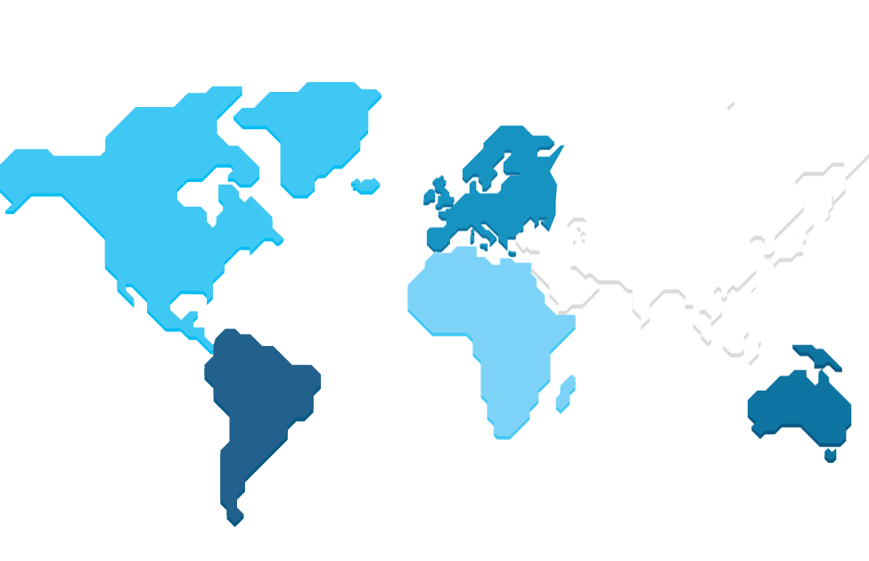
Global geographic coverage, true client proximity
Austria
Belgium
Bulgaria
Czech Republic
Denmark
Finland
France
Germany
Hungary
Ireland
Italy
Luxembourg
Netherlands
Poland
Romania
Slovakia
Spain
Sweden
Switzerland
United Kingdom
Dublin
London
Paris
Munich
Prague
Warsaw
Erevan
Hong Kong
Boston
Mumbai
Shanghai
Seoul
Madrid
Durham
Argentina
Canada
Chile
Mexico
USA
Milan
Vienna
Tokyo
Budapest
Australia
China
India
Japan
Malaysia
South Korea
Taiwan
Thailand
Singapore
Kuala Lumpur
Investment hubs
Local investment centers
Joint Ventures
Casablanca
Singapore
Armenia
Morocco
United Arab
Emirates

Slide 6
Amundi ETF, Indexing & Smart Beta platform
One of Amundi’s key strategic areas of development, accounting for more than €90 bn AUM*
ETF
INDEXING
SMART BETA
5th Largest European provider** with over 38bn€ AUM*
Fast and consistent growth pace
100+ UCITS ETFs covering all asset allocation needs
500+ cross listings on the main European stock exchanges
2 strong pillars : cost efficiency & innovation
30y+ track record with more than 100 indexes replicated in Equity & Fixed Income
Leverage on Amundi’s outstanding pricing power & dealing excellence
Strong customization capabilities, incl. ESG & low carbon index solutions
Open-ended range covering the main equity & fixed income exposure
Broad range of Factor investing & Risk-efficient solutions (e.g MinVar / Risk Parity)
Experience in both active & passive implementation totalizing over €20bn AUM
Strong tailor-made & advisory capabilities
Research-backed approach leveraging Amundi’s Quant & Research teams & reputable partners
BESPOKE SOLUTIONS
ETF-based solutions for Distributors : Portfolio Models, Advisory, Training & digital solutions
Indexing & Factor dedicated mandates with full range of customization capabilities incl. ESG integration
Proprietary Factor design, analysis & implementation
Product design: Dedicated funds, White-labelling…
Sources: *Amundi ETF Indexing & Smart Beta at end December 2017 / **Deutsche Bank European Monthly ETF Market Review as of December 29th, 2017.

Slide 7

Smart Beta & Factor Investing at Amundi - Our philosophy
We strongly believe that:
The best way to deliver consistent performance over the long term is by managing risks
Risk is multifaceted, encompassing many aspects…
… and can only be addressed properly through a scientific & disciplined portfolio construction process
Bruno Taillardat
Global Head of Smart Beta & Factor Investing at Amundi

Slide 8

Smart Beta & Factor Investing at Amundi – Our solutions
A broad range of strategies to address investors’ challenges & requirements, implemented in open-ended funds and dedicated mandates
RISK EFFICIENT SOLUTIONS
FACTOR INVESTING SOLUTIONS
To Avoid Unrewarded Risks
To Capture Rewarded Risk Factors
Minimum Variance
(Conservative flagship range)
Single Factors
(MSCI ETF Europe/US Factor Range)
Risk Parity Strategy
(ERI Scientific Beta partnership / passive solutions)
Risk-based Dynamic Factor Allocation
(Amundi Smart Beta Platform proprietary strategy)
To Capture Alpha Factors
Return-based Dynamic Factor allocation
(CPR AM, Amundi’s quant boutique strategy)
8
Smart Beta - Investment Solutions

Slide 9
Smart Beta & Factor Investing at Amundi - In a nutshell
Broad coverage
Factor Investing Solutions
Risk Efficient Solutions
Global/Europe/Euro/Japan/EM equities
Meeting various client needs
To provide robust performance
To enhance diversification
To exploit return asymmetry
Track record & Size
First strategy launched in 2007
Close to €12 bn AUM split between open-ended and customized solutions
Sources: Amundi ETF Indexing & Smart Beta at end June 2017
Smart Beta - Investment Solutions

Slide 10
















Smart Beta at Amundi - A dedicated set-up
Portfolio Management
CPR
Quantitative Research
Bruno Taillardat
Global Head of Smart Beta & Factor Investing
21 years’ experience
Melchior Dechelette
Head of Risk Efficient Solutions
21 years’ experience
Cyrille Collet. CFA. SFAF
Head of Quantitative portfolio management
21 years’ experience
Thierry Roncalli
Head of Quantitative Research
20 years’ experience
Alessandro Russo. CFA
Head of Factor Investing
17 years’ experience
Olivier Avertin
Portfolio Manager. Paris
23 years’ experience
+ 8 analysts/PMs
+ 15 analysts
Investment Specialists
ESG Research
David Liddell. CFA
PM Factor Investing
20 years’ experience
Hiba Aourir
Junior Portfolio Manager. Paris
4 years’ experience
Frederic Hoogveld.
CFA. CAIA
Head of Investment Specialists. Index and Smart Beta
15 years’ experience
Antoine Sorange
Head of ESG Research
17 years’ experience
Giacomo Sarchioni
Data Scientist
5 years’ experience
Hicham Lahbabi
Portfolio Manager. Hong-Kong
17 years’ experience
Ludovic Ferreira
Investment Specialist. Paris
7 years’ experience
+ 16 analysts
Satoru Kobayashi
Portfolio manager. Tokyo
19 years’ experience
Vincent Masson
Portfolio Manager. Paris
20 years’ experience
Hugo Sperry
Investment Specialist. Paris
7 years’ experience

Slide 11
Risk-efficient solutions
01
Minimum Variance "Avoid unrewarded risks with reduced drawdowns"

Slide 12
The Conservative Equities Range
Europe
Global
Launch date | April 2009
Domicile | Amundi Funds Luxembourg Sicav
Launch date | July 2012
Domicile | Amundi Funds Luxembourg Sicav
Emerging
Euro
Launch date | September 2013
Domicile | Amundi Funds Luxembourg Sicav
Launch date | January 2017
Domicile | French FCP
Smart Beta - Investment Solutions

Slide 13
A risk-efficient approach that reduces drawdowns
The Conservative equity strategy can limit market drawdowns
Europe Conservative strategy: Quarterly maximum drawdowns
Europe conservative
MSCI Europe Index
Source: Amundi AM. Gross performance as of 29/12/2017 of the IE share class of AF Equity Europe Conservative Investors are reminded that the past performance cannot be regarded as a reliable indicator of future results. nor can they guarantee expected return

Slide 14
A risk-efficient approach that delivers return asymmetry
A Minimum Variance approach on a European Equity universe can enable clients to participate in market gains (83%) while limiting exposure to drawdowns (53%)
Europe Conservative Strategy Participation profile to monthly calendar returns
Source: Amundi AM. Gross performance as of 31/01/2018 of the IE share class of AF Equity Europe Conservative. Compared with reference indicator (MSCI Europe NR Close). Based on monthly data: performance of strategy in up markets (months when index performance is positive) and down markets (months when index performance is positive). Past performance is not a reliable indicator of future results or a guarantee of future returns.

Slide 15
A risk-efficient approach to get better risk-adjusted returns
Europe Conservative Strategy Annualized Performance comparison
Annualized Performance +13.0%
Annualized Performance +10.8%
Amundi Fds Europe Conservative
MSCI Europe
Source: Amundi AM, Gross performance as of 31/01/2018 of the IE share class of AF Equity Europe Conservative Investors are reminded that the past performance cannot be regarded as a reliable indicator of future results, nor can they guarantee expected return.

Slide 16
A risk-efficient approach to get better risk-adjusted returns
Europe Conservative Strategy Calendar year performance comparison
Amundi Fds Europe Conservative
MSCI Europe
Source: Amundi AM, Gross performance as of 31/01/2018 of the IE share class of AFE Europe Conservative Amundi Funds Equity Europe Conservative was launched on 4/29/2009. Investors are reminded that the past performance cannot be regarded as a reliable indicator of future results, nor can they guarantee expected return.

Slide 17
A risk-efficient approach to deliver consistent performance
Mono-thematic market
Steady bull market
From 29/04/2009 to 15/11/2009
Portfolio: +14.8%
Benchmark: +25.5%
Excess return: -10.7%
From 15/10/2014 to 15/04/2015
Portfolio: +40.4%
Benchmark: +33.7%
Excess return: +6.7%
Market turmoil
Range trading market
From 17/02/2011 to 22/09/2011
Portfolio: -13.1%
Benchmark: -24.3%
Excess return: +11.2%
From 30/04/2015 to 24/07/2015
Portfolio: +2.7%
Benchmark: +0.1%
Excess return: +2.6%
Source: Amundi AM, Gross performance of the IE share class of Amundi Funds Equity Europe Conservative Past performance is not a reliable indicator of future results or a guarantee of future returns.
AF Equity Europe Conservative
MSCI Europe Index

Slide 18
A disciplined investment process to address a wide spectrum of risks
Multifaceted and challenging risk framework implies a rigorous and structured portfolio construction process
Volatility
Top down Risks
Correlation
Macro risks
Stock specific risks
(ESG risks, fundamental risks, etc.)
Valuation
Liquidity
Source: Amundi AM
Bottom up Risks

Slide 19
A disciplined investment process to address a wide spectrum of risks
EUROPEAN / EM / GLOBAL INVESTMENT UNIVERSE
1. Eligible Universe definition
Quality screening ESG risk
Liquidity risk Specific risk
2. Volatility reduction
A portfolio composed of stocks with lower volatility and high diversification properties
Limit stock concentration
In case of decision from the Smart Beta Committee:
Integration of adjustments from 3rd step
Optimization under new constraints
3. Active Risk Management
Macro risk (country or macro-economic risk)
Valuation risk
Portfolio guidelines
Between 80 and 130 stocks
Fully exposed to Equities
Quality stock investing
Low beta exposure
High level of diversification
Source: Amundi AM Investment in emerging markets carries an above average degree of risk due to the less developed nature of securities markets in those countries

Slide 20
Risk-efficient solutions
02
Risk Parity "Limit unrewarded risks with capital diversification"

Slide 21
A risk-efficient approach limiting drawdowns
In market drops, Euro Risk Parity strategy could limit drawdowns
Quarterly Max Drawdowns
AF Equity Euro Risk Parity
MSCI EMU Index
Source: Amundi AM, Gross performance as of 29/12/2017 of the IE share class of AF Equity Euro Risk Parity Past performance is not a reliable indicator of future results or a guarantee of future returns.
Smart Beta - Investment Solutions

Slide 22
A risk-efficient approach to achieve a higher capital diversification
The investor’s risk budget is spread over a very large number of stocks
Weight distribution Eurozone capitalization weighted index and risk parity portfolio
3.5%
3.0%
2.5%
2.0%
1.5%
Weight Risk Parity
1.0%
Weight Cap Weighted
0.5%
0.0%
Source: Amundi, 31/12/2016 Past performance is not a reliable indicator of future results or a guarantee of future returns.
Smart Beta - Investment Solutions

Slide 23
A risk-efficient approach that delivers return asymmetry
A Risk parity approach on a Euro Equity universe can enable clients to participate in market gains (89%) while limiting exposure to drawdowns (75%)
Euro Risk Parity Strategy Distribution of monthly calendar returns
Source: Amundi AM, Gross performance as of 31/01/2018 of the IE share class of AF Equity Euro Risk Parity Compared with reference indicator (MSCI EMU NR Close). Based on monthly data: performance of strategy in up markets (months when index performance is positive) and down markets (months when index performance is positive). Investors are reminded that the past performance cannot be regarded as a reliable indicator of future results, nor can they guarantee expected return
Smart Beta - Investment Solutions

Slide 24
A risk-efficient approach to get better risk-adjusted returns
Euro Risk Parity Strategy Annualized Performance comparison
Risk Indicators | YTD | 1 year | 3 years | 5 years | Since inception (24/06/2010)
Portfolio Volatility | 1,9% | 16.4% | 8.3% | 12.1% | 10.1%
Benchmark Volatility | 3,2% | 17.2% | 7.4% | 10.7% | 8.7%
Annualized Performance +10.1%
Annualized Performance +8.7%
Source: Amundi AM, Gross performance as of 31/01/2018 of the IE share class of Amundi Fds Euro Risk Parity Investors are reminded that the past performance cannot be regarded as a reliable indicator of future results, nor can they guarantee expected return

Slide 25
A risk-efficient approach to get better risk-adjusted returns
Euro Risk Parity Strategy Calendar Performance comparison
Amundi Fds Euro Risk Parity
MSCI EMU Index
Source: Amundi AM, Gross performance as of 31/01/2018 of the IE share class of AF Equity Euro Risk Parity * 2010 (partial): From 24/06/2010 to Dec 2010 Investors are reminded that the past performance cannot be regarded as a reliable indicator of future results, nor can they guarantee expected return
Smart Beta - Investment Solutions

Slide 26
Risk Parity: allocate the same risk budget to each asset
Simple concept…
Overweight the least risky stocks, underweight the most risky stocks
Ensure a very high level of capital diversification and limit market drawdown
…but many possible implementations
Overly simple implementation
Only volatilities are estimated for all stocks
The weight of each stock is inversely proportional to its volatility
End portfolio is highly biased, diversification opportunities are not taken into account
Amundi
Risk Parity
Volatilities taken into account at stock level
Correlations taken into account at sector level
Overly complex implementation
Volatilities and correlations are estimated for all stocks
The weight of each stock is obtained by equalizing risk contribution between stocks
Calculation is computationally challenging
Source: Amundi AM

Slide 27
Amundi Risk Parity process
Sector portfolio
construction
Final portfolio
construction
1 Risk parity within sectors
2 Risk parity between sectors
We build ten sector sub-portfolios
Within each sector portfolio, the weight of each stock is inversely proportional to its volatility
We calculate the Marginal Contribution to Risk of each sector portfolio
The weight of each sector portfolio in the final portfolio is inversely proportional to its MCR
PORTFOLIO
Portfolio more exposed to low volatility stocks
Very high level of capital diversification
Profit taking policy associated with systematic monthly rebalancing
Source: Amundi AM Investment in emerging markets carries an above average degree of risk due to the less developed nature of securities markets in those countries

Slide 28
Step 1: Equalizing risk contribution within sectors
For each sector, we create a “sector portfolio” where:
All the stocks of the original sector portfolio are inserted
The weight of each stock is inversely proportional to its forecasted volatility
Weights of stocks in the Healthcare sector Risk Parity
Weights of stocks in the Healthcare sector MSCI EMU
Source: Amundi * Weights are rebased and provided for illustrative purposes only
Weight in Euro Risk Parity
Volatility
Weight in Euro Risk Parity
Volatility

Slide 29
Step 2: Equalizing risk contribution between sectors
We calculate each new “sector portfolio” Marginal Contribution to Risk* (MCR)
The volatility measures the “riskiness” of an asset on a stand-alone basis
The MCR takes into account not only the volatility of the asset, but also its correlation with the other assets in portfolio
The weight of each “sector portfolio” is inversely proportional to its MCR
Weights of GICS1 sectors Risk Parity
Weights of GICS1 sectors MSCI EMU
Source: Amundi * Weights are rebased and provided for illustrative purposes only
Weight in Risk Parity Euro
MC to Total Risk
Weight in Risk Parity Euro
MC to Total Risk

Slide 30
Factor Investing
03
From mono to multi factors
Multi Beta Multi Smart with ERI Scientific Beta
Dynamic Factor allocation
CPR AM solution
Smart Beta - Investment Solutions

Slide 31
Factor Theory: from CAPM to Factor investing
CAPM
Risk free rate
Market risk
“Old” Alpha
Residual
Factor Investing
Risk free rate
Value
Momentum
Quality
Size
Low
volatility
Residual
“New” Alpha
Within each factor, stocks share similar style characteristics and behavior and have the same level of expected returns
Smart Beta - Investment Solutions

Slide 32
Mapping of our selected risk factors
Momentum
Price related
SIZE
Low volatility
Value
Quality
Fundamentals
Risk Premium
Market inefficiencies
Given for illustrative purpose only

Slide 33
Payoff of Amundi Value factor
Construction of our factor portfolios
Monthly returns of Amundi Value factor vs. Eurostoxx index
Value factor
Value factors tend to exhibit high tail market movements
Eurostoxx index
Source: Amundi, DJ Stoxx Eurostoxx, the Value factor being constructed by Amundi, 31/03/1997 – 29/09/2017, Past performance is not a reliable indicator of future results or a guarantee of future returns
33
Smart Beta - Investment Solutions

Slide 34
Payoff of Amundi Low volatility factor
Construction of our factor portfolios
Monthly returns of Amundi Low Vol factor vs. Eurostoxx index
Low Vol factor
Eurostoxx index
Source: Amundi, DJ Stoxx Eurostoxx, the low vol factor being constructed by Amundi, 31/03/1997 – 29/09/2017, Past performance is not a reliable indicator of future results or a guarantee of future returns
34
Smart Beta - Investment Solutions

Slide 35
Factor performance are highly cyclical
MSCI World Factor indices vs MSCI World
Min Vol
9.7%
Mom
150.0%
Div
9.5%
Value
13.4%
Value
149.3%
Mid Cap
5.3%
Mid Cap
9.2%
Value
10.3%
Value
11.1%
Min Vol
12.8%
Value
5.2%
Min Vol
6.4%
Min Vol
6.0%
Mid Cap
101.7%
Mom
5.1%
Mom
6.1%
Mom
18.3%
Div 7.9%
Mom
10.4%
Min Vol
11.0%
Mid Cap
7.8%
Mom
9.8%
Mom
3.0%
Quality 3.5%
Mom
4.9%
Mom
9.7%
Quality 60.0%
Value
4.3%
Value
23.0%
Min Vol
5.3%
Value
7.3%
Mid Cap
1.0%
Quality
7.2%
Quality 6.9%
Quality 2.6%
Mid Cap
8.8%
Div
9.4%
Mid Cap
1.3%
Mom
1.6%
Quality 4.6%
Div 1.8%
Quality
3.6%
Min Vol
57.7%
Quality
3.1%
Mid Cap
7.7%
Div 4.4%
Mid Cap
6.2%
Min Vol
0.4%
Value
0.7%
Mom
0.5%
Div
2.5%
Mom
4.4%
Quality 9.4%
Mid Cap
0.5%
Quality 0.4%
Mid Cap
0.2%
Mid Cap
0.4%
Value
0.6%
Mid Cap
0.9%
Div
9.9%
Div
-3.6%
Quality
-2.6%
Min Vol
-1.8%
Mom
-1.3%
Div
-2.5%
Div
-2.3%
Min Vol
-13.6%
Min Vol
-0.3%
Mid Cap
-2.2%
Value
-1.6%
Div
-4.8%
Value
-1.0%
Div
-2.3%
Mid Cap
-0.01%
Value
-0.3%
Mom
-7.7%
Div
-1.8%
Quality
-3.9%
Min Vol
-3.5%
Value
-2.3%
Mom
-15.8%
Quality
-1.1%
Value
-6.0%
Mom
-1.7%
Min Vol
-8.1%
Div
-2.5%
Value
-2.4%
Min Vol
-0.04%
Div
-4.3%
Min Vol
-7.9%
Quality
-4.0%
Mid Cap
-4.1%
Mid Cap
-3.3%
Value
-3.2%
Quality
-2.8%
Quality
-3.0%
Min Vol
-5.1%
Quality
-11.7%
Div
-5.5%
Div
-3.5%
Mom
-3.3%
Min Vol
-7.8%
2002
2003
2004
2005
2006
2007
2008
2009
2010
2011
2012
2013
2014
2015
2016
2017
Since inception
Value
Momentum
Mid Cap
Minimum Volatility
Quality
High Dividend Yield
Source: MSCI / Data as of Dec 2017, net total return in USD Past performance is not a reliable indicator of future results or a guarantee of future returns

Slide 36
Factor Investing to harvest uncorrelated risk factors
Correlations of excess return – Global 2002-2017
Rewarded factors tend to be uncorrelated with one another
In particular, factors such as Value and Momentum offers attractive diversification opportunities
Factors Investors should consider diversified investment to rewarded factors to benefit from diversification
 | Mid Cap | Minimum Volatility | Momentum | Quality | Value
Mid Cap | 100%
Minimum Volatility | -19.0% | 100%
Momentum | 16.3% | 31.1% | 100%
Quality | -30.9% | 39.7% | 31.8% | 100%
Value | 28.9% | -35.2% | -22.1% | -53.9% | 100%
Source: MSCI, Amundi as of December 2017, net total returns in USD.
Smart Beta - Investment Solutions

Slide 37
Multi-Factor Investing through a consistent index design
Scientific Beta
Scientific Beta Multi-Beta Multi-Strategy Index
SUB-INDICES CONSTRUCTION PROCESS
INDEX CONSTRUCTION PROCESS
Stock Selection
Weighting Scheme
Sub-Indices
Weighting Scheme
VALUE
50% highest
book-to-market stocks
Diversified
Multi-strategy
weights
=
Value Diversified
Multi-Strategy index
EQUAL RISK CONTRIBUTION
HIGH
MOMENTUM 50% highest momentum stocks
=
High Momentum
Diversified
Multi-Strategy index
Investment universe
Multi-Beta Multi-Strategy ERC Index
MID CAP 50% mid cap stocks
=
Mid Cap Diversified
Multi-Strategy index
LOW
VOLATILITY 50% lowest volatility stocks
=
Low Volatility
Diversified
Multi-Strategy index
Source: Scientific Beta
Smart Beta - Investment Solutions

Slide 38
Multi-Factor Investing to diversify across factors
Scientific Beta
Source: Scientific Beta, Amundi. Data from May 2014 to January 2018 in USD Investors are reminded that the past performance cannot be regarded as a reliable indicator of future results, nor can they guarantee expected return
Smart Beta - Investment Solutions

Slide 39
Portfolio snapshot – January 2018
Scientific Beta
Sector breakdown
Country breakdown
Top 10 holdings
As of 31/01/2018 | SciBeta MBMS 4F ERC
WAL-MART STORES INC | 0.4%
AETNA INC | 0.4%
ANTHEM INC | 0.4%
REGIONS FINANCIAL CORP | 0.4%
CME GROUP INC | 0.4%
CITIZENS FIN GRP INC | 0.4%
BEST BUY CO INC | 0.4%
COMERICA INC | 0.4%
XCEL ENERGY INC | 0.4%
CITIZENS FIN GRP INC | 0.4%
TOTAL | 3.9%
Number of holdings | 1279
Source: Scientific Beta, Amundi. Data as per end of January 2018 in USD
Investors are reminded that the past performance cannot be regarded as a reliable indicator of future results, nor can they guarantee expected return
Smart Beta - Investment Solutions

Slide 40
Factors construction matters: Value
Sector and country biases need to be monitored and mitigated
Sector Breakdown
% allocation
Problem - Valuation ratios have significant sector biases
→ The choice of metrics is crucial
High Book to Market Value portfolio vs MSCI Europe sector allocation
Source: FactSet, Amundi, as of 30/09/2016
Msci World
High BtP Selection

Slide 41
From theory to practice: a robust definition of factors
Factor | Most common definition in theory | Amundi definition
Value | Price to Book | Combination of Price to Book, Price To Earnings and Price to Cash Flow Split the universe into Financials and Non Financials
Momentum | 1-year Price momentum ex 1 month | 1-year Price momentum ex 1 month Calculated in local currency
Low Volatility | Lowest volatile stocks | Lowest volatile stocks Calculated in local currency
Size | Mid cap stocks | Mid cap stocks Identified in each region
Quality | ROE | Combination of Profitability and Leverage indicators Split the universe into Financials and Non Financials

Slide 42
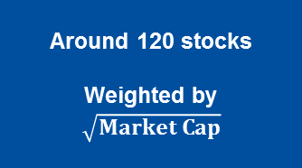
Construction of our factor portfolios: example with Value North America
1. Investment universe
2. Stock selection
3. Weighting scheme
MSCI North America
Filtered investment universe based on Liquidity
(around 600 stocks)
Financials
Ranking based on
P/B
P/E
P/CF*
Quintile 1
Non
Financials
Quintile 1
Value Factor
Around 120 stocks
Weighted by
$$\sqrt{Market Cap}$$
Selection of highest ranked stocks
Financial stocks excluded - Given for illustrative purpose only

Slide 43
Our factor allocation approach: a dynamic risk allocation
Dynamic Factor Allocation
We believe that the combination of factors should be risk based and should rely on a strategic allocation and a tactical allocation
Strategic allocation:
The strategic allocation needs to be long-term oriented
And should be based on factor risks
With the objective to limit the expected drawdowns
Tactical allocation:
The tactical allocation should capture short-term risks
And could introduce a limited deviation from the strategic allocation
This allocation is solely based on risks and doesn’t use any expected return scenario
Source: Amundi
Smart Beta - Investment Solutions

Slide 44
Strategic allocation: Minimize expected drawdowns
Dynamic Factor Allocation
FACTORS
ERC* factor allocation
Min Drawdown allocation
Factor 1
Factor 1
Factor 1
∑
Factor 2
Inflexion points in macro-
economic
regimes
Factor 2
Factor 2
Factor 3
Covariance matrix
Returns of 4 factors
Each factor weight will be dependent on its contribution to the volatility of the multi-factor portfolio
Factor 3
Factor 3
Factor 4
Adjustment based on risks that would change in different macro environments
Factor 4
Factor 4
The covariance matrix needs to take into account turning points in macro-economic regimes to better reflect the current risk environment that could impact the factors
* Equal Risk Contribution

Slide 45
Strategic allocation - Minimize expected drawdowns
Dynamic Factor Allocation
Expected drawdowns of each factor depending on a changing market context
Switch from… …To | Expansion Contraction | Contraction Recession | Recession Recovery
Value | Higher | Higher
Momentum | Higher |  | Higher
Low Volatility
Quality |  |  | Higher
Expected Drawdowns
Higher: “Higher risk contribution than long-term average”
Relationships between factor risks and turning points in macro-economic regimes can be observed
Some factors will be underweight vs. the original ERC allocation when the economic environment is switching from one to another
Source: Amundi Quantitative Research.
Smart Beta - Investment Solutions

Slide 46
Tactical allocation: adjust for Valuation pressure
Dynamic Factor Allocation
Valuation level compared to 5 years history of each factor
March 2017 | 5 Years Z-Score
Eurozone | Price to Earnings Z-Score | Price to Book Z-Score | Average Z-score | Valuation risk
Low Volatility | 0,89 | 0,87 | 0,88
Momentum | 0,80 | -0,53 | 0,14
Quality | 0,97 | 1,47 | 1,22
Value | 1,65 | 0,58 | 1,11
Quality and Value are traded at high valuation multiples, compared to the last 5 years
A high valuation vs. 5 years history may be an indication of a high risk due to Valuation pressure on the factor
Our tactical allocation decreases the allocation to these factors based on its over-valuation
Source: Amundi, Factset, MSCI
Valuation figures of Factors calculated on a monthly basis from December 2001
Z-scores of Price to Earnings Last 12 months and Price to Book, computed over 5 years rolling
Smart Beta - Investment Solutions

Slide 47
Tactical allocation: adjust for valuation pressure
Dynamic Factor Allocation
Strategic allocation
Tactical allocation
Execution
Factor 1
Factor 1
Factor 2
Factor 2
Final portfolio
(around 400 stocks)
Factor 3
Factor 3
Factor 4
Best execution
Turnover management
Portfolio guidelines
Max per position
Min per position
Max per sector
Max per country
Factor 4
Adjustment based on valuation trends of factors
Tracking Error budget vs. Strategic portfolio
Smart Beta - Investment Solutions

Slide 48
CPR
CPR AM Multi-factors - Multi-Regime, Multi-Factor allocation
Core beliefs
Implementation
1
In equities, alpha can be explained by factors over the long term
Bottom-up selection and combination of Systematic Strategic Factors
2
Factors efficiency is driven by market cycles
Identification of market regimes and related multi factor models
3
Each investment universe has its own trends & specificities
Model adjustment according to target region
4
External events may affect financial perception at the stock level
PM team has a leeway to implement tactical changes to manage special situation
A quantitative, yet reactive & adaptive approach drawing on a long track record & first class proprietary management tool
48
Smart Beta - Investment Solutions

Slide 49
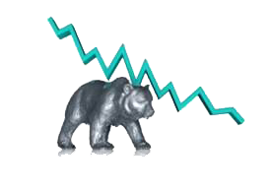

CPR
CPR AM Multi-factor - 5 combinations of relevant factors according to market regimes
Market Regime
BEAR
BULL
5 multi-factor combinations
DEFENSIVE
MOMENTUM
BLEND
AGGRESSIVE
DEEP VALUE
Low Volatility
Price Momentum
AGGRESSIVE
Quality
Value
Dividend yield
Value
Piotroski
Earnings revision Momentum
MOMENTUM
Growth
Deep Value
49
Smart Beta - Investment Solutions

Slide 50



CPR
Identification of current market regime and selection of relevant factor
1
Evaluate current market conditions
Monthly
Global
CIRCUIT
BREAKER
The circuit breaker takes into account Credit and Equity market trends to determine the global market regime
2
Build the most relevant factor allocation
Weekly
Regional
DEEP VALUE
INFORMATION COEFFICIENT
AGGRESSIVE
BLEND
The Information Coefficient allows to determine the relevance of each multi-factor combination in terms of additional relative returns
DEFENSIVE
MOMENTUM
Weekly
Regional
RISK
ENVELOPE
The Risk Envelope defines statistically the potential uptrend of each multi-factor combination according to its recent track record
50
Smart Beta - Investment Solutions

Slide 51
Map the smart beta stars
05

Slide 52
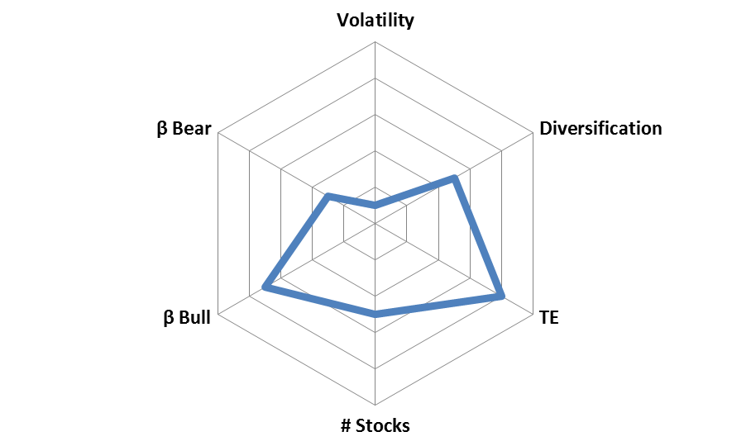
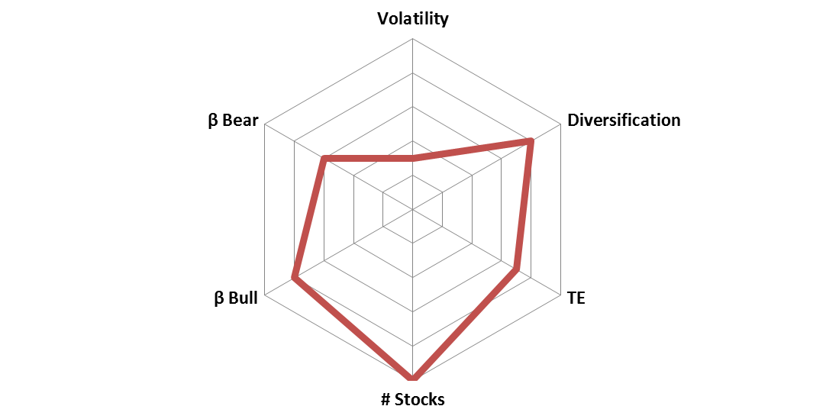
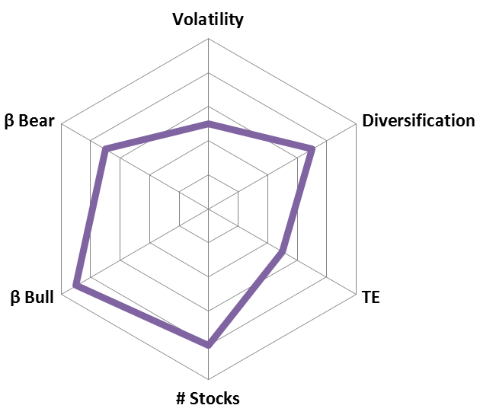
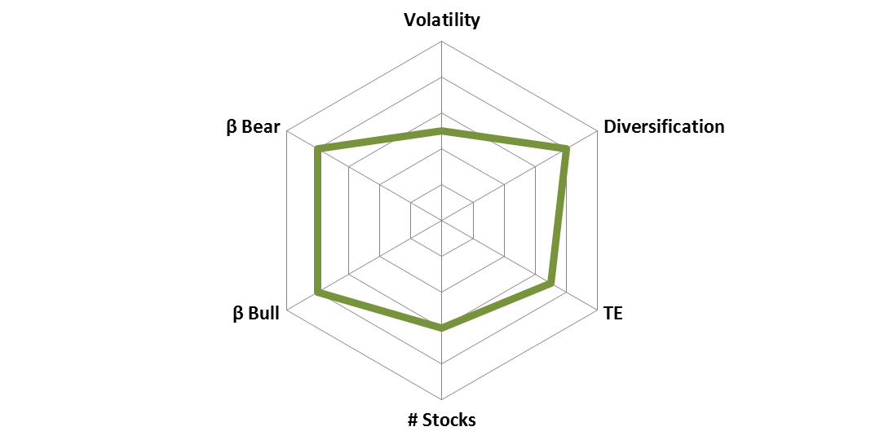
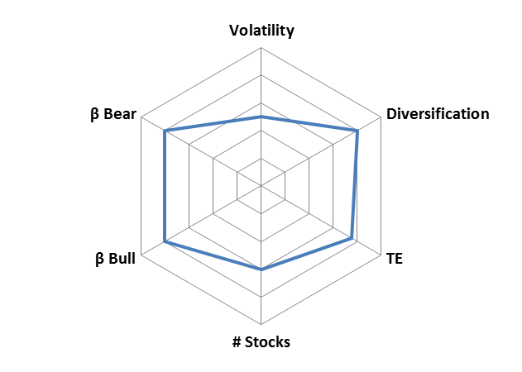
A broad range to offer investors various benefits
Avoid Unrewarded Risks
Capture Rewarded Risks
Harness alpha factors
Minimum
Variance
Risk Parity
EDHEC Multi smart
Mono factors
Dynamic factor allocation
Dynamic factor allocation
Client Need
« Avoid unrewarded risks with reduced drawdowns »
« Limit unrewarded risks with capital diversification »
« Capture & diversify rewarded risks »
« Capture rewarded risks »
« Capture rewarded risks through market cycles »
« Generate return from multi-factors allocation »
Amundi Flagship
Amundi Funds Conservative range
AF Equity Euro Risk Parity
Amundi Index Eq. Multi Smart Alloc. Sci. Beta & ETF equivalent
Amundi ETF MSCI Europe Factor range
NA
CPR GEAR range
Funds / Strategy AUM
1430 M€ / 4 400 M€*
671 M€ / 1 870 M€
960 M€
1200 M€
NA
2 500 M€ **
Strategy scoring (from Low to High)
Client Benefits
Steady performance
High Sharpe ratio due to high return asymmetry
High risk distribution
Robust performance even when equities exhibit higher correlation
Premium associated with factors
Good diversification across styles
Cost efficient building blocks to implement factor views
Steady performance
Exploiting factors’ behavior to navigate market cycle and regimes
An all-weather market regime approach
Steady and resilient performance
Adaptable and scalable model
*Including minimum variance & optimum diversification strategies / Source : Amundi as of June 2017
** Including dedicated strategies / Source : CPR AM as of June 2017
Smart Beta - Investment Solutions

Slide 53
Appendix
06
Product Flagships

Slide 54
Smart Beta at Amundi: Product flagships
RISK EFFICIENT SOLUTIONS
FACTOR INVESTING SOLUTIONS
To Avoid Unrewarded Risks
To Capture Rewarded Risk Factors
Minimum Variance
(Conservative flagship range)
Single Factors
(MSCI ETF Europe/US Factor Range)
Risk Parity Strategy
(ERI Scientific Beta partnership / passive solutions)
Risk-based Dynamic Factor Allocation
(Amundi Smart Beta Platform proprietary strategy)
To Capture Alpha Factors
Return-based Dynamic Factor allocation
(CPR AM, Amundi’s quant boutique strategy)
54
Smart Beta - Investment Solutions

Slide 55
Portfolio construction matters in Factor investing - Example with the Momentum factor
Brexit: currency and equity performance of MSCI UK
Abenomics: currency and equity performance of MSCI Japan
Source: FactSet, BarraOne, Amundi, as of 31/12/2016

Slide 56
Performance of Amundi Funds Equity Europe Conservative
Gross annualized performance in EUR as of 31/01/2018 | YTD | 1 year | 3 years | 5 years | Since inception (29/04/2009)
Portfolio | 1.4% | 11.9% | 7.2% | 12.0% | 13.0%
Benchmark | 1.6% | 12.4% | 5.1% | 9.1% | 10.8%
Excess Return | -0.2% | -0.5% | 2.2% | 2.8% | 2.2%
Risk Indicators | YTD | 1 year | 3 years | 5 years | Since inception
Portfolio Volatility | 8.1% | 7.5% | 13.2% | 12.7% | 12.6%
Benchmark Volatility | 7.2% | 7.7% | 14.6% | 14.2% | 16.0%
Ex-post Tracking Error | - | - | - | - | 6.0%
Portfolio Max drawdown | -1.5% | -6.5% | -18.3% | -18.3% | -18.3%
Benchmark Max drawdown | -1.6% | -6.2% | -25.9% | -25.9% | -25.9%
Portfolio Return to Risk | 0.2 | 1.6 | 0.5 | 0.9 | 1.0
Benchmark Return to Risk | 0.2 | 1.6 | 0.3 | 0.6 | 0.7
AuM (€M) | 851
Morningstar Rating (Overall) | ««««
(Amundi Fds Eq Europe Conservative - IE (C))
Source: Amundi AM. Gross performance as of 31/01/2018 of the IE share class.
Amundi Funds Equity Europe Conservative was launched on 29/04/2009.
Morningstar Rating Overall of the IE share class as of January 2018
Past performance is not a reliable indicator of future results or a guarantee of future returns.

Slide 57

Europe Conservative – Portfolio views
Sector breakdown
Country breakdown
Main holdings
As of 31/01/2018 | AFE Europe Conservative | MSCI Europe
NOVO NORDISK A/S | 2.5% | 1.1%
SWISSCOM AG | 2.4% | 0.1%
DIAGEO PLC | 2.4% | 0.9%
VINCI SA | 2.4% | 0.5%
HENKEL AG AND CO KGAA | 2.3% | 0.4%
ENEL SPA | 2.1% | 0.5%
MICHELIN (CIE GALE DES ETABTS) | 2.1% | 0.3%
SANOFI | 2.1% | 1.0%
BEIERSDORF AG | 2.1% | 0.1%
ROCHE HOLDING AG | 2.0% | 1.7%
TOTAL | 22.3% | 6.7%
Number of holdings | 100
Source: Amundi AM. 31/01/2018 Morningstar Rating Overall of the IE share class as of January 2018

Slide 58
Performance of Amundi Funds Equity Global Conservative
Gross annualized performance in USD as of 31/01/2018 | YTD | 1 year | 3 years | 5 years | Since inception (09/07/2012)
Portfolio | 3.7% | 19.8% | 10.8% | 11.2% | 11.7%
Benchmark | 5.3% | 25.8% | 11.8% | 11.7% | 13.4%
Excess Return | -1.6% | -6.1% | -1.1% | -0.5% | -1.7%
Risk Indicators | YTD | 1 year | 3 years | 5 years | Since inception
Portfolio Volatility | 4.4% | 4.7% | 8.8% | 8.9% | 8.9%
Benchmark Volatility | 6.9% | 5.3% | 11.0% | 10.7% | 10.8%
Ex-post Tracking Error | - | - | - | - | 3.6%
Portfolio Max drawdown | -1.1% | -2.8% | -11.9% | -11.9% | -11.9%
Benchmark Max drawdown | -1.5% | -2.0% | -17.9% | -17.9% | -17.9%
Portfolio Return to Risk | 0.8 | 4.2 | 1.2 | 1.3 | 1.3
Benchmark Return to Risk | 0.8 | 4.9 | 1.1 | 1.1 | 1.2
AuM (€M) | 208
Source: Amundi AM. Gross performance as of 31/01/2018 of the IU share class.
Amundi Funds Equity Global Conservative was launched on 09/07/2012
Morningstar Rating Overall of the IU share class as of January 2018
Past performance is not a reliable indicator of future results or a guarantee of future returns.

Slide 59
Global Conservative – Portfolio views
Sector breakdown
Country breakdown
Main holdings
As of 31/01/2018 | AFE Global Conservative | MSCI World
NORTHROP GRUMMAN CORP | 2.1% | 0.1%
3M CO. | 2.0% | 0.4%
HONEYWELL INTERNATIONAL INC | 2.0% | 0.3%
BEIERSDORF AG | 2.0% | 0.0%
MCDONALD S CORP | 1.9% | 0.3%
JOHNSON & JOHNSON | 1.9% | 0.9%
NEXTERA ENERGY INC | 1.9% | 0.2%
PEPSICO INC/NC | 1.9% | 0.4%
PFIZER INC | 1.7% | 0.5%
AGL ENERGY LTD | 1.6% | 0.0%
TOTAL | 19.0% | 3.1%
Number of holdings | 130
Source: Amundi AM. 31/01/2018 Morningstar Rating Overall of the IU share class as of January2018

Slide 60
Performance of Amundi Funds Equity Emerging Conservative
Gross annualized performance in USD as of 31/01/2018 | YTD | 1 year | 3 years | Since inception (04/09/2013)
Portfolio | 5.7% | 32.0% | 8.1% | 7.0%
Benchmark | 8.3% | 41.0% | 11.8% | 9.3%
Excess Return | -2.6% | -9.0% | -3.7% | -2.2%
Risk Indicators | YTD | 1 year | 3 years | Since inception
Portfolio Volatility | 5.1% | 7.8% | 12.9% | 12.3%
Benchmark Volatility | 9.2% | 11.0% | 16.8% | 15.7%
Ex-post Tracking Error | - | - | - | 5.5%
Portfolio Max drawdown | -1.3% | -2.5% | -28.3% | -29.5%
Benchmark Max drawdown | -2.0% | -4.8% | -34.2% | -35.5%
Portfolio Return to Risk | 1.1 | 4.1 | 0.6 | 0.6
Benchmark Return to Risk | 0.9 | 3.7 | 0.7 | 0.6
AuM (€M) | 80
Source: Amundi AM. Gross performance as of 31/01/2018 the IU share class.
Amundi Funds Equity Emerging Conservative was launched on 04/09/2013
Past performance is not a reliable indicator of future results or a guarantee of future returns.

Slide 61
Euro Risk Parity: Performance
Gross annualized performance in EUR as of 31/01/2018 | YTD | 1 year | 3 years | 5 years | Since inception (24/06/2010)
Portfolio | 1.9% | 16.4% | 8.3% | 12.1% | 10.1%
Benchmark | 3.2% | 17.2% | 7.4% | 10.7% | 8.7%
Excess Return | -1.3% | -0.9% | 0.9% | 1.4% | 1.4%
Risk Indicators | YTD | 1 year | 3 years | 5 years | Since inception
Portfolio Volatility | 11.2% | 9.0% | 14.4% | 13.9% | 15.3%
Benchmark Volatility | 12.2% | 9.6% | 15.8% | 15.7% | 17.7%
Portfolio Max drawdown | -2.3% | -5.6% | -21.7% | -21.7% | -24.6%
Benchmark Max drawdown | -1.8% | -5.3% | -26.3% | -26.3% | -30.6%
Portfolio Return to Risk | 0.2 | 1.8 | 0.6 | 0.9 | 0.7
Benchmark Return to Risk | 0.3 | 1.8 | 0.5 | 0.7 | 0.5
AuM (€M) | 743
Morningstar Rating (Overall) | ««««
(Amundi Fds Eq Euro Risk Parity - IE (C))
Source: Amundi, Gross in EUR performance as of 31/01/2018. Past performance is not a reliable indicator of future results or a guarantee of future returns.

Slide 62
Euro Risk Parity: Portfolio views
Country breakdown
Sector breakdown
Top 10 holdings
As of 31/01/2018 | Euro Risk Parity | MSCI EMU | Spread
TELECOM ITALIA SPA/MILANO | 1.3% | 0.3% | 1.0%
TOTAL SA | 1.3% | 2.6% | -1.3%
ENI SPA | 1.2% | 0.9% | 0.4%
HENKEL AG AND CO KGAA | 1.2% | 0.7% | 0.5%
ELISA OYJ | 1.1% | 0.1% | 1.0%
ORANGE SA | 1.1% | 0.7% | 0.4%
GALP ENERGIA SGPS SA | 1.1% | 0.2% | 0.9%
SNAM SPA | 1.1% | 0.2% | 0.9%
REPSOL SA | 1.1% | 0.5% | 0.6%
GALP ENERGIA SGPS SA | 1.1% | 0.1% | 1.0%
TOTAL | 11.6% | 6.3% | 5.4%
Number of holdings | 250
Source: Amundi, 31/01/2018
Morningstar Rating Overall of the IE share class as of January 2018

Slide 63
Mono factor: Amundi ETF suite
 | ISIN Code | Ticker | Currency | Ongoing Charges¹
AMUNDI ETF MSCI EUROPE QUALITY FACTOR UCITS ETF | FR0013140522 | QCEU | Reinvested | 0.23%
AMUNDI ETF MSCI EUROPE MOMENTUM FACTOR UCITS ETF | FR0013140514 | MCEU | Reinvested | 0.23%
AMUNDI ETF MSCI EUROPE MINIMUM VOLATILITY FACTOR UCITS ETF | FR0010713768 | MIVO | Reinvested | 0.23%²
AMUNDI ETF MSCI EUROPE LOW SIZE FACTOR UCITS ETF | FR0010612218 | CEM | Reinvested | 0.23%²
AMUNDI ETF MSCI EUROPE HIGH DIVIDEND FACTOR UCITS ETF | FR0010718874 | CD9 | Reinvested | 0.23%²
AMUNDI ETF MSCI EUROPE VALUE FACTOR UCITS ETF | FR0010717116 | CV9 | Reinvested | 0.23%²
AMUNDI ETF MSCI EUROPE GROWTH UCITS ETF | FR0010717108 | CG9 | Reinvested | 0.35%
1-The ongoing charges represent the charges taken from the fund over a year as disclosed in the KID. When the fund has not closed its accounts for the first time, the ongoing charges are estimated. It is a measure that compares the annual total management and operating costs (all taxes included) charged to a fund against the value of that fund's assets. Transaction cost and commissions may occur when trading ETFs 2- 24/05/2016. The ongoing charges referred to in the KIID will be updated with this new
63
Smart Beta - Investment Solutions

Slide 64
Multi Factor range: Amundi ETF & Index funds
 | ISIN | ETF Ticker | Currency | Listing currency | Ongoing charges¹
AMUNDI ETF GLOBAL EQUITY MULTI SMART ALLOCATION SCIENTIFIC BETA UCITS ETF | FR0011829084 FR0011839943 | SMRT FP SMRU FP | EUR USD | EUR USD GBP | 0.40%
AMUNDI ETF EUROPE EQUITY MULTI SMART ALLOCATION SCIENTIFIC BETA UCITS ETF | FR0013040292 | SMRE FP | EUR | EUR | 0.40%
 | ISIN | Share class | Currency
AMUNDI INDEX EQUITY GLOBAL MULTI SMART ALLOCATION SCIENTIFIC BETA | FR0012355188 | I EUR (C)² | EUR
 | FR0012355253 | I2 EUR (C)³ | EUR
 | FR0012355287 | I2 GBP (C)³ | GBP
 | FR0012355303 | P EUR (C)⁴ | EUR
 | FR0012355311 | R EUR (C)⁵ | EUR
Also available as index fund
(1)The ongoing charges represent the charges taken from the fund over a year as disclosed in the KID. When the fund has not closed its accounts for the first time, the ongoing charges are estimated. It is a measure that compares the annual total management and operating costs (all taxes included) charged to a fund against the value of that fund's assets. Transaction cost and commissions may occur when trading ETFs (2)All subscribers, more specifically legal entities / (3) All subscribers, more specifically major institutional investors / (4) All subscribers, more specifically individuals / (5) All subscribers, more specifically the clients of distribution platforms located in the United Kingdom or the Netherlands
64

Slide 65
Multi factor investing generates steady outperformance
Gross annualized in USD as of 31/01/2018 | YTD | 1 year | 3 years | Since inception (27/05/2014)
Portfolio | 4.2% | 23.8% | 11.2% | 9.4%
MSCI World | 5.3% | 25.8% | 11.8% | 9.3%
Excess Return | -1.1% | -2.0% | -0.6% | 0.1%
Risk Indicators | YTD | 1 year | 3 years | Since inception
Portfolio Volatility | 4.4% | 4.7% | 9.7% | 9.9%
MSCI World Volatility | 6.9% | 5.3% | 11.0% | 11.0%
Portfolio Max drawdown | -1.5% | -1.8% | -15.0% | -15.0%
MSCI World Max drawdown | -1.5% | -2.0% | -17.9% | -17.9%
Portfolio Return to Risk | 1.0 | 5.1 | 1.2 | 1.0
MSCI World Return to Risk | 0.8 | 4.8 | 1.1 | 0.8
AuM (€M) | 527
Source: Scientific Beta, Amundi, Data from May 2014 to January 2018 – in USD
Investors are reminded that the past performance cannot be regarded as a reliable indicator of future results, nor can they guarantee expected return
Smart Beta - Investment Solutions

Slide 66
AMUNDI ETF & INDEXING FUNDS MAIN RISKS
Risk associated with the markets to which the ETF is exposed. The price and value of investments are linked to the liquidity risk of the components. Investments can go up as well as down. Risk associated with the markets to which the ETF is exposed. The price and value of investments are linked to the liquidity risk of the components. Investments can go up as well as down. Risk associated with the volatility of the securities/currencies composing the underlying index. The fund investment objective may only be partially reached.
Risk of the loss of invested capital. Investors may not get back the original amount invested and may lose all of their investment.
Investment in emerging markets carries an above average degree of risk due to the less developed nature of securities markets in those countries.
The policy regarding portfolio transparency and information on the funds’ assets are available on amundietf.com. Indicative net asset value is published by stock exchanges. The Funds’ units purchased on the secondary market cannot usually be sold directly back to the Funds. Investors must buy and sell units on a secondary market with the assistance of an intermediary (e.g. a stockbroker) and may incur fees for doing so. In addition, investors may pay more than the current net asset value when buying units and may receive less than the current net asset value when selling them.
For further details regarding risks of Amundi ETF & Indexing Funds, please refer to Key Investor Information Document (KIID) and prospectus for the relevant fund, which are available in [insert language according to the country] upon request to Amundi Asset Management or online on www.amundi.com
66
Smart Beta - Investment Solutions

Slide 67
DISCLAIMER 1/3
This document is directed only at professional clients and eligible counterparties within the meaning of the European directive n°2004/39 on markets in financial instruments (the “MiFID Directive”) and/or at qualified or sophisticated clients within the meaning of the local jurisdiction, all acting solely and exclusively on their own account. In Switzerland, it is solely for the attention of qualified investors within the meaning of Article 10 paragraph 3 a), b), c) and d) of the Federal Act on Collective Investment Scheme of June 23, 2006. Amundi Suisse SA is distributing in Switzerland and from Switzerland the collective investment schemes managed by Amundi AM and /or Amundi Luxembourg. In this respect, Amundi Suisse SA informs investors that it collects, from Amundi AM and/ or Amundi Luxembourg, a compensation under article 34 al. 2bis in the Ordinance on collective investment schemes (Ordonnance sur les placements collectifs de capitaux, OPCC). This compensation can constitute a part of the management fees stated in the prospectus. Additional information regarding the existence, nature and calculation method for the compensation received by Amundi Suisse SA within the frame of its distribution activity in Switzerland or from Switzerland may be provided upon written request to Amundi Suisse SA 6-8 rue de Candolle 1205 Genève Suisse
This document is not intended for citizens or residents of the United States of America or to any «U.S. Person» , as this term is defined in SEC Regulation S under the U.S. Securities Act of 1933. The US person definition is indicated in the legal mentions section on www.amundi.com and in the prospectus of the funds mentioned in this document.
Promotional & non-contractual Information which should not in any way be regarded as investment advice, a personalized investment recommendation, solicitation of an investment offer, or a purchase.
Some of the sub-funds of the Amundi Index Solutions SICAV (the ≪Sub-Funds≫) and funds (all together "Funds") described in this document may not be authorized for distribution in your country. The Sub-Funds mentioned in this document, are from Amundi Index Solutions, a Luxembourg UCITS, RCS B206810, located 5, allee Scheffer, L-2520 Luxembourg.
Before any subscriptions, the potential investor must read the offering documents of the Funds approved by the Commission de Surveillance du Secteur Financier of Luxembourg or Autorité des Marchés Financiers, including the KIID, available on www.amundi.com or upon request from the headquarters of the investment manager company.
Investment in a Fund carries a substantial degree of risk (i.e. risks are detailed in the DICI and prospectus).
The Funds presents a risk associated with the volatility of the securities/currencies composing the underlying index.
Past performance cannot be regarded as a reliable indicator for future results. The Funds do not offer any performance guarantee.
Transaction cost and commissions may occur when trading ETFs.
The policy regarding portfolio transparency and information on the funds' assets are available on amundietf.com. Indicative net asset value is published by stock exchanges. The Amundi ETF Funds' units purchased on the secondary market cannot usually be sold directly back to the Funds. Investors must buy and sell units on a secondary market with the assistance of an intermediary (e.g. a stockbroker) and may incur fees for doing so. In addition, investors may pay more than the current net asset value when buying units and may receive less than the current net asset value when selling them.
For France only : Some information may constitute a general investment recommendation as defined in the article 313-208 of the Réglement Général de l’AMF. This material has not been produced in conformity with regulatory provisions aiming to promote the independency of financial analysis, and Amundi Asset Management, as an investment services provider, has no restriction in negotiating any financial instruments described in this material before its issue.
The exactness, exhaustiveness or relevance of the information, the prevision and analysis provided is not guaranteed. It is based on sources considered as reliable and may change without prior notice. It is inevitably partial, provided based on market data stated at a particular moment and is subject to change. It is the investor’s responsibility to make sure his/her investment is in compliance with the applicable laws she/he depends on, and to check if this investment is matching his/her investment objective with his/her patrimonial situation (including tax aspects).
It is not permitted to copy, modify, translate or distribute the Document without the prior approval of Amundi Asset Management.
Information reputed exact as of April 2017. Reproduction prohibited without the written consent of the Management Company. Amundi ETF designates the ETF business of Amundi Asset Management. Amundi Asset Management, with a share capital of EUR 1 086 262 605, an investment manager regulated by the French Autorité des Marchés Financiers under n° GP 04000036 - Registered office : 90 boulevard Pasteur 75015 Paris France - 437 574 452 RCS Paris.
Smart Beta - Investment Solutions

Slide 68
DISCLAIMER 2/3
Switzerland disclaimer :
For FINMA registered Funds :
These Funds have been authorized for distribution to non-qualified investors by FINMA.The Key Investor Information Document (“KIID”) and the prospectus, or the funds regulation as well as the annual and semi-annual financial reports are available free of charge from the Swiss Representative: CACEIS (Switzerland) SA - Route de Signy 35 - CH1260 Nyon.Paying Agent in Switzerland: CACEIS Bank Paris, Nyon Branch/Switzerland, Route de Signy 35, CH- 1260 Nyon.
For unregistered funds :
These Funds, (collective investment schemes) authorized by the AMF, have not been approved by the Swiss Financial Market Supervisory Authority (≪FINMA≫).These Funds are available in Switzerland for distribution exclusively to Qualified Investors, as defined in the Collective Investment Schemes Act of 23 June 2006, as amended (≪CISA≫) and its implementing ordinance.The KIID, Prospectus, funds regulations, annual and/or semi-annual reports relating to these Funds are available free of charge from the Swiss representative and/or authorised distributors to Qualified Investors. Swiss Representative: CACEIS (Switzerland) SA - Route de Signy 35, CH- 1260 Nyon. Paying Agent in Switzerland: CACEIS Bank Paris, Nyon Branch/Switzerland, Route de Signy 35, CH- 1260 Nyon.
UK disclaimer
The Funds mentioned in this document are recognized collective investment schemes for the purposes of the Financial Services and Markets Act 2000 of the United Kingdom (the “Act”). This document is being issued inside the United Kingdom by Amundi which is authorised by the Autorité des marchés financiers and subject to limited regulation by the Financial Conduct Authority (“FCA”). Details about the extent of regulation by the FCA are available on request. This document is only directed at persons who are professional clients or eligible counterparties for the purposes of the FCA’s Conduct of Business Sourcebook. The investments described herein are only available to such persons and this document must not be relied or acted upon by any other persons. This document may not be distributed to any person other than the person to whom it is addressed without the express prior consent of Amundi.
France
La documentation règlementaire peut être obtenue gratuitement au siège social de la SICAV ou auprès de CACEIS Bank au 1-3, place Valhubert - 75013 PARIS, correspondant centralisateur de la SICAV en France. Des seuils de réservation sont fixés en appliquant un pourcentage de variation de la part, indiqué dans le prospectus des Fonds mentionnés dans ce Document et d’autre de le Valeur Liquidative Indicative ou « VLI » de ces Fonds, publié par Euronext Paris SA et actualisée de manière estimative en cours de séance en fonction de la variation de l’indice de chacun des Fonds indiqué dans ce Document; Le Teneur de Marché s’assure que le cours de bourse des parts des Fonds ne s’écarte pas plus du pourcentage indiqué dans le prospectus des Fonds mentionnés dans ce Document et d’autre de la valeur liquidative des OPCVM, afin de respecter les seuils de réservation fixés par Euronext Paris SA.
Germany
Die Verkaufsunterlagen der in Deutschland zum öffentlichen Vertrieb registrierten Amundi ETFs sind auf Anfrage kostenlos und als Druckstücke bei Marcard, Stein & Co. AG, Ballindamm 36, 20095 Hamburg, Deutschland, erhältlich. Bei den Fonds handelt es sich um Organismen für gemeinsame Anlagen, die von der AMF zugelassen sind.“
Austria
The sales documentation of the Sub-Funds registered for public marketing in Germany are available free of charge and as printed copies at MEINL BANK AG an Austrian Bank with its registered office at Bauernmarkt 2, 1014 Wien, Austria, represented by Mr Robert Kelfer and Mr Peter Grandl as Director of Meinl Bank A.G. and Director of Meinl Bank A.G
Smart Beta - Investment Solutions

Slide 69
DISCLAIMER 3/3
The Funds have been passported into Sweden pursuant to the Swedish Securities Funds Act (as amended) (Sw. lag (2004:46) om värdepappersfonder), implementing the UCITS IV Directive and may accordingly be distributed to Swedish investors. The Key Investor Information Document (“KIID”) (in Swedish) and the prospectuses for the funds, as well as the annual and semi-annual reports are also available from the Swedish paying agent free of charge. The name and details of the Swedish paying agent are: SKANDINAVISKA ENSKILDA BANKEN AB (publ) through its entity Transaction Banking, SEB Merchant Banking, with its principal offices
Disclaimer MSCI
The funds are not sponsored, endorsed, sold or promoted by Morgan Stanley Capital International Inc. (“MSCI”), any of its affiliates, any of its information providers or any other third party involved in, or related to, compiling, computing or creating any MSCI index (collectively, the “MSCI parties”). The MSCI indexes are the exclusive property of MSCI. MSCI and the MSCI index names are service mark(s) of MSCI or its affiliates and have been licensed for use for certain purposes by Amundi None of the MSCI parties makes any representation or warranty, express or implied, to the issuer or owners of this fund or any other person or entity regarding the advisability of investing in funds generally or in this fund particularly or the ability of any MSCI index to track corresponding stock market performance. A complete description of the MSCI indexes is available on request from MSCI. MSCI indexes are registered trademark of MSCI which are used to identify indexes it calculates and publishes. MSCI guarantees neither the value of the index at any given time nor the results or performance of products indexed against this index.
Disclaimer Scientific Beta Developed Multi-Beta Multi-Strategy ERC
The Scientific Beta Developed Multi-Beta Multi-Strategy ERC (the Index) referenced herein is the property of EDHEC Risk Institute Asia Ltd (ERIA) and has been licensed for use in connection with AMUNDI ETF GLOBAL EQUITY MULTI SMART ALLOCATION SCIENTIFIC BETA UCITS ETF within the framework of ERI Scientific Beta activity. The Index is calculated by ERI Scientific Beta on the basis of the EDHEC-Risk Institute methodology.
Each party acknowledges and agrees that AMUNDI ETF GLOBAL EQUITY MULTI SMART ALLOCATION SCIENTIFIC BETA UCITS ETF is not sponsored or endorsed by ERIA. ERIA makes no representation whatsoever, whether express or implied, and hereby expressly disclaim all warranties (including without limitation, those of merchantability or fitness for a particular purpose or use), with respect to the Index or any data included therein or relating thereto, and in particular disclaim any warranty either as to the quality, accuracy and/or completeness of the Index or any data included therein, the results obtained from the use of the Index and/or the composition of the Index at any particular time on any particular date or otherwise and/or the creditworthiness of any entity, or the likelihood of the occurrence of a credit event or similar event (however defined) with respect to an obligation, in the Index at any particular time on any particular data or otherwise. ERIA shall not be liable (whether in negligence or otherwise) to the parties or any other person for any error in the Index and ERIA is under no obligation to advise the parties or any person of any error therein.
ERIA makes no representation whatsoever, whether express or implied, as to the advisability of purchasing or selling AMUNDI ETF GLOBAL EQUITY MULTI SMART ALLOCATION SCIENTIFIC BETA UCITS ETF the ability of the Index to track relevant markets’ performances, or otherwise relating to the Index or any transaction or product with respect thereto, or of assuming any risks in connection therewith. ERIA has no obligation to take the needs of any party into consideration in determining, composing or calculating the Index. No party purchasing or selling AMUNDI ETF GLOBAL EQUITY MULTI SMART ALLOCATION SCIENTIFIC BETA UCITS ETF, nor ERIA, shall have any liability to any party for any act or failure to act by ERIA in connection with the determination, adjustment, calculation or maintenance of the Index.
Smart Beta - Investment Solutions

