Slide 1
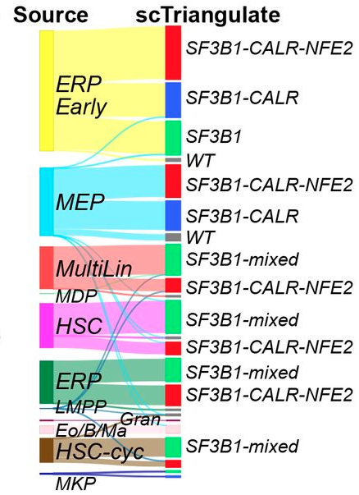
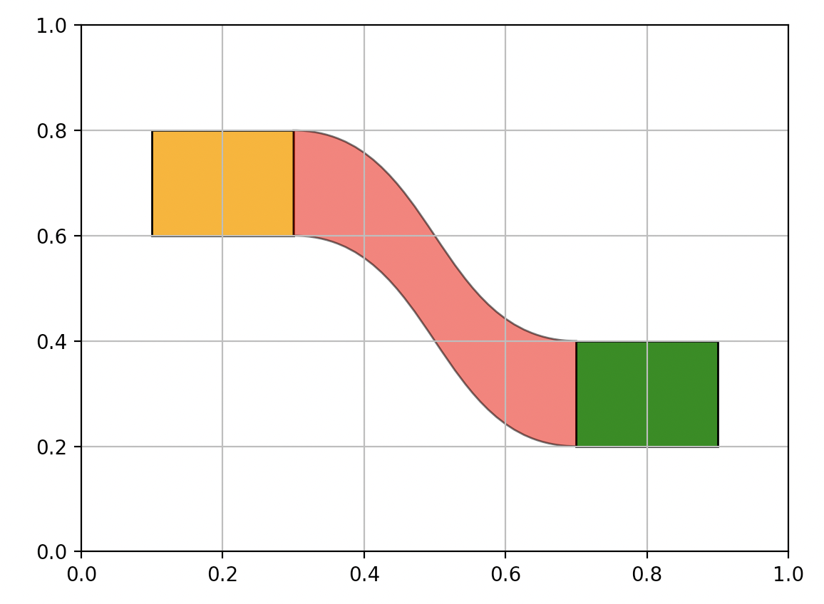
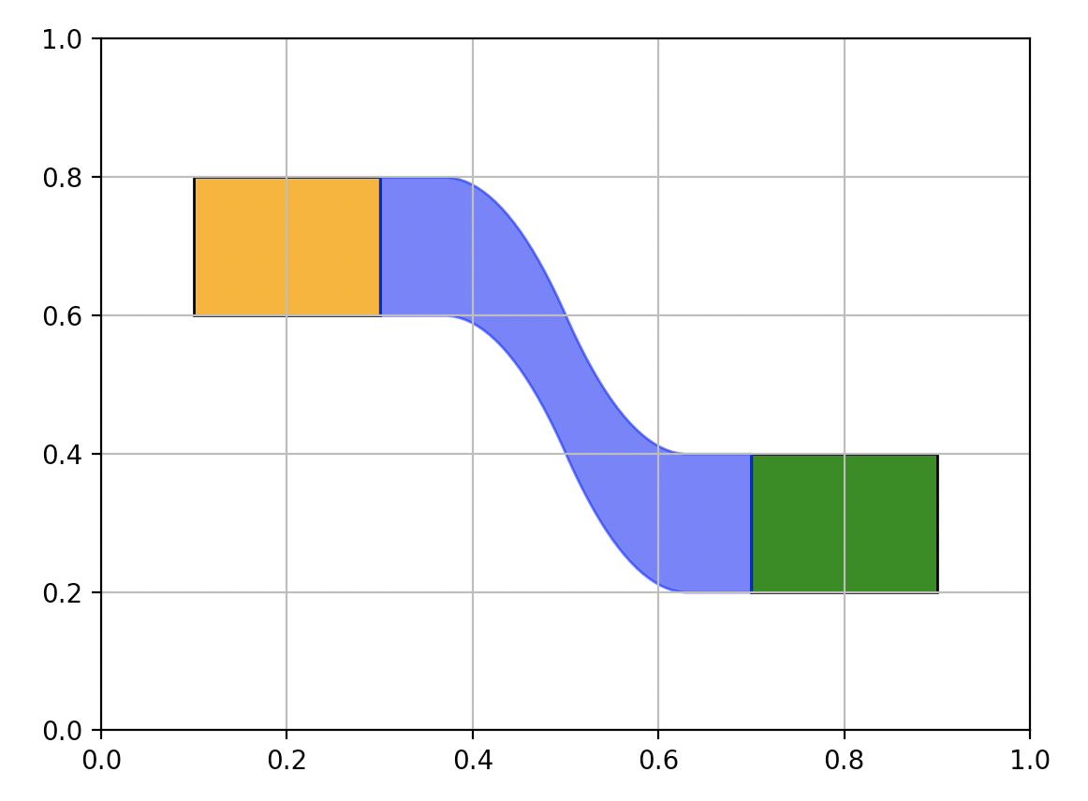
Method1:
Matplotlib Path
Method2:
Numpy Convolve

Slide 2
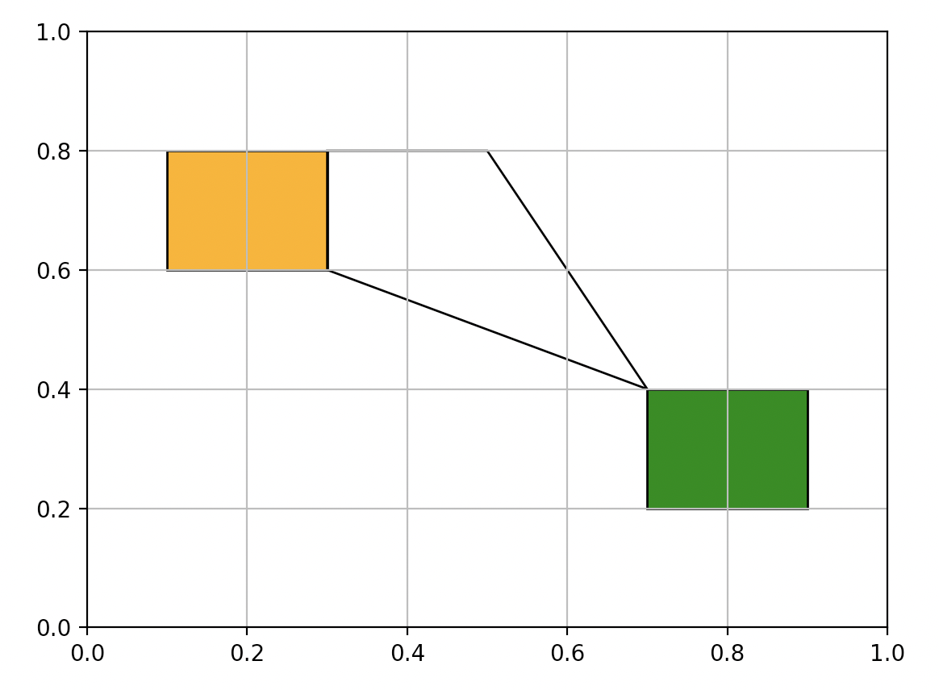
(0.3,0.8), CLOSEPOLY:
Tell the program to stop at this point
(0.3,0.8), MOVETO: move your pen to this point to start drawing
(0.5,0.8), LINETO: draw a line from previous point to this point
(0.7,0.4), LINETO: draw a line from previous point to this point
(0.3,0.6), LINETO: draw a line from previous point to this point

Slide 3
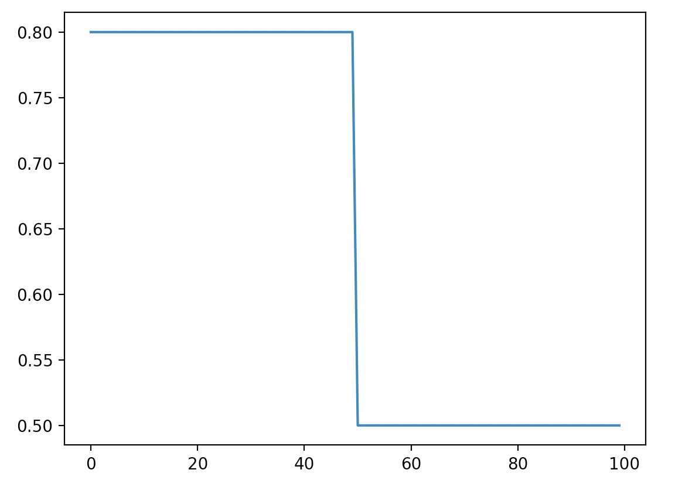
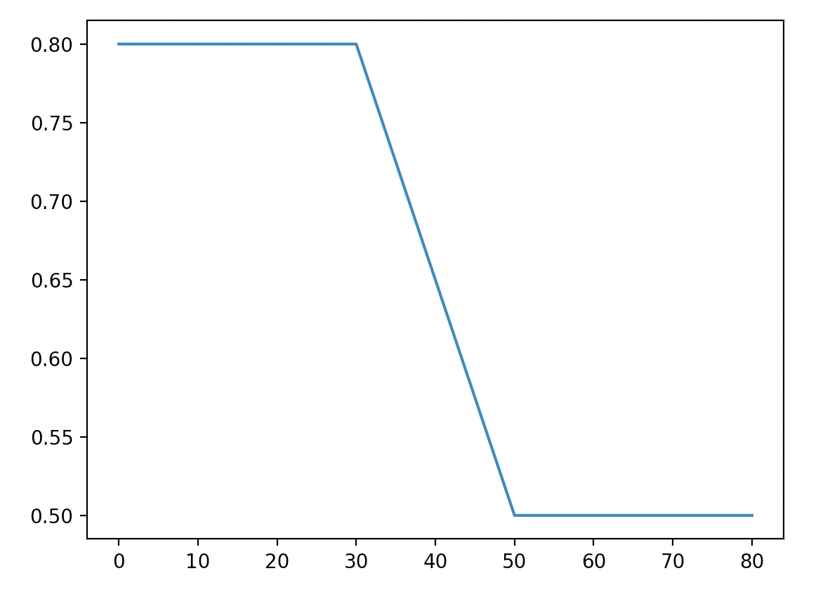
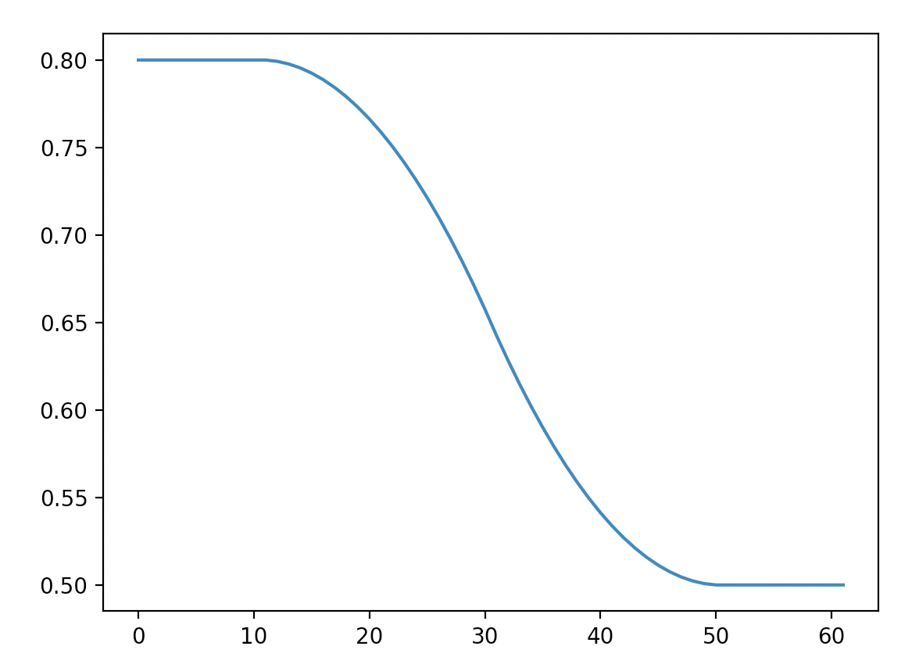
ys_d = np.array(50*[0.8] + 50*[0.5])
ys_d_cc = np.convolve(ys_d_c, 0.05 * np.ones(20), mode='valid')
ys_d_c = np.convolve(ys_d, 0.05 * np.ones(20), mode='valid')

