Slide 1
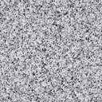
The tennis ball texture
Is made from 3 layers
A yellow square
A textured semitransparent overlay
A thick line for the seam
Group them then copy and paste as an image
Save the image

Slide 2
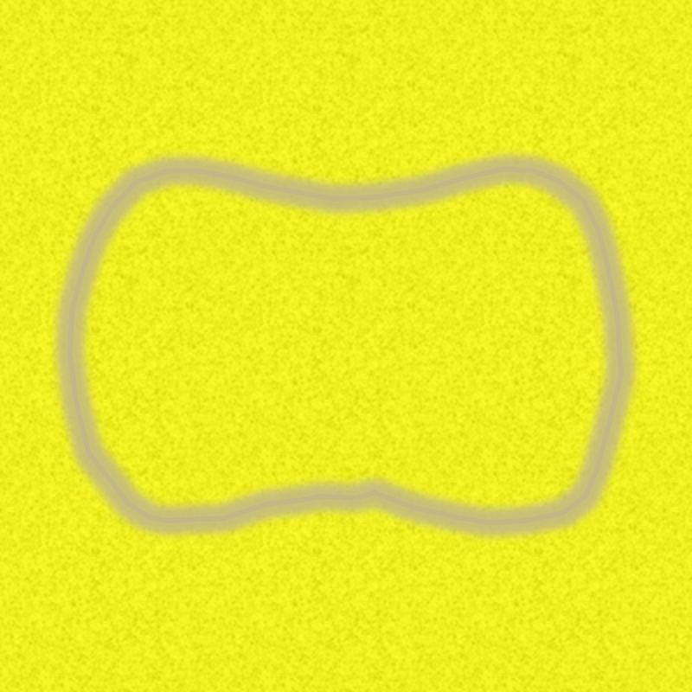

Slide 3
