Slide 1



Superstore Sales Analysis
Profile

Slide 2


Today's agenda
Project recap
Process
Insights
Summary

Slide 3

Project Recap
This dataset contains 4 years of transaction data from a global superstore. It includes various details such as product categories, customer segments, shipping locations, total sales, and others.
Code
https://github.com/BenAdrian/Project-Portfolio/tree/main/Superstore_Analyst
Source Data
https://www.kaggle.com/datasets/rohitsahoo/sales-forecasting/data

Slide 4

This analysis focuses on Exploratory Data Analysis (EDA) to understand sales patterns based on product categories and customer segments. The study does not include sales prediction but aims to identify business trends, customer segment contributions to total GMV, and potential marketing strategies that can be applied.
Objective
Tools:
Python
Pandas
Matplotlib
Seaborn

Slide 5

Process
1
Data Understanding
2
Data Cleaning
3
Data Analysis
4
Data Visualization
5
Uncover Insight

Slide 6
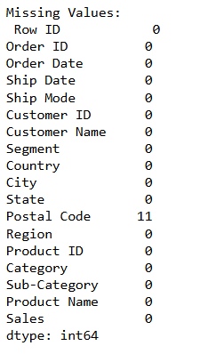
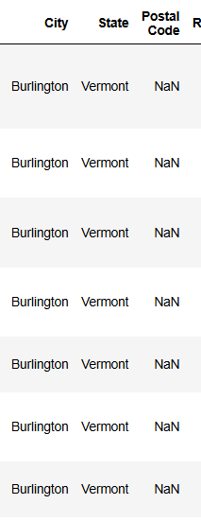

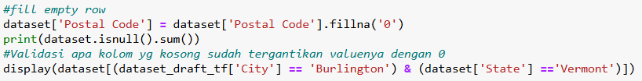
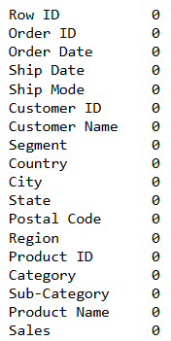
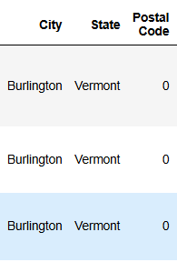
Data Cleansing
Missing Value
Validation
Result
Further verification confirms that Burlington, Vermont, does not have a Postal Code Available
There are 11 missing values in the 'Postal Code' column.
The missing Postal Codes are from the city of Burlington and the state of Vermont.

Slide 7
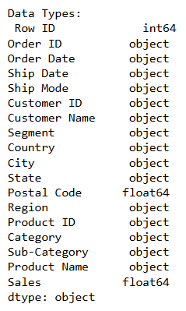

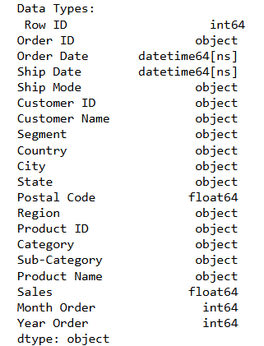
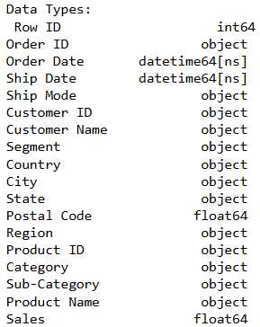
Data Cleansing
Change Data Type
Process
Add Column
Result
Result
Change the Data Type Order Date and Ship Date from object to datetime
Notes:
The increasing GMV trend in Q4 indicates a surge in spending towards the end of the year, which is likely caused by events such as Black Friday or Christmas holidays. The company can capitalize on this momentum by offering major promotions in that month. Conversely, in months with low GMV, marketing strategies can be focused on sales campaigns to increase buyer interest during quiet periods.

Slide 8

Insights
$2.261.536
Technology
West
TOTAL
GMV
TOP SELLING CATEGORIES
REGION WITH THE MOST GMV

Slide 9
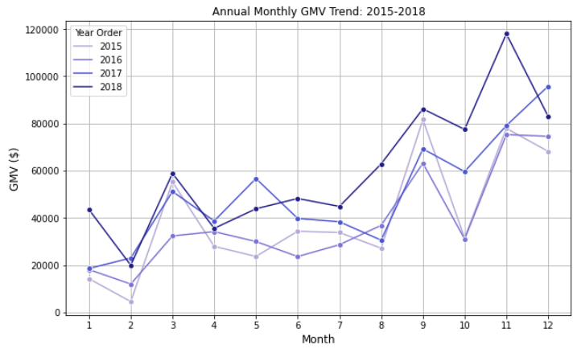
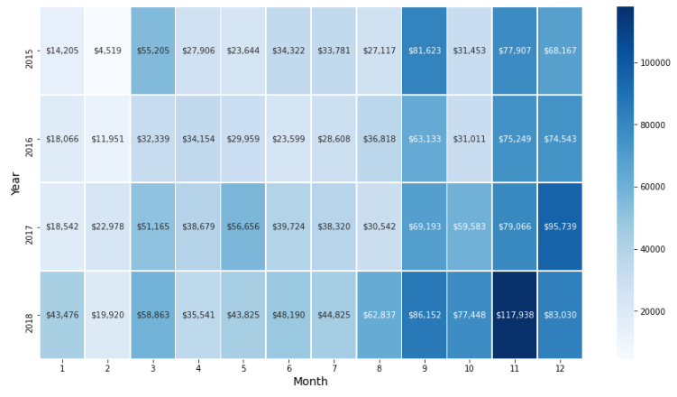
Trend Sales over the year
GMV has shown a steady annual growth trend from 2015 to 2018.
There is a clear seasonal pattern, with consistent spikes in sales during the end of the year (October-December).
The heatmap confirms this upward trend across all years, highlighting specific months with higher GMV.
Marketing strategies and promotional campaigns should be optimized toward the year-end period to maximize sales potential.
Notes:
Dari dataset ini kita dapat melihat bahwa terdapat pola penjualan musiman yang dimana penjualan mulai akan naik di q4. Dimana pada bulan 9 ke bulan 10 penjualan menurun, dapat dikarenakan Oktober sering kali merupakan periode antara setelah musim "kembali ke sekolah" dan sebelum dimulainya musim liburan. Mulai naik lagi di bulan November bisa di karenakan terdapat beberapa event seperti Black Fridy dan Cyber Monday yang merupakan acara belanja di US.

Slide 10
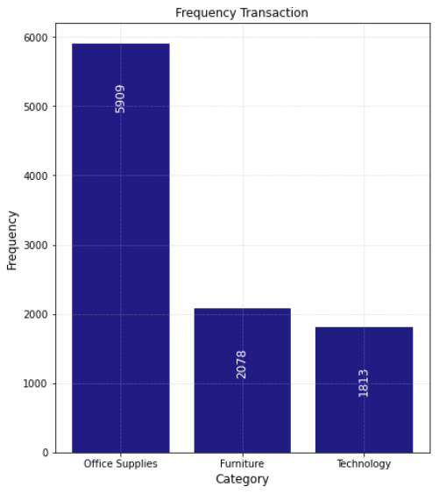
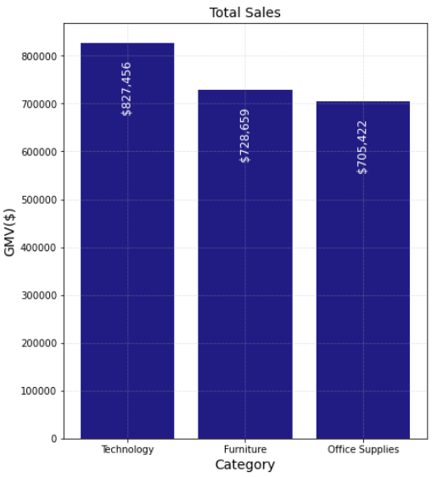
Category Performance: Transaction Frequency and Sales Value
Office Supplies has the highest transaction count (5,909), but the lowest GMV ($705,422).
Technology has the lowest transaction count (1,813), but the highest GMV ($827,455).
High transaction volume does not guarantee high revenue—product pricing significantly impacts GMV. Higher-priced products can generate a higher GMV even with fewer transactions..
In Percent
Notes:
From these charts, we can say that there is a discrepancy between the total purchase frequency and the total sales. When looking at the total transaction frequency, the 'Office Supplies' category has the highest purchase frequency with 5909 transactions. However, when we look at the Gross Merchandise Value (GMV), the 'Office Supplies' category has the lowest GMV figure of 705422. This is in contrast to 'Technology', which has the lowest frequency of 1813, but contributes the highest GMV of 827455.

Slide 11
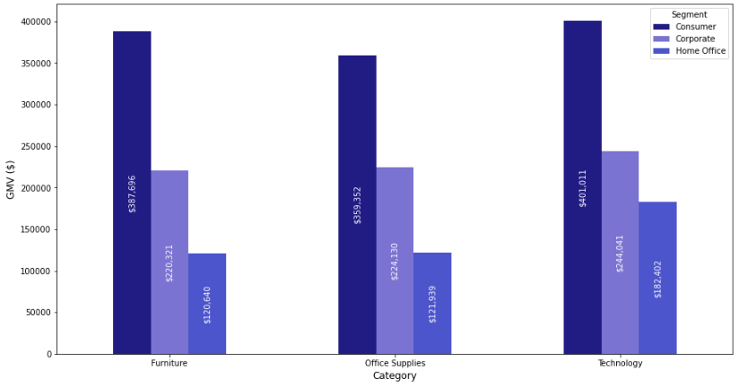
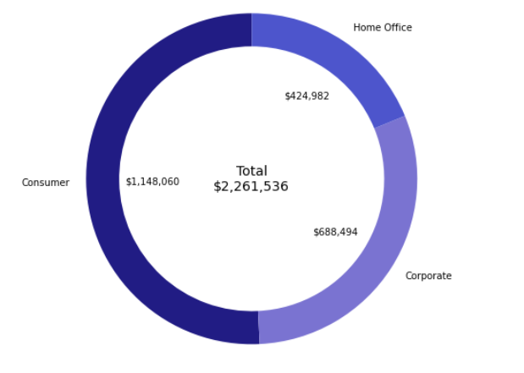
Sales Contribution of Customer Segments Across Product Categories
Marketing efforts can be more strongly directed towards the Consumer segment, as they are the largest contributor to sales.
The Technology category performs the best, so promotional campaigns and upselling strategies can be more focused on products in this category.
There is an opportunity to increase engagement with the Corporate and Home Office segments, especially in the Technology and Office Supplies categories, to drive further sales growth.
In Percent

Slide 12
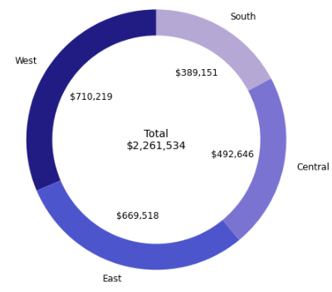
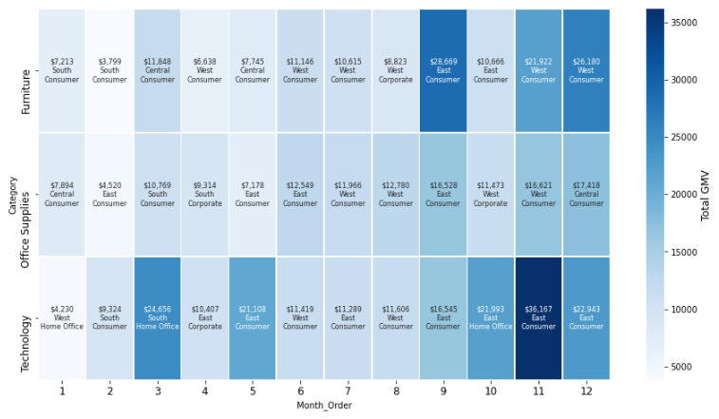
Top-Selling Product Categories by Month, Region, and Customer Segment
Optimize marketing efforts in high-GMV regions to maintain growth momentum.
Increase market penetration in lower-GMV regions with targeted strategies, such as promotions or bundling.
Plan seasonal campaigns based on GMV trends in the heatmap, especially during peak months.
In Percent
Notes:
Berdasarkan visualisasi donut chart ini West memiliki konstribusi GMV terbesar dibandingkan wilayah lain, sedangkan untuk tren Top selling Product perwilayah dan bulan tetap menunjukan adanya lonjakan penjualan di waktu-waktu tertentu, yang dapat digunakan untuk perencanaan promosi dan stok barang

Slide 13
Summary
The Consumer segment is the primary contributor to GMV. However, there are significant growth opportunities in the Corporate and Home Office segments.
The Corporate segment can be further expanded through a more aggressive B2B approach, such as corporate partnerships and tailored marketing strategies.
Implement loyalty programs and exclusive business offers to encourage repeat purchases.
Leverage competitive pricing and discount strategies to attract small business owners.
Consider targeted advertising and customized bundles to increase engagement in this segment.

Slide 14
Thank you!
ANY QUESTIONS?

