Slide 1
BTE5052 Softwaredesign und Projekte
01.03.2016 / Vorbereitung Projektarbeit
Versionskontrolle mit Git
Qt Framework / Qt Creator
Template Spieleentwicklung
https://github.com/BenAxiamo/GitAndQtIntroduction/

Slide 2
GIT
http://gitref.org/
https://www.youtube.com/watch?v=Fwdg8-thBAc&feature=youtu.be
http://github.com

Slide 3
Qt
http://www.qt.io/download/
http://www.slideshare.net/isbvietnam/meet-qt-intro-50454957?qid=f37c1530-2d39-42ff-9b58-740357aae61e&v=&b=&from_search=2

Slide 4
Important classes and concepts
QObject
Container: QList
QTimer
QDebug
QProperty
Signals and slots
Model View (MV)

Slide 5
QObject
http://doc.qt.io/qt-5/qobject.html#details
Base class for all Qt Classes
Provides Signal / Slot mechanism
Maintain Object hierarchy

Slide 6
QObject
#ifndef MAINGAME_H
#define MAINGAME_H
#include <QObject> //Include QObject so the type is known
class MainGame : public QObject //Inherit from QObject
{
Q_OBJECT //Insert Q_OBJECT Macro, needed by MOC to work
public:
explicit MainGame(QObject *parent = 0); //Parent / Children relations for hierarchy
~MainGame();
signals:
public slots:
};
#endif // MAINGAME_H

Slide 7
Q_Property
A property has: Name, type, read / write / notify
Bind it to a QML object -> automatic update

Slide 8
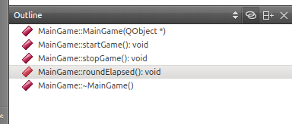
How to get Help
Auto Completion
Type . or -> after object, or type ctrl->space
Context sensitive help
Mark a word (e.g. QTimer and press F1), online help open
Navigate within Code
<Ctrl> click on method name jumps between definition and implementation
The outline window shows all methods in current class
Use the examples on the home page in QCreator!

Slide 9
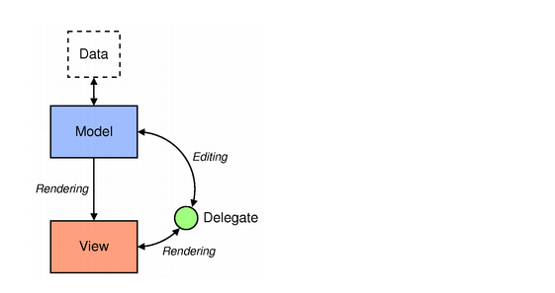
Model View
http://doc.qt.io/qt-5/qtquick-modelviewsdata-modelview.html
http://doc.qt.io/qt-5/qtquick-modelviewsdata-cppmodels.html

Slide 10
Examples
From QML to C++
Calling a C++ slot from Qml
Connect to a C++ signal

Slide 11
Examples
From C++ to QML
Expose a single object
Populate a QML list from C++

Slide 12
Qt Quick Controls
QML General:
http://doc.qt.io/qt-5/qtqml-index.html
QtQuick Controls:
http://doc.qt.io/qt-5/qtquickcontrols-overview.html
Qml / C++ integration:
http://doc.qt.io/qt-5/qtqml-cppintegration-topic.html
Exposing a C++ Object to QML with ContextProperty
http://doc.qt.io/qt-5/qtqml-cppintegration-contextproperties.html

