Slide 1
QtSpim Demo & Tutorial
ECE232@UMASS
SPRING 2011

Slide 2
Outline
How to write your own MIPS assembly language program
How to use QtSpim simulator

Slide 3
First steps
Define clearly the problem you’re going to tackle
1
Write your program:
#include <cstdio>
int main(int argc, char** argv) {
int vectorA[5] = {1,2,3,4,5};
int vectorB[5] = {2,4,6,8,10};
int result = 0;
int i=0;
while (i<5) {
result += vectorA[i]*vectorB[i];
i+=1;
}
printf(“result %d\n”,result);
}
Test it:
g++ main.cpp
./a.out
Result 110
Example:
Calculate the dot product of two vectors:
  Scalar = [A]•[B] = ∑a_{i}*b_{i}
  with i=1…5
Then, write a C code for it:

Slide 4
Simplify your C code - 1
To make the transformation to Assembly simpler
#include <cstdio>
int main(int argc, char** argv) {
int vectorA[5] = {1,2,3,4,5};
int vectorB[5] = {2,4,6,8,10};
int result = 0;
int i=0;
while (i<5) {
result += vectorA[i]*vectorB[i];
i+=1;
}
printf(“result %d\n”,result);
}
2
1
int main(int argc, char** argv) {
int vectorA[5] = {1,2,3,4,5};
int vectorB[5] = {2,4,6,8,10};
int result = 0;
int i=0;
int valueA = 0;
int valueB = 0;
while (i<5) {
valueA = vectorA[i];
valueB = vectorB[i];
result += valueA*valueB;
i+=1;
}
}
reading values

Slide 5
Simplify your C code - 2
3
2
int main(int argc, char** argv) {
int vectorA[5] = {1,2,3,4,5};
int vectorB[5] = {2,4,6,8,10};
int result = 0;
int i=0;
int valueA = 0;
int valueB = 0;
bool condition = true;
while (condition) {
valueA = vectorA[i];
valueB = vectorB[i];
result += valueA*valueB;
i+=1;
condition = (i>=5) ? false : true;
}
}
int main(int argc, char** argv) {
int vectorA[5] = {1,2,3,4,5};
int vectorB[5] = {2,4,6,8,10};
int result = 0;
int i=0;
int valueA = 0;
int valueB = 0;
while (i<5) {
valueA = vectorA[i];
valueB = vectorB[i];
result += valueA*valueB;
i+=1;
}
}
separate branching from
condition evaluation

Slide 6
Simplify your C code - 3
3
4
int main(int argc, char** argv) {
int vectorA[5] = {1,2,3,4,5};
int vectorB[5] = {2,4,6,8,10};
int result = 0;
int intermidiateResult = 0;
int i=0;
int* addressA = vectorA;
int* addressB = vectorB;
int valueA = 0;
int valueB = 0;
bool condition = true;
while (condition) {
valueA = *(addressA);
valueB = *(addressB);
intermidiateResult = valueA*valueB;
result = result + intermidiateResult;
i+=1;
addressA+=1;
addressB+=1;
condition = (i>=5) ? false : true;
}
}
int main(int argc, char** argv) {
int vectorA[5] = {1,2,3,4,5};
int vectorB[5] = {2,4,6,8,10};
int result = 0;
int i=0;
int valueA = 0;
int valueB = 0;
bool condition = true;
while (condition) {
valueA = vectorA[i];
valueB = vectorB[i];
result += valueA*valueB;
i+=1;
condition = (i>=5) ? false : true;
}
}
break down operations
break down memory accesses

Slide 7
Simplify your C code - 4
#include <cstdio>
Int main(int argc, char** argv) {
int vectorA[5] = {1,2,3,4,5};
int vectorB[5] = {2,4,6,8,10};
int result = 0;
int i=0;
while (i<5) {
result += vectorA[i]*vectorB[i];
i+=1;
}
printf(“result %d\n”,result);
}
4
int main(int argc, char** argv) {
int vectorA[5] = {1,2,3,4,5};
int vectorB[5] = {2,4,6,8,10};
int result = 0;
int intermediateResult = 0;
int i=0;
int* addressA = vectorA;
int* addressB = vectorB;
int valueA = 0;
int valueB = 0;
bool condition = true;
while (condition) {
valueA = *(addressA);
valueB = *(addressB);
intermediateResult = valueA*valueB;
result += intermediateResult;
i+=1;
addressA+=1;
addressB+=1;
condition = (i>=5) ? false : true;
}
}
1
Break your code
into its basic OPs

Slide 8
Transform C code into MIPS Assembly
int main(int argc, char** argv) {
int vectorA[5] = {1,2,3,4,5}; $s0
int vectorB[5] = {2,4,6,8,10}; $s1
int result = 0; $s2
int intermidiateResult = 0; $t6
int i=0; $s3
int* addressA = vectorA; $t2
int* addressB = vectorB; $t3
int valueA = 0; $t4
int valueB = 0; $t5
bool condition = true;
while (condition) {
valueA = *(addressA);
valueB = *(addressB);
intermidiateResult = valueA*valueB;
result += intermidiateResult;
i+=1;
addressA+=1;
addressB+=1;
condition = (i>=5) ? false : true;
}
}
Map your variables to MIPS regs
Annotate your mappings
$s0 stores the address of vectorA
$s1 stores the address of vectorB
$s2 stores the final result (initialized to $zero)
$s3 counter i
$t0 condition
$t1 internal flag used to compare to 1
$t2 stores the address of vectorA[i]
$t3 stores the address of vectorB[i]
$t4 stores the value of vectorA[i]
$t5 stores the value of vectorB[i]
$t6 stores the intermidiate addition of t4 and t5

Slide 9
Code your Assembly using this template
# ======================================
# Description: perform dot product of 2 vectors
# Test:
# A = [1,2,3,4,5] = [0x1,0x2,0x3,0x4,0x5]
# B = [2,4,6,8,10] = [0x2,0x4,0x6,0x8,0xA]
# Expected result
# R = A.B = 2+8+18+32+50 = 110 = 0x6E
# ======================================
# Your annotated registers
# ========== Data Segment
.data
#your data will come here
# ========== Code Segment
.text
.globl main
main:
# your code will come here
EXIT:
li $v0,10
syscall
# End of file

Slide 10
Annotate your register assignments & data
# ======================================
# Description: perform dot product of 2 vectors
# Test:
# A = [1,2,3,4,5] = [0x1,0x2,0x3,0x4,0x5]
# B = [2,4,6,8,10] = [0x2,0x4,0x6,0x8,0xA]
# Expected result
# R = A.B = 2+8+18+32+50 = 110 = 0x6E
# ======================================
# Your annotated registers
# ========== Data Segment
.data
#your data will come here
# ========== Code Segment
.text
.globl main
main:
# your code will come here
EXIT:
li $v0,10
syscall
# End of file
$s0 stores the address of vectorA
$s1 stores the address of vectorB
$s2 stores the final result (initialized to $zero)
$s3 counter i
$t0 condition
$t1 internal flag used to compare to 1
$t2 stores the address of vectorA[i]
$t3 stores the address of vectorB[i]
$t4 stores the value of vectorA[i]
$t5 stores the value of vectorB[i]
$t6 stores the intermediate addition of t4 and t5
vectorA: .word 1,2,3,4,5
vectorB: .word 2,4,6,8,10

Slide 11
Transform C code into MIPS Assembly
int main(int argc, char** argv) {
int vectorA[5] = {1,2,3,4,5};
int vectorB[5] = {2,4,6,8,10};
int result = 0;
int intermidiateResult = 0;
int i=0;
int* addressA = vectorA;
int* addressB = vectorB;
int valueA = 0;
int valueB = 0;
bool condition = true;
while (condition) {
valueA = *(addressA);
valueB = *(addressB);
intermidiateResult = valueA*valueB;
result += intermidiateResult;
i+=1;
addressA+=1;
addressB+=1;
condition = (i>=5) ? false : true;
}
}
main:
la $s0, vectorA # [pseudo] puts address of vectorA into $s0
la $s1, vectorB # [pseudp] puts address of vectorB into $s1
addi $s2, $zero, 0 # initialized the result to zero
addi $s3, $zero, 0 # i=0
addi $t1, $zero, 1 # $t1=1
addi $t2, $s0, 0 # $t2 stores the address of a[0]
addi $t3, $s1, 0 # $t3 stores the address of b[0]
LOOP:
slti $t0, $s3, 5 # $t0=1 if i < 5
bne $t0, $t1, EXIT # if i >= 5, exit from the loop
lw $t4, 0($t2) # load a[i] to $t4
lw $t5, 0($t3) # load b[i] to $t5
mult $t5, $t4 # $LO<=b[i]*a[i]
mflo $t6 # $t0<=$LO
add $s2,$s2,$t6
addi $s3, $s3, 1 # i=i+1
addi $t2, $t2, 4 # increment address of a[] by 4 bytes, 1 ptr.
addi $t3, $t3, 4 # increment address of b[] by 4 bytes, 1 ptr.
j LOOP
EXIT:

Slide 12
Quick remark on pointers
In C/C++
int vectorA[5] = {1,2,3,4,5}
int* addressA = vectorA;
addressA+=1;
In MIPS [32 bit architecture]
vectorA: .word 1,2,3,4,5
la $s0, vectorA
addi $t2, $s0, 0
addi $t2, $t2, 4
$t2 $t2+4
1 2 3 4 5
4 bytes
1 2 3 4 5

Slide 13
Now that you have MIPS code => SPIM
# ======================================
# Description: perform dot product of 2 vectors
# Test:
# A = [1,2,3,4,5] = [0x1,0x2,0x3,0x4,0x5]
# B = [2,4,6,8,10] = [0x2,0x4,0x6,0x8,0xA]
# Expected result
# R = A.B = 2+8+18+32+50 = 110 = 0x6E
# ======================================
# $s0 stores the address of vectorA
# $s1 stores the address of vectorB
# $s2 stores the final result (initialized to $zero)
# $s3 counter i
# $t0 condition
# $t1 internal flag used to compare to 1
# $t2 stores the address of vectorA[i]
# $t3 stores the address of vectorB[i]
# $t4 stores the value of vectorA[i]
# $t5 stores the value of vectorB[i]
# $t6 stores the intermediate addition of t4 and t5
# ========== Data Segment
.data
vectorA: .word 1,2,3,4,5
vectorB: .word 2,4,6,8,10
# ========== Code Segment
.text
.globl main
main:
la $s0, vectorA # [pseudo] puts the address of vectorA into $s0
la $s1, vectorB # [pseudp] puts the address of vectorB into $s1
addi $s2, $zero, 0 # initialized the result to zero
addi $s3, $zero, 0 # i=0
addi $t1, $zero, 1 # $t1=1
addi $t2, $s0, 0 # $t2 stores the address of a[0]
addi $t3, $s1, 0 # $t3 stores the address of b[0]
LOOP:
slti $t0, $s3, 5 # $t0=1 if i < 5
bne $t0, $t1, EXIT # if i >= 5, exit from the loop
lw $t4, 0($t2) # load a[i] to $t4
lw $t5, 0($t3) # load b[i] to $t5
mult $t5, $t4 # $LO<=b[i]*a[i]
mflo $t6 # $t0<=$LO
add $s2,$s2,$t6
addi $s3, $s3, 1 # i=i+1
addi $t2, $t2, 4 # increment address of a[] by 4 bytes, 1 ptr.
addi $t3, $t3, 4 # increment address of b[] by 4 bytes, 1 ptr.
j LOOP
EXIT:
li $v0,10
syscall
# End of file

Slide 14
QtSpim
spim is a simulator that runs MIPS32 programs
It’s been around for more than 20 years (improving over time).
QtSpim is a new interface for spim built on the Qt UI framework which supports various platforms (Windows, Mac, Linux)
It reads and executes assembly language programs.
It contains a simple debugger

Slide 15
Outline
How to write your own MIPS assembly language programs
How to use QtSpim simulator

Slide 16
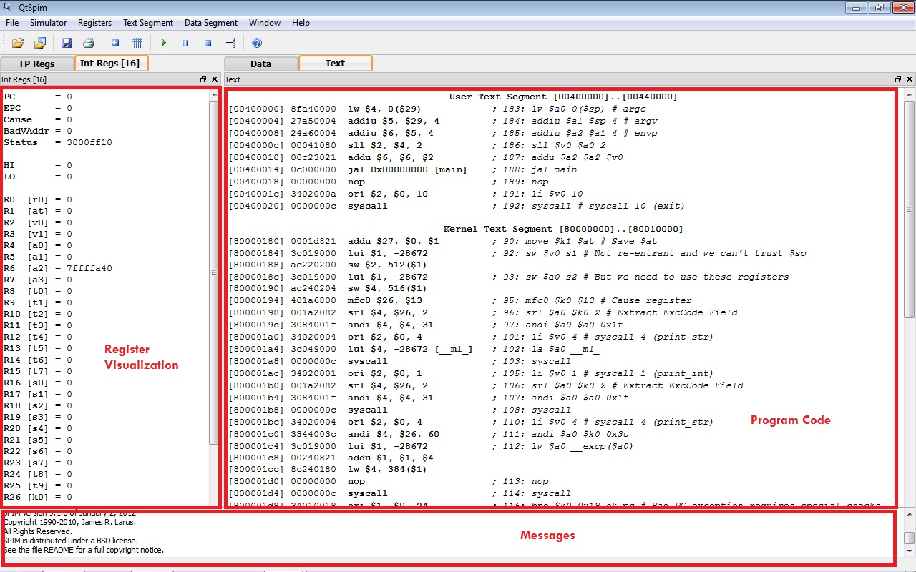
Start SPIM

Slide 17
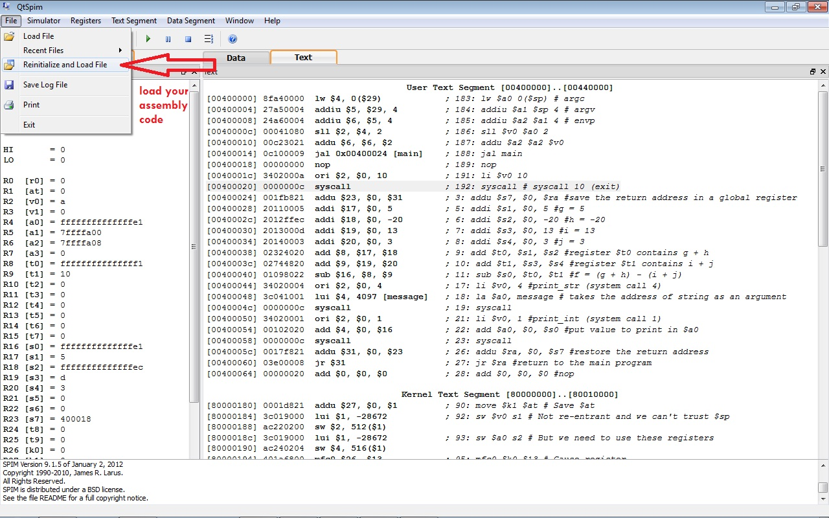
Load Program

Slide 18
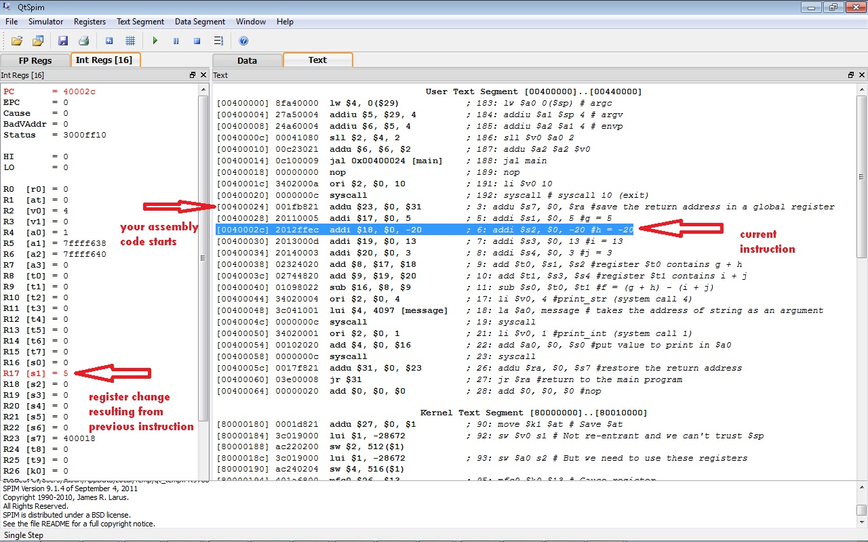
Execute Program

Slide 19
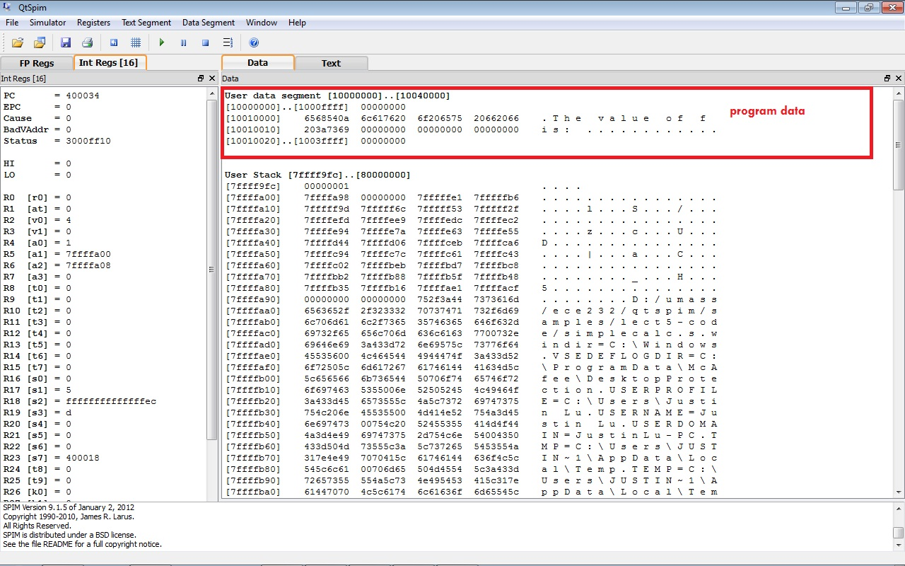
Program data

Slide 20
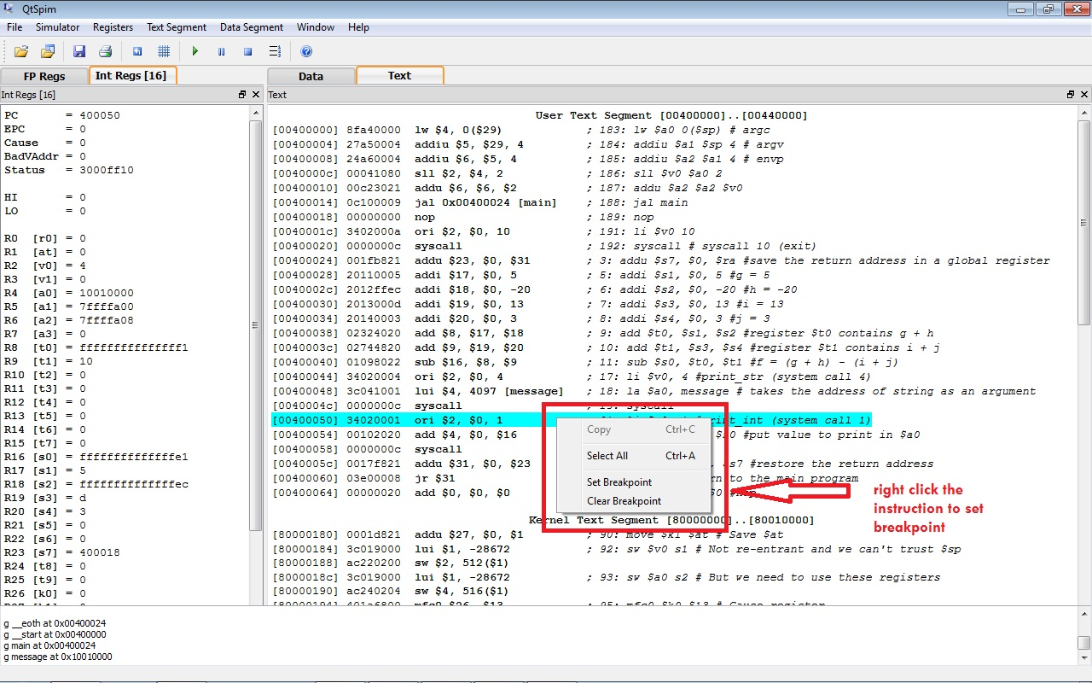
Set a break point
Set a break point at the conditional instruction

Slide 21
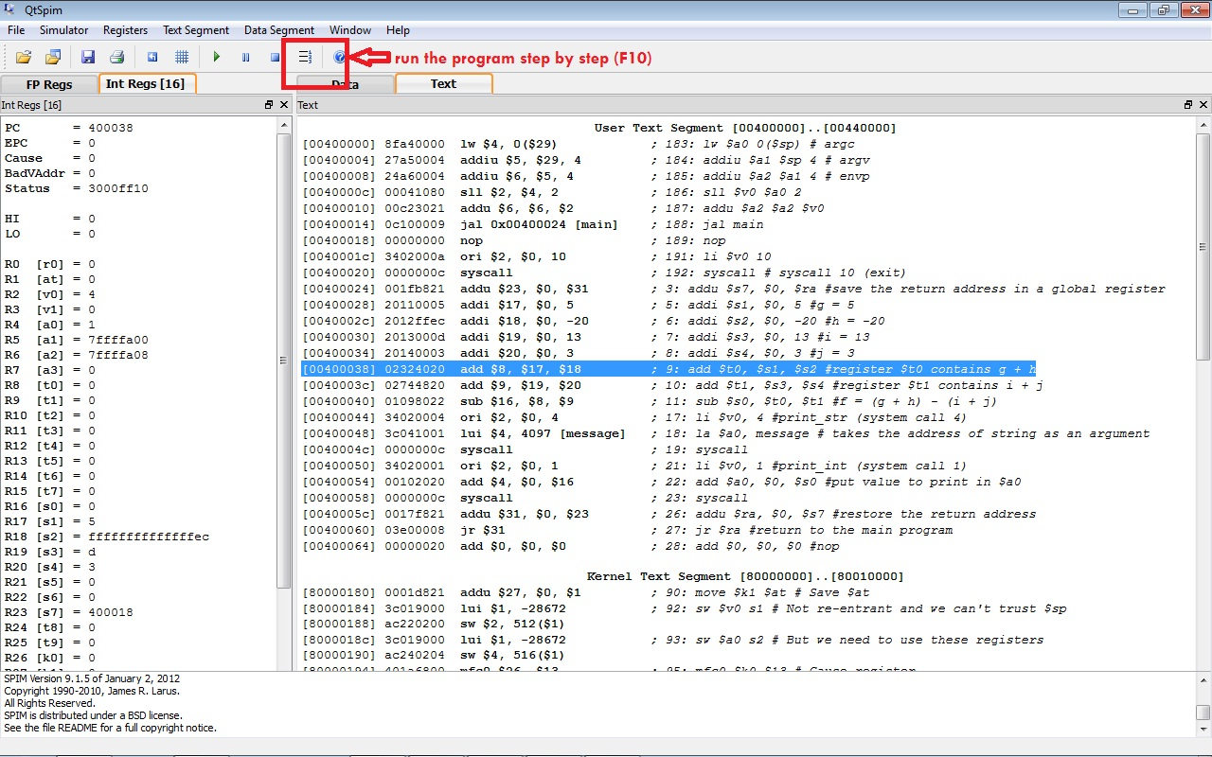
Debug by stepping your code line by line

