Slide 1
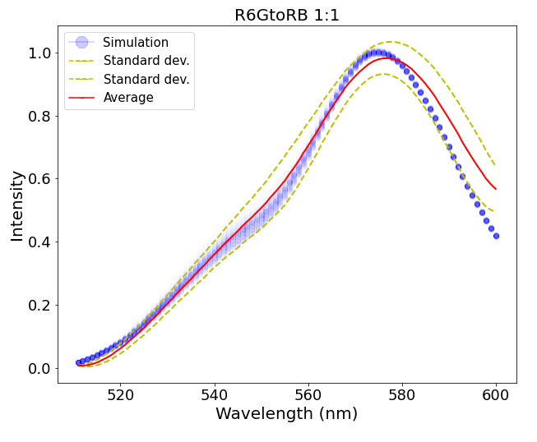
Project: Study of ultrabright fluorescent SiNPs Date: 08-16-2021 Goal: To understand a possible degree of variations between different silica-based (SiNP) nanothermomethers in their ability to measure temperature.
Immediate goal: Find the best distance between dye molecules.
Distances of 2.7nm and 2.8nm show the best match!

Slide 2
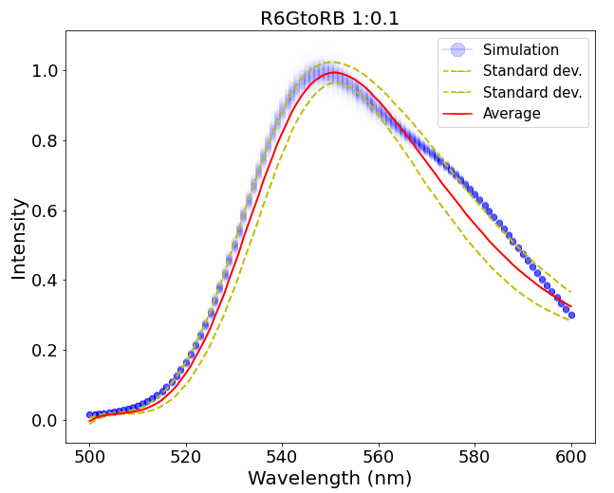
Distances of 2.2nm and 2.3nm show the best match!

Slide 3
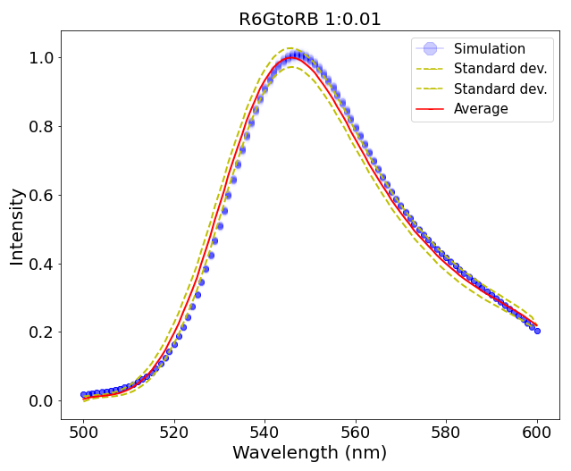
Distance of 2.6nm shows the best match!

