Slide 1
Portfolio - T1A2
Benjamin Bartholomew

Slide 2
About my website
For my portfolio I decided to go with a space-y, minimalist theme, as it resonates with me personally. I’ve styled this slideshow in a similar fashion, to act as an example.
All pages have their content spaced around a central section that takes the attention of the user and allows for easier navigation. Content wise, everything should be accessible without having to scroll through paragraphs of text. Pages feature a background image of outer space. Specifically This one ->

Slide 3
Why those themes?
Space-y:
Minimalist:
I wanted to hint about a part of my personality without needing to put it explicitly in text. I’m a big sci-fi nerd, and the space theme suited that. Plus, artistically, it looks good to me and fills empty bits of my website nicely.
The minimalism came along because I wanted my website to be less a complete preview of who I was and more of an introduction. I wanted to make people curious and invite them to contact me directly, especially for employers.

Slide 4
Sitemap

Slide 5
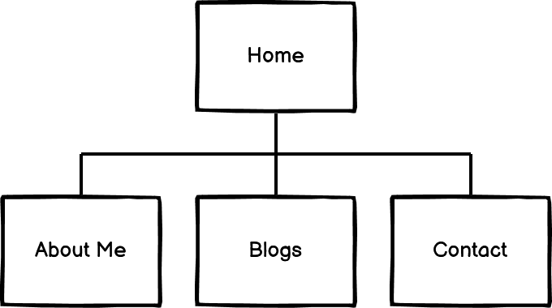
Site Layout
Simple and easy to navigate.
All pages linked together. Originally going to be set out in a linear format, however I found that this would be too problematic for users if the wanted to visit a particular page.

Slide 6
Wireframes

Slide 7
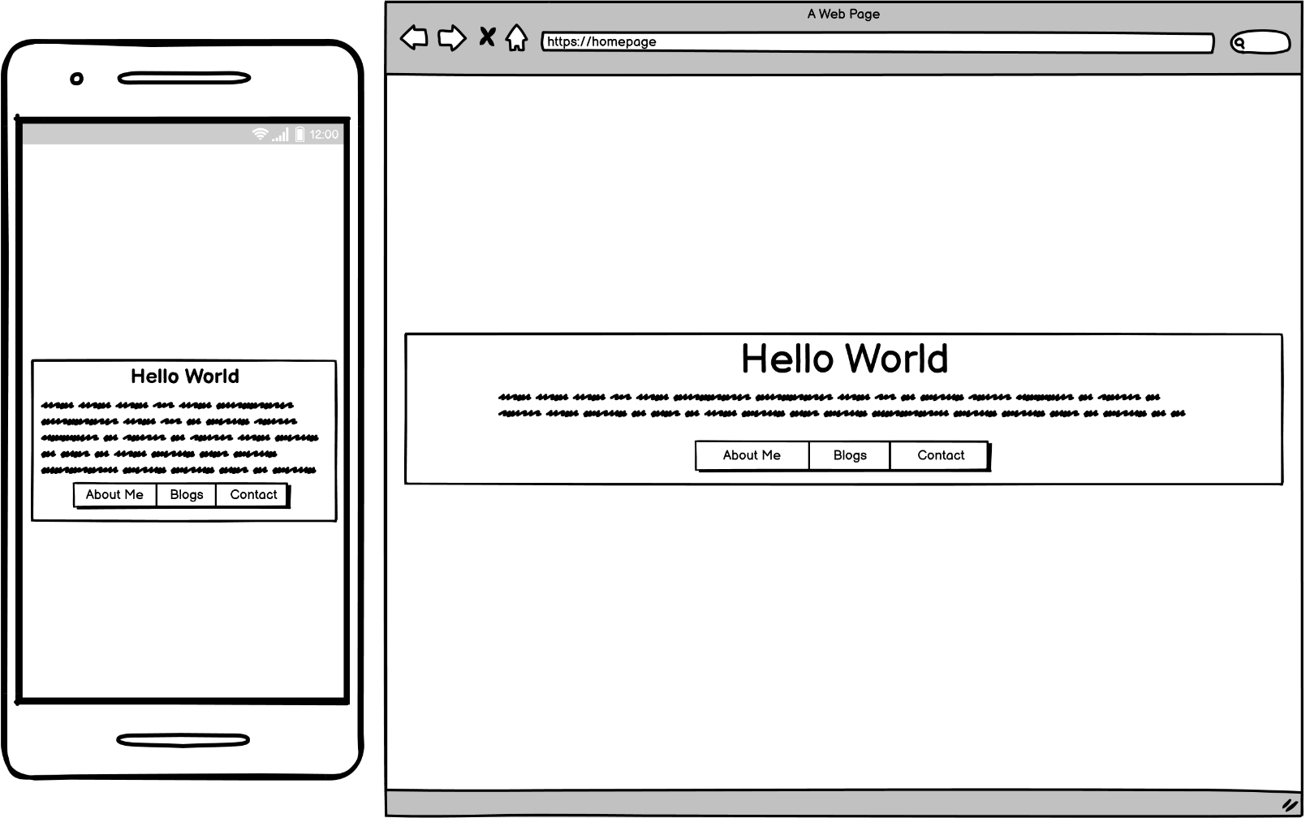
Homepage
Minimalistic central navigation page.
Central header with simple button links to other pages.
Welcome title, with a quick message from me thanking the user for visiting the site, a description of the purpose of the site as well as a brief overview of the other pages in the site.

Slide 8
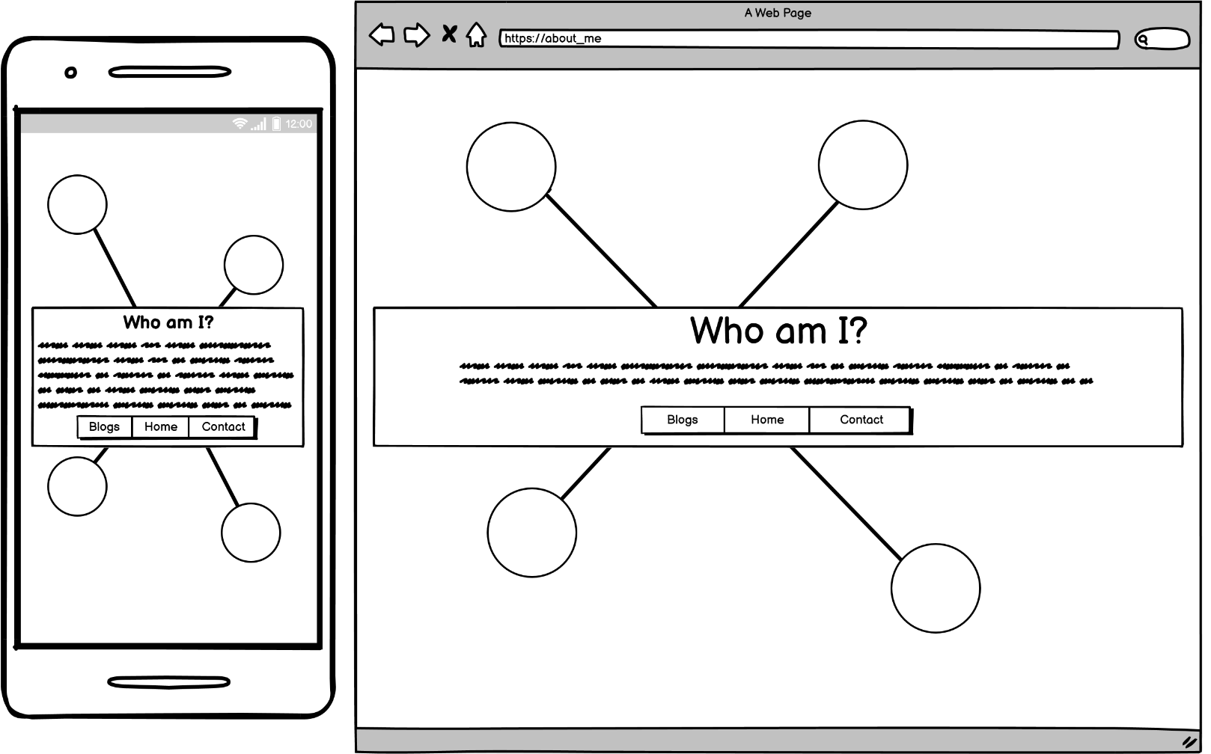
About Me Page
Central header/nav area contains a brief overview of who I am.
Around the navigation area are 4 bubbles arranged in the shape of the southern cross (get it... I'm an aussie and we’re in space). Bubbles expand to reveal paragraphs on my hobbies, interests, previous work, study history etc.

Slide 9
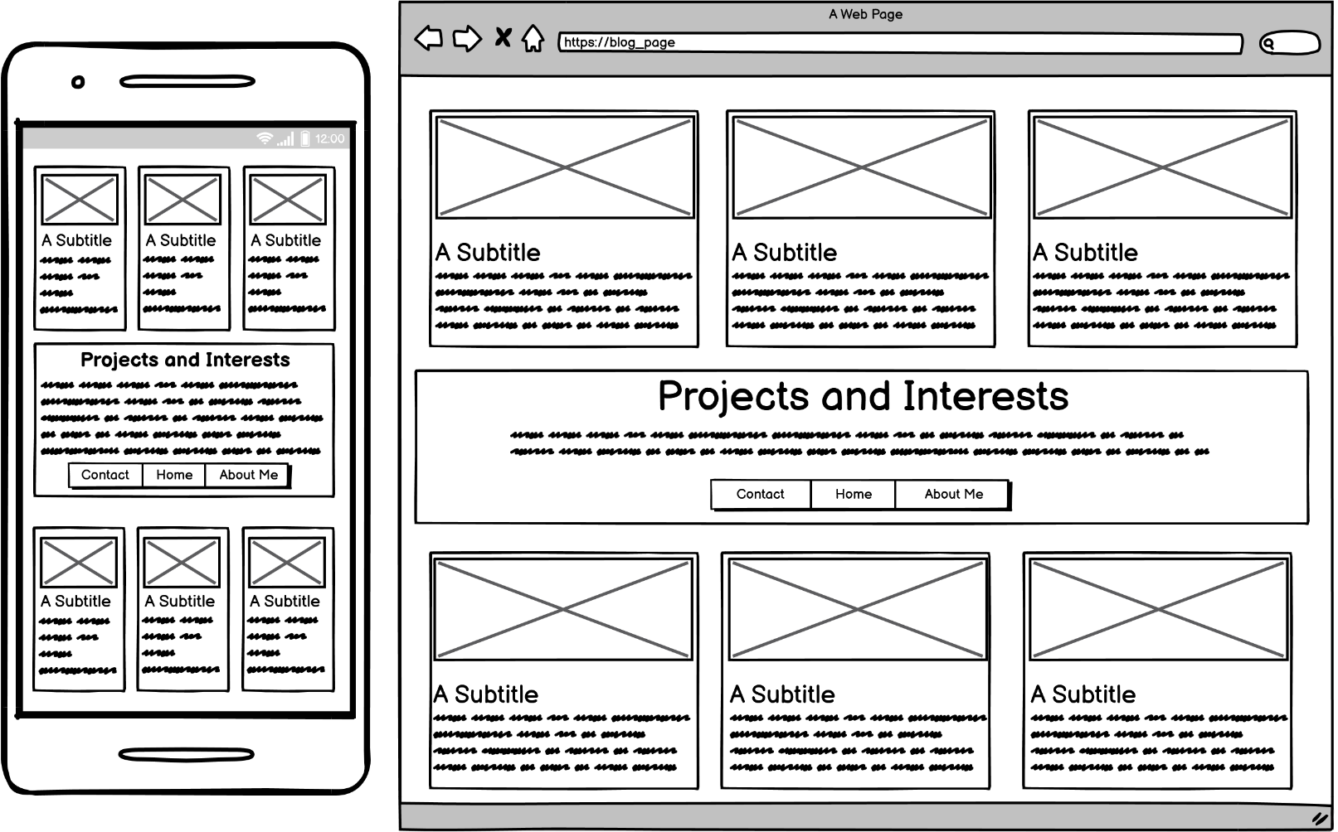
Blogs Page
Horizontal lists of blogs showcasing interests and previous dev work separated into ‘projects’ above and ‘interests’ below the central area.
Blogs resize based on screen size to allow for more info available on desktop view.
All blogs contain titles (subtitles in wireframe) with links to blogs, project homepages or github.

Slide 10
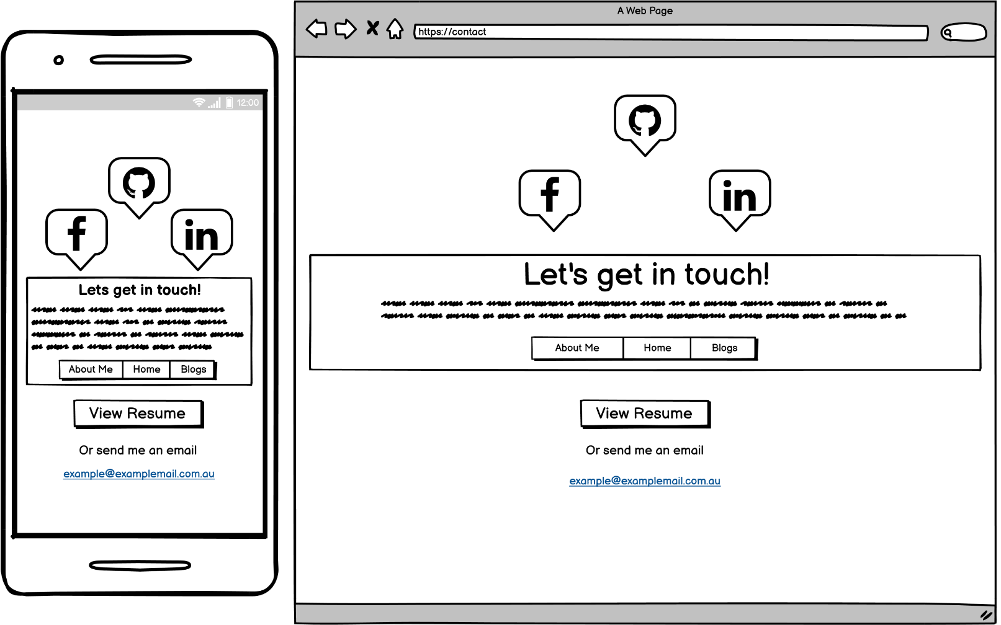
Contact Page
Contact information page with a thank you message.
Links to facebook, github and linkedin, using symbols as links all within “clouds” denoted in wireframe by speech bubbles. View resume button should open pdf version of my resume in a separate tab. Also includes an alternate link to direct email address.

Slide 11
Challenges
Not too much to mention here as still in early stages of development.
Getting the background to rotate. (WIP)
Layout of blog page particularly problematic, went through by far the most changes.
Keeping vertical grid sizing in such a way that no scrolling is necessary for desktop view, whilst also keeping it responsive.

Slide 12
Thanks for your time!

