Slide 1
BCIS207
Exam Revision

Slide 2
Topics
Why IT Projects fail
IT Development Life Cycles
System Development Methodologies
Requirements Engineering
Triple/Quadruple Constraints
Managing Project Implementation (Network diagrams)
Managing Project Implementation (Types of Changeover methods)
Use Microsoft Project

Slide 3
Written Question Types
General Topics
Multiple Choice – Pick the best answer from several possible
Short Answer – requires a simple yet complete answer (i.e. very succinct)
Long Answer – requires more in-depth and thorough explanations with clear reasoning / justification.
Choice of questions (e.g. 1 out of the 2)
Be succinct – don’t ramble, don’t be too vague/general
Use examples to back up your statements (even if not explicitly stated)

Slide 4
Short / Long Answer Question Guide
Compare and contrast - Similarities vs Differences.
Describe - Give details of processes, properties, events etc. How and why something happens or how it works.
Explain - Give detailed reasons for an idea, principle, situation or result.
Illustrate - Give concrete examples – including figures or diagrams.
Discuss - Requires an answer that explains an item or concept, and then gives details about it with supportive information, examples, points for and against, and explanations for the facts put forward. It is important to give both sides of an argument and come to a conclusion.
https://www.dummies.com/test-prep/defining-common-exam-instruction-words/

Slide 5
Practice exam questions
Discuss why the initiation phase is critical to the success of every project development. (10 marks)
Explain the difference between progressive elaboration of requirements and scope creep? (10 marks)
Requirements can be categorised into general, technical, functional and non-functional requirements. Explain two (2) of these categories – (i) Technical and (ii) another of your choice. Use examples to illustrate your answers. (6 marks)
Notes:
The initiation phase is critical to the success of every project development as it establishes the project's core foundations. It takes into account all aspects of planning including stakeholder engagement, benefits mapping, risk assessment as well as the actual plan (schedule) itself. Clear roles and responsibilities, and communication are established.

Slide 6
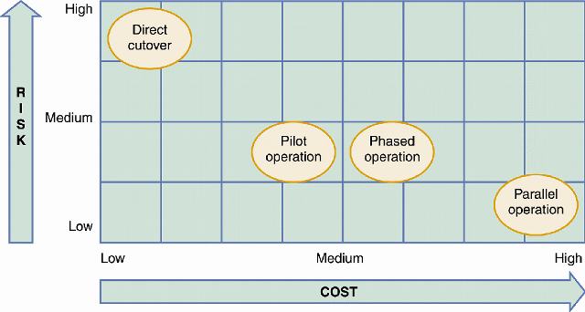
System Changeover – Risk vs Cost
Question
Discuss why the pilot operation is considered a combination of parallel and direct changeover methods.
Notes:
Explain why the parallel system changeover is an expensive process to adopt.

Slide 7
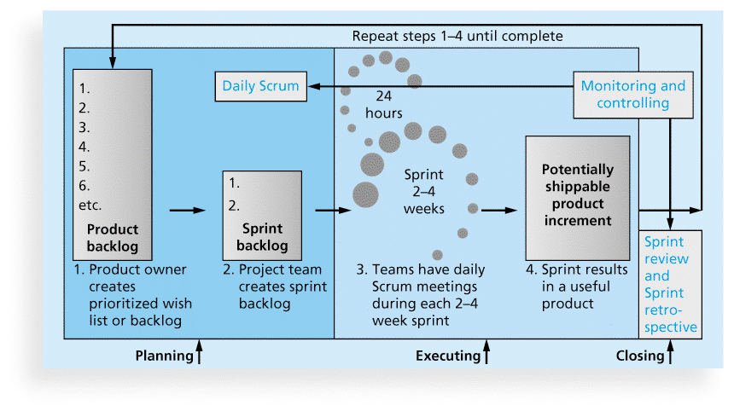
Scrum Framework
Question
Explain when and why a sprint retrospective ceremony is performed?

